Slide 1
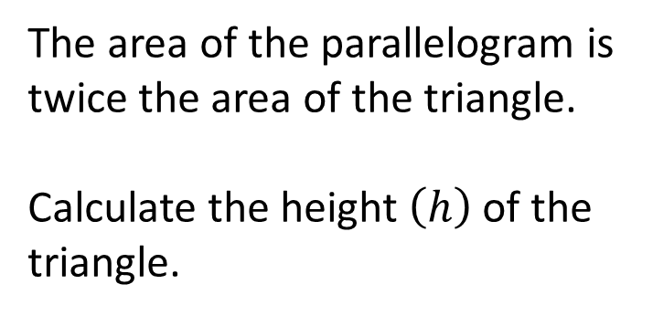

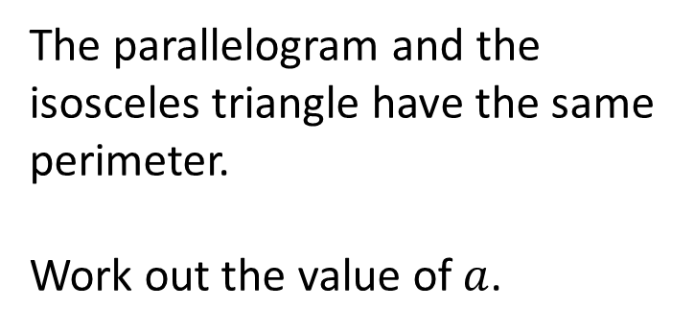



5 cm
5 cm
$a$ cm
$h$ cm
4 cm
4 cm
4 cm
4 cm
The parallelogram and the isosceles triangle have the same perimeter.
Work out the value of $a$.
The area of the parallelogram is twice the area of the triangle.
Calculate the height $\left(h\right)$of the triangle.
$$a = 7$$
$$h =5$$

Slide 2

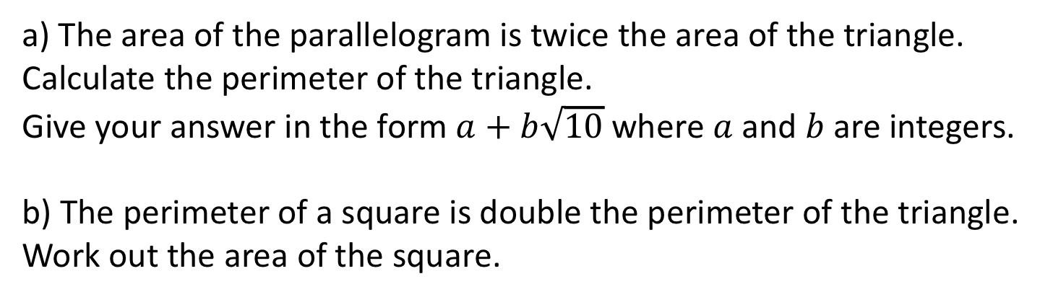

6 cm
4 cm
4 cm
a) The area of the parallelogram is twice the area of the triangle.
Calculate the perimeter of the triangle.
Give your answer in the form $a+b\sqrt{10}$where $a$ and $b$ are integers.
b) The perimeter of a square is double the perimeter of the triangle.
Work out the area of the square.
$$4+4\sqrt{10}$$
$$44+8\sqrt{10}$$

Slide 3
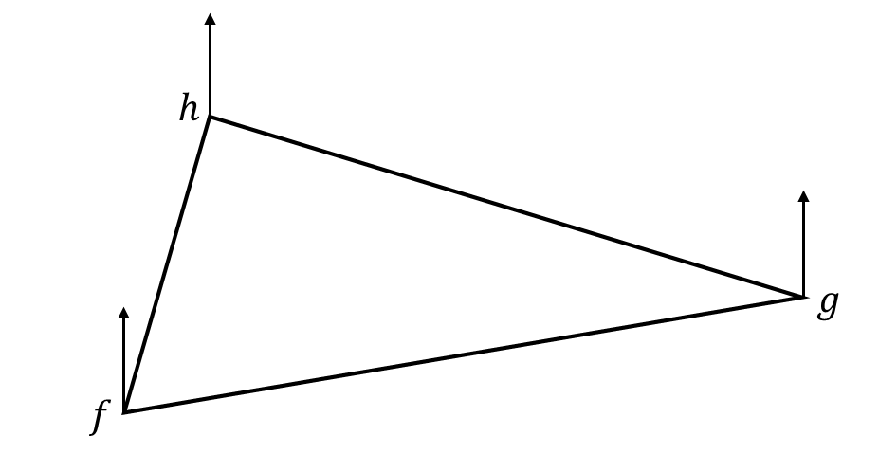

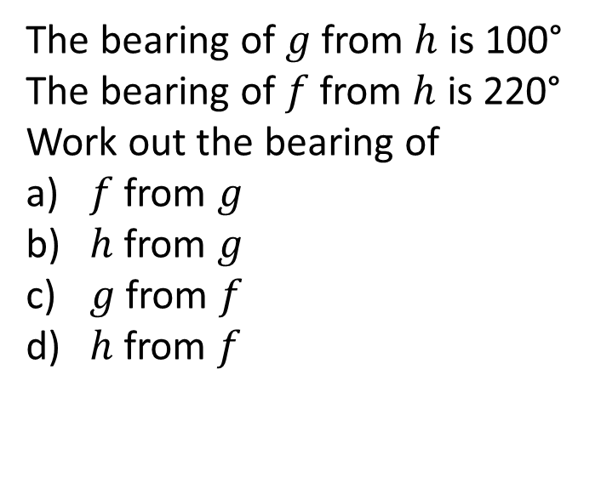


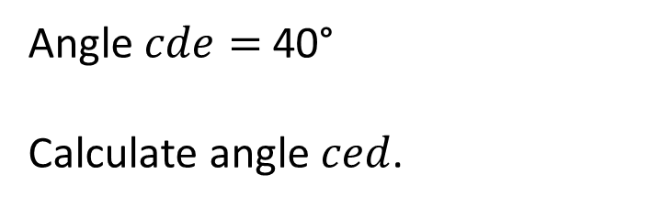





N
$$e$$
$$d$$
25°
302°
$$c$$
The bearing of $g$ from $h$ is 100°
The bearing of $f$ from $h$ is 220°
Work out the bearing of
a) $f$ from $g$
b) $h$ from $g$
c) $g$ from $f$
d) $h$ from $f$
Angle $cde=$ 40°
Calculate angle $ced$.
$$255°$$
$$82°$$
$$280°$$
$$075°$$
$$040°$$

Slide 4


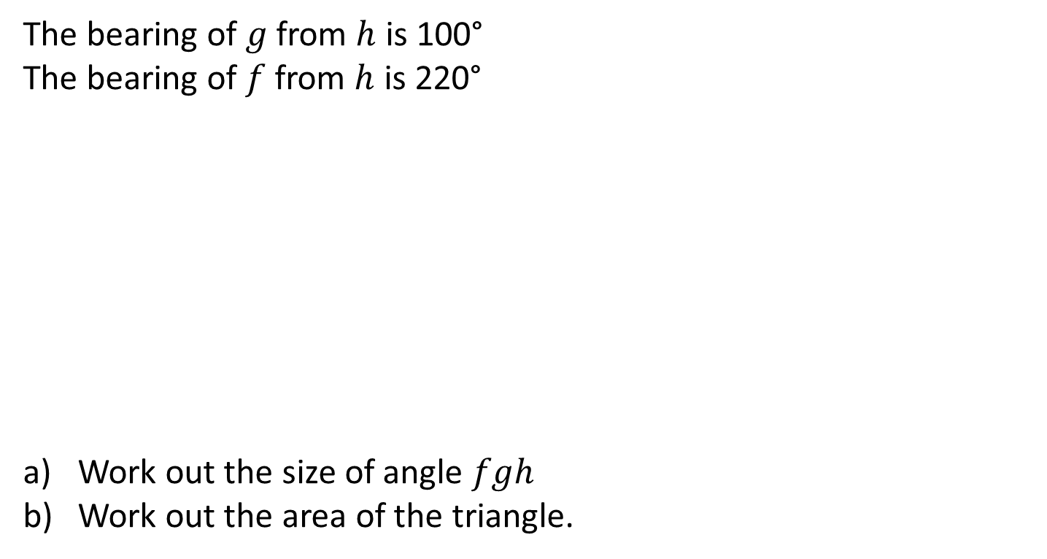



N
The bearing of $g$ from $h$ is 100°
The bearing of $f$ from $h$ is 220°
Work out the size of angle $fgh$
Work out the area of the triangle.
$$h$$
50 m
$$g$$
$$f$$
100 m
$$25.7°$$
$$1410.3{ m}^{2}$$

Slide 5


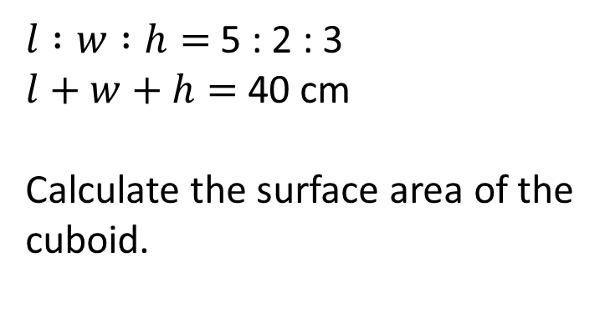



5 cm
$$h$$
5 cm
$$w$$
$$l$$
The length of the cuboid is a square number between 10 and 20
Work out the surface area of the cuboid.
$l :w :h=$ 5 : 2 : 3
$l+w+h=$ 40 cm
Calculate the surface area of the cuboid.
$$370 cm^{2}$$
$$992 cm^{2}$$

Slide 6

The dimensions of the cuboid are in the ratio 1 : 2 : 3
The surface area of the cuboid is 4950 cm²
Work out the volume of the cuboid.
$$20250 cm^{3}$$

Slide 7




There are 8 green counters and 2 red counters in a bag.
Zak takes a counter out of the bag.
What is the probability he chooses a green counter?
What is the probability he chooses a yellow counter?
What is the probability he chooses a red or a green counter?
There are 8 green counters and 2 red counters in a bag.
Zak takes a counter out of the bag, notes the colour and puts it back.
He then chooses another counter.
Calculate the probability that he chooses two red counters.
$P\left(Green\right)=\frac{8}{10}=\frac{4}{5}$
$P\left(RR\right)=\frac{4}{100}=\frac{1}{25}$
$$P\left(Yellow\right)=0$$
$$P\left(Red or Green\right)=1$$

Slide 8

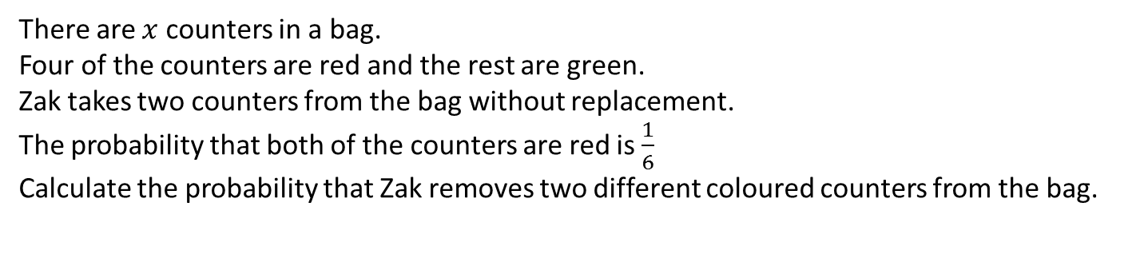
There are $x$ counters in a bag.
Four of the counters are red and the rest are green.
Zak takes two counters from the bag without replacement.
The probability that both of the counters are red is $\frac{1}{6}$
Calculate the probability that Zak removes two different coloured counters from the bag.
$P\left(RG or GR\right)=\frac{40}{72}=\frac{10}{18}$

Slide 9





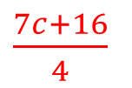




Here are some number cards.
The mean of the cards is 9
What is the value of the missing card?
Here are some expression cards.
Write an expression for the mean of the cards.
$$3$$
$$8$$
$$c+9$$
$$2c+7$$
$$15$$
$$?$$
$$c$$
$$3c$$
$$10$$
$\frac{7c+16}{4}$

Slide 10








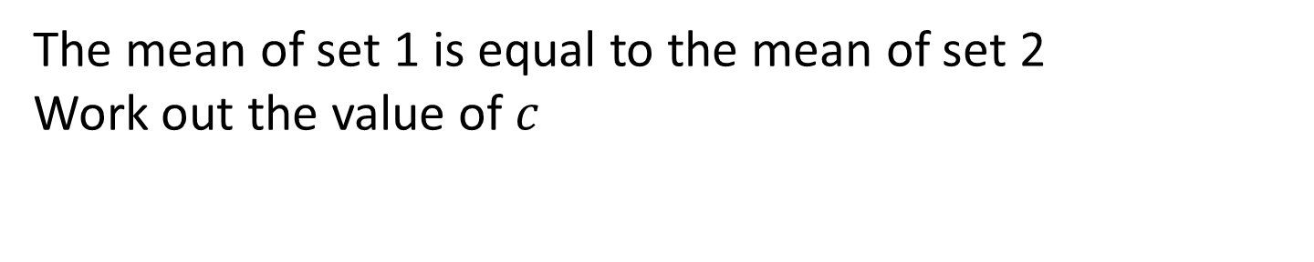
Here are two sets of algebra expression cards.
Set 1
$$c+5$$
$$2c$$
$$3c−2$$
Set 2
$$c+9$$
$$2c+7$$
$$c$$
$$c$$
The mean of set 1 is equal to the mean of set 2
Work out the value of $c$
$$c=4$$

Slide 11



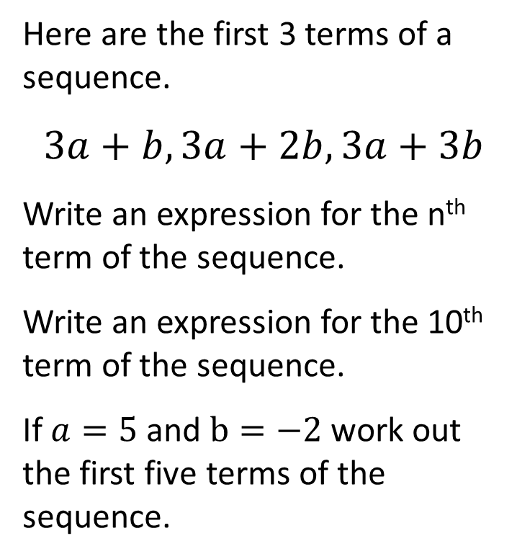

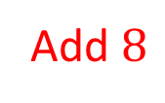


Here is part of a linear sequence.
3, ____, ____, 27
Complete the 2nd and 3rd terms.
What is the term to term rule of the sequence?
What is the n^{th} term of the sequence.
Here are the first 3 terms of a sequence.
$$3a+b, 3a+2b, 3a+3b$$
Write an expression for the n^{th} term of the sequence.
Write an expression for the 10th term of the sequence.
If $a=5$ and $b=−2$ work out the first five terms of the sequence.
$$11$$
$$19$$
$$bn+3a$$
Add $8$
$$10b+3a$$
$$8n −5$$
$$13, 11, 9, 7, 5$$

Slide 12

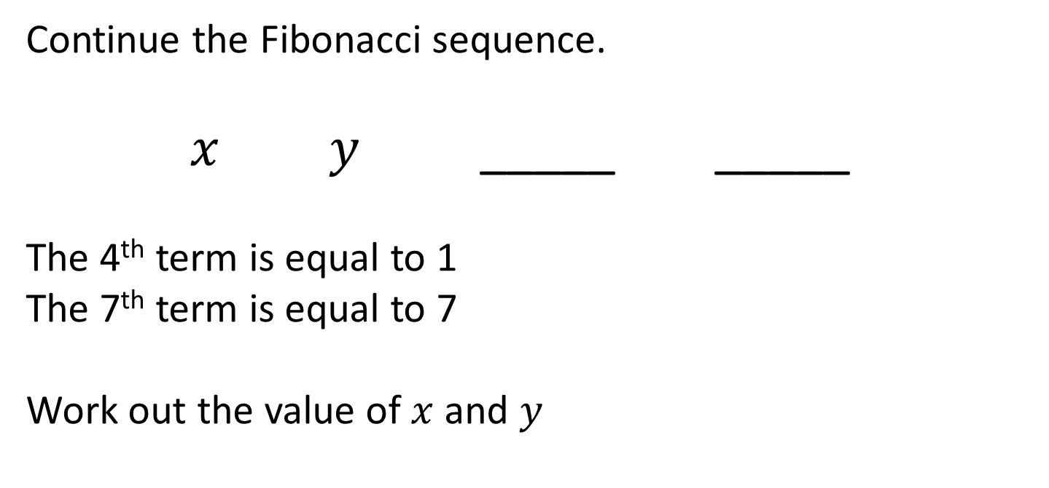


Continue the Fibonacci sequence.
$x y$ _____ _____
The 4th term is equal to 1
The 7th term is equal to 7
Work out the value of $x$ and $y$
$$x+y$$
$$x+2y$$
$$x=3, y=−1$$

Slide 13


400 students are asked how they travel to school.
30% say they travel to school by car.
25% say they walk to school.
The rest travel by bus.
How many students travel by bus?
300 students are asked how they travel to school.
60% say they walk to school.
The remaining travel by car or by bus.
The ratio of students who travel by car to those that travel by bus is 2 : 3
How many more students walk to school than travel by car?
$$180$$
$$132$$

Slide 14

A group of students are asked how they travel to school.
55% say they walk to school.
The remaining travel by car or by bus.
The ratio of students who travel by car to those who travel by bus is 2 : 3
140 more students walk than travel by bus.
How many students travel by car?
$$90$$

Slide 15

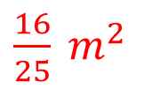

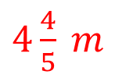


A frame is made using four of these rectangles.
They are arranged as shown.
Work out the perimeter of the frame.
A frame is made using four of these rectangles.
They are arranged as shown.
Work out the area of the
inner square.
$1$ m
$1$ m
$\frac{1}{5}$ m
$\frac{1}{5}$ m
$4\frac{4}{5} m$
$\frac{16}{25} m^{2}$

Slide 16


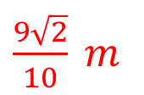
A frame is made using four of these rectangles.
They are arranged as shown.
Work out the length of the diagonal of the frame.
$\frac{7}{10}$ m
$\frac{1}{5}$ m
$\frac{9\sqrt{2}}{10} m$

Slide 17


A circle is cut out of a square.
Find the area of the shaded region.
A circle is cut out of a square.
What percentage of the
square is shaded?
5 cm
10 cm
9 cm
$$21.5 cm^{2}$$
$$21.5\%$$

Slide 18

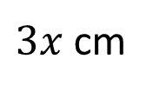
4 circles are cut out of a square.
Estimate the percentage of the square that is shaded.
$3x$ cm
$$25\%$$

