Slide 1
Fibonacci Day
23rd November
23/11?
In other parts of the world the date is written as 11/23
The numbers 1, 1, 2, 3 are the first four terms of the Fibonacci Sequence

Slide 2
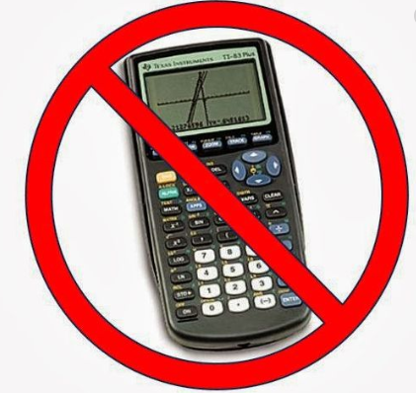
The Fibonacci Sequence
1, 1, 2, 3, 5…
In one minute continue the Fibonacci Sequences as much as you can!

Slide 3
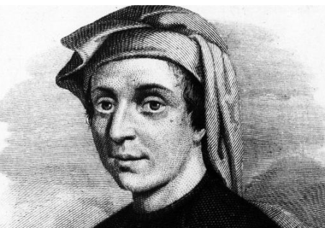
Fibonacci
He was a medieval Italian mathematician, who was born in 1175 and died around 1250.
Now best known for his sequence, Fibonacci's real claim to fame is the major part he played in introducing the numbers we now use to replace Roman numerals.

Slide 4
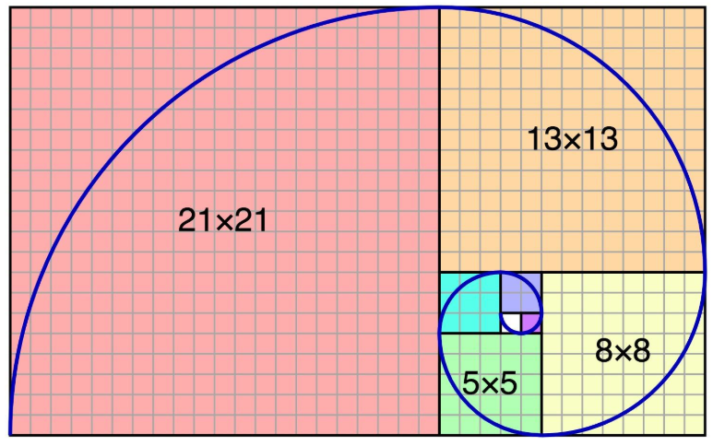
Watch this to learn more!
This is a Fibonacci Spiral

