Slide 1
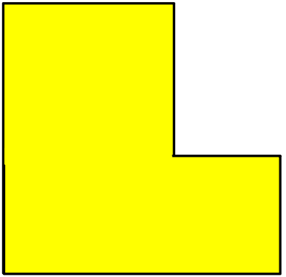
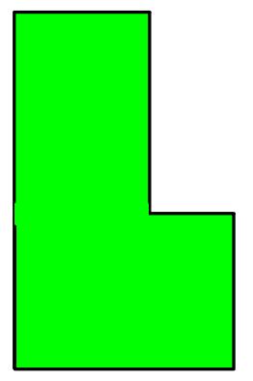




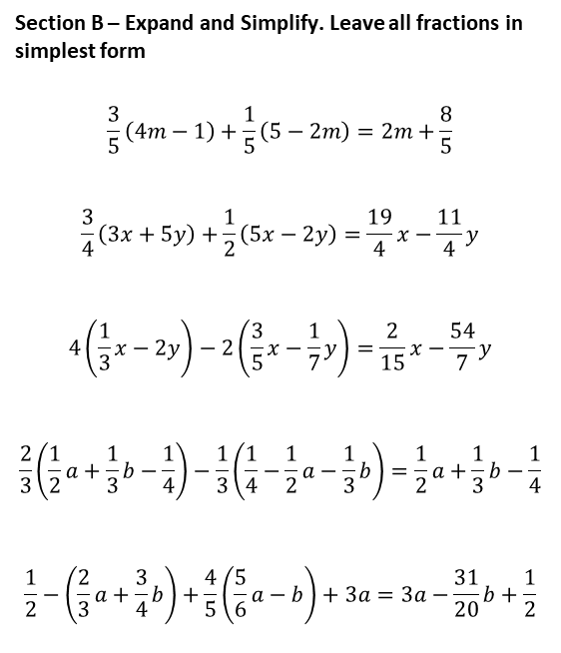





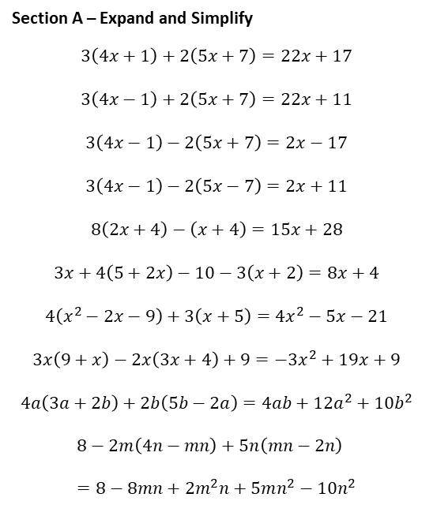







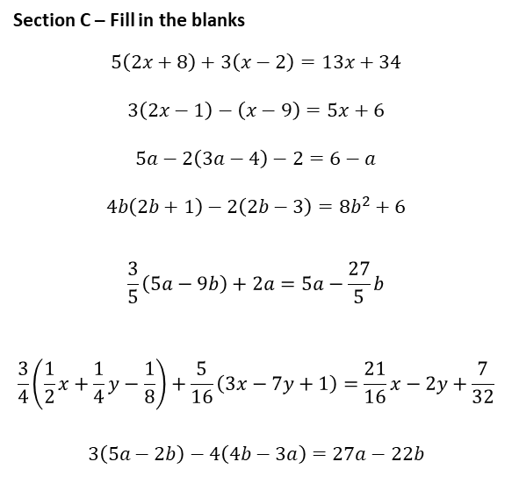



Section A – Expand and Simplify
$$3\left(4x+1\right)+2\left(5x+7\right)=22x+17$$
$$3\left(4x−1\right)+2\left(5x+7\right)=22x+11$$
$$3\left(4x−1\right)−2\left(5x+7\right)=2x−17$$
$$3\left(4x−1\right)−2\left(5x−7\right)=2x+11$$
$$8\left(2x+4\right)−\left(x+4\right)=15x+28$$
$$3x+4\left(5+2x\right)−10−3\left(x+2\right)=8x+4$$
$$4\left(x^{2}−2x−9\right)+3\left(x+5\right)=4x^{2}−5x−21$$
$$3x\left(9+x\right)−2x\left(3x+4\right)+9=−3x^{2}+19x+9$$
$$4a\left(3a+2b\right)+2b\left(5b−2a\right)=4ab+12a^{2}+10b^{2}$$
$$8−2m\left(4n−mn\right)+5n\left(mn−2n\right)=8−8mn+2m^{2}n+5mn^{2}−10n^{2}$$
Section B – Expand and Simplify. Leave all fractions in simplest form
$$\frac{3}{5}\left(4m−1\right)+\frac{1}{5}\left(5−2m\right)=2m+\frac{8}{5}$$
$$\frac{3}{4}\left(3x+5y\right)+\frac{1}{2}\left(5x−2y\right)=\frac{19}{4}x−\frac{11}{4}y$$
$$4\left(\frac{1}{3}x−2y\right)−2\left(\frac{3}{5}x−\frac{1}{7}y\right)=\frac{2}{15}x−\frac{54}{7}y$$
$$\frac{2}{3}\left(\frac{1}{2}a+\frac{1}{3}b−\frac{1}{4}\right)−\frac{1}{3}\left(\frac{1}{4}−\frac{1}{2}a−\frac{1}{3}b\right)=\frac{1}{2}a+\frac{1}{3}b−\frac{1}{4}$$
$$\frac{1}{2}−\left(\frac{2}{3}a+\frac{3}{4}b\right)+\frac{4}{5}\left(\frac{5}{6}a−b\right)+3a=3a−\frac{31}{20}b+\frac{1}{2}$$
Section C – Fill in the blanks
$$5\left(2x+8\right)+3\left(x−2\right)=13x+34$$
$$3\left(2x−1\right)−\left(x−9\right)=5x+6$$
$$5a−2\left(3a−4\right)−2=6−a$$
$$4b\left(2b+1\right)−2\left(2b−3\right)=8b^{2}+6$$
$$\frac{3}{5}\left(5a−9b\right)+2a=5a−\frac{27}{5}b$$
$$\frac{3}{4}\left(\frac{1}{2}x+\frac{1}{4}y−\frac{1}{8}\right)+\frac{5}{16}\left(3x−7y+1\right)=\frac{21}{16}x−2y+\frac{7}{32}$$
$$3\left(5a−2b\right)−4\left(4b−3a\right)=27a−22b$$
Section D – Write an expression for the area
$$5$$
$$3a$$
$$x+1$$
$$2b$$
$$5a−b$$
$$6$$
$$2x+3$$
$$4$$
$$Area=17x+23$$
$$Area=15a−12b+6ab$$
$$5$$
$$2x−9$$
$$5−x$$
$$7$$
$$2$$
$$4$$
$$3x+4$$
$$5+3x$$
$$Area=\frac{19}{2}x$$
$$Area=13x+71$$

Slide 2
Section A – Expand and Simplify
$$3\left(4x+1\right)+2\left(5x+7\right)=22x+17$$
$$3\left(4x−1\right)+2\left(5x+7\right)=22x+11$$
$$3\left(4x−1\right)−2\left(5x+7\right)=2x−17$$
$$3\left(4x−1\right)−2\left(5x−7\right)=2x+11$$
$$8\left(2x+4\right)−\left(x+4\right)=15x+28$$
$$3x+4\left(5+2x\right)−10−3\left(x+2\right)=8x+4$$
$$4\left(x^{2}−2x−9\right)+3\left(x+5\right)=4x^{2}−5x−21$$
$$3x\left(9+x\right)−2x\left(3x+4\right)+9=−3x^{2}+19x+9$$
$$4a\left(3a+2b\right)+2b\left(5b−2a\right)=4ab+12a^{2}+10b^{2}$$
$$8−2m\left(4n−mn\right)+5n\left(mn−2n\right)=8−8mn+2m^{2}n+5mn^{2}−10n^{2}$$
Section B – Expand and Simplify. Leave all fractions in simplest form
$$\frac{3}{5}\left(4m−1\right)+\frac{1}{5}\left(5−2m\right)=2m+\frac{8}{5}$$
$$\frac{3}{4}\left(3x+5y\right)+\frac{1}{2}\left(5x−2y\right)=\frac{19}{4}x−\frac{11}{4}y$$
$$4\left(\frac{1}{3}x−2y\right)−2\left(\frac{3}{5}x−\frac{1}{7}y\right)=\frac{2}{15}x−\frac{54}{7}y$$
$$\frac{2}{3}\left(\frac{1}{2}a+\frac{1}{3}b−\frac{1}{4}\right)−\frac{1}{3}\left(\frac{1}{4}−\frac{1}{2}a−\frac{1}{3}b\right)=\frac{1}{2}a+\frac{1}{3}b−\frac{1}{4}$$
$$\frac{1}{2}−\left(\frac{2}{3}a+\frac{3}{4}b\right)+\frac{4}{5}\left(\frac{5}{6}a−b\right)+3a=3a−\frac{31}{20}b+\frac{1}{2}$$
Section C – Fill in the blanks
$$5\left(2x+8\right)+3\left(x−2\right)=13x+34$$
$$3\left(2x−1\right)−\left(x−9\right)=5x+6$$
$$5a−2\left(3a−4\right)−2=6−a$$
$$4b\left(2b+1\right)−2\left(2b−3\right)=8b^{2}+6$$
$$\frac{3}{5}\left(5a−9b\right)+2a=5a−\frac{27}{5}b$$
$$\frac{3}{4}\left(\frac{1}{2}x+\frac{1}{4}y−\frac{1}{8}\right)+\frac{5}{16}\left(3x−7y+1\right)=\frac{21}{16}x−2y+\frac{7}{32}$$
$$3\left(5a−2b\right)−4\left(4b−3a\right)=27a−22b$$
Section D – Write an expression for the area
$$5$$
$$3a$$
$$x+1$$
$$2b$$
$$5a−b$$
$$6$$
$$2x+3$$
$$4$$
$$Area=17x+23$$
$$Area=15a−12b+6ab$$
$$5$$
$$2x−9$$
$$5−x$$
$$7$$
$$2$$
$$4$$
$$3x+4$$
$$5+3x$$
$$Area=\frac{19}{2}x$$
$$Area=13x+71$$

