Slide 1
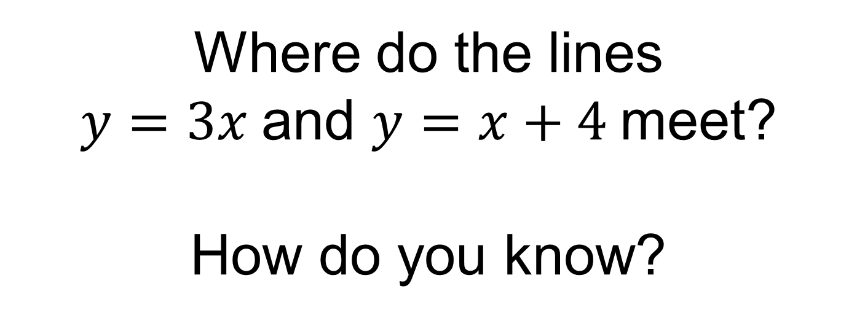
Where do the lines
$y=3x$and $y=x+4$meet?
How do you know?

Slide 2
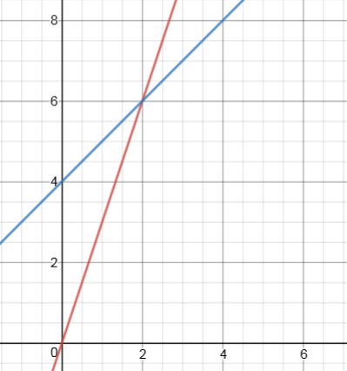



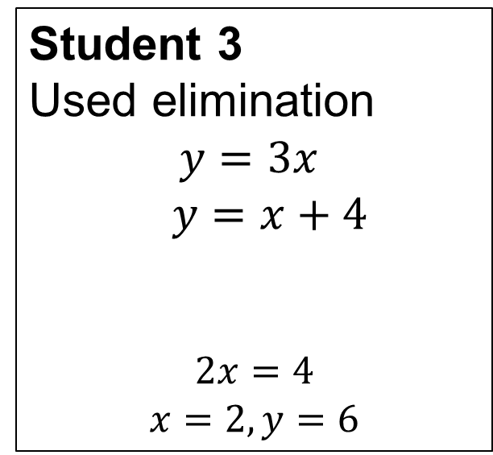
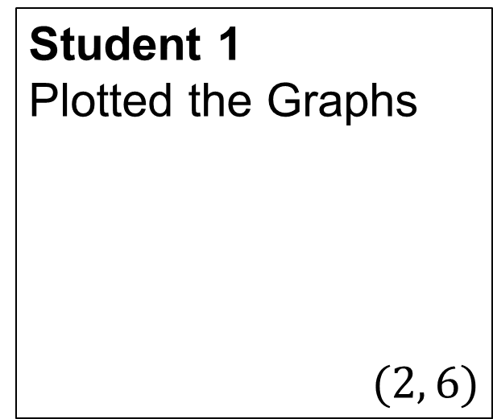




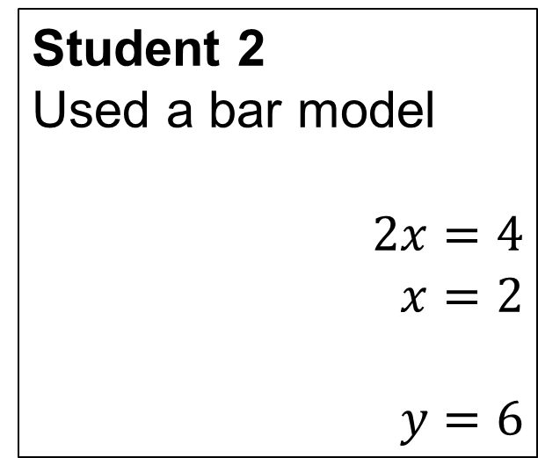


Student 1
Plotted the Graphs
$$(2, 6)$$
Student 2
Used a bar model
$$2x=4$$
$$x=2$$
$$y=6$$
$$x$$
$$x$$
$$x$$
$$y$$
$$x$$
$$4$$
$$y$$
Student 3
Used elimination
$$y=3x$$
$y=x+4$
$$2x=4$$
$$x=2, y=6$$
In pairs discuss these different methods
Which method do you prefer?
Why?
$$−$$
$$0=2x −4$$

Slide 3














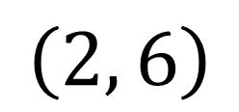



Another student also used a bar model but in a different way:
$$x$$
$$x$$
$$x$$
$$y$$
$$x$$
$$x$$
$$x$$
$$x$$
$$x$$
$$x$$
$$x$$
$$4$$
$$4$$
$$2$$
$$x$$
$$4$$
$$y$$
$$\left(2, 6\right)$$
This method is called substitution

Slide 4






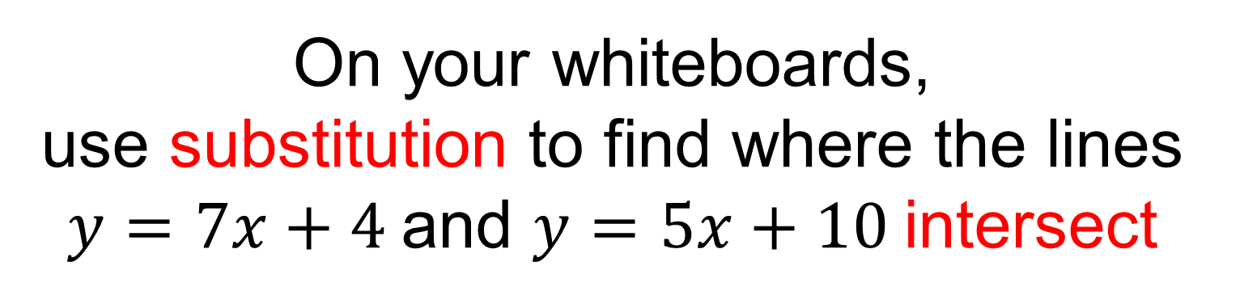









On your whiteboards, use substitution to find where the lines $y=7x+4$and $y=5x+10$intersect
$$x$$
$$x$$
$$x$$
$$x$$
$$x$$
$$x$$
$$x$$
$$4$$
$$y$$
$$x$$
$$x$$
$$x$$
$$x$$
$$x$$
$$10$$
$$y$$

Slide 5

















On your whiteboards, use substitution to find where the lines $y=7x+4$and $y=5x+10$intersect
$$x$$
$$x$$
$$x$$
$$x$$
$$x$$
$$x$$
$$x$$
$$4$$
$$x$$
$$x$$
$$x$$
$$x$$
$$x$$
$$10$$
$$2x+4=10$$
$$2x=6$$
$$x=3$$
$$3$$
$$3$$
$$3$$
$$3$$
$$3$$
$$10$$
$$y=15+10=25$$
$$y$$

Slide 6
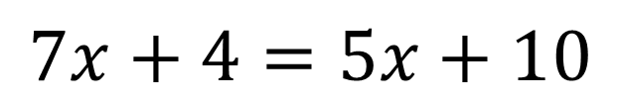
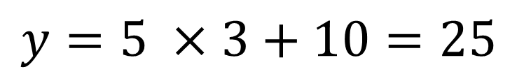
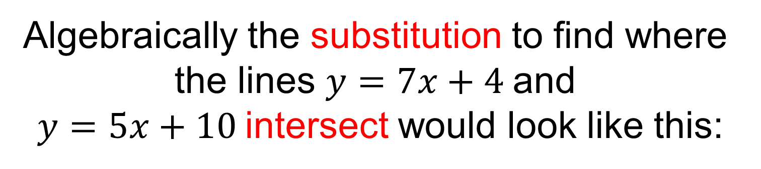
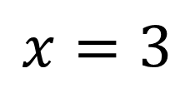
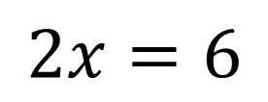
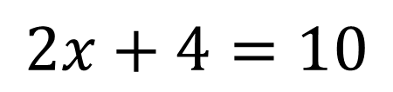
Algebraically the substitution to find where the lines $y=7x+4$and
$y=5x+10$intersect would look like this:
$$7x+4=5x+10$$
$$2x+4=10$$
$$2x=6$$
$$x=3$$
$$y=5 ×3+10=25$$

Slide 7








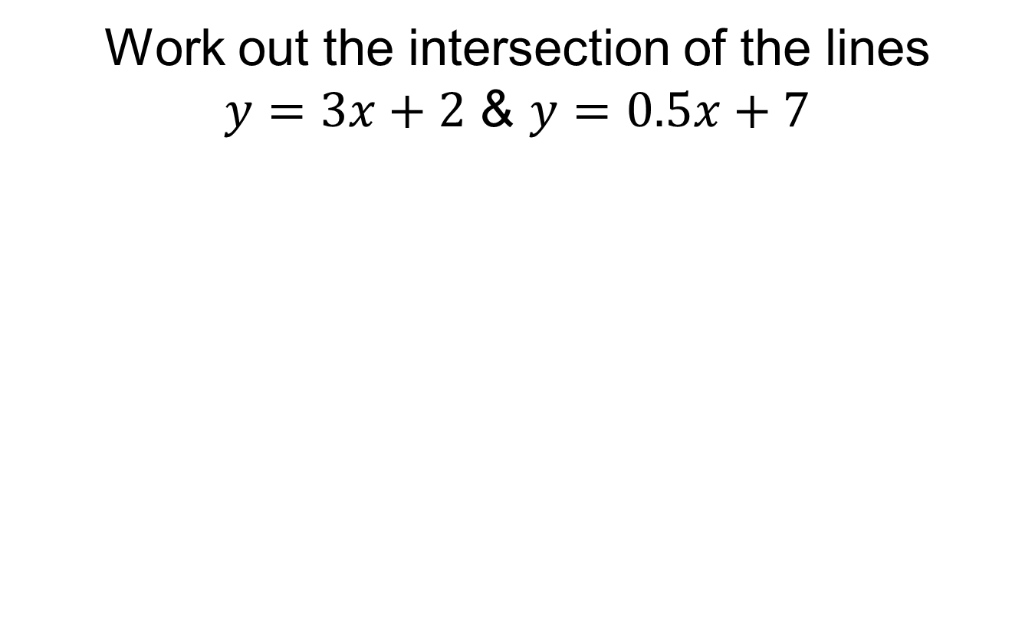













Title: Using substitution to solve a pair of simultaneous equations
Work out the intersection of the lines $y=3x+2$ & $y=0.5x+7$
$$x$$
$$x$$
$$x$$
$$2$$
$$0.5x+7=3x+2$$
$$0.5x$$
$$7$$
$$x$$
$$x$$
$$0.5x$$
$$x=2$$
$$5=2.5x$$
$$5$$
$$2=x$$
$$2$$
$$2$$
$$2$$
$$2$$
$$y=8$$
$$y=3×2+2=8$$
$$y$$

Slide 8
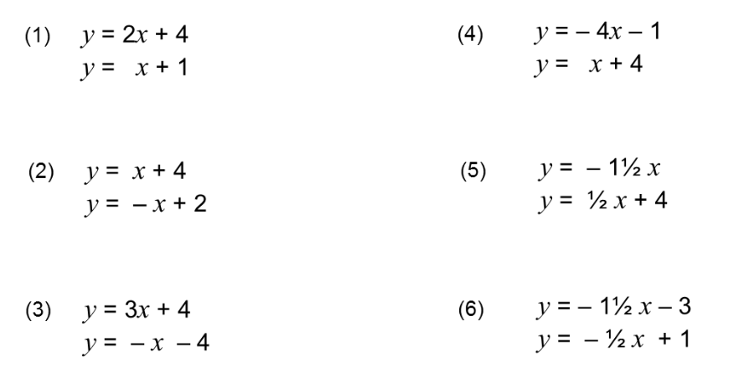
In your books, use substitution to work out where the two lines meet.
Notes:
Acknowledgements: Don Steward

Slide 9
Now plot these graphs on the axes provided to check your answers.

Slide 10
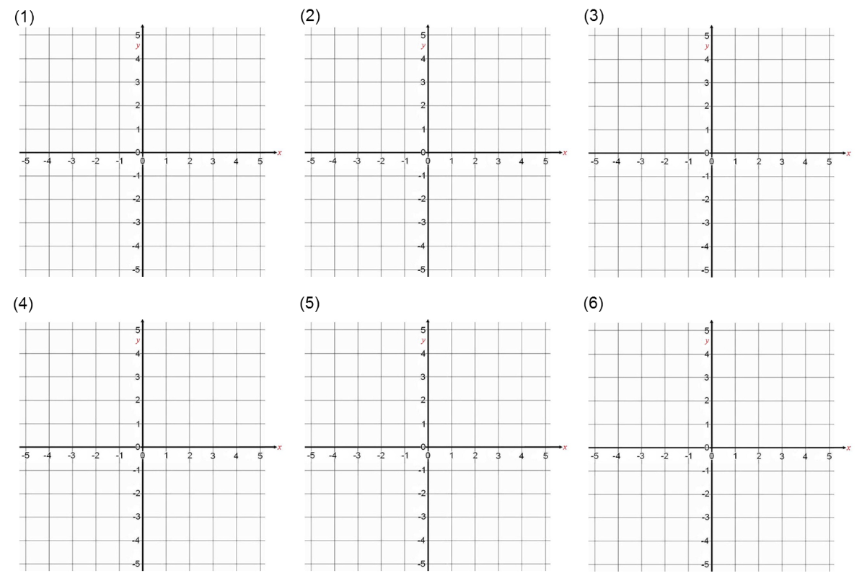
Notes:
Print out for students

Slide 11
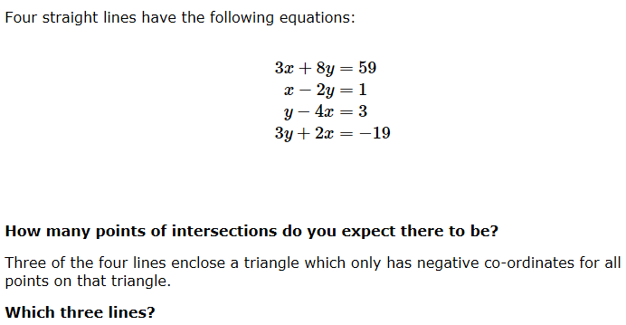
Challenge
Notes:
Acknowledgements: Nrich

Slide 12
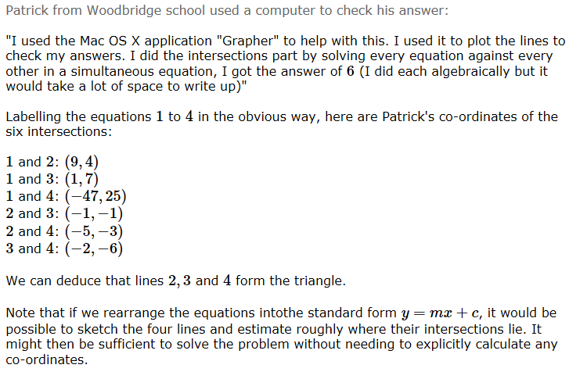
Challenge Solution

