Slide 1
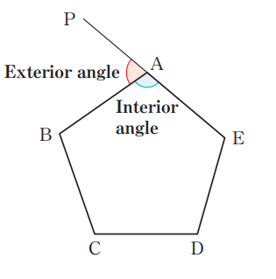
Last lesson we looked at calculating interior angles
Today we are going to learn about exterior angles

Slide 2
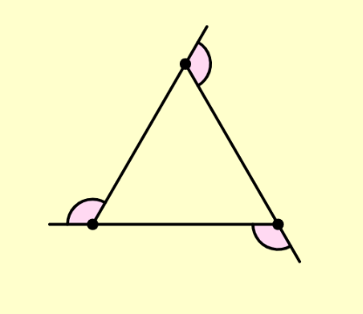


Exterior Angles
Notes:
https://www.mathspad.co.uk/interactives/interiorExteriorAnglesTool/exteriorTool2.php
This tool is fantastic

Slide 3



Exterior Angles

Slide 4



Exterior Angles

Slide 5



Exterior Angles

Slide 6



Exterior Angles

Slide 7
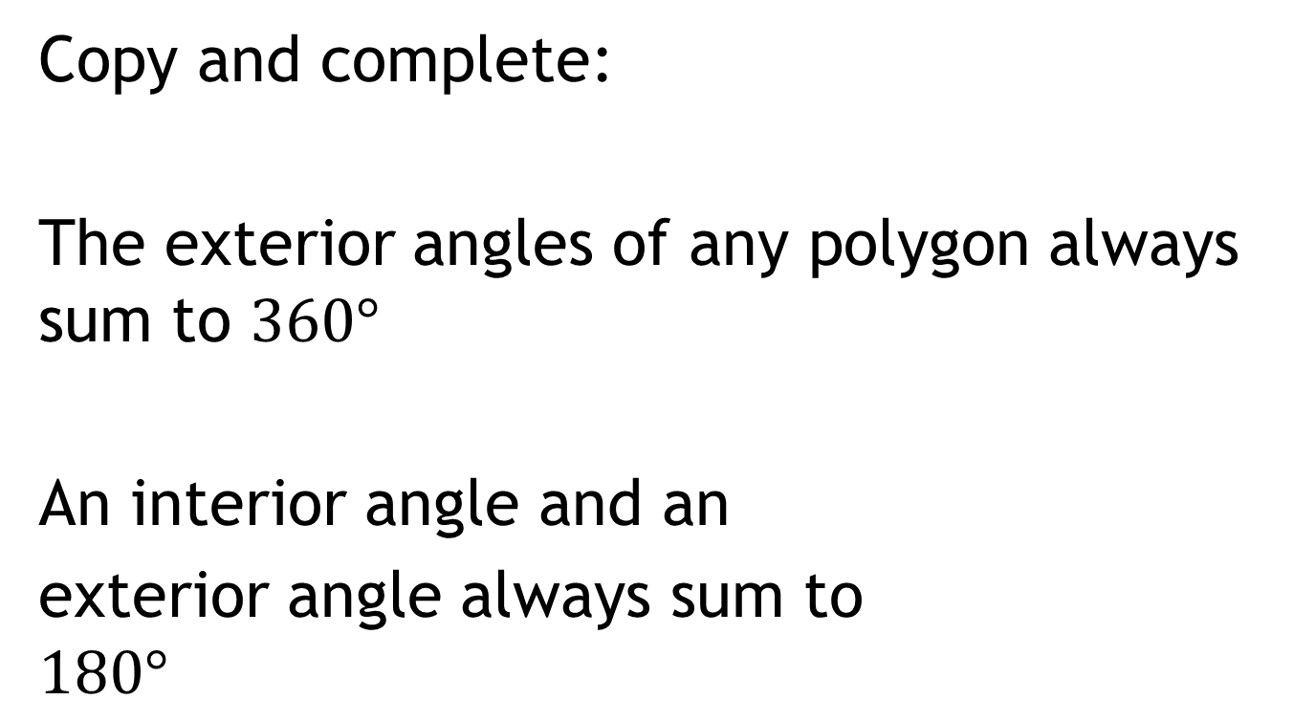
Exterior Angles
Copy and complete:
The exterior angles of any polygon always sum to $360°$
An interior angle and an
exterior angle always sum to
$$180°$$

Slide 8
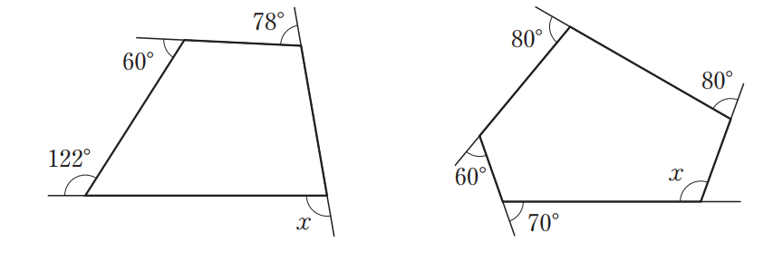
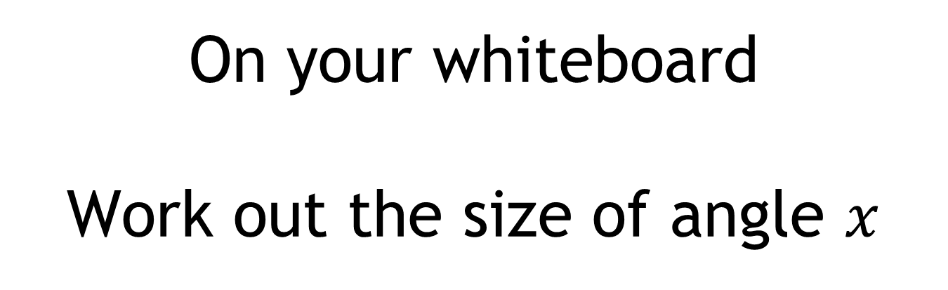
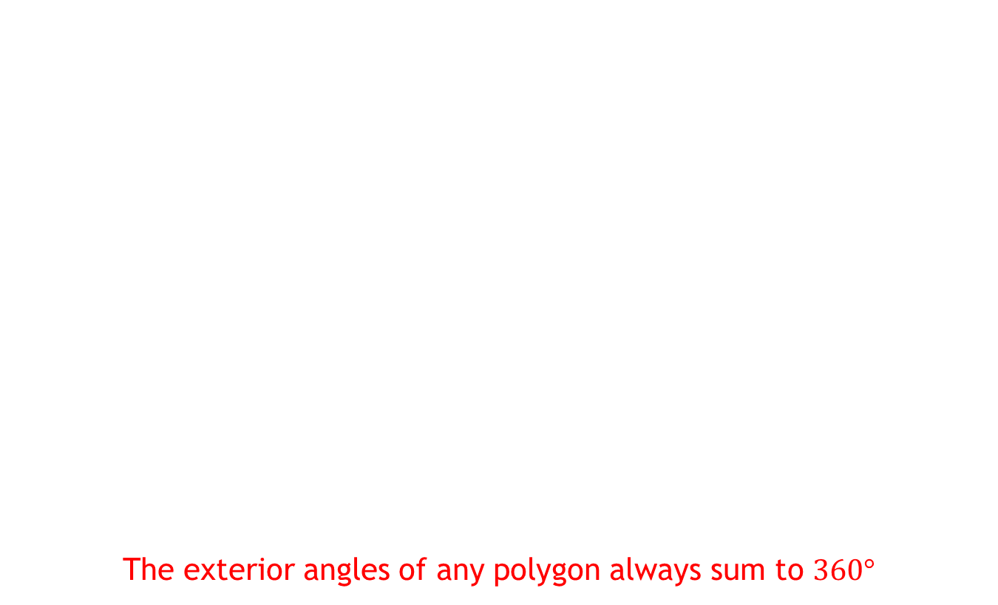
On your whiteboard
Work out the size of angle $x$
The exterior angles of any polygon always sum to $360°$

Slide 9
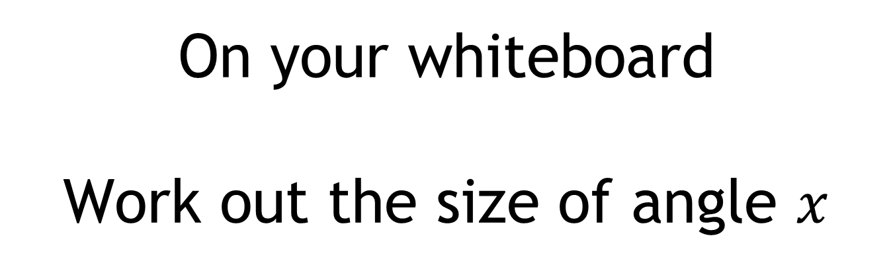
On your whiteboard
Work out the size of angle $x$
An interior angle and an exterior angle always sum to $180°$

Slide 10
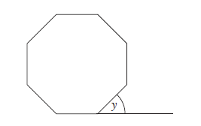
On your whiteboard
What is the size of each of the exterior angles in a regular octagon?

Slide 11
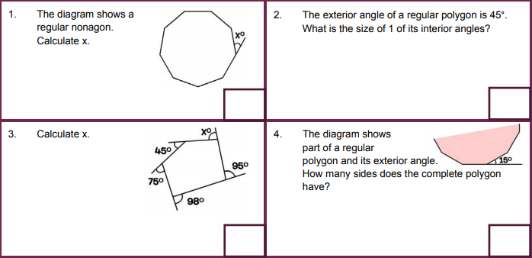
Exterior Angles
Notes:
https://www.mathspad.co.uk/teach/worksheets/angles/exteriorProblems.php

Slide 12
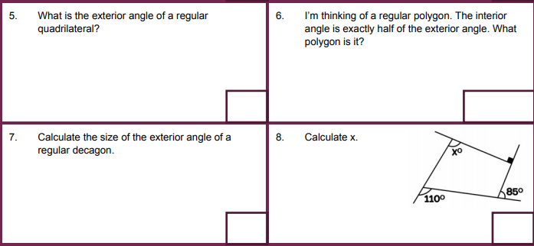

Slide 13
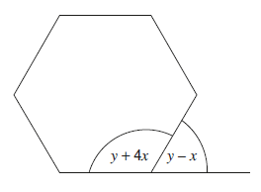
Challenge
This diagram shows a regular hexagon.
Work out the values of x and y

Slide 14
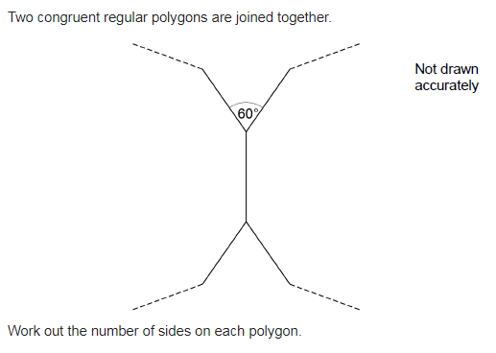
Exam Question
Notes:
Compare and share different method for solving this problem

