Slide 1
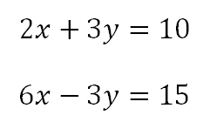
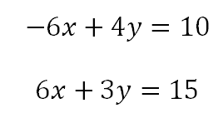
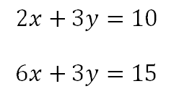
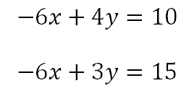
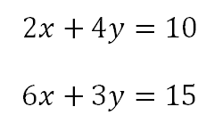
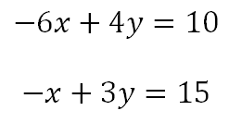

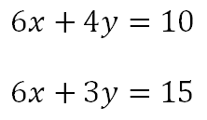
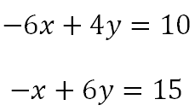

Tick or Trash
Ready for elimination?
Notes:
Linking to previous lesson:
In pairs, tick which equations are ready to be added or subtracted.

Slide 2
Tick or Trash
Ready for elimination?
Notes:
In pairs, tick which equations are ready to be added or subtracted.

Slide 3



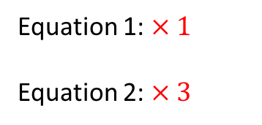

On your whiteboards:
What is the missing value?
$$4x+3y=21$$
Equation 1: $×1$
Equation 2: $×3$
$$4x+3y = 21$$
$$5x+ y =18$$
$$15x+3y =54$$
Notes:
Recap exercise

Slide 4




On your whiteboards:
What is the missing value?
$$4x+3y=21$$
Equation 1: $×1$
Equation 2: $×3$
$$4x+3y = 21$$
$$5x+ y =18$$
$$−$$
$$15x+3y =54$$
$$−11x =−33$$

Slide 5

On your whiteboards:
What is the missing value?
$$4x+3y=21$$
Equation 1: $×1$
Equation 2: $×3$
$$4x+3y = 21$$
$$5x+ y =18$$
$$−$$
$$15x+3y =54$$
$$−11x =−33$$
$$∴x=3$$

Slide 6

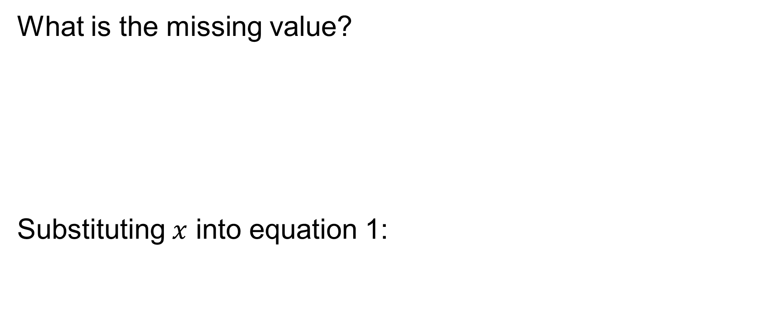




On your whiteboards:
What is the missing value?
Substituting $x$ into equation 1:
$$4x+3y=21$$
Equation 1: $×1$
Equation 2: $×3$
$$4x+3y = 21$$
$$5x+ y =18$$
$$−$$
$$15x+3y =54$$
$$−11x =−33$$
$$∴x=3$$
$$4×3+3y=21$$
$$12 +3y=21$$
$$3y=9$$

Slide 7

On your whiteboards:
What is the missing value?
Substituting $x$ into equation 1:
$$4x+3y=21$$
Equation 1: $×1$
Equation 2: $×3$
$$4x+3y = 21$$
$$5x+ y =18$$
$$−$$
$$15x+3y =54$$
$$−11x =−33$$
$$∴x=3$$
$$4×3+3y=21$$
$$12 +3y=21$$
$$3y=9$$
$$∴y=3$$
Notes:
Leading students to fully solve

Slide 8
To solve a pair of simultaneous equations the values of both variables must be worked out.

Slide 9


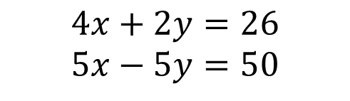








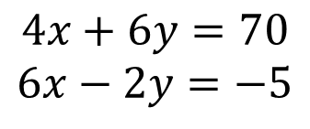


TITLE: SOLVING SIMULTANEOUS EQUATIONS
Worked Example:
Your Turn (demonstrate you understand on your whiteboards)
$$4x+2y=26$$
$$5x−5y=50$$
$$4x+6y=70$$
$$6x−2y=−5$$
$y = 7$, work out $x$
$y =10$, work out $x$
$$x$$
$$x$$
$$x$$
$$x$$
7
7
$$26$$
$$x$$
$$x$$
$$x$$
$$x$$
$$12$$
Notes:
Silent teacher: Complete worked example with bar model to link to early methods shown in Year 10 Autumn 2. Write the algebraic method alongside.
Your Turn: For students to do on whiteboards to check all are ready for the independent and intelligent practise

Slide 10
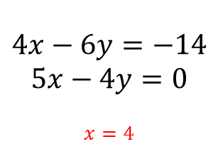
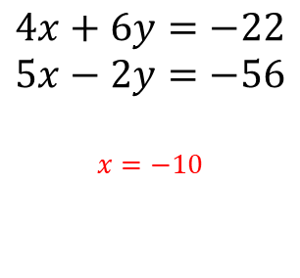
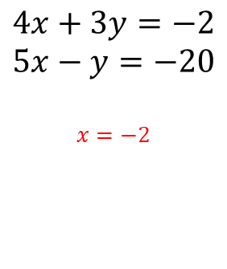
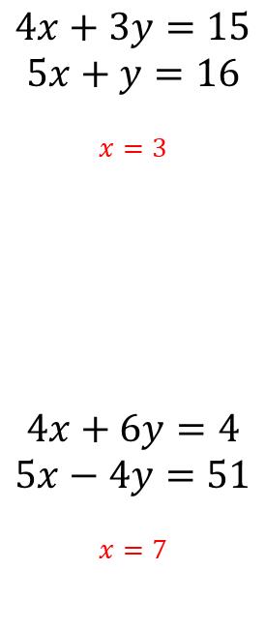
Independent Practise:
Work out the value of $y$.
1.
$$4x+3y=15$$
$$5x+y=16$$
$$x=3$$
$$4x+6y=4$$
$$5x−4y=51$$
$$x=7$$
2.
$$4x+3y=−2$$
$$5x−y=−20$$
$$x=−2$$
3.
$$4x+6y=−22$$
$$5x−2y=−56$$
$$x=−10$$
$$4x−6y=−14$$
$$5x−4y=0$$
$$x=4$$
4.
5.
Extension: Show how the value of $x$ was calculated
Notes:
Acknowledgements: Edited from variationtheory.com

Slide 11
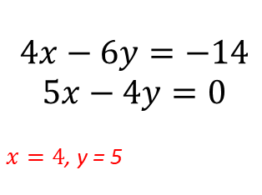
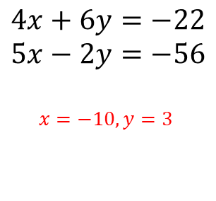
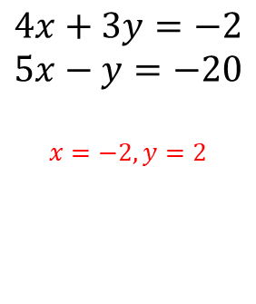
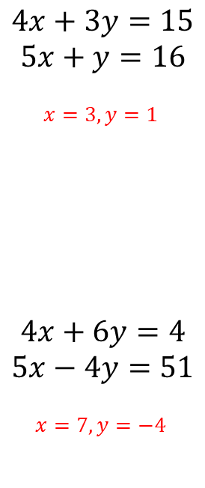
Mark your work
Work out the value of $y$.
1.
$$4x+3y=15$$
$$5x+y=16$$
$$x=3, y=1$$
$$4x+6y=4$$
$$5x−4y=51$$
$$x=7, y=−4$$
2.
$$4x+3y=−2$$
$$5x−y=−20$$
$$x=−2, y=2$$
3.
$$4x+6y=−22$$
$$5x−2y=−56$$
$$x=−10, y=3$$
$$4x−6y=−14$$
$$5x−4y=0$$
$x=4$, y = 5
4.
5.
Extension: Show how the value of $x$ was calculated

