Slide 1
Welcome to Maths

Slide 2
Seating Plan

Slide 3
Who am I?
Mrs Elder

Slide 4
What do I expect?
Arrive on time, stand quietly in an orderly line, waiting to enter the room.
Uniform will be perfect before, during and after the lesson.
After coming in, go immediately to your assigned seat and unpack your belongings.
Bring the correct equipment with you every lesson: Pen, pencil, ruler, rubber, calculator, planner and book should be brought to every lesson.
Classrooms, resources and equipment are used respectfully.
Homework is always written in planners, completed and handed in on time (ask for help if needed!)

Slide 5
Confidential Student Questionnaire
Complete this questionnaire honestly and in silence.
Only I will see what you write.
10 mins

Slide 6
Class Work
Margins should be drawn with date and title.
Work in books should be your best work.
Always write using a pen and draw using a pencil and ruler as appropriate.
You are not allowed to graffiti on or in your books – instances of this will be photocopied and sent home. Take pride in your work!
You and your partner will mark and correct your own or each others work – make sure this is always done properly.
Always listen when the teacher is speaking.
Put your hand up and wait if you want to ask/answer a question.

Slide 7
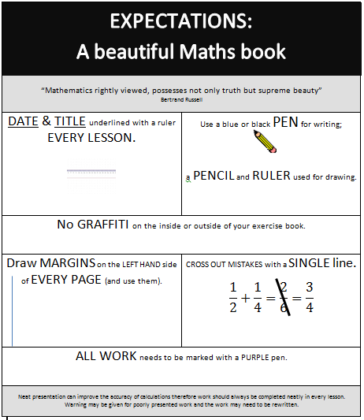
This will be stuck on the inside of the front cover of your book.
Notes:
Ensure you use your schools’ version of this handout..

Slide 8
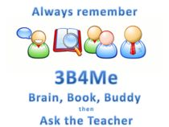

Stuck?
When we’re stuck we keep
trying and we:
Read the question again, carefully
Identify the key words
Look again at the textbook example
Try another question, coming back to the one I find difficult later
Try breaking the question into smaller parts
Draw or sketch a diagram that might help
Write down what I do know
3B4Me

Slide 9

Stuck on a topic?
Homework too tough?
Need a bit of extra help?
Mon, Wed & Fri lunch

Slide 10
New Books!
Label your exercise book with your name and form
By subject, write: Maths + YOUR SET
Stick the expectations sheet on the inside of the front cover of your exercise book.
Now draw in your margins with a pencil and ruler.
Notes:
Amend for your school

