Slide 1
A survey of 20 people asked how they preferred their tea to be made.
The results were as follows:
4 liked milk and sugar
8 liked only milk
6 liked only sugar
2 liked neither milk or sugar
Represent this information in a Venn Diagram
Notes:
Whiteboards: to recap set notation and using a venn to calculate simple probabilities

Slide 2
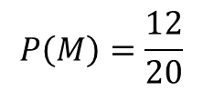






$$M$$
$$S$$
A survey of 20 people asked how they preferred their tea to be made.
The results were as follows:
4 liked milk and sugar
8 liked only milk
6 liked only sugar
2 liked neither milk or sugar
$$8$$
$$4$$
$$6$$
$$2$$
One of the 20 people was asked at random how they preferred their tea.
What is the probability that the chosen person preferred milk?
$$P\left(M\right)=\frac{12}{20}$$

Slide 3
$$M$$
$$S$$
A survey of 20 people asked how they preferred their tea to be made.
The results were as follows:
4 liked milk and sugar
8 liked only milk
6 liked only sugar
2 liked neither milk or sugar
$$8$$
$$4$$
$$6$$
$$2$$
One of the 20 people was asked at random how they preferred their tea.
What is the probability that the chosen person preferred milk?
$$P\left(M\right)=\frac{12}{20}$$

Slide 4
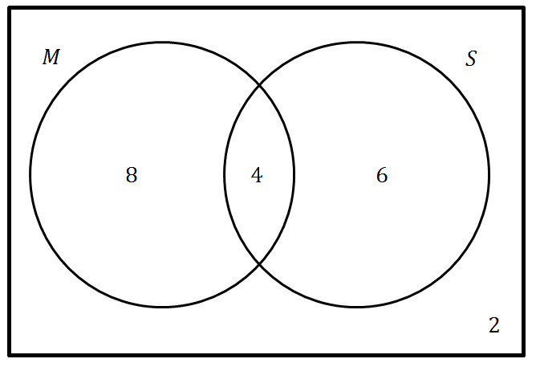
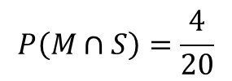
A survey of 20 people asked how they preferred their tea to be made.
The results were as follows:
4 liked milk and sugar
8 liked only milk
6 liked only sugar
2 liked neither milk or sugar
One of the 20 people was asked at random how they preferred their tea.
What is the probability that the chosen person preferred sugar and milk?
$$P\left(M∩S\right)=\frac{4}{20}$$

Slide 5
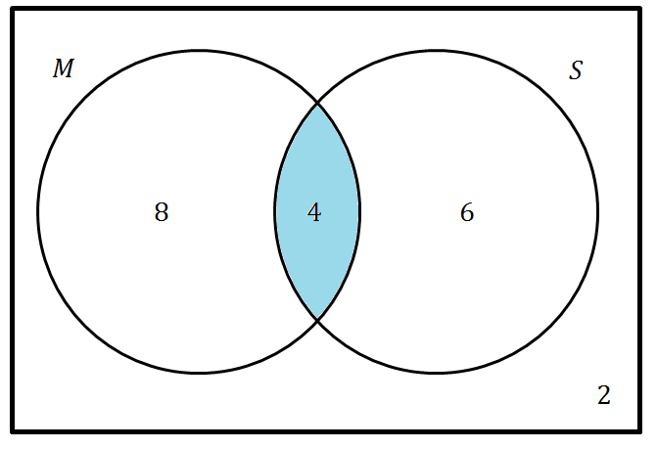
A survey of 20 people asked how they preferred their tea to be made.
The results were as follows:
4 liked milk and sugar
8 liked only milk
6 liked only sugar
2 liked neither milk or sugar
One of the 20 people was asked at random how they preferred their tea.
What is the probability that the chosen person preferred sugar and milk?
$$P\left(M∩S\right)=\frac{4}{20}$$

Slide 6
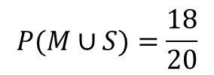
$$M$$
$$S$$
A survey of 20 people asked how they preferred their tea to be made.
The results were as follows:
4 liked milk and sugar
8 liked only milk
6 liked only sugar
2 liked neither milk or sugar
$$8$$
$$4$$
$$6$$
$$2$$
One of the 20 people was asked at random how they preferred their tea.
What is the probability that the chosen person preferred sugar or milk or both?
$$P(M∪S)=\frac{18}{20}$$

Slide 7
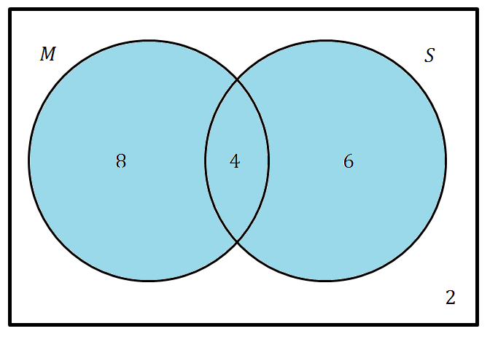
A survey of 20 people asked how they preferred their tea to be made.
The results were as follows:
4 liked milk and sugar
8 liked only milk
6 liked only sugar
2 liked neither milk or sugar
One of the 20 people was asked at random how they preferred their tea.
What is the probability that the chosen person preferred sugar or milk or both?
$$P(M∪S)=\frac{18}{20}$$

Slide 8
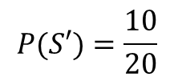
$$M$$
$$S$$
A survey of 20 people asked how they preferred their tea to be made.
The results were as follows:
4 liked milk and sugar
8 liked only milk
6 liked only sugar
2 liked neither milk or sugar
$$8$$
$$4$$
$$6$$
$$2$$
One of the 20 people was asked at random how they preferred their tea.
What is the probability that the chosen person preferred no sugar?
$$P(S′)=\frac{10}{20}$$

Slide 9
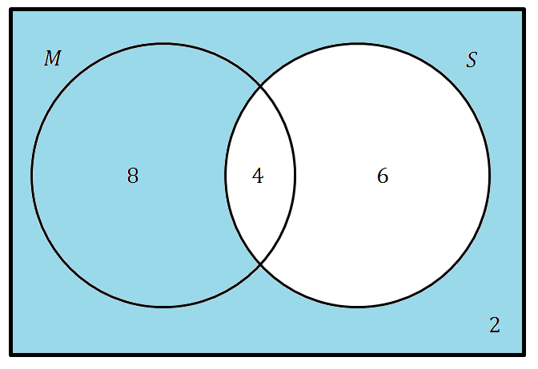
$$M$$
$$S$$
A survey of 20 people asked how they preferred their tea to be made.
The results were as follows:
4 liked milk and sugar
8 liked only milk
6 liked only sugar
2 liked neither milk or sugar
$$8$$
$$4$$
$$6$$
$$2$$
One of the 20 people was asked at random how they preferred their tea.
What is the probability that the chosen person preferred no sugar?
$$P(S′)=\frac{10}{20}$$

Slide 10
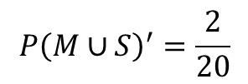
$$M$$
$$S$$
A survey of 20 people asked how they preferred their tea to be made.
The results were as follows:
4 liked milk and sugar
8 liked only milk
6 liked only sugar
2 liked neither milk or sugar
$$8$$
$$4$$
$$6$$
$$2$$
One of the 20 people was asked at random how they preferred their tea.
What is the probability that the chosen person preferred no milk or sugar?
$$P{\left(M∪S\right)}^{′}=\frac{2}{20}$$

Slide 11
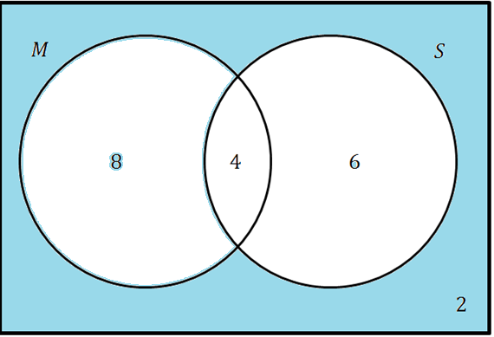
$$M$$
$$S$$
A survey of 20 people asked how they preferred their tea to be made.
The results were as follows:
4 liked milk and sugar
8 liked only milk
6 liked only sugar
2 liked neither milk or sugar
$$8$$
$$4$$
$$6$$
$$2$$
One of the 20 people was asked at random how they preferred their tea.
What is the probability that the chosen person preferred no milk or sugar?
$$P{\left(M∪S\right)}^{′}=\frac{2}{20}$$

Slide 12
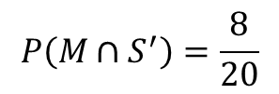
$$M$$
$$S$$
A survey of 20 people asked how they preferred their tea to be made.
The results were as follows:
4 liked milk and sugar
8 liked only milk
6 liked only sugar
2 liked neither milk or sugar
$$8$$
$$4$$
$$6$$
$$2$$
One of the 20 people was asked at random how they preferred their tea.
What is the probability that the chosen person preferred only milk?
$$P\left(M∩S^{′}\right)=\frac{8}{20}$$

Slide 13
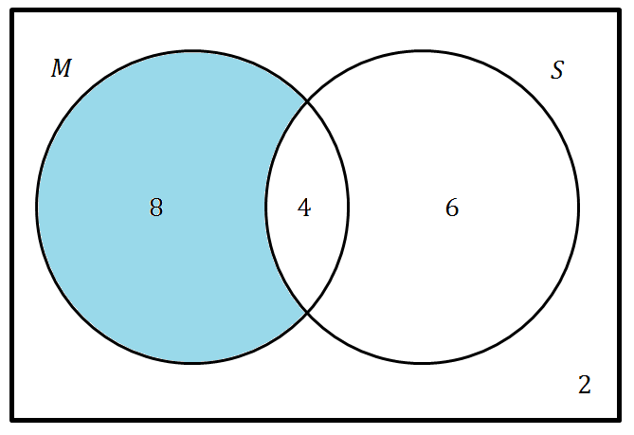
$$M$$
$$S$$
A survey of 20 people asked how they preferred their tea to be made.
The results were as follows:
4 liked milk and sugar
8 liked only milk
6 liked only sugar
2 liked neither milk or sugar
$$8$$
$$4$$
$$6$$
$$2$$
One of the 20 people was asked at random how they preferred their tea.
What is the probability that the chosen person preferred only milk?
$$P\left(M∩S^{′}\right)=\frac{8}{20}$$

Slide 14
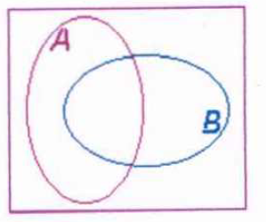








Shade the correct region
$$A$$
$$A′$$
$$A∩B$$
$$(A∩B)′$$
$$A∪B$$
$$(A∪B)′$$
$$A∩B′$$
$$A′∩B$$
Notes:
Print

Slide 15
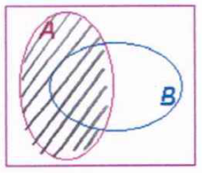
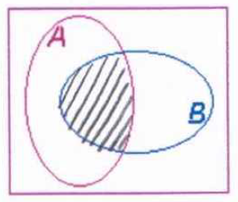
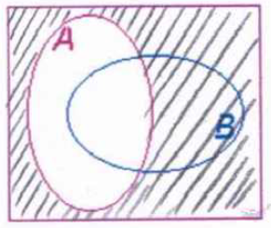
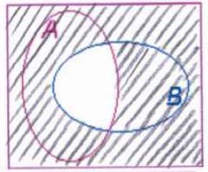
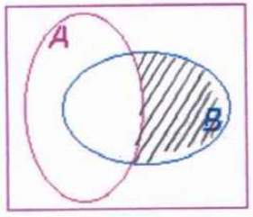
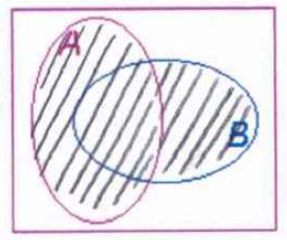
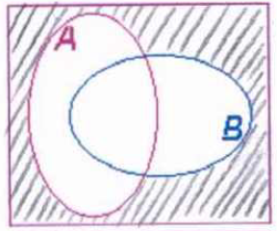
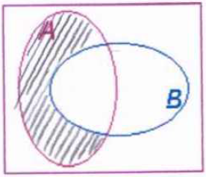
Check your work
$$A$$
$$A′$$
$$A∩B$$
$$(A∩B)′$$
$$A∪B$$
$$(A∪B)′$$
$$A∩B′$$
$$A′∩B$$

Slide 16
Your Turn
A group of 200 Year 10 students are asked if they own a dog or a cat.
32 own both a dog and a cat;
25 students only have a cat;
95 students own a dog.
Produce a Venn diagram to represent this situation.
Devise a set of 12 probability questions to ask a friend about the Venn diagram.
Ensure you work out the answers (including the set notation) for
the questions you have devised.
Notes:
Allow students to refer to their shaded regions worksheet

Slide 17
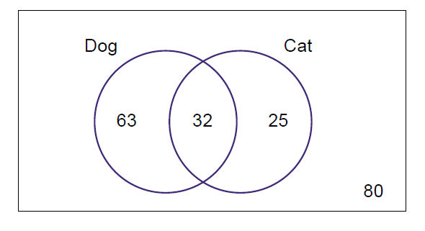
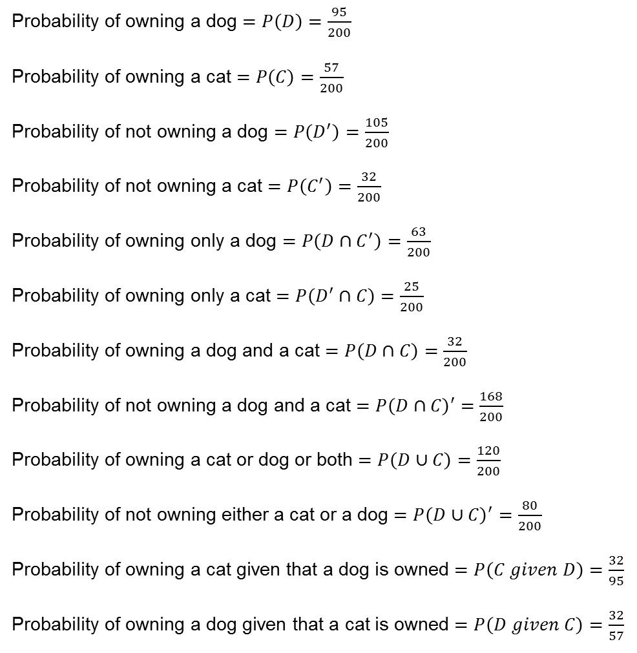
Mark your work
Probability of owning a dog $=P\left(D\right)=\frac{95}{200}$
Probability of owning a cat $=P\left(C\right)=\frac{57}{200}$
Probability of not owning a dog $=P\left(D^{′}\right)=\frac{105}{200}$
Probability of not owning a cat $=P\left(C^{′}\right)=\frac{32}{200}$
Probability of owning only a dog $=P\left(D∩C^{′}\right)=\frac{63}{200}$
Probability of owning only a cat $=P\left(D^{′}∩C\right)=\frac{25}{200}$
Probability of owning a dog and a cat $=P\left(D∩C\right)=\frac{32}{200}$
Probability of not owning a dog and a cat $=P\left(D∩C\right)′=\frac{168}{200}$
Probability of owning a cat or dog or both $=P\left(D∪C\right)=\frac{120}{200}$
Probability of not owning either a cat or a dog $=P{\left(D∪C\right)}^{′}=\frac{80}{200}$
Probability of owning a cat given that a dog is owned $=P\left(C given D\right)=\frac{32}{95}$
Probability of owning a dog given that a cat is owned $=P\left(D given C\right)=\frac{32}{57}$
Notes:
There are more options… check with students any other questions that they have devised.

Slide 18
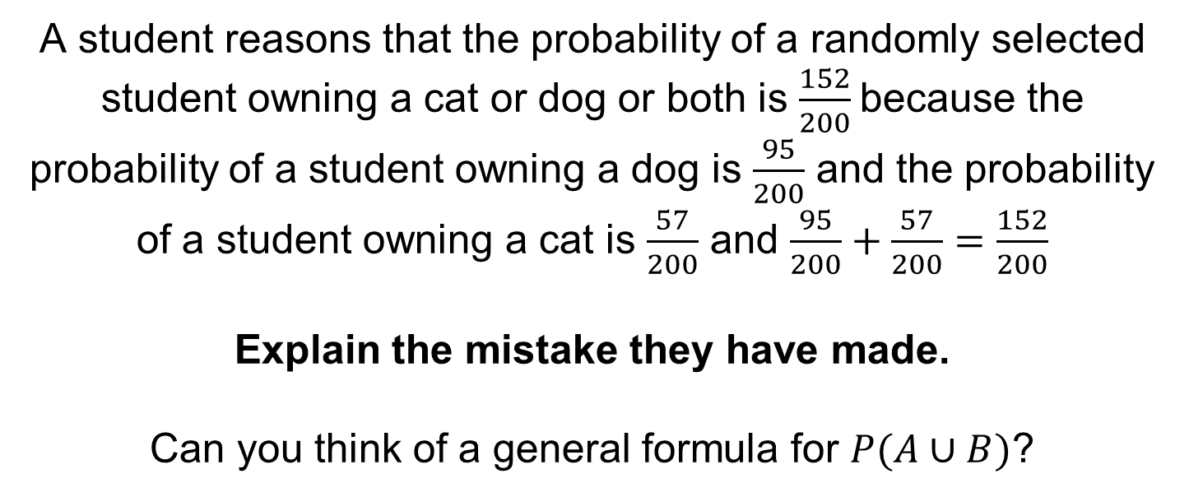
A student reasons that the probability of a randomly selected student owning a cat or dog or both is $\frac{152}{200}$because the probability of a student owning a dog is $\frac{95}{200}$ and the probability of a student owning a cat is $\frac{57}{200}$ and $\frac{95}{200}+\frac{57}{200}=\frac{152}{200}$
Explain the mistake they have made.
Can you think of a general formula for $P(A∪B)$?
Notes:
$$P\left(A∪B\right)=P\left(A\right)+P\left(B\right)−P(A∩B)$$

