Slide 1

Square Journey
Can you create a square journey on your starter sheet?
Notes:
Students attempt to draw a square on their starter sheet based upon the given vector

Slide 2
Square Journey

Slide 3
Square Journey

Slide 4
Understanding Column Vector Notation
Tuesday, 03 September 2019
Understand what a column vector represents
Be able to manipulate column vectors and understand what the resultant vector represents

Slide 5
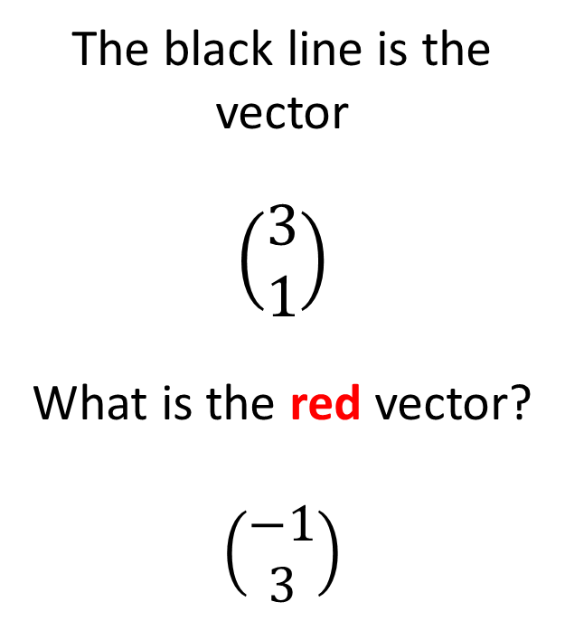
Square Journey
The black line is the vector
$$\left(\begin{matrix}3 \\ 1\end{matrix}\right)$$
What is the red vector?
$$\left(\begin{matrix}−1 \\ 3\end{matrix}\right)$$

Slide 6
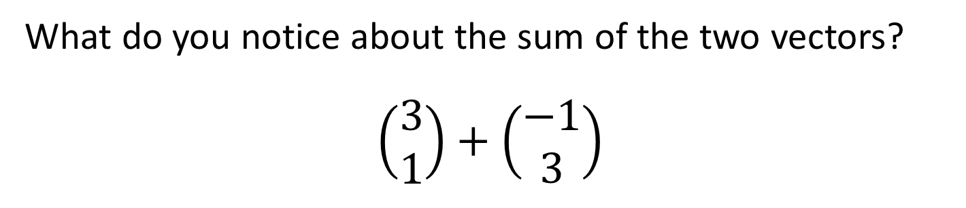
Square Journey
What do you notice about the sum of the two vectors?
$$\left(\begin{matrix}3 \\ 1\end{matrix}\right)+\left(\begin{matrix}−1 \\ 3\end{matrix}\right)$$

Slide 7

Square Journey
Can you find the vector path of the square?
$\left(\begin{matrix}3 \\ 1\end{matrix}\right)$ $\left(\begin{matrix}−1 \\ 3\end{matrix}\right)$
What do you notice?
Draw another vector path that makes a different square.
How can you prove that this vector path creates a square?

Slide 8

Square Journey
Can you find the vector path of the square?
$\left(\begin{matrix}3 \\ 1\end{matrix}\right)$ $\left(\begin{matrix}−1 \\ 3\end{matrix}\right)$ $\left(\begin{matrix}−3 \\ −1\end{matrix}\right)$ $\left(\begin{matrix}1 \\ −3\end{matrix}\right)$

Slide 9
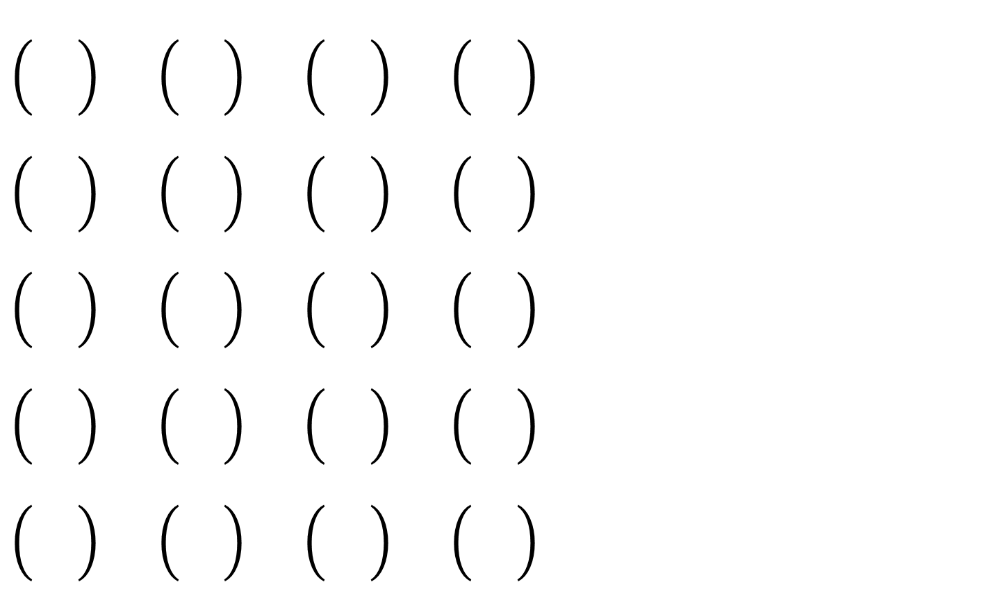
Other square vector paths
Do these have anything in common?
Does it apply to all vector paths?
How could you check a vector path makes a square

Slide 10
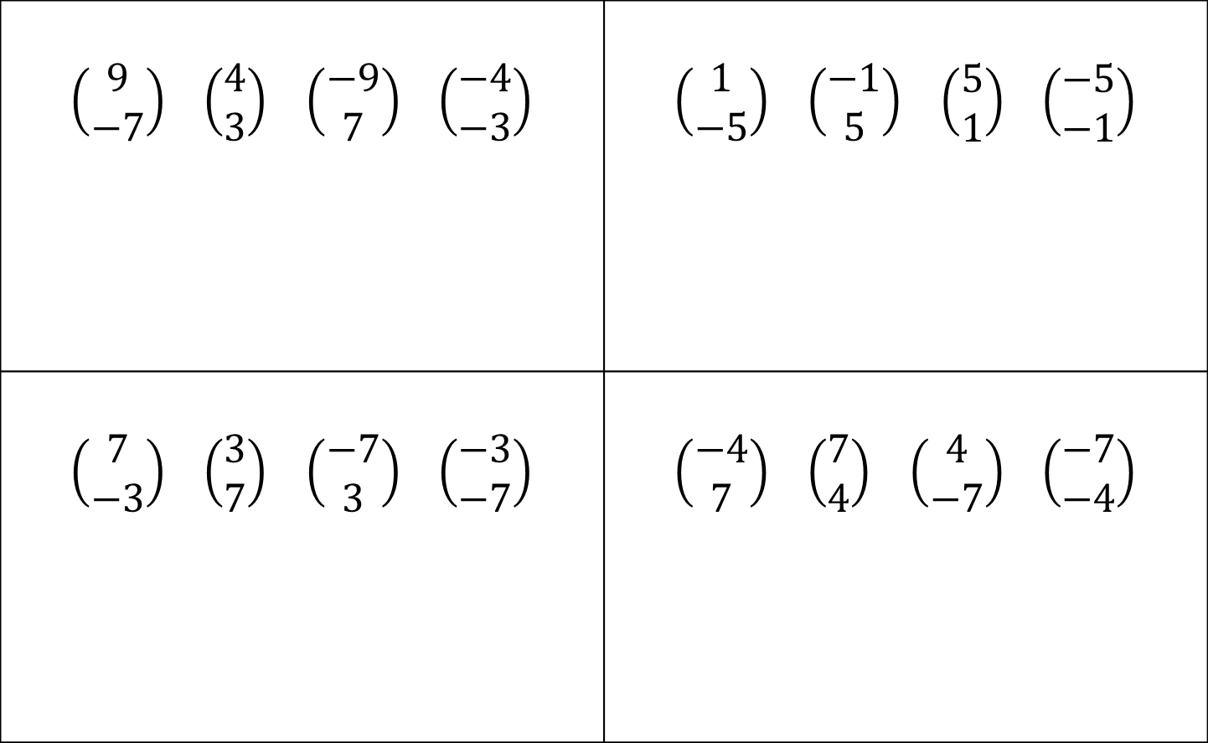
Square or not?
$\left(\begin{matrix}9 \\ −7\end{matrix}\right)$ $\left(\begin{matrix}4 \\ 3\end{matrix}\right)$ $\left(\begin{matrix}−9 \\ 7\end{matrix}\right)$ $\left(\begin{matrix}−4 \\ −3\end{matrix}\right)$ | $\left(\begin{matrix}1 \\ −5\end{matrix}\right)$ $\left(\begin{matrix}−1 \\ 5\end{matrix}\right)$ $\left(\begin{matrix}5 \\ 1\end{matrix}\right)$ $\left(\begin{matrix}−5 \\ −1\end{matrix}\right)$
$\left(\begin{matrix}7 \\ −3\end{matrix}\right)$ $\left(\begin{matrix}3 \\ 7\end{matrix}\right)$ $\left(\begin{matrix}−7 \\ 3\end{matrix}\right)$ $\left(\begin{matrix}−3 \\ −7\end{matrix}\right)$ | $\left(\begin{matrix}−4 \\ 7\end{matrix}\right)$ $\left(\begin{matrix}7 \\ 4\end{matrix}\right)$ $\left(\begin{matrix}4 \\ −7\end{matrix}\right)$ $\left(\begin{matrix}−7 \\ −4\end{matrix}\right)$

Slide 11
Consolidate
Complete the worksheet in classbooks

