Slide 1


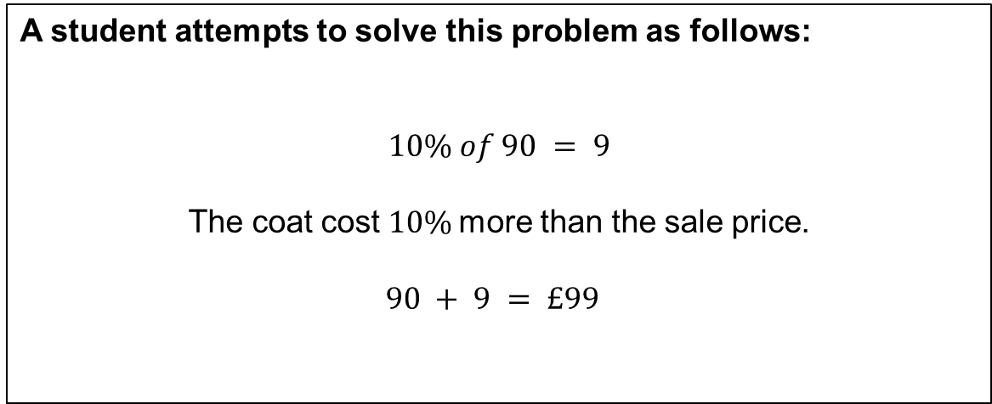
A coat is reduced by 10% in a sale and now costs £90.
How much was the coat before it was reduced?
A student attempts to solve this problem as follows:
$$10\% of 90 = 9$$
The coat cost $10\%$more than the sale price.
$$90 + 9 = £99$$
This is incorrect.
How can we show this student that this is incorrect?
Notes:
Allow students to attempt this question first.
Display the common misconception.
Allow students time to discuss, anticipate that many students will still believe this to be true at this point!

Slide 2
If the coat was £99 originally…
10% of 99 = 9.90
99 – 9.90 = £89.10
In the sale the coat would have cost £89.10

Slide 3

















A coat is reduced by 10% in a sale and now costs £90.
How much was the coat before it was reduced?
$$0\%$$
$$90\%$$
$$100\%$$
$$£10$$
$$£10$$
$$£10$$
$$£10$$
$$£10$$
$$£10$$
$$£10$$
$$£10$$
$$£10$$
$$£10$$
$$£0$$
$$£90$$
$$?$$
What is the value of each box?
The coat originally cost £100.
Notes:
Allow students to attempt this question first.
Display the common misconception.
Allow students time to discuss, anticipate that many students will still believe this to be true at this point!

Slide 4

A TV is reduced by 20% in a sale and now costs £240.
How much was the TV before it was reduced?
Attempt this question on your whiteboard using a bar model.
Notes:
Allow students to attempt this question first.
Display the common misconception.
Allow students time to discuss, anticipate that many students will still believe this to be true at this point!

Slide 5











A TV is reduced by 20% in a sale and now costs £240.
How much was the TV before it was reduced?
$$0\%$$
$$80\%$$
$$100\%$$
$$£60$$
$$£60$$
$$£60$$
$$£60$$
$$£60$$
$$£0$$
$$£240$$
$$?$$
The TV originally cost £300
Notes:
Allow students to attempt this question first.
Display the common misconception.
Allow students time to discuss, anticipate that many students will still believe this to be true at this point!

Slide 6
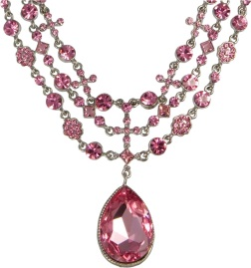
A necklace increased in value by 25% and now costs £550.
How much was the necklace before it increased in value?
Attempt this question on your whiteboard using a bar model.
Notes:
Allow students to attempt this question first.
Display the common misconception.
Allow students time to discuss, anticipate that many students will still believe this to be true at this point!

Slide 7











A necklace increased in value by 25% and now costs £550.
How much was the necklace before it increased in value?
$$0\%$$
$$100\%$$
$$125\%$$
$$£110$$
$$£110$$
$$£110$$
$$£110$$
$$£110$$
$$£0$$
$$?$$
$$£550$$
The necklace originally cost £440
Notes:
Allow students to attempt this question first.
Display the common misconception.
Allow students time to discuss, anticipate that many students will still believe this to be true at this point!

Slide 8
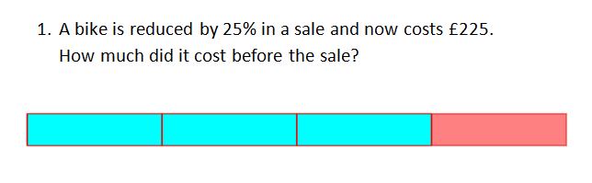
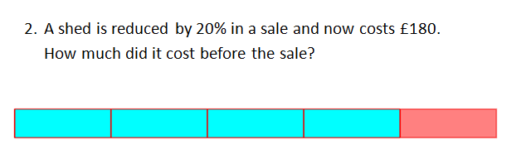
Independent Practise
Notes:
See scaffolded worksheet

Slide 9
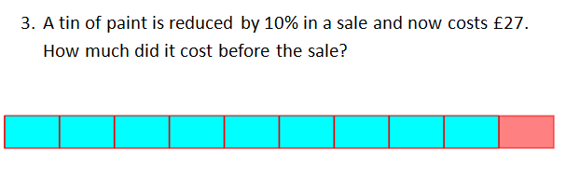
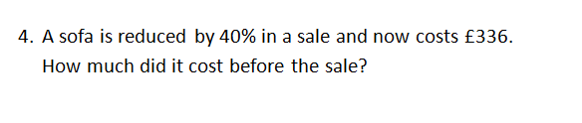
Notes:
Share student approaches to Q4

Slide 10
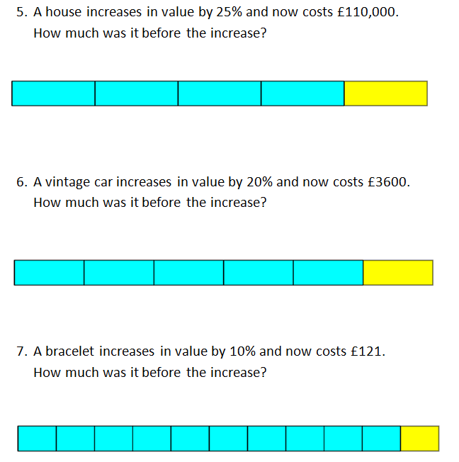

Slide 11
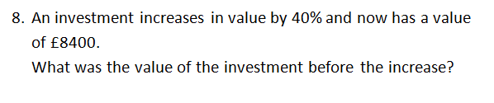
Notes:
No scaffold, share students approaches to this question too.

Slide 12
Mark/Correct your work
£300
£225
£30
£560
£88,000
£3000
£110
£6000

Slide 13
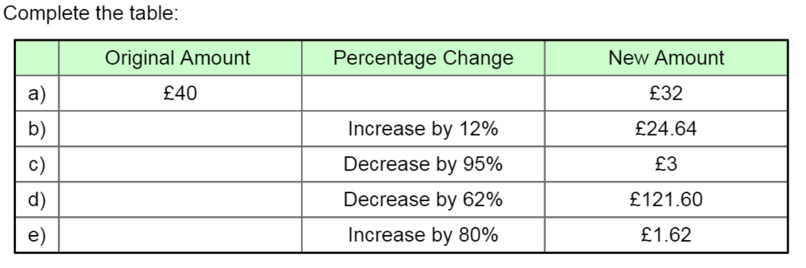
Challenge

