Slide 1


$$B:G=1:4$$
Write down an equivalent ratio
and another…
and another…
Notes:
From http://educatingmrmattock.blogspot.co.uk/2015/12/ratios-fractions-and-linear-functions.html
Fraction of whole

Slide 2



$$B:G=1:4$$
$$B:G=2:8$$
$$B:G=3:12$$

Slide 3

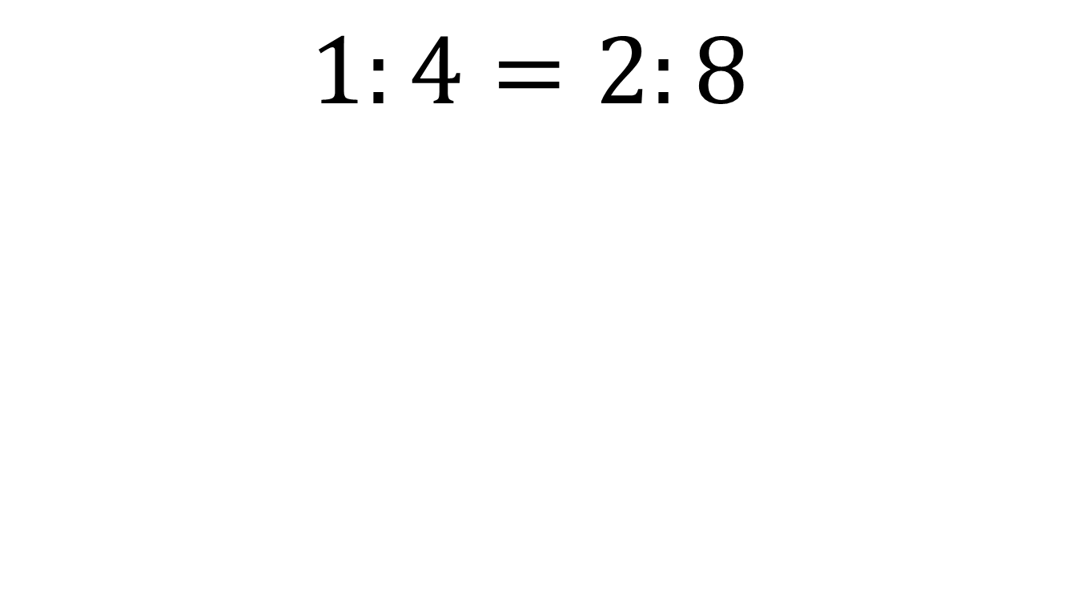

$$4×2=8$$
$$1:4=2:8$$
$$1×8=8$$

Slide 4

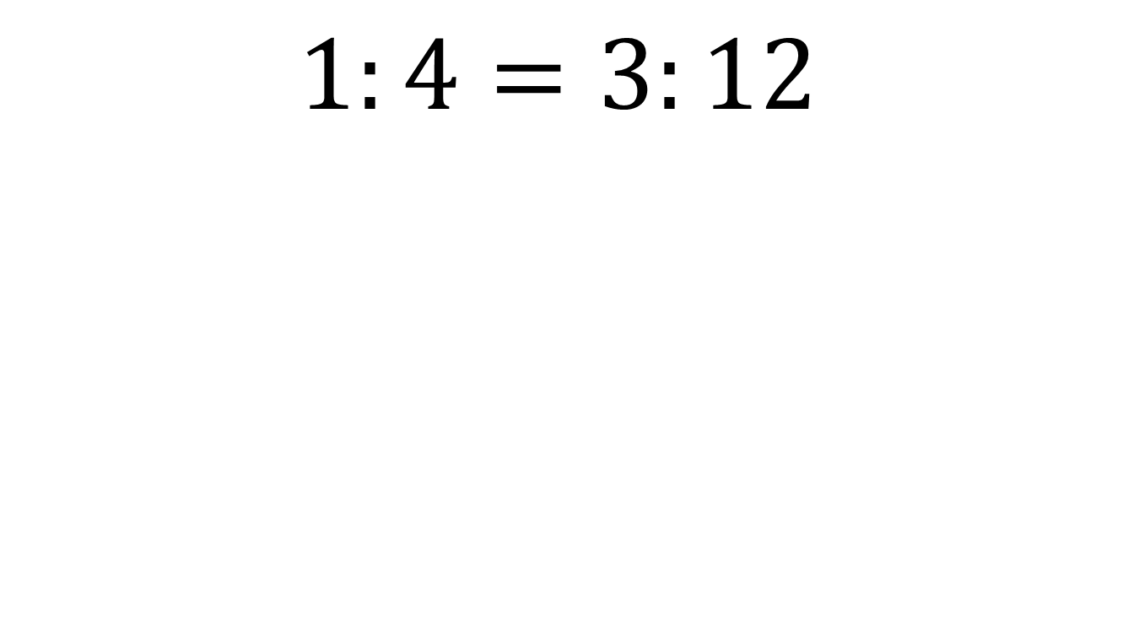

$$4×3=12$$
$$1:4=3:12$$
$$1×12=12$$

Slide 5

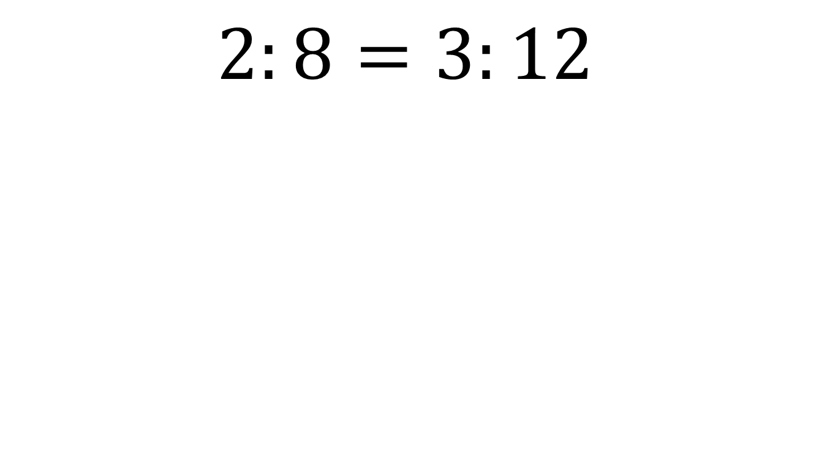

$$8×3=24$$
$$2:8=3:12$$
$$2×12=24$$
Describe what you have noticed.
The product of the outer parts is equal to the product of the inner parts

Slide 6


$$B:G=2:3$$
Write down an equivalent ratio
And another…
And another…
Notes:
Emphasis that B only equals 2 when G equals 3

Slide 7

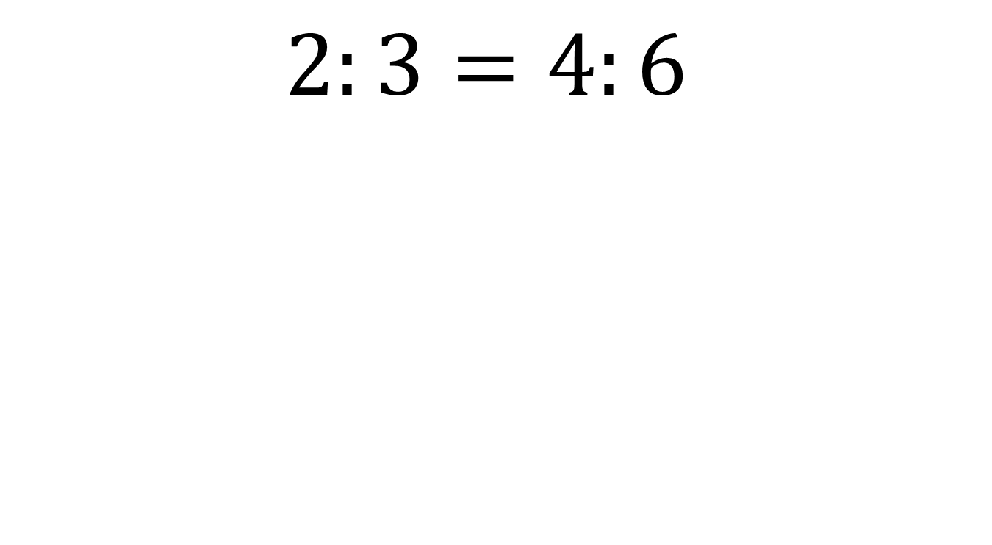

$$3×4=12$$
$$2:3=4:6$$
$$2×6=12$$

Slide 8

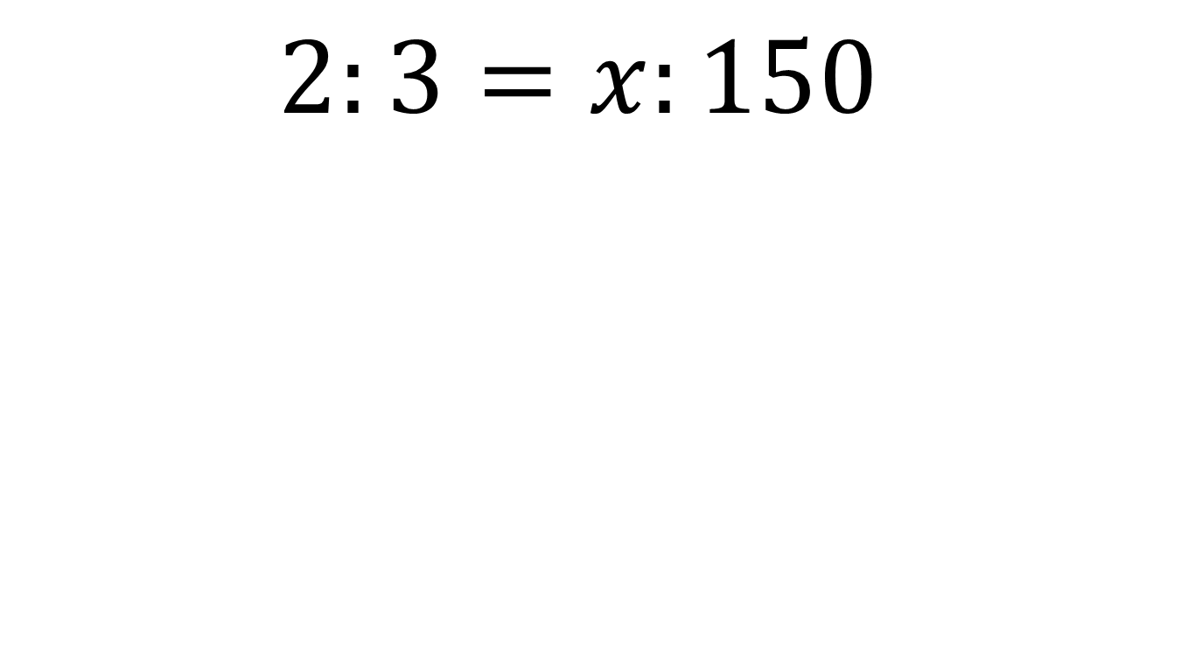

$$3×?=300$$
$$2:3=x:150$$
$$2×150=300$$
On your whiteboards: What is the missing value?
Show your working

Slide 9

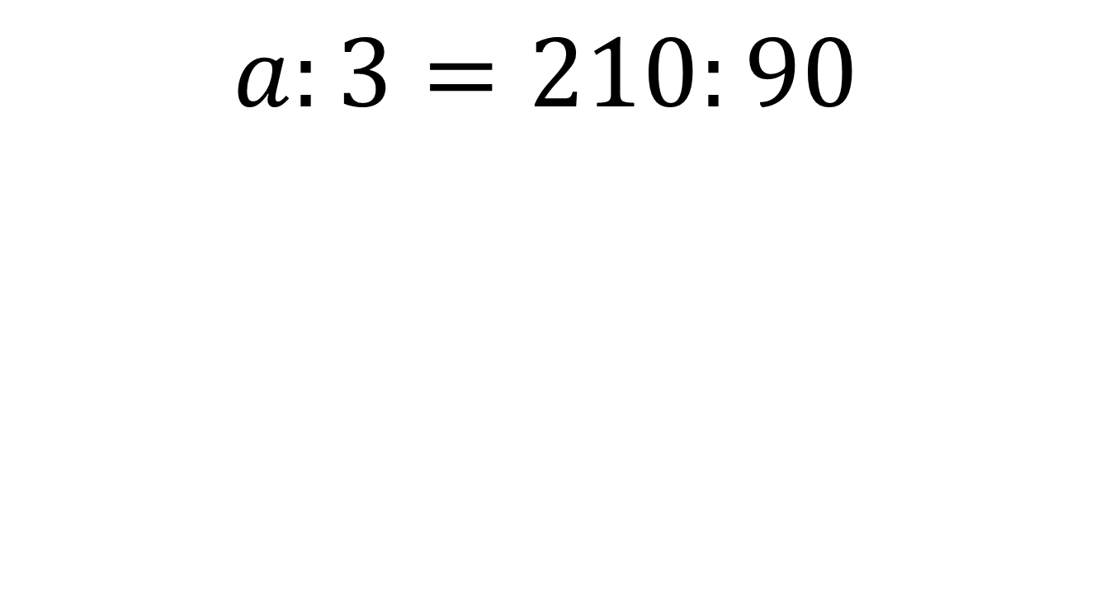

$$3×210=630$$
$$a:3=210:90$$
$$90a=630$$
On your whiteboards: What is the missing value?
Show your working

Slide 10

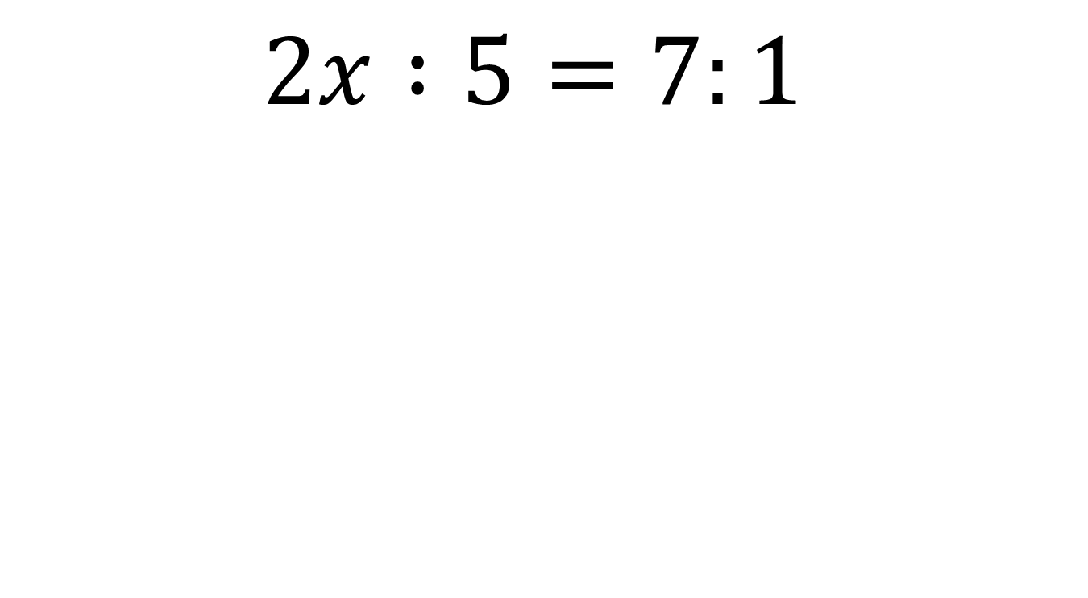

$$5×7=35$$
$$2x :5=7:1$$
$$2x=35$$
On your whiteboards: What is the missing value?
Show your working

Slide 11

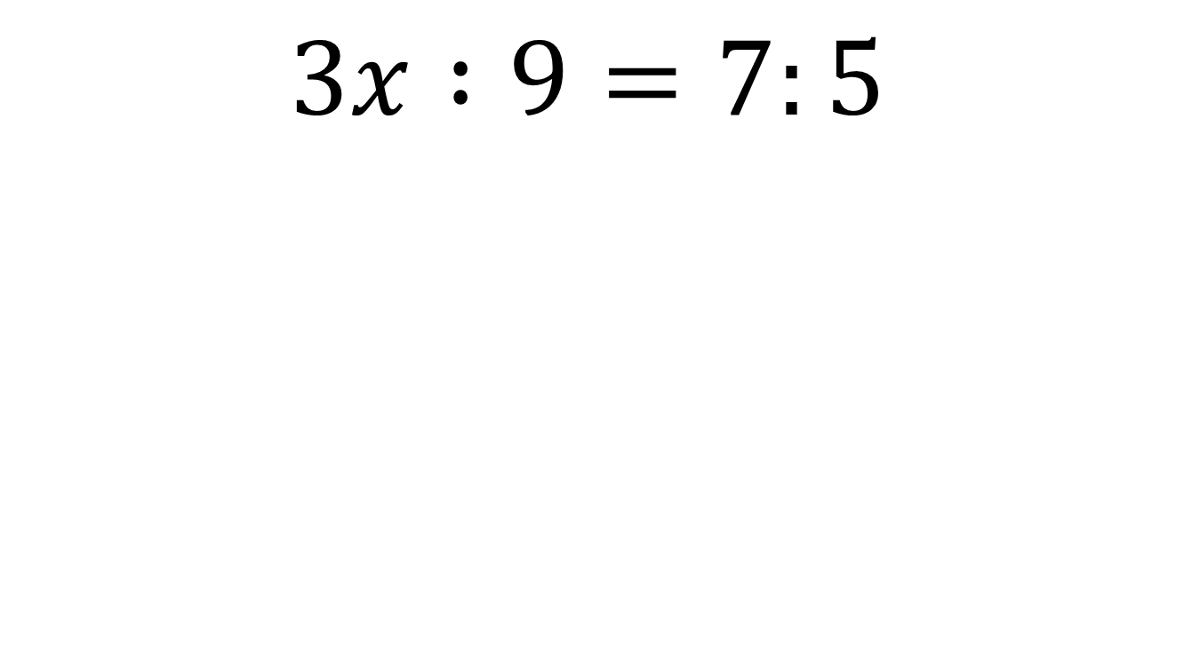

$$9×7=63$$
$$3x :9=7:5$$
$$15x=63$$
On your whiteboards: What is the missing value?
Show your working

Slide 12

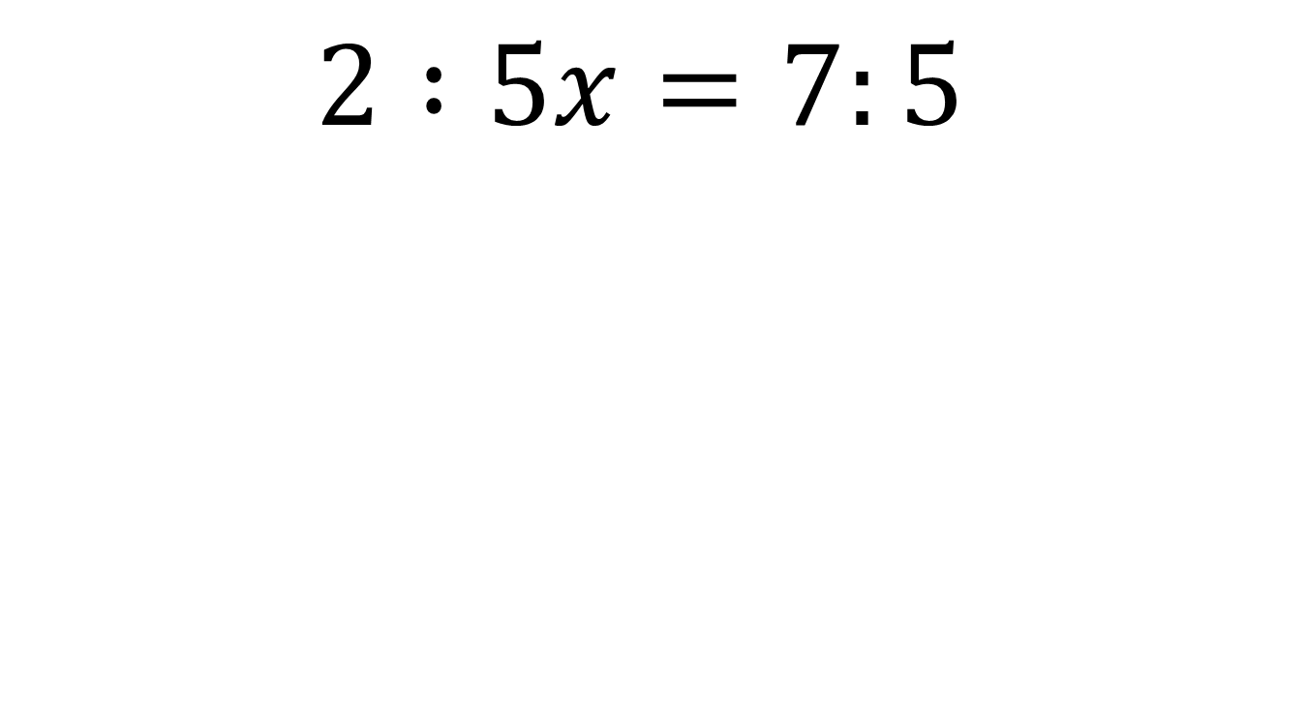

$$35x=10$$
$$2 :5x=7:5$$
$$2×5=10$$
On your whiteboards: What is the missing value?
Show your working

Slide 13

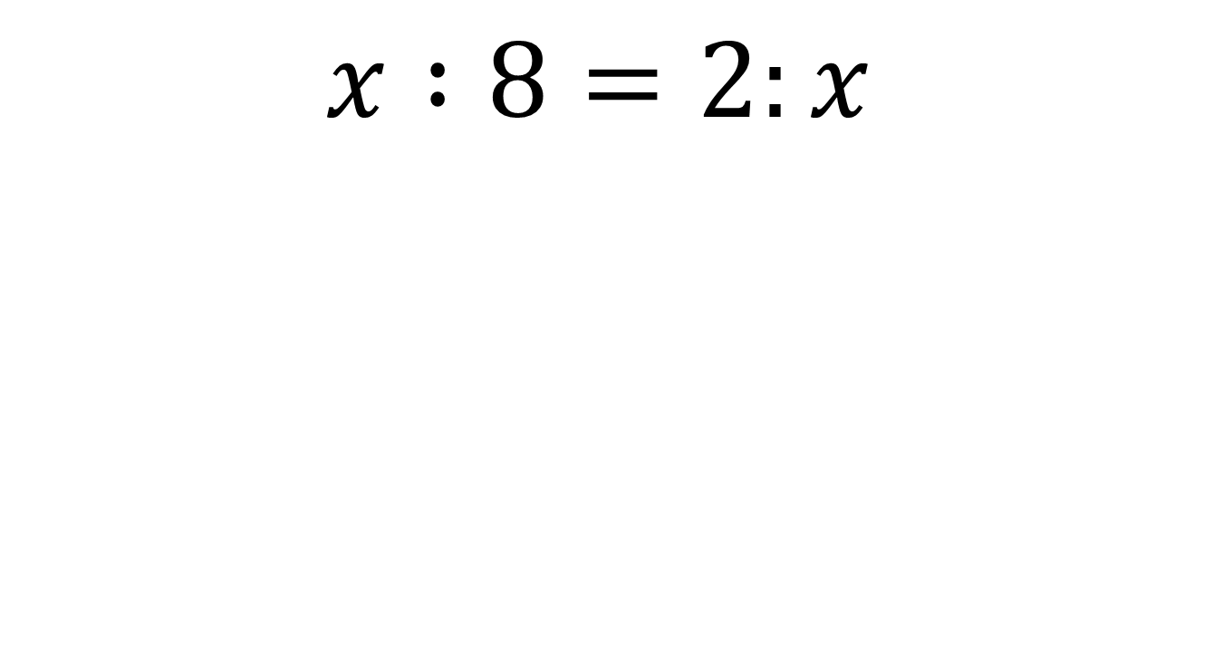

$$8×2=16$$
$$x :8=2:x$$
$$x^{2}=16$$
On your whiteboards: What is the missing value?
Show your working

Slide 14
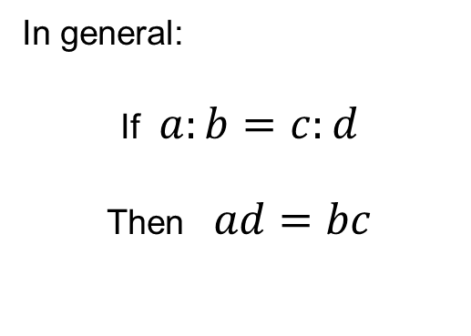
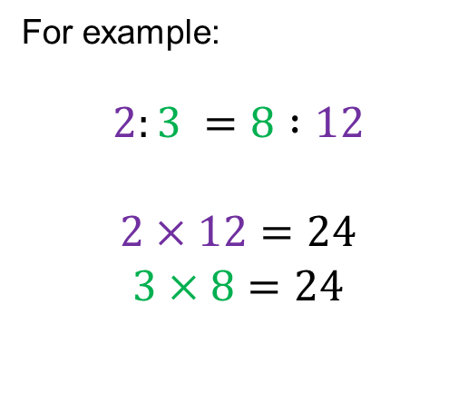
Title: Solving Equations involving Ratio
Two ratios are equivalent if the product of the outer parts is equal to the product of the inner parts.
For example:
$$2:3 =8 :12$$
$$2×12=24$$
$$3×8=24$$
In general:
If $a:b=c:d$
Then $ad=bc$
Missing words? product, similar, equivalent, identical, sum

Slide 15
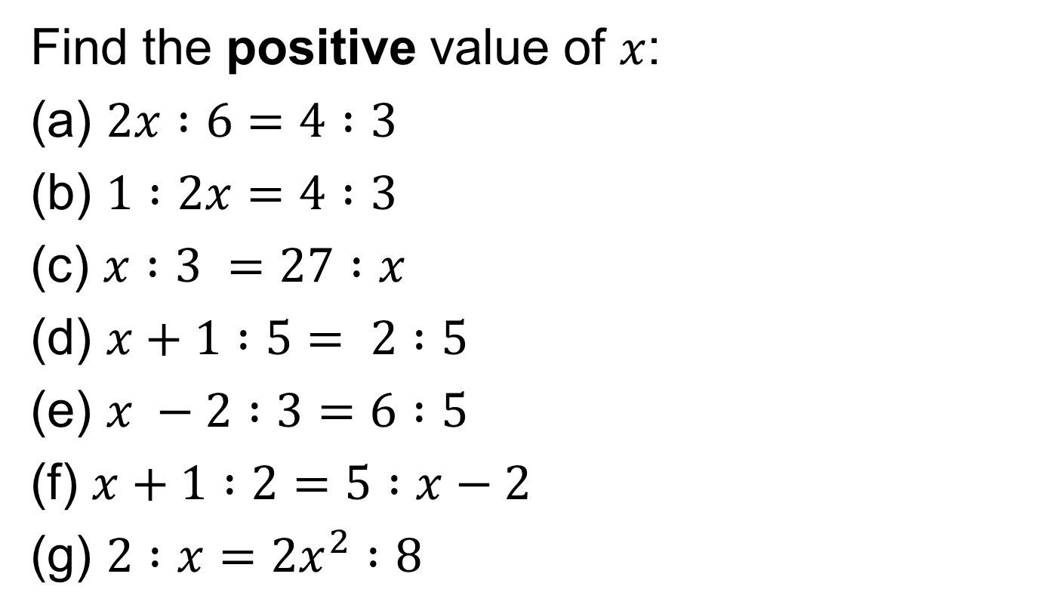
Your Turn:
Find the positive value of $x$:
(a) $2x :6=4 :3$
(b) $1 :2x=4 :3$
(c) $x :3 =27 :x$
(d) $x+1 :5= 2 :5$
(e) $x −2 :3=6 :5$
(f) $x+1 :2=5 :x−2$
(g) $2 :x={2x}^{2} :8$

Slide 16
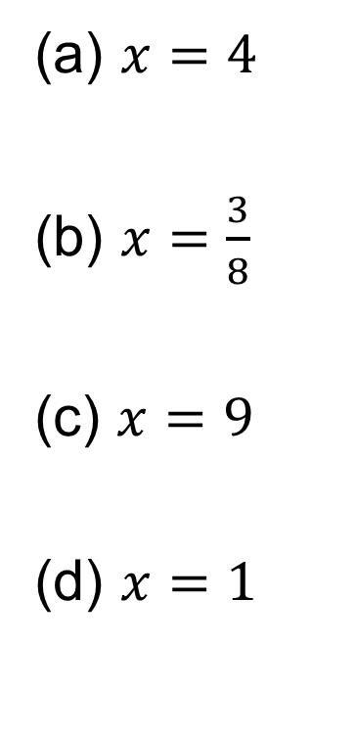
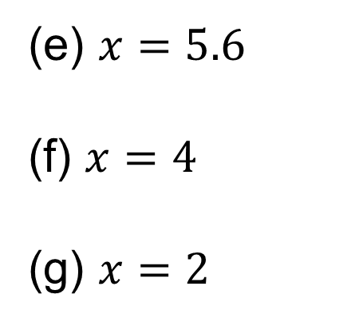
Mark your work
(a) $x=4$
(b) $x=\frac{3}{8}$
(c) $x=9$
(d) $x=1$
(e) $x=5.6$
(f) $x=4$
(g) $x=2$

Slide 17
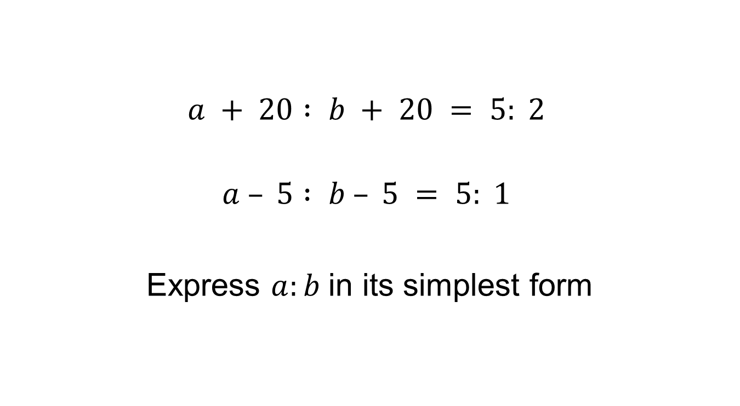
Challenge
$$a + 20 : b + 20 = 5: 2$$
$$a – 5 : b – 5 = 5: 1$$
Express $a:b$in its simplest form
Notes:
4 : 1

