Slide 1
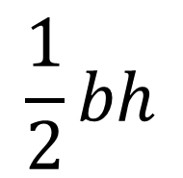
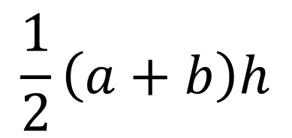
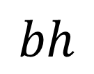
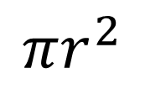
Area
Shape
$$πr^{2}$$
$$\frac{1}{2}\left(a+b\right)h$$
Match the shape to the formula that calculates it’s area.
$$\frac{1}{2}bh$$
$$bh$$

Slide 2
Area
Shape
$$πr^{2}$$
$$\frac{1}{2}\left(a+b\right)h$$
$$\frac{1}{2}bh$$
$$bh$$

Slide 3


Area of a Rectangle
Your Turn: On your whiteboards…
Calculate the area
$$13 cm$$
$$12 cm$$

Slide 4

Area of a Rectangle
Your Turn: On your whiteboards…
First, calculate the height…
$$13 cm$$
$$h$$
$$12 cm$$

Slide 5
Area of a Rectangle
Your Turn: On your whiteboards…
Calculate the area
$$13 cm$$
$$12 cm$$

Slide 6


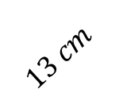

Area of a Trapezium
Your Turn: On your whiteboards…
Calculate the area.
$$13 cm$$
$$17 cm$$
$$15 cm$$
$$24 cm$$

Slide 7

Area of a Trapezium
Your Turn: On your whiteboards…
First, calculate the height..
$$h$$
$$13 cm$$
$$17 cm$$
$$15 cm$$
$$24 cm$$

Slide 8
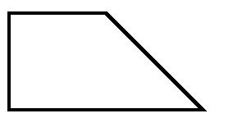




Area of a Trapezium
Worked Example
Calculate the area.
$$10 cm$$
$$h$$
$$17 cm$$
$$25 cm$$

Slide 9
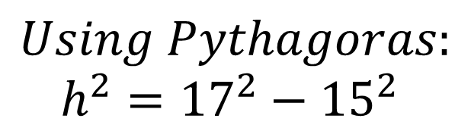





Area of a Trapezium
Worked Example
Calculate the area.
$$10 cm$$
$$Using Pythagoras:$$
$$h^{2}={17}^{2}−{15}^{2}$$
$$17 cm$$
$$h$$
$$h^{2}=64$$
$$h=8$$
$$15$$
$$25 cm$$

Slide 10
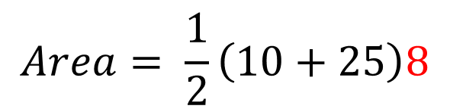
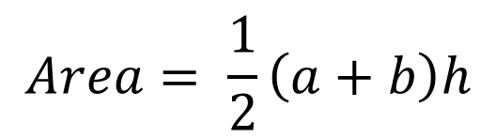

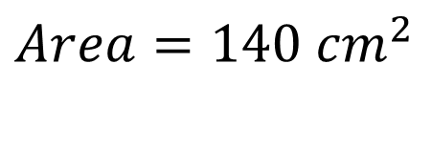

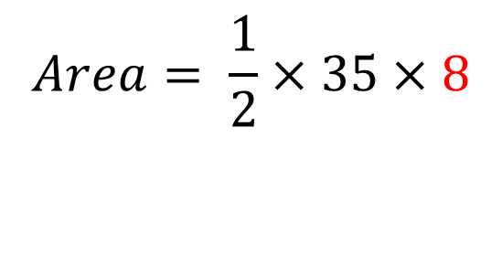
Area of a Trapezium
Worked Example
Calculate the area.
$$Area= \frac{1}{2}\left(a+b\right)h$$
$$10 cm$$
$$Area= \frac{1}{2}\left(10+25\right)8$$
$$17 cm$$
$$8$$
$$Area= \frac{1}{2}×35×8$$
$$25 cm$$
$Area=140 {cm}^{2}$

Slide 11




Area of a Trapezium
Your Turn: On your whiteboards…
Calculate the area.
$$20 cm$$
$$h$$
$$13 cm$$
$$15 cm$$

Slide 12

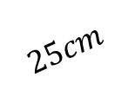


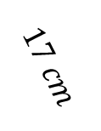
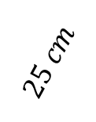

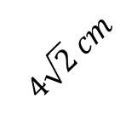
Find the area of these shapes
$$25cm$$
$$25 cm$$
$$24 cm$$
$$10 cm$$
$$48 cm$$
$$17 cm$$
$$15 cm$$
$$4\sqrt{2} cm$$

Slide 13



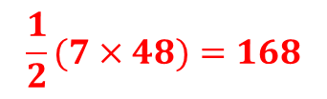

Mark/Correct your work
$$25cm$$
$$25 cm$$
$$7×24=168$$
$$\frac{1}{2}(7×48)=168$$
$$24 cm$$
$$10 cm$$
$$48 cm$$
$$17 cm$$
$$4\sqrt{2} cm$$
$$15 cm$$
$$\frac{1}{2}\left(10+26\right)15=270$$
$$4×4=16$$

Slide 14
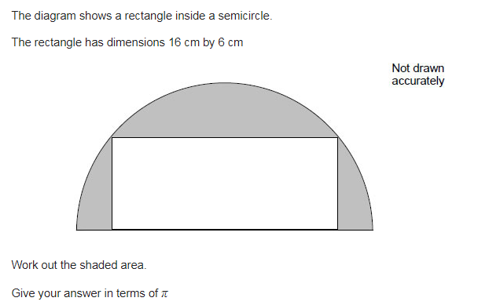
Challenge

