Slide 1
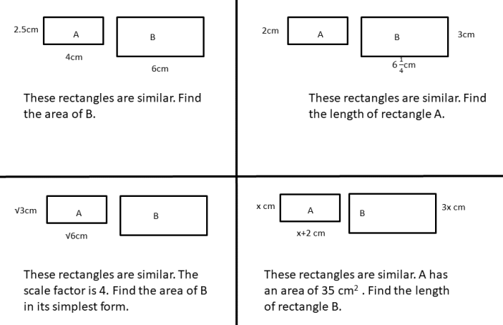

Slide 2
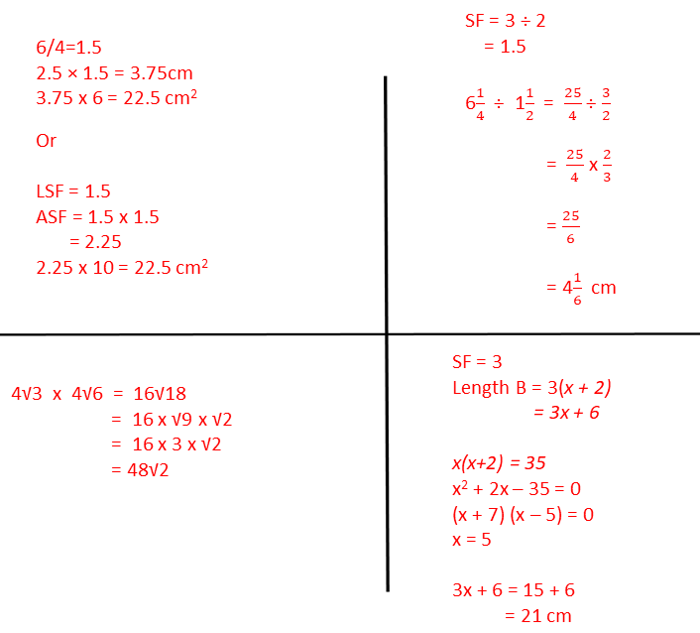

Slide 3
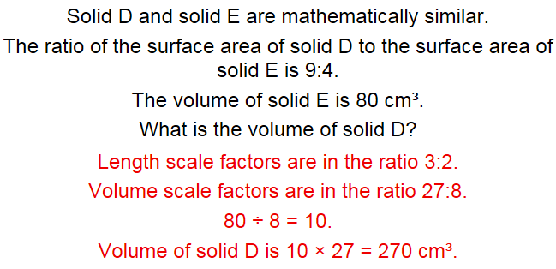
Exam Question
Notes:
https://mathsbot.com/gcseQuestions

Slide 4
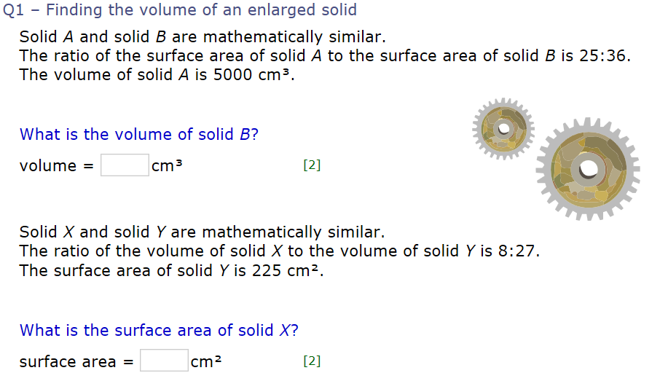
On your whiteboards
A : B
LSF 5 : 6
ASF 25 : 36
VSF 125 : 216
Volume of B = 5000 ÷ 125 x 216
= 8640 cm³
X : Y
LSF 2 : 3
ASF 4 : 9
VSF 8 : 27
SA of X = 225 ÷ 9 x 4
= 100 cm²
Notes:
MyMaths

Slide 5
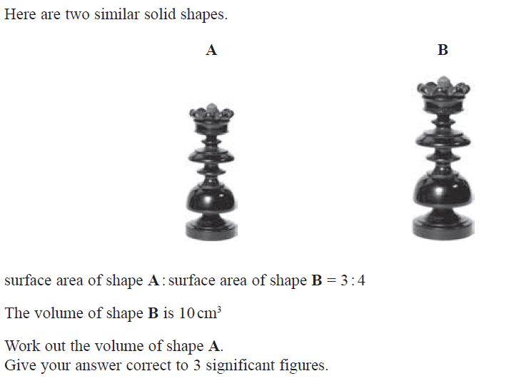
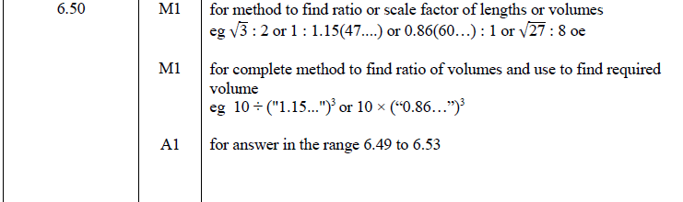

Slide 6
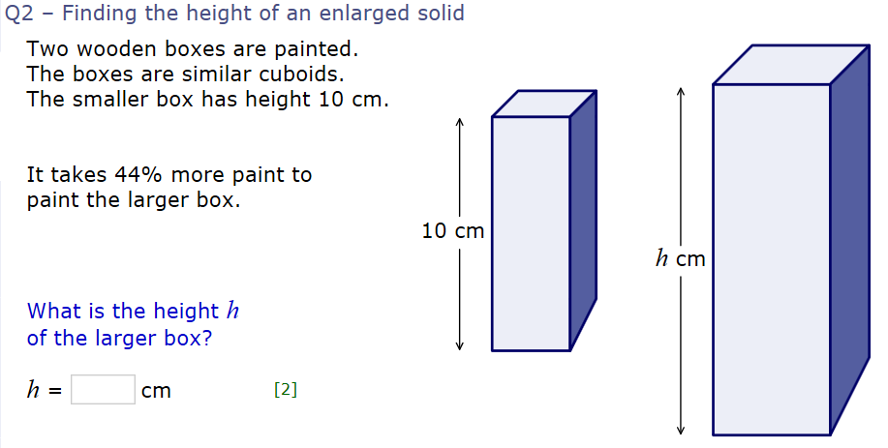
Small : Large
ASF 1 : 1.44 (44% increase)
LSF 1 : 1.2
Height 10cm : 12cm (10cm x 1.2)
Notes:
MyMaths

Slide 7
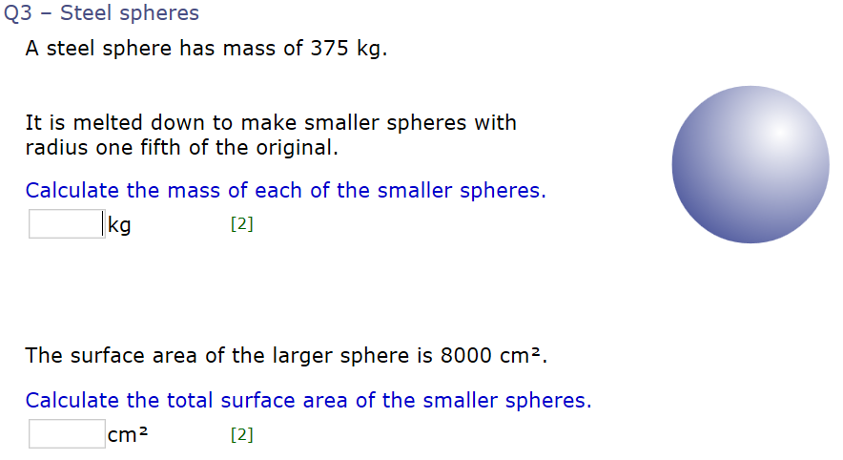
Did you expect these answers?
Small : Large
LSF ¹/₅ : 1 (¹/₅ of the original)
VSF ¹/₁₂₅ : 1 (¹/₅ cubed)
Mass is directly proportional to volume. So the mass will increase by the same factor as the volume if the two spheres have the same density.
Mass of smaller spheres = 375 x ¹/₁₂₅ = 3kg
Small : Large
LSF ¹/₅ : 1 (¹/₅ of the original)
ASF ¹/₂₅ : 1 (¹/₅ squared)
SA of 1 smaller sphere = 8000 x ¹/₂₅ = 320 cm²
If each small sphere has a volume ¹/₁₂₅ of the original, then there must be 125 smaller spheres. Thus, the total SA = 125 x 320 = 40,000 cm².
Notes:
MyMaths

Slide 8
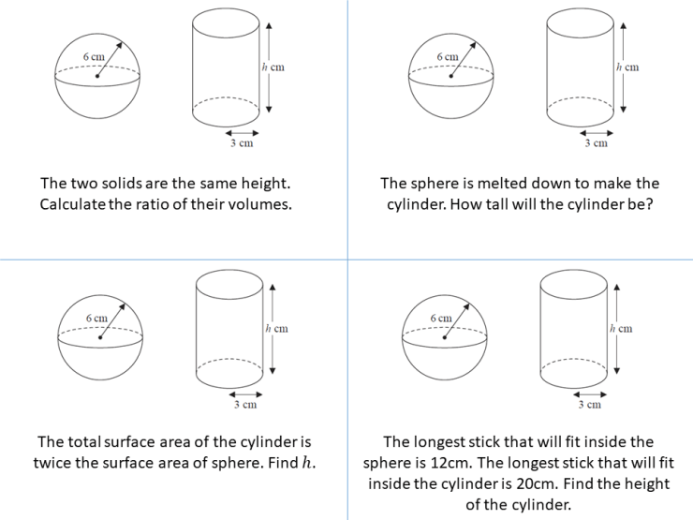
Notes:
https://ssddproblems.com/the-sphere-and-the-cylinder-part-1/

Slide 9
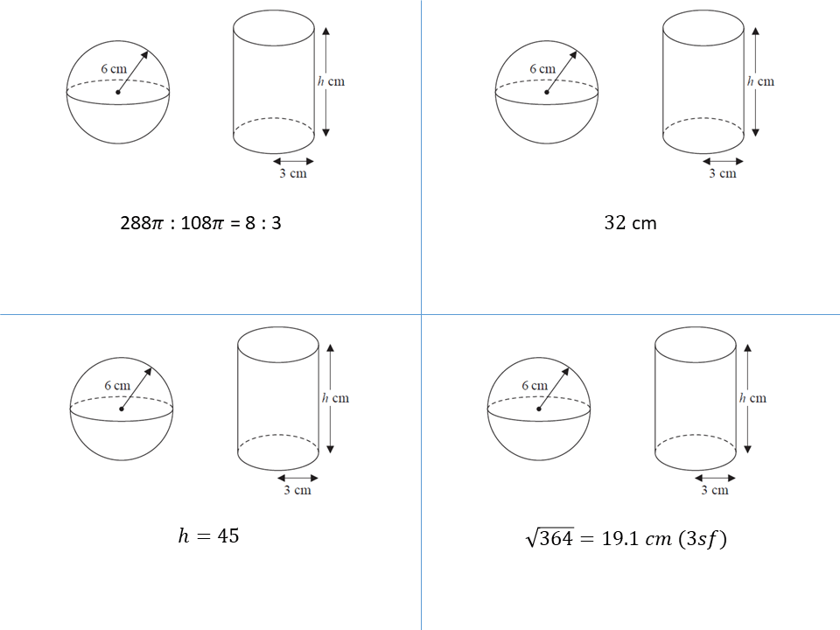

Slide 10
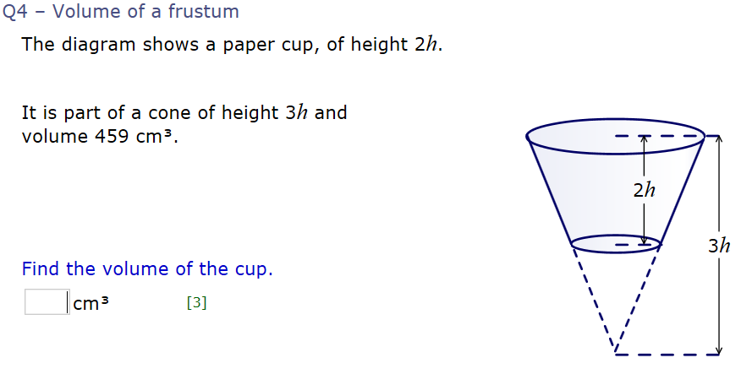
If the total height is 3h, then the height of the tip of the cone (which is similar to the whole cone) is 1h.
Tip of Cone : Whole Cone
LSF 1 : 3
VSF 1 : 27
The volume of the whole cone is 27 times bigger than the tip.
Volume of small cone = 459cm³ ÷ 27
= 17cm³
Volume of cup (a “frustum”) = 459 – 17 = 442cm³

Slide 11
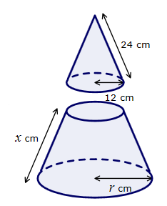
What is the question?
Notes:
Ask students to discuss in pairs and consider what questions could be asked about the above image. Encourage students to be imaginative and creative.
All students should be able to contribute some questions, even if it’s just “what is x” or “what is r”.
Note down all potential questions on the slide/whiteboard and ask students to answer them in pairs.

Slide 12
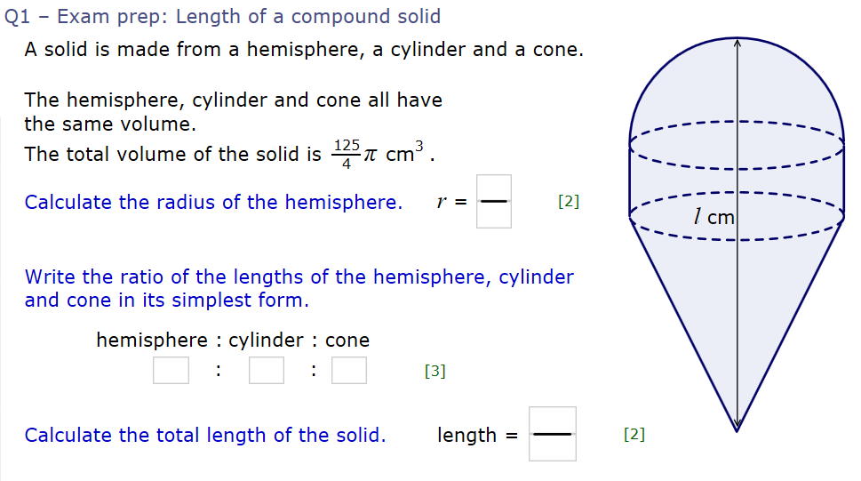
Challenge

Slide 13
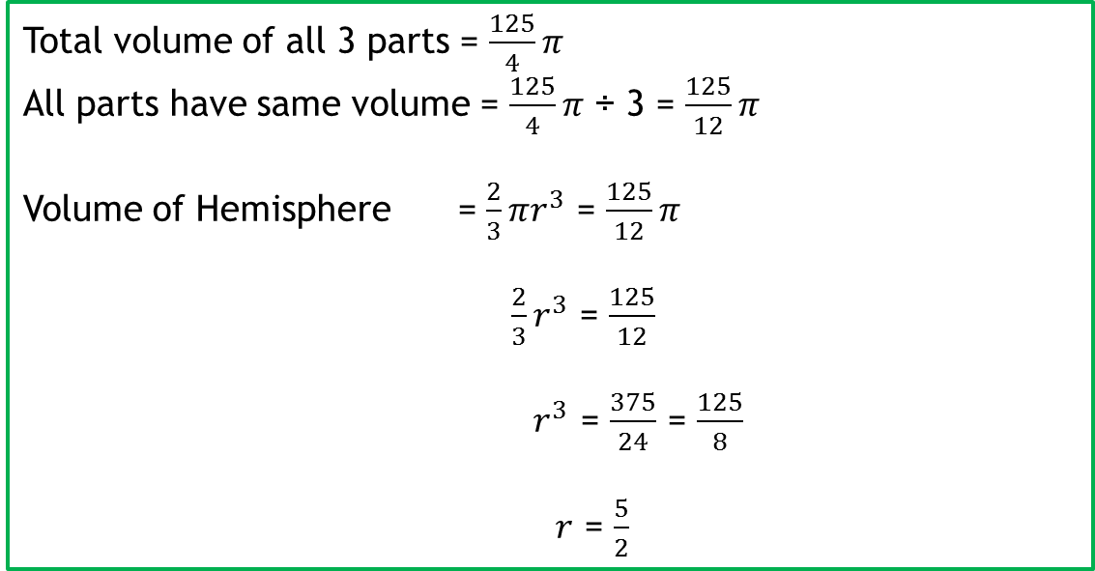
Challenge
Total volume of all 3 parts = $\frac{125}{4}π$
All parts have same volume = $\frac{125}{4}π$ ÷ 3 = $\frac{125}{12}π$
Volume of Hemisphere = $\frac{2}{3}πr^{3}$ = $\frac{125}{12}π$
$\frac{2}{3}r^{3}$ = $\frac{125}{12}$
$r^{3}$ = $\frac{375}{24}$ = $\frac{125}{8}$
$r$ = $\frac{5}{2}$

Slide 14
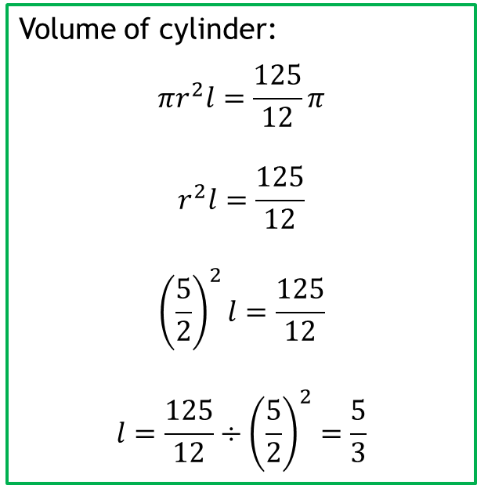
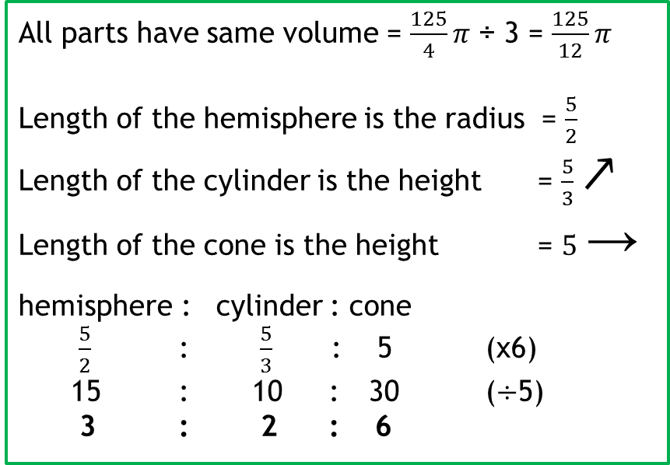
Volume of cylinder:
$$πr^{2}l=\frac{125}{12}π$$
$$r^{2}l=\frac{125}{12}$$
$${\left(\frac{5}{2}\right)}^{2}l=\frac{125}{12}$$
$$l=\frac{125}{12}÷{\left(\frac{5}{2}\right)}^{2}=\frac{5}{3}$$
Challenge
All parts have same volume = $\frac{125}{4}π$ ÷ 3 = $\frac{125}{12}π$
Length of the hemisphere is the radius = $\frac{5}{2}$
Length of the cylinder is the height = $\frac{5}{3}$ ↗
Length of the cone is the height = $5$ →
hemisphere : cylinder : cone
$\frac{5}{2}$ : $\frac{5}{3}$ : 5 (x6)
15 : 10 : 30 (÷5)
3 : 2 : 6
Volume of cone:
The volume of a cone is 1/3 of the volume of a cylinder with the same base and height.
If a cone and cylinder with the same base also have the same volume, then the height must be 3 times bigger. Check it!

Slide 15
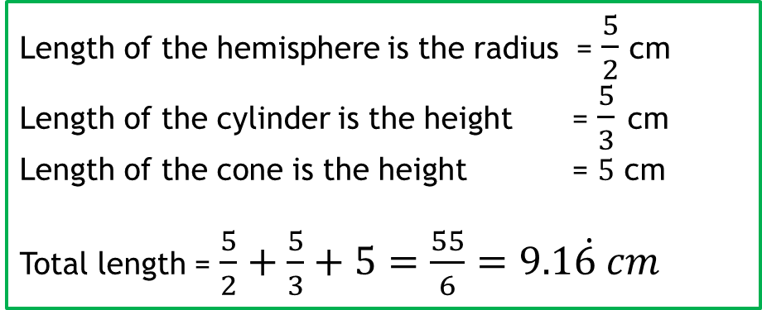
Challenge
Length of the hemisphere is the radius = $\frac{5}{2}$ cm
Length of the cylinder is the height = $\frac{5}{3}$ cm
Length of the cone is the height = $5$ cm
Total length = $\frac{5}{2}+\frac{5}{3}+5=\frac{55}{6}=9.1\dot{6 }cm$

