Slide 1



Will all of the sand in a 10cm cube-shaped box fit into a box measuring 4cm by 5cm by 20cm?
Doubling the dimensions of a three dimensional figure will increase its volume by a factor of: 2, 4, 6 or 8?
A rectangular prism has side lengths in the ratio 2 : 3 : 5. If the volume of the prism is 1,920 cubic units, what could be the length of one of its sides: 4cm, 5cm, 12cm, 15cm?
How many cubic centimetres are in a cubic metre? (HINT: There are 100cm in 1m)
$$3$$
$$2$$
$$1$$
Answers
1. No - the new box is too small (400 cm³ c.f. 1000 cm³).
2. SF = 8
3. 12cm since LSF = 4 (4 x 3cm = 12cm)
4. 100 x 100 x 100 = 1,000,000

Slide 2
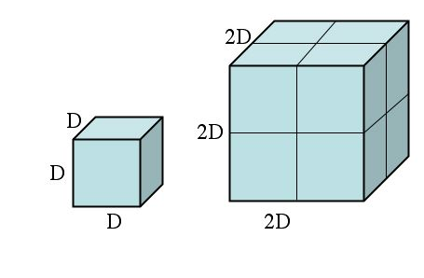
Enlargement and Reduction
If the side of the small cube is D cm long, complete the table below:
 | Small | Big | SF
Length cm
Area cm ²
Volume cm ³
What are the scale factors in going from big to small?
There are two ways of saying this. What are they?

Slide 3
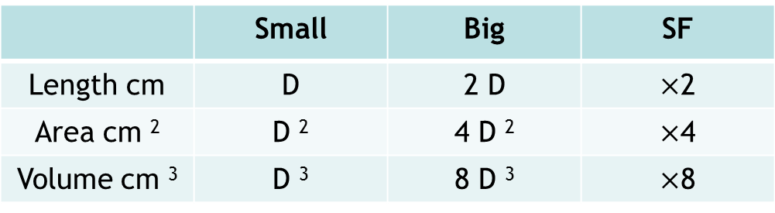
Enlargement and Reduction
If the side of the small cube is D cm long, complete the table below:
 | Small | Big | SF
Length cm | D | 2 D | $×$2
Area cm ² | D ² | 4 D ² | $×$4
Volume cm ³ | D ³ | 8 D ³ | $×$8
What are the scale factors in going from big to small?
There are two ways of saying this. What are they?

Slide 4
Enlargement and Reduction
If the side of the small cube is D cm long, complete the table below:
 | Small | Big | SF
Length cm | D | 2 D | $×$2
Area cm ² | D ² | 4 D ² | $×$4
Volume cm ³ | D ³ | 8 D ³ | $×$8
What are the scale factors in going from big to small?
There are two ways of saying this. What are they?
Divide by 2, 4 or 8
Multiply by ½, ¼, or ⅛

Slide 5
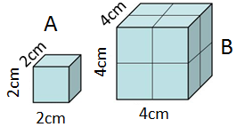
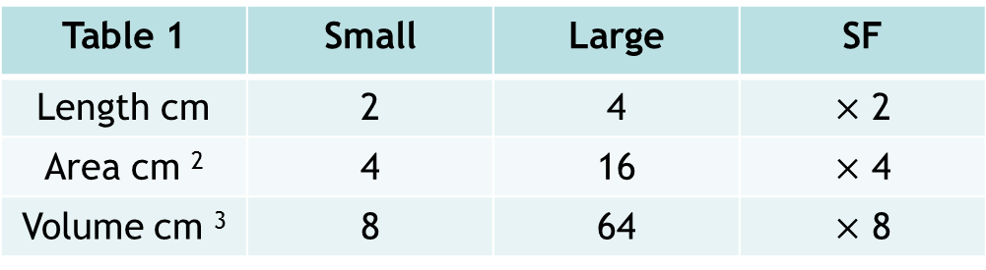
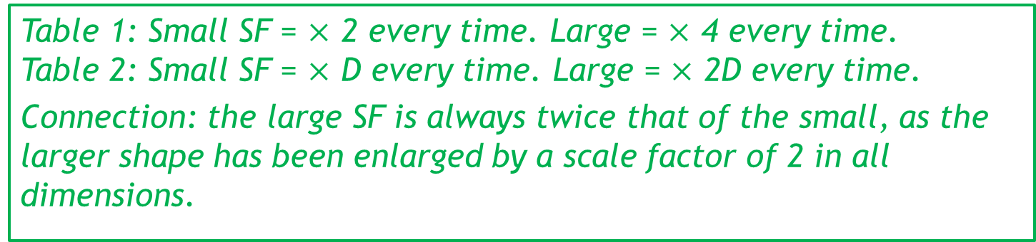
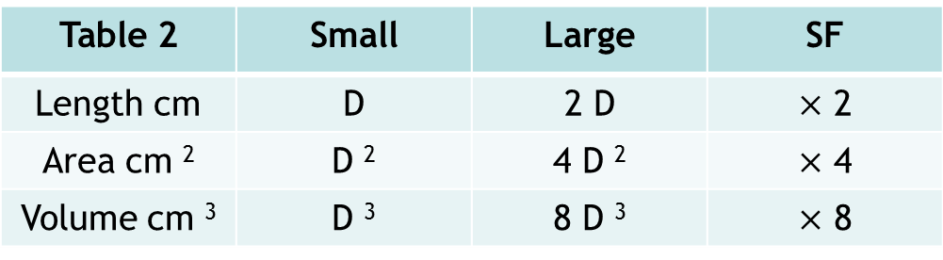
Consider the scale factor tables that we have looked at previously:
Table 1 | Small | Large | SF
Length cm | 2 | 4 | $×$ 2
Area cm ² | 4 | 16 | $×$ 4
Volume cm ³ | 8 | 64 | $×$ 8
Table 2 | Small | Large | SF
Length cm | D | 2 D | $×$ 2
Area cm ² | D ² | 4 D ² | $×$ 4
Volume cm ³ | D ³ | 8 D ³ | $×$ 8
Table 1: Small SF = $×$ 2 every time. Large = $×$ 4 every time.
Table 2: Small SF = $×$ D every time. Large = $×$ 2D every time.
Connection: the large SF is always twice that of the small, as the larger shape has been enlarged by a scale factor of 2 in all dimensions.
What are the scale factors following the red arrows? What is the connection between the small and the big SF following this direction? Why is this?

Slide 6
Volume, Area and Linear Scale Factors combined
Previously we learned about the connection between a linear scale factor and the area and volume scale factors of similar objects:
Area Scale Factor = (Linear Scale Factor)²
Volume Scale Factor = (Linear Scale Factor)³
Discuss: if we know the volume scale factor, how could we calculate the area scale factor?

Slide 7
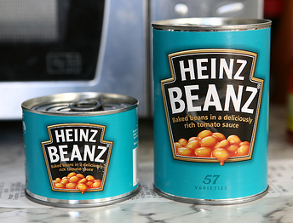
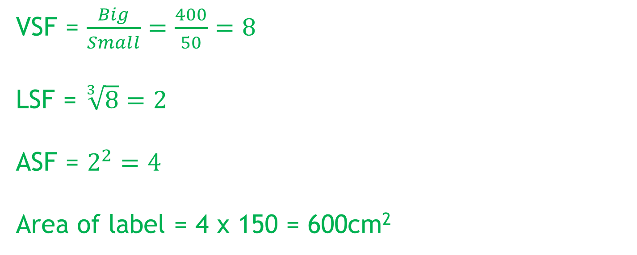
Volume, area and linear scale factors together:
The larger tin of beans has a mass of 400g while the smaller tin has a mass of 50g.
The label on the smaller tin has an area of 150cm².
Assuming that all dimensions are similar, calculate the area of the label on the larger tin.
VSF = $\frac{Big}{Small}=\frac{400}{50}=8$
LSF = $\sqrt[3]{8}=2$
ASF = $2^{2}=4$
Area of label = 4 x 150 = 600cm²

Slide 8
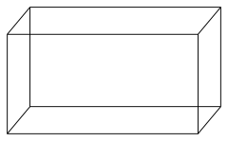
1
2
B
A
A
B
4cm
x
x
30cm
The volume of solid A is 12cm³.
The volume of solid B is 96cm³.
Find the length x.
The volume of solid A is 800cm³.
The volume of solid B is 172.8cm³.
Find the length x.
3
The volume of solid A is 13m³.
The volume of solid B is 351m³.
The surface area of solid A is 24cm². Calculate the surface area of solid B.
4
The volume of solid A is 288cm³.
The volume of solid B is 4.5cm³.
The surface area of solid A is 322cm².
Calculate the surface area of solid B.
B
B
A
A
Notes:
PRINT FOR STUDENTS

Slide 9
SOLUTIONS
1
2
B
A
A
B
4cm
x
x
30cm
The volume of solid A is 12cm³.
The volume of solid B is 96cm³.
Find the length x.
The volume of solid A is 800cm³.
The volume of solid B is 172.8cm³.
Find the length x.
8cm
50cm
3
The volume of solid A is 13m³.
The volume of solid B is 351m³.
The surface area of solid A is 24cm². Calculate the surface area of solid B.
4
The volume of solid A is 288cm³.
The volume of solid B is 4.5cm³.
The surface area of solid A is 322cm².
Calculate the surface area of solid B.
B
B
A
A
207cm²
20.125cm²
Notes:
PRINT FOR STUDENTS

Slide 10
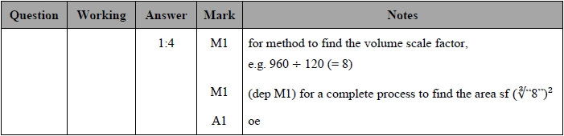
Exam Question
Two solid cones are mathematically similar.
Cone A has a volume of 120 cm³
Cone B has a volume of 960 cm³
Work out the ratio of the surface area of cone A to the surface area of cone B.

Slide 11
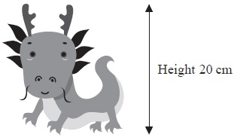
Exam Question
A company makes monsters.
The company makes small monsters
with a height of 20 cm.
A small monster has a surface area of 300 cm².
The company also makes large monsters with a height of 120cm.
A small monster and a large monster are mathematically similar.
Work out the surface area of a large monster.
Notes:
Edexcel
Students may have attempted this in an earlier lesson.

Slide 12
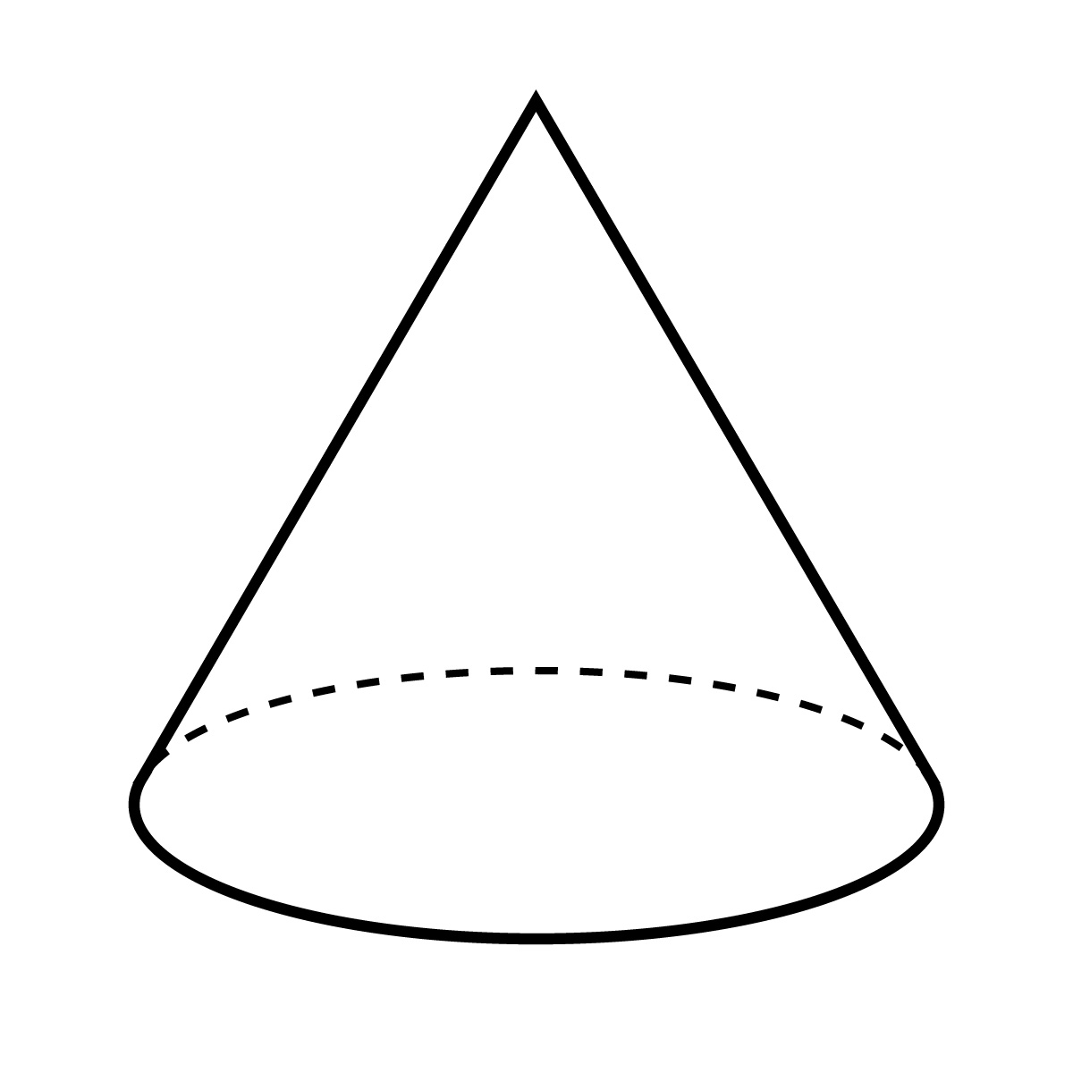
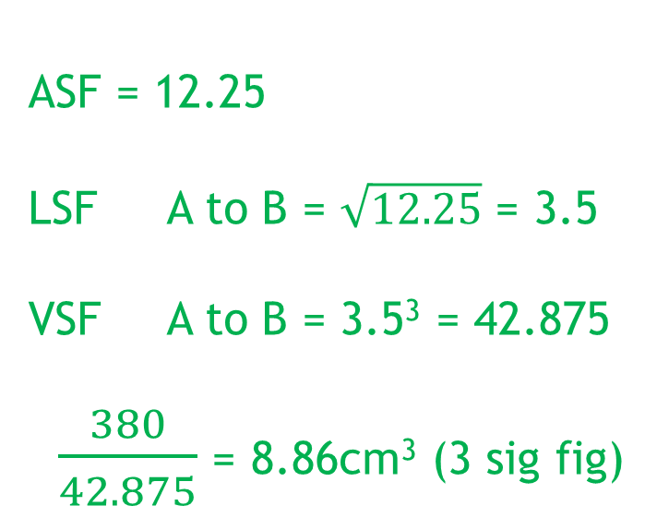
Exam Question
The surface area of cone B is 12.25 times bigger than cone A. If the volume of cone B is 380cm³, calculate the volume of cone A. Give your answer correct to 3 significant figures.
ASF = 12.25
LSF A to B = $\sqrt{12.25}$ = 3.5
VSF A to B = 3.5³ = 42.875
$\frac{380}{42.875}$ = 8.86cm³ (3 sig fig)
A
B

Slide 13
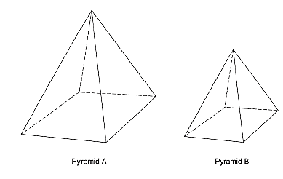
Exam Question
Two similar pyramids A and B have surface areas 180 cm² and 80 cm² respectively.
The volume of pyramid A is 810 cm³.
Show that the volume of pyramid B is 240 cm³.

Slide 14
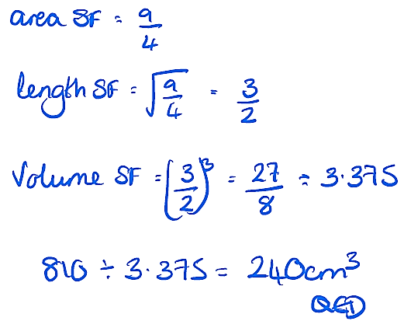
Exam Question
Two similar pyramids A and B have surface areas 180 cm² and 80 cm² respectively.
The volume of pyramid A is 810 cm³.
Show that the volume of pyramid B is 240 cm³.

