Slide 1
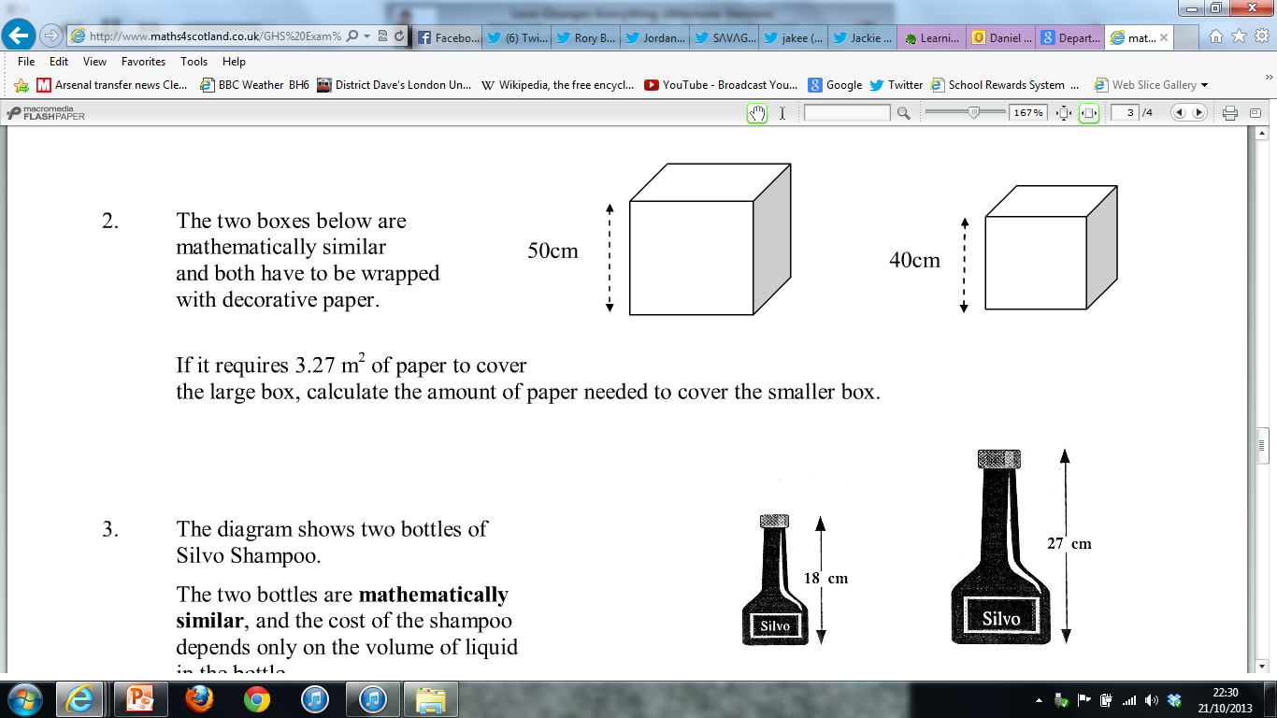
Can you find two different methods to answer this question?
LSF: A to B = 0.8 ASF: A to B = (0.8)² = 0.64
3.27 x 0.64 = 2.0928 m²

Slide 2
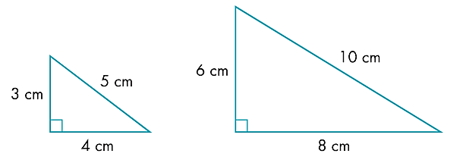
D
A
6cm²
24cm²
B
C
E
F
Previously, we learned that the Area Scale Factor is found by dividing the area of the larger shape by the area of the smaller shape.
We also found that there was a connection between the Linear Scale Factor and the Area Scale Factor:
Area Scale Factor = (Linear Scale Factor)²

Slide 3
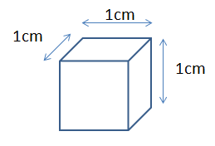
Volume Scale Factor
Consider this cube.
If we enlarge its dimensions by a linear scale factor of 2, how will that affect its volume?
On your whiteboards, can you draw the enlarged cube?
What is its volume?
Can you summarise how the Volume Scale Factor is connected to the Linear Scale Factor?

Slide 4
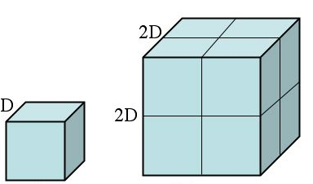
Volume Scale Factor
How much bigger is Cube B compared to Cube A?
A
4cm
B
2cm
4cm
2cm
2cm
4cm
A B SF
Edge Length: 2cm → 4cm 2
Surface Area: 24cm² → 96cm² 4 = 2²
Total Volume: 8cm³ → 64cm³ ?
Knowing what you do about Length to Area Scale Factors, what can you say about extending this idea for the Volume Scale Factor?

Slide 5
Volume Scale Factor
How much bigger is Cube B compared to Cube A?
A
4cm
B
2cm
4cm
2cm
2cm
4cm
A B SF
Edge Length: 2cm → 4cm 2
Surface Area: 24cm² → 96cm² 4 = 2²
Total Volume: 8cm³ → 64cm³ 8 = 2³
The volume of B is eight times as big as A.
The Volume Scale Factor is the cube of the linear scale factor.

Slide 6

Volume Scale Factor
Volume Scale Factor (VSF):
The proportional increase in the volume of two similar shapes
Volume Scale Factor = (Linear Scale Factor)³

Slide 7
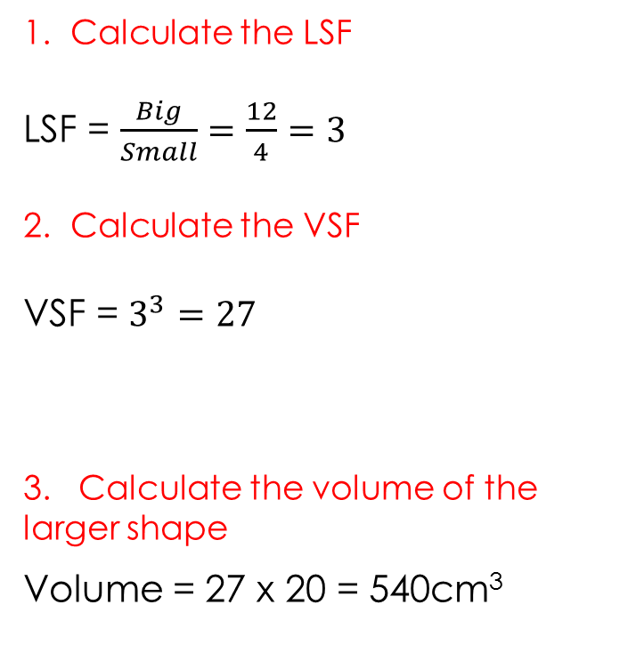
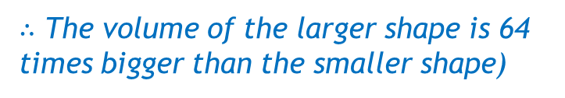
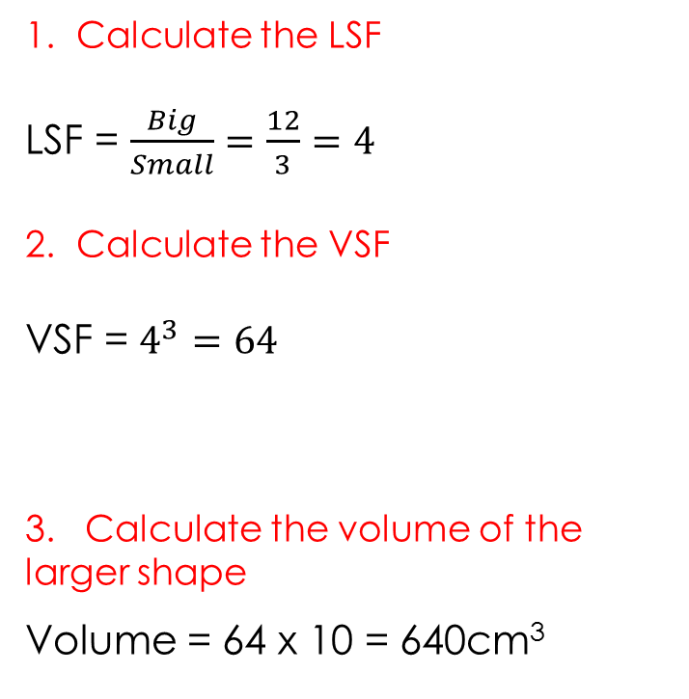
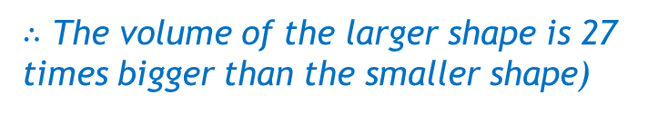
Example
Your Turn
The smaller cylinder has a volume of 20cm³.
Calculate the
volume of the
larger cylinder.
The smaller cylinder has a volume of 10cm³.
Calculate the
volume of the
larger cylinder.
4cm
12cm
3cm
12cm
1. Calculate the LSF
LSF = $\frac{Big}{Small}=\frac{12}{4}=3$
2. Calculate the VSF
VSF = $3^{3}=27$
3. Calculate the volume of the larger shape
Volume = 27 x 20 = 540cm³
1. Calculate the LSF
LSF = $\frac{Big}{Small}=\frac{12}{3}=4$
2. Calculate the VSF
VSF = $4^{3}=64$
3. Calculate the volume of the larger shape
Volume = 64 x 10 = 640cm³
$∴$ The volume of the larger shape is 27 times bigger than the smaller shape)
$∴$ The volume of the larger shape is 64 times bigger than the smaller shape)

Slide 8
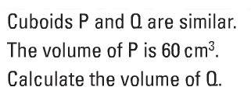
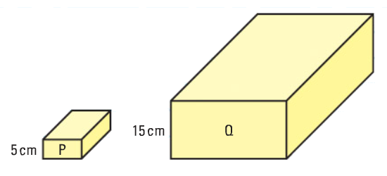


On your whiteboards:
 | P | Q | SF
Length (cm) | 5 | 15 | 3
Area (cm²) |  |  | 9
Volume (cm³) | 60 | 1620 | 27
You might like to set it out in a table to organise your values:

Slide 9
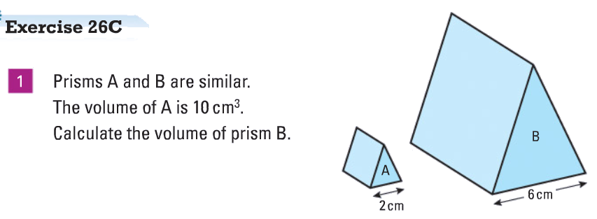

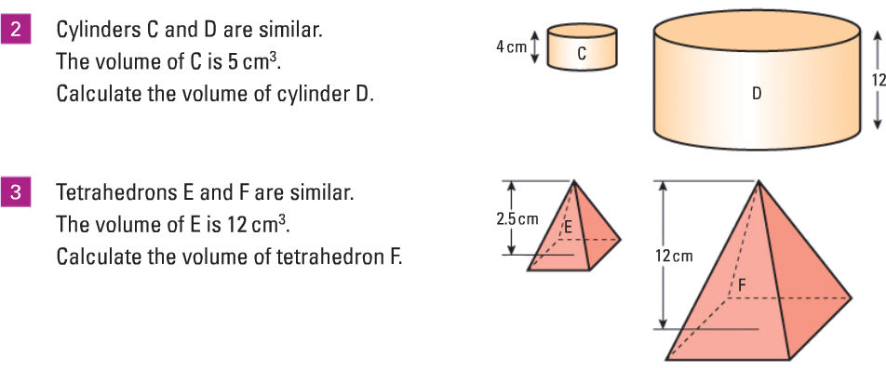

Slide 10
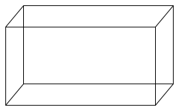
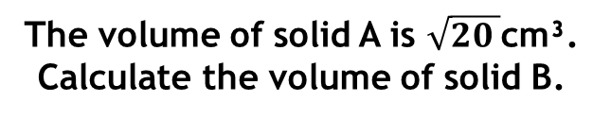
Practice 1
2
1
B
A
A
B
4cm
8cm
16cm
8cm
The volume of solid A is 14cm³. Calculate the volume of solid B.
The volume of solid A is 900cm³. Calculate the volume of solid B.
3
4
The volume of solid A is $\sqrt{20 }$cm³. Calculate the volume of solid B.
The volume of solid A is 1000m³. Calculate the volume of solid B.
B
A
A
B
2.5cm
12.5cm
24m
8m
Notes:
PRINT FOR STUDENTS

Slide 11
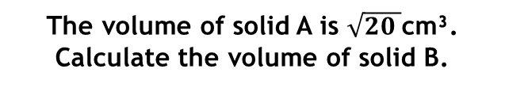
SOLUTIONS
2
1
B
A
A
B
4cm
8cm
16cm
8cm
The volume of solid A is 14cm³. Calculate the volume of solid B.
112cm³
The volume of solid A is 900cm³. Calculate the volume of solid B.
112.5cm³
3
250√5 or 559cm³
4
37.0m³
The volume of solid A is $\sqrt{20 }$cm³. Calculate the volume of solid B.
The volume of solid A is 1000m³. Calculate the volume of solid B.
B
A
A
B
2.5cm
12.5cm
24m
8m

Slide 12
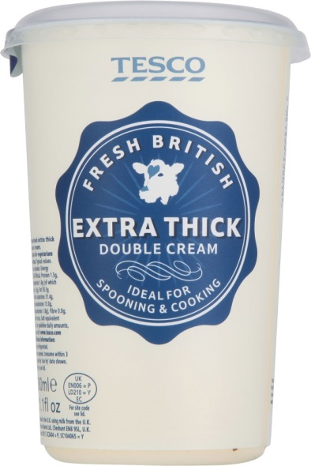

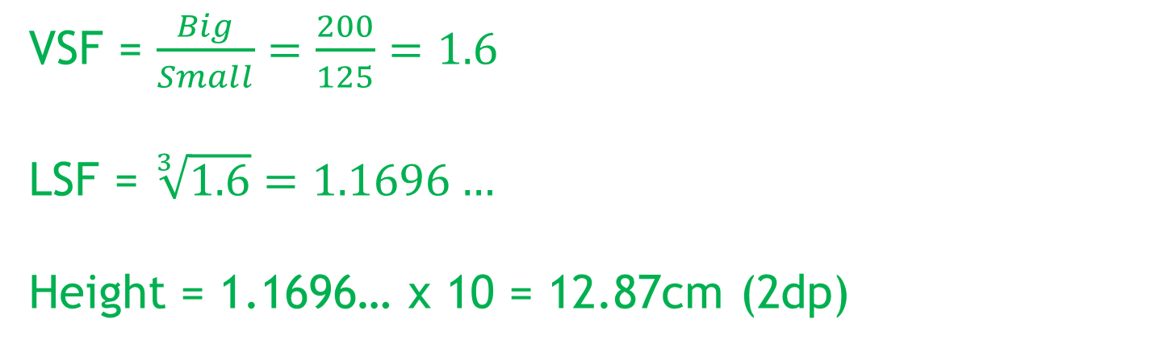
Finding the LSF:
The smaller carton of double cream holds 125ml, while the larger carton holds 200ml. Assuming the dimensions of the two are similar, calculate the height of the larger carton.
11cm
VSF = $\frac{Big}{Small}=\frac{200}{125}=1.6$
LSF = $\sqrt[3]{1.6}=1.1696…$
Height = 1.1696… x 10 = 12.87cm (2dp)

Slide 13
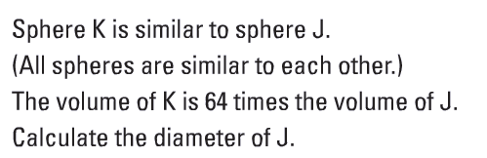
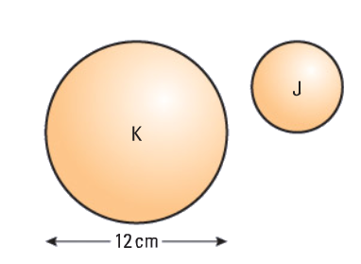
On your whiteboards:

Slide 14
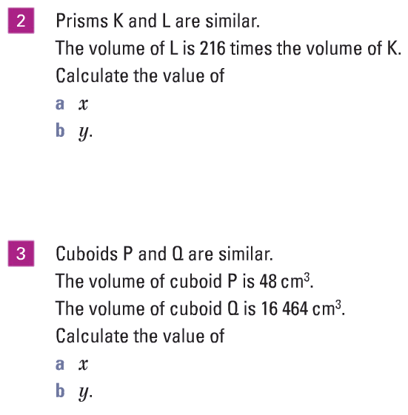
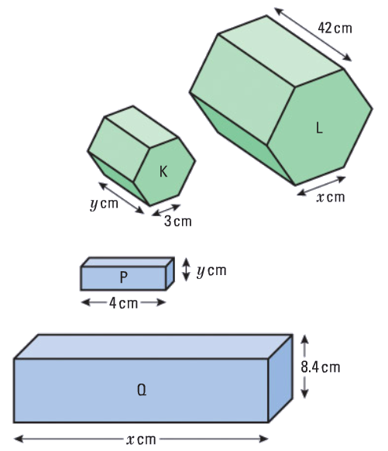


Slide 15
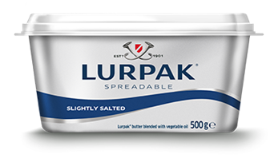
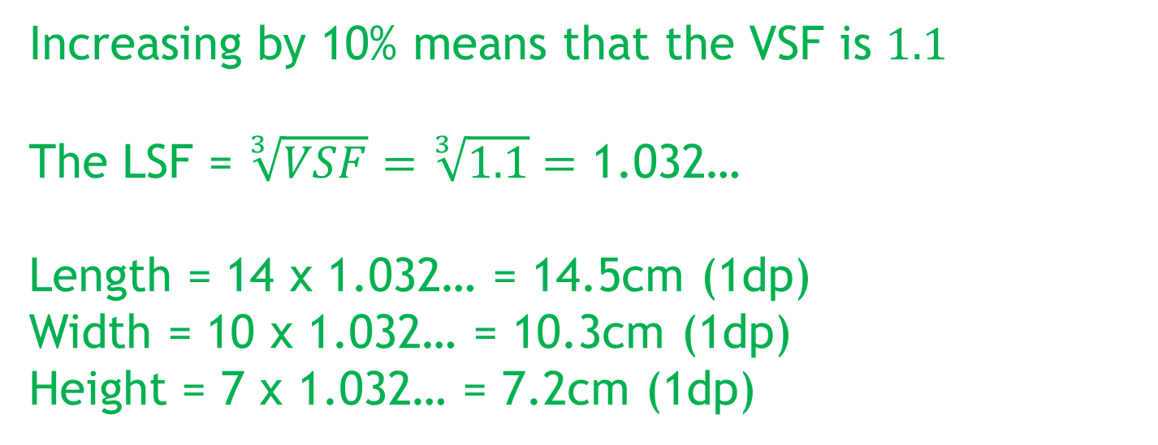
A butter manufacturer wants to increase the size of their tubs to hold 10% more butter.
The dimensions of the current tub are
14 x 10 x 7.
Assuming the tubs are similar, what will the dimensions of the new tub be?
Give your answer to 1 decimal place.
Increasing by 10% means that the VSF is $1.1$
The LSF = $\sqrt[3]{VSF}=\sqrt[3]{1.1}=$ 1.032…
Length = 14 x 1.032… = 14.5cm (1dp)
Width = 10 x 1.032… = 10.3cm (1dp)
Height = 7 x 1.032… = 7.2cm (1dp)

Slide 16
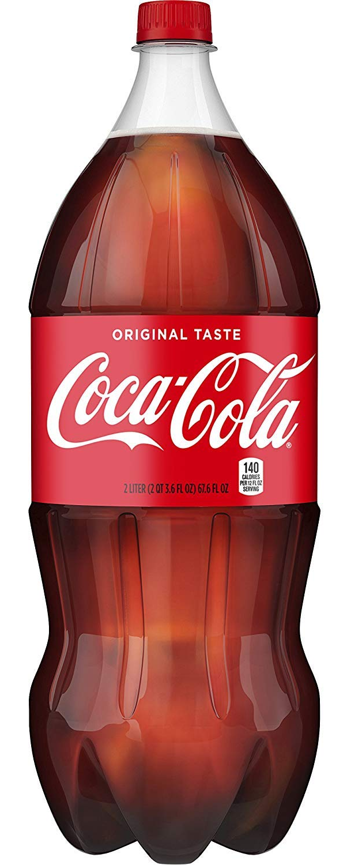



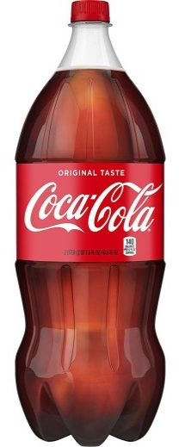
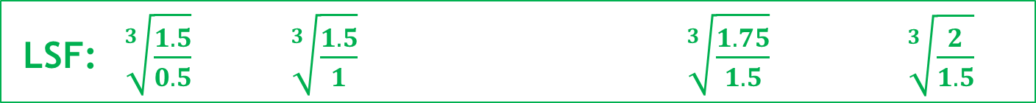
A 1.5L bottle of Coca Cola has a height of 32cm.
If all bottles are geometrically similar, what are their heights? Give these measurements to 1dp.
Predict your answers before
calculating them.
35.2cm
33.7cm
28.0cm
22.2cm
32cm
How accurate were your predictions?
500ml 1L 1.5L 1.75L 2L
LSF: $\sqrt[3]{\frac{1.5}{0.5}}$ $\sqrt[3]{\frac{1.5}{1}}$ $\sqrt[3]{\frac{1.75}{1.5}}$ $\sqrt[3]{\frac{2}{1.5}}$

Slide 17
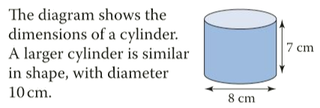
a Find the height of the larger cylinder
b Find the area of the top of the larger cylinder.
Give your answer in terms of π.
c Find the volume of both cylinders.
Give your answers in terms of π.
 | Small | Large | SF
Diameter (cm) | 8 | 10 | 1.25
Height (cm) | 7 | 8.75 | 1.25
Area of top (cm²) | 16π | 25π | 1.25²
Volume (cm³) | 112π | 218.75π | 1.25³

