Slide 1
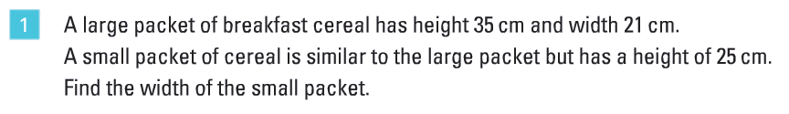
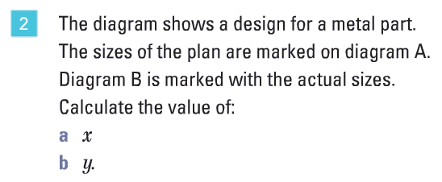
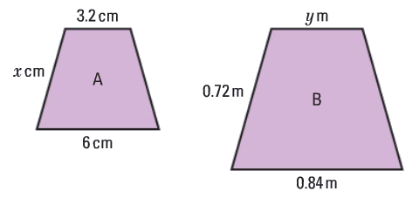
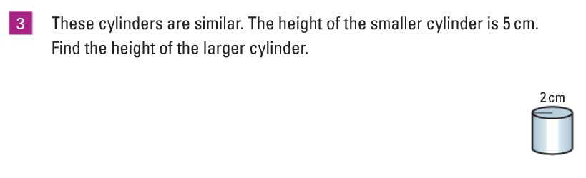
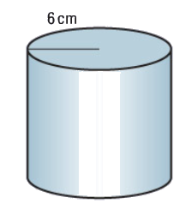

Slide 2
What is the difference between congruence and similarity?
In your own words, write down what the difference is between similar and congruent shapes.

Slide 3
How many of these points did you correctly identify?
Congruent shapes are exactly the same, meaning that their side lengths are the same and their interior/exterior angles are the same. You can create a congruent figure by rotating, translating, or reflecting the original.
Similar shapes look the same but their corresponding side lengths are proportional to each other and their interior/exterior angles are the same. You can create a similar figure by enlarging the original figure (making it smaller or larger by a scale factor).

Slide 4
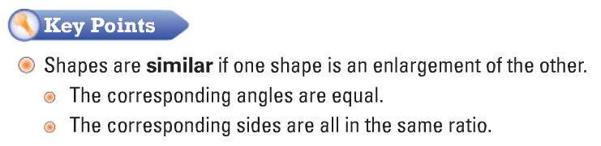
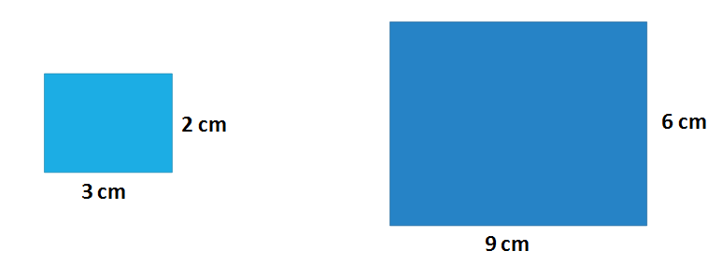

Slide 5
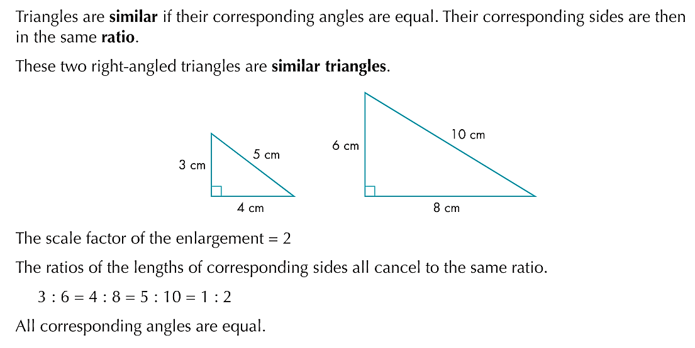
6cm²
24cm²
Find the area of each of the triangles above.
What do you notice?

Slide 6

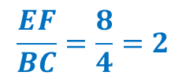
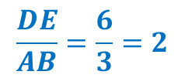
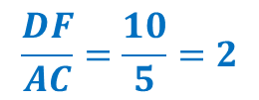
D
A
6cm²
24cm²
B
C
E
F
The Linear Scale Factor is found by dividing one of the sides of the larger shape by the corresponding side of the smaller shape.
$$\frac{DF}{AC}=\frac{10}{5}=2$$
$$\frac{DE}{AB}=\frac{6}{3}=2$$
$$\frac{EF}{BC}=\frac{8}{4}=2$$
$$Linear Scale Factor=2$$
Discuss: how could we find an Area Scale Factor?
What do you think it might be?

Slide 7

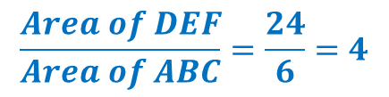

D
A
6cm²
24cm²
B
C
E
F
The Area Scale Factor is found by dividing the area of the larger shape by the area of the smaller shape.
$$\frac{Area of DEF}{Area of ABC}=\frac{24}{6}=4$$
$$Area Scale Factor=4$$
$$Linear Scale Factor=2$$
Discuss: Is there a connection between the Linear Scale Factor and the Area Scale Factor? What do you think it might be?
Area Scale Factor = (Linear Scale Factor)²
Why do you think that might be?

Slide 8
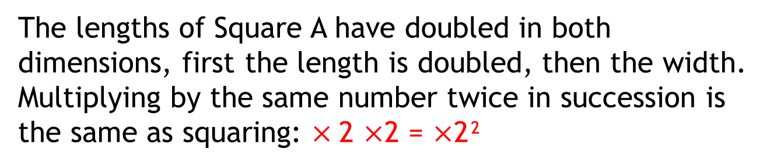
Area Scale Factor = (Linear Scale Factor)²
How much bigger is Square B compared to Square A?
Square A
Square B
5cm
10cm
5cm
10cm
A B SF
Length: 5cm → 10cm 2
Area: 25cm² → 100cm² 2² = 4
The lengths of Square A have doubled in both dimensions, first the length is doubled, then the width.
Multiplying by the same number twice in succession is the same as squaring: $×$2 $×$2 = $×$2²

Slide 9
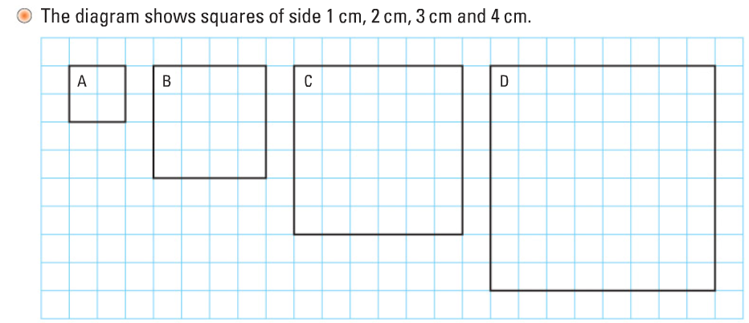
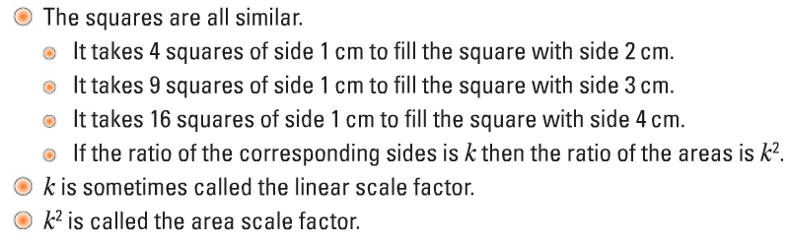

Slide 10
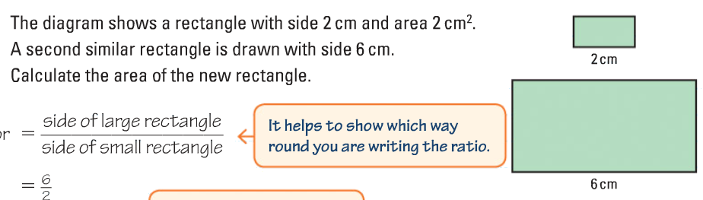
On your whiteboards:

Slide 11

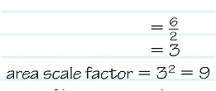

On your whiteboards:
Is there another method?

Slide 12
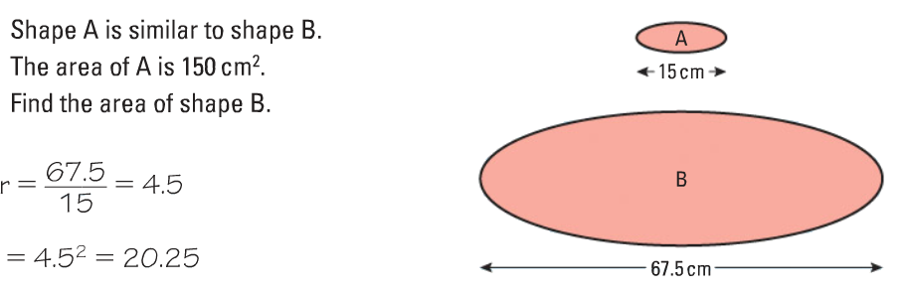
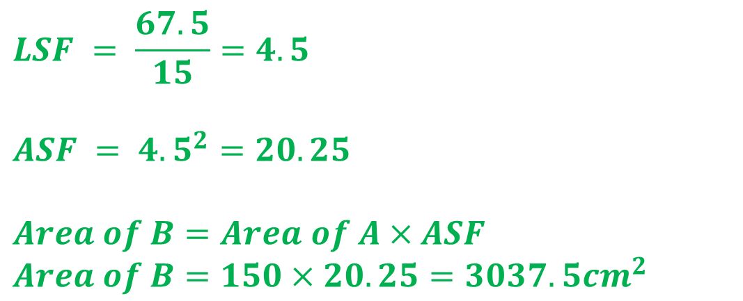
On your whiteboards:
$$LSF = \frac{67.5}{15}=4.5$$
$$ASF = {4.5}^{2}=20.25$$
$$Area of B=Area of A×ASF$$
$$Area of B=150×20.25=3037.5{cm}^{2}$$

Slide 13
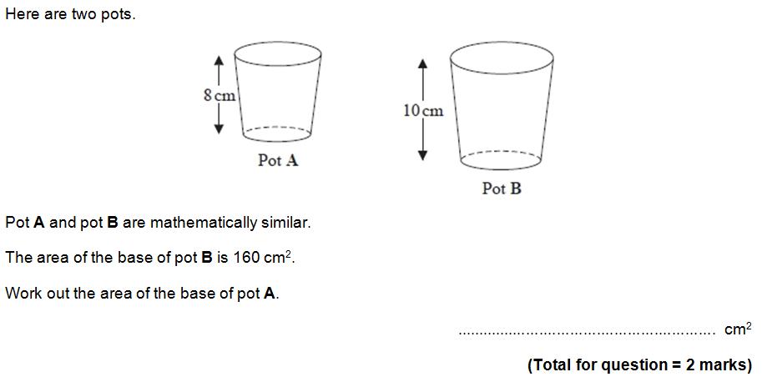

On your whiteboards:

Slide 14
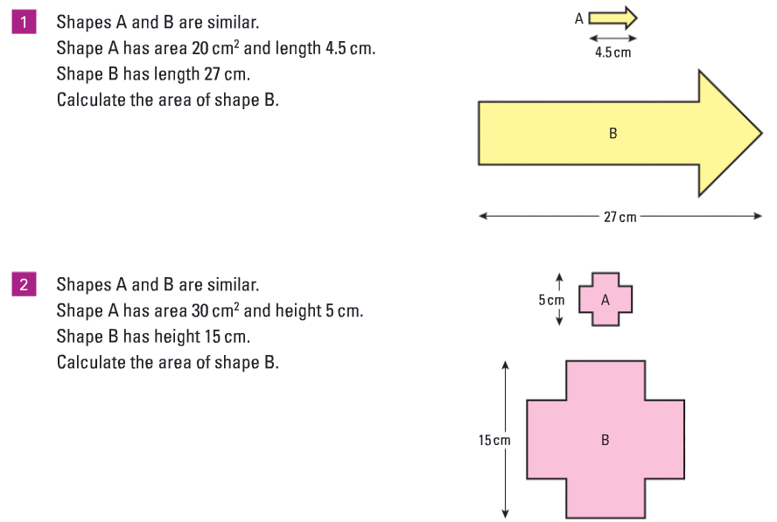
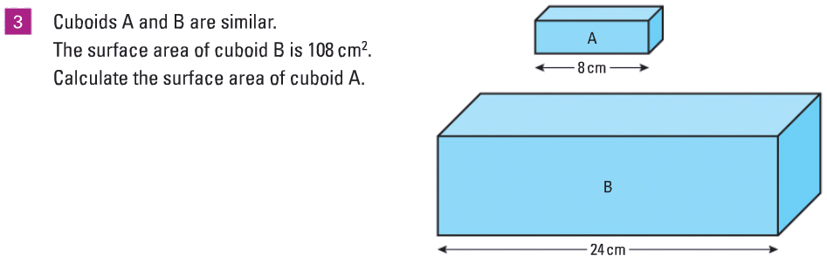
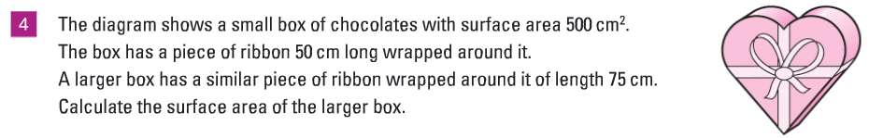
1
2
3

Slide 15



1
2
3

Slide 16
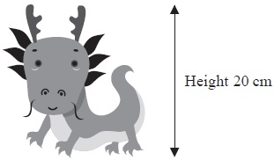

Exam Question
A company makes monsters.
The company makes small monsters
with a height of 20 cm.
A small monster has a surface area of 300 cm².
The company also makes large monsters with a height of 120cm.
A small monster and a large monster are mathematically similar.
Work out the surface area of a large monster.
Notes:
Edexcel

Slide 17
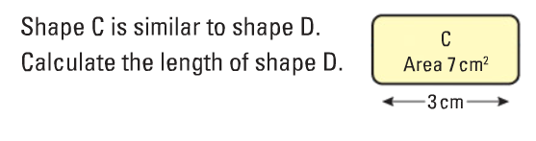
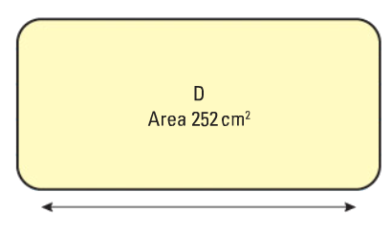
How is this question different?
?

Slide 18
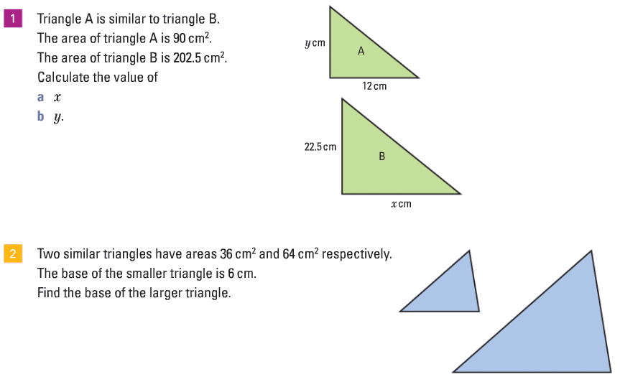

Slide 19


Slide 20
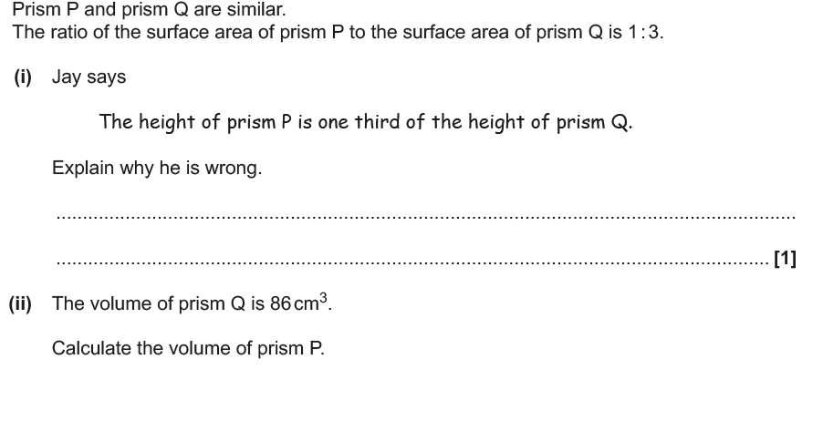
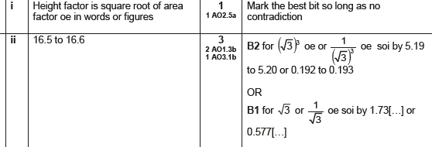
On your whiteboards:

