Slide 1

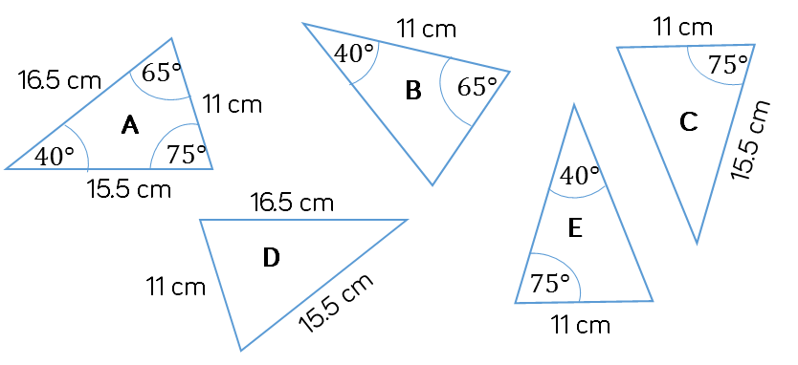


Which of the following triangles are congruent to triangle A? Justify your answers.
SAS
SSS
ASA
Notes:
https://whiterosemaths.com/resources/schemes-of-learning/secondary-sols/
Year 10 Autumn

Slide 2
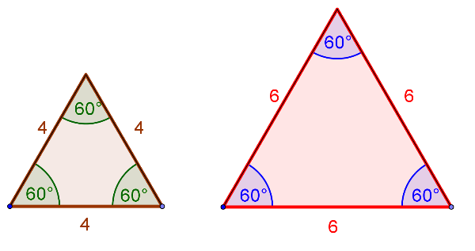
What about AAA?
Given three angles, is it possible to construct more than one triangle?
How do we describe the relationship between these shapes?

Slide 3
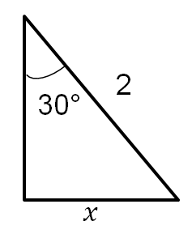
Thinking back to previous work…
θ°
1
How big is θ?
30°

Slide 4
Thinking back to previous work…
x
30°
1
2
How big is θ?
How big is x?
30°
4

Slide 5
Thinking back to previous work…
4
8
x
30°
1
2
y
4
How big is θ?
How big is θ?
How big is x?
How big is y?
30°
4
4
Discuss: What do you notice about these triangles?
What is the same, what is different?

Slide 6





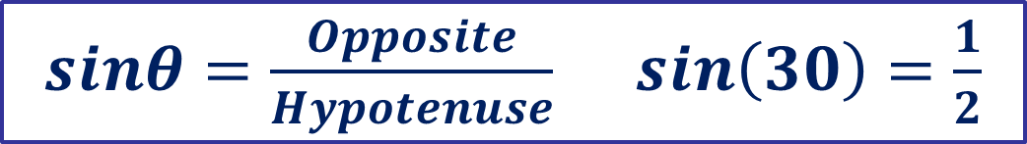








1.
2.
3.
4
$$x$$
$$x$$
$$x$$
$$4$$
$$1$$
30°
30°
30°
4.
5.
6.
$$2$$
$$x$$
$$6$$
60°
60°
60°
$$x$$
$$6$$
$$x$$
7.
What do you notice about these triangles?
What is the same, what is different?
$$6$$
30°
$$x$$
$sinθ=\frac{Opposite}{Hypotenuse}$ $\sin\left(30\right)=\frac{1}{2}$
Notes:
https://variationtheory.com/2019/04/01/trigonometry-exact-values-finding-sides/
@mathsmiles_k

Slide 7
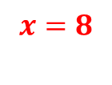
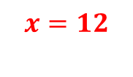
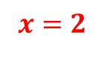
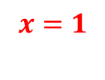
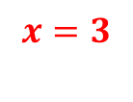
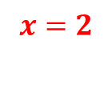
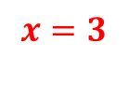
1.
2.
3.
$$x=2$$
$$x=8$$
4
$$x$$
$$x$$
$$x$$
$$4$$
$$1$$
$$x=2$$
30°
30°
30°
4.
5.
6.
$$x=12$$
$$2$$
$$x$$
$$6$$
60°
60°
60°
$$x$$
$$6$$
$$x$$
$$x=1$$
$$x=3$$
7.
What do you notice about these triangles?
What is the same, what is different?
$$6$$
30°
$$x$$
$$x=3$$
$sinθ=\frac{Opposite}{Hypotenuse}$ $\sin\left(30\right)=\frac{1}{2}$
Notes:
https://variationtheory.com/2019/04/01/trigonometry-exact-values-finding-sides/
@mathsmiles_k

Slide 8
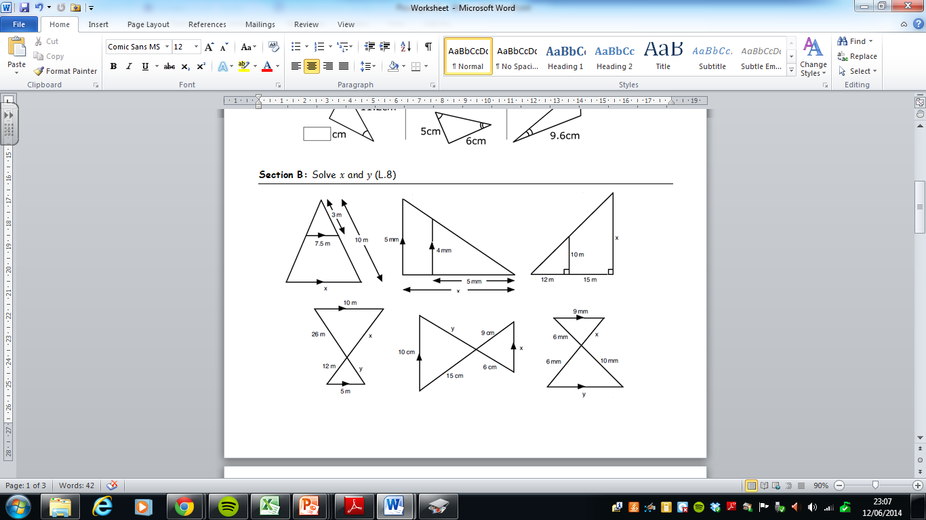
What is similarity?
The diagram shows two overlapping triangles.
What makes the two shapes similar?

Slide 9
What is similarity?
When two shapes are similar, their corresponding angles are equal.

Slide 10
How do you know the following overlapping triangles are similar?

Slide 11
How do you know the following overlapping triangles are similar?
C
C
A
D
B
B
A
E
A
E
D

Slide 12
How do you know the following overlapping triangles are similar?
A
B
C
D
E

Slide 13
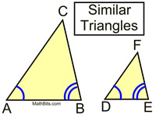
Construct two similar triangles
Draw two lines of different length (5cm & 10cm)
Construct the same angles at each vertex (40° & 80°)
Continue the lines until they
intersect.
How big is the third angle?
How long are the side lengths?
Label the triangles A and B
5cm
10cm

Slide 14
Compare the corresponding lengths
Length of side in triangle A | Length of corresponding side in triangle B
Can you spot a relationship between the sides?

Slide 15
Compare the corresponding lengths
Shown below is another example of two similar triangles
Length of side in triangle A | Length of corresponding side in triangle B
3 | 12
4 | 16
5 | 20
Can you spot a relationship between the sides?

Slide 16
Compare the corresponding lengths
Shown below is another example of two similar triangles
Length of side in triangle A | Length of corresponding side in triangle B
4.5 | 3
13.5 | 9
15 | 10
Can you spot a relationship between the sides?

Slide 17
What is similarity?
When two shapes are similar, their corresponding angles are equal
and the corresponding sides lengths have all enlarged by the same scale factor.

Slide 18
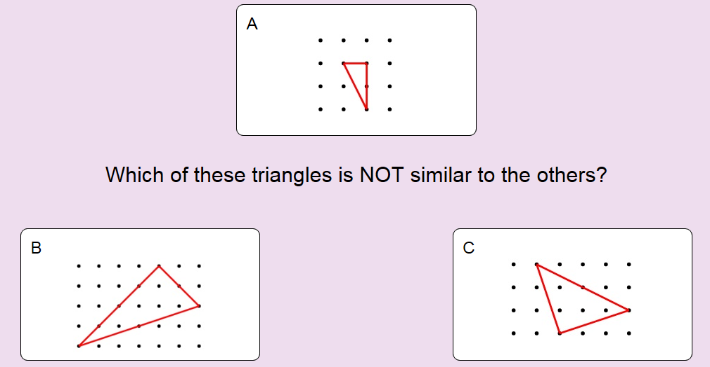
On your whiteboards:
A and B are both right-angled scalene triangles, whilst C is isosceles. Look at the relationship between the side lengths.
Notes:
https://nonexamples.com/oddOneOut

Slide 19
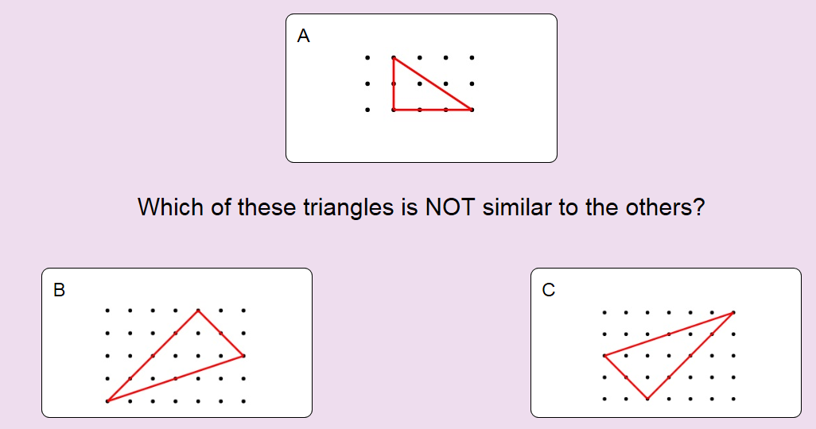
On your whiteboards:
B and C are in fact congruent!
Notes:
https://nonexamples.com/oddOneOut

Slide 20
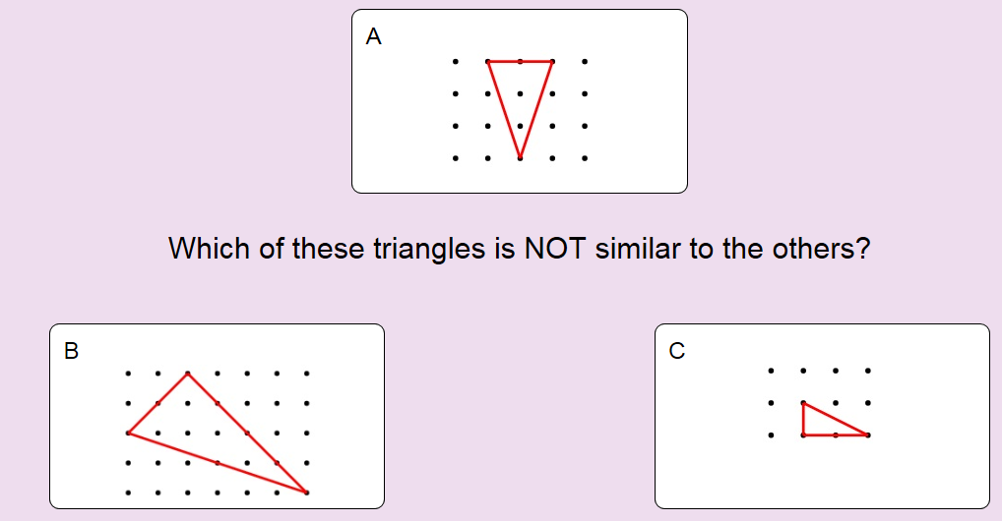
On your whiteboards:
B and C are both right-angled triangles, whilst A is isosceles. Look at the relationship between the side lengths.
Notes:
https://nonexamples.com/oddOneOut

Slide 21
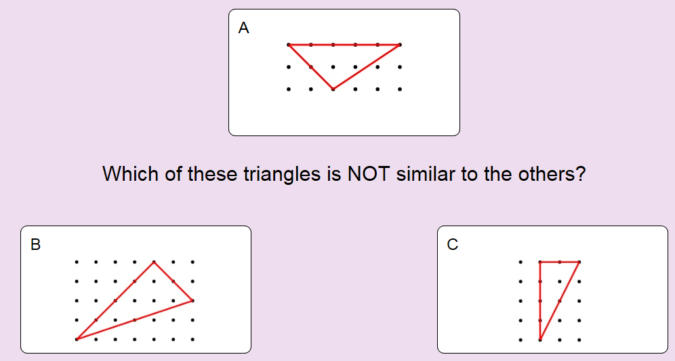
On your whiteboards:
B and C are both right-angled triangles, whilst A is scalene. Look at the relationship between the side lengths.
Notes:
https://nonexamples.com/oddOneOut

