Slide 1
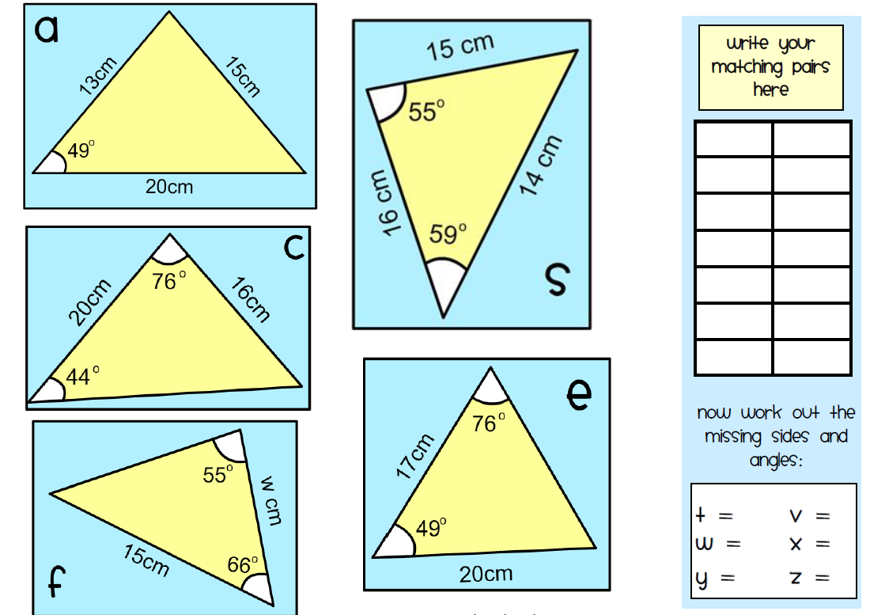
Recap
Working in pairs complete the worksheet on identifying congruent triangles.
Make sure you write down the matching pairs in the table.
Notes:
https://www.mathspad.co.uk/

Slide 2
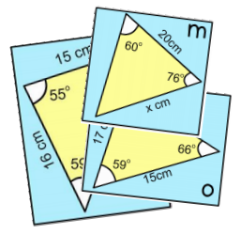
Congruent triangles are reflections, rotations or
translations of each other. They are exactly the same
shape and size.
To be sure that triangles are congruent they must have
three sides and three angles the same. You can use these
rules to help you find out if that will be the case:
SSS—Three sides the same;
SAS—An angle in between two sides that are the same;
ASA—Two angles the same and the side in between them;
AAS—Two angles the same and the side opposite them;
You have a set of 14 triangles. Match them into pairs that are definitely congruent.
Hints : To get started, label all the angles in the triangles that are missing, by using the fact that they must add up to 180 degrees.
Once you have matched the triangles, record your results in the table. Then work out what the missing angles and sides must be that are labelled t, w, x, y, z.
Notes:
https://www.mathspad.co.uk/

Slide 3
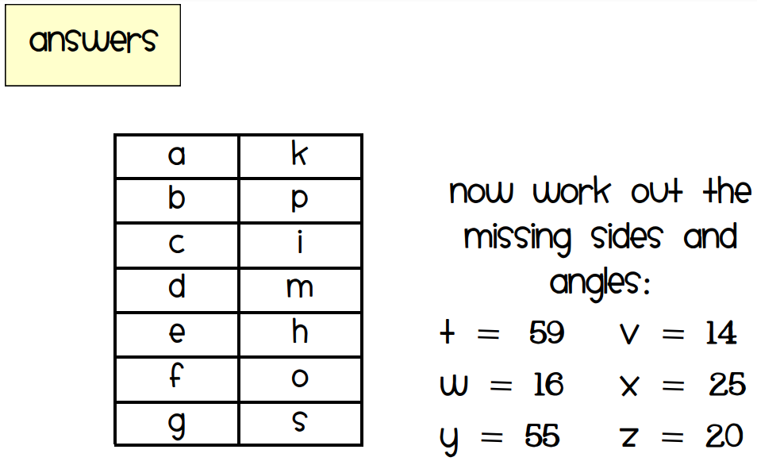

Slide 4

Which two of the following triangles are congruent?
Prove it.
Triangle ABC, AB = 5 cm, ∠CAB = 40° and AC = 3 cm
Triangle DEF, DE = 5 cm, ∠DEF = 40° and EF = 3 cm
Triangle GHI, GH = 5 cm, ∠IGH = 40° and GI = 3 cm
Top tip: try sketching the triangles to help visual the problem.
Notes:
https://whiterosemaths.com/resources/schemes-of-learning/secondary-sols/
Year 10 Autumn

Slide 5
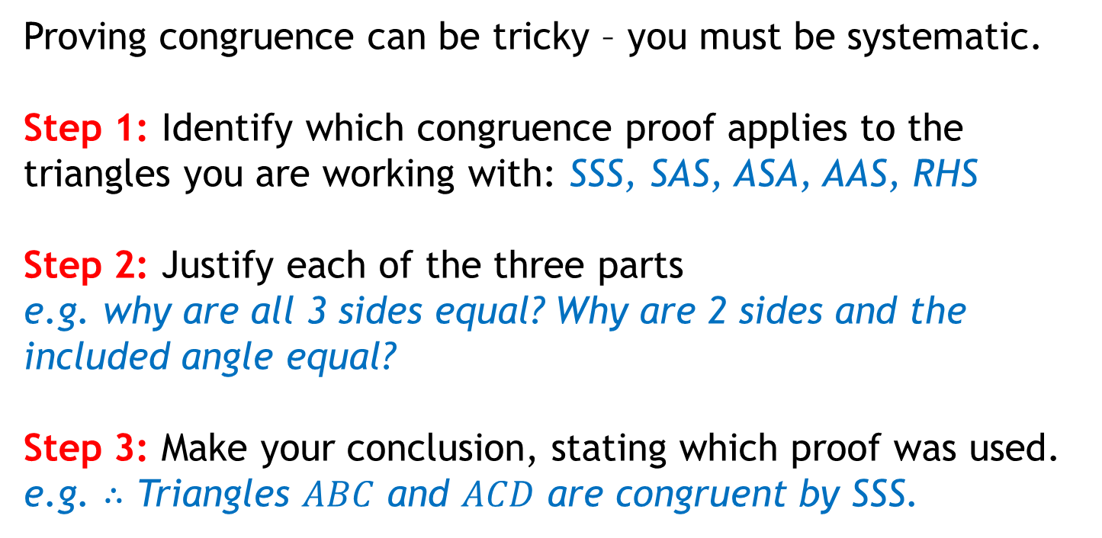
Proving Congruence
Proving congruence can be tricky – you must be systematic.
Step 1: Identify which congruence proof applies to the triangles you are working with: SSS, SAS, ASA, AAS, RHS
Step 2: Justify each of the three parts
e.g. why are all 3 sides equal? Why are 2 sides and the included angle equal?
Step 3: Make your conclusion, stating which proof was used.
e.g. $∴$ Triangles $ABC$ and $ACD$ are congruent by SSS.
Notes:
https://www.drfrostmaths.com/

Slide 6
Proving Congruence
What kinds of justifications can be used for sides and angles?
Circle Theorems
Common sides (shared between the shapes, are equal)
Alternate or Corresponding angles (are equal)
Properties of quadrilaterals
Sides & interior angles of regular polygon (are equal)
Notes:
https://www.drfrostmaths.com/

Slide 7

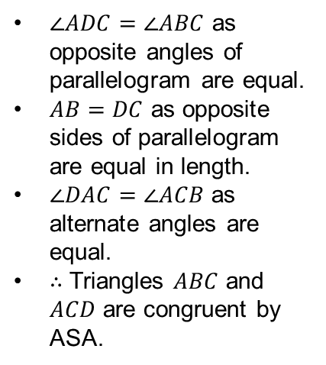

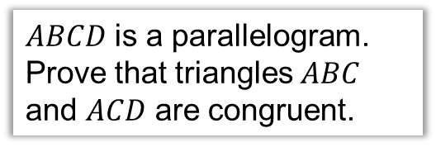


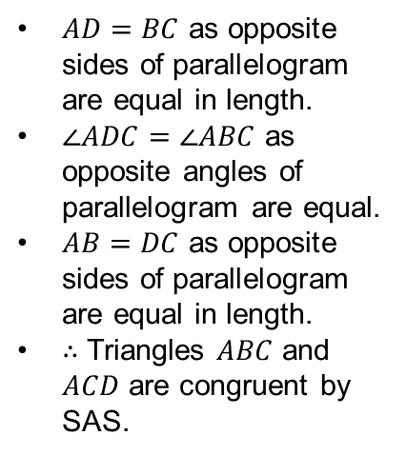



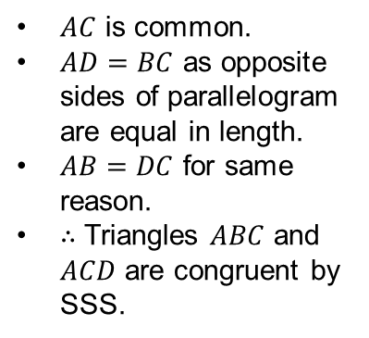
$$A$$
$$B$$
$ABCD$ is a parallelogram. Prove that triangles $ABC$ and $ACD$ are congruent.
(If you finish quickly, try proving another way)
$$D$$
$$C$$
Using $SSS$:
Using $SAS$:
Using $ASA$:
?
$AD=BC$ as opposite sides of parallelogram are equal in length.
$∠ADC=∠ABC$ as opposite angles of parallelogram are equal.
$AB=DC$ as opposite sides of parallelogram are equal in length.
$∴$ Triangles $ABC$ and $ACD$ are congruent by SAS.
?
$AC$ is common.
$AD=BC$ as opposite sides of parallelogram are equal in length.
$AB=DC$ for same reason.
$∴$ Triangles $ABC$ and $ACD$ are congruent by SSS.
?
$∠ADC=∠ABC$ as opposite angles of parallelogram are equal.
$AB=DC$ as opposite sides of parallelogram are equal in length.
$∠DAC=∠ACB$ as alternate angles are equal.
$∴$ Triangles $ABC$ and $ACD$ are congruent by ASA.
Notes:
https://www.drfrostmaths.com/

Slide 8
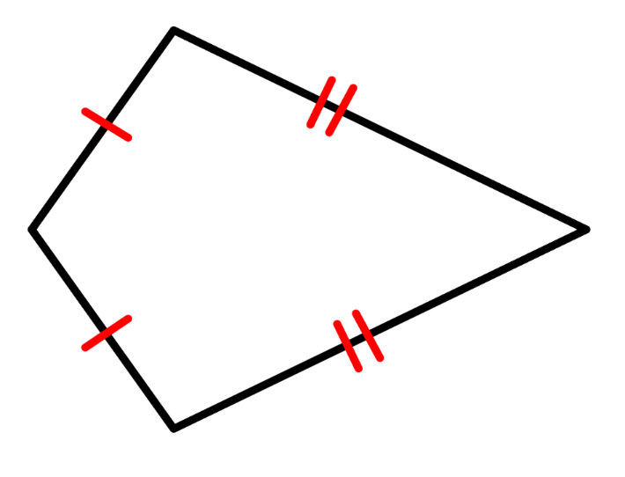
Check Your Understanding
ABCD is a kite. Prove that triangle ABC is congruent to triangle ADC.
A
5cm
5cm
AD
AB =
B
D
CD
BC =
AC is common.
12cm
12cm
So: ΔABC = ΔADC (SSS)
C
Notes:
https://www.drfrostmaths.com/

Slide 9
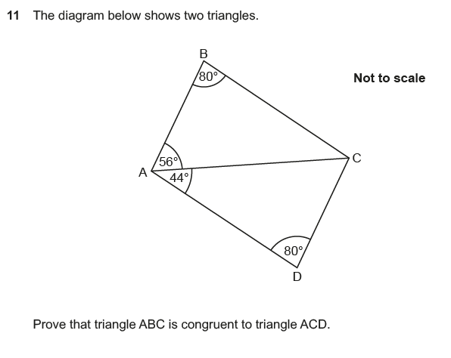

Slide 10
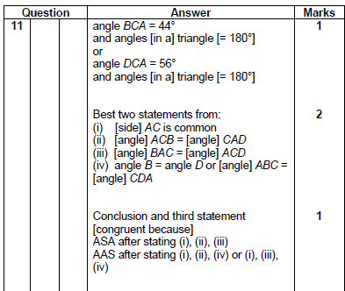

Slide 11
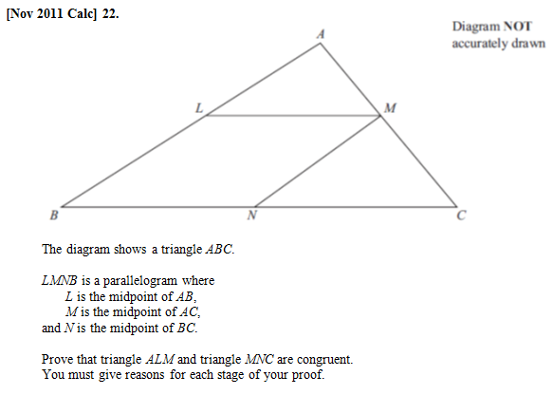
Notes:
https://www.drfrostmaths.com/

Slide 12
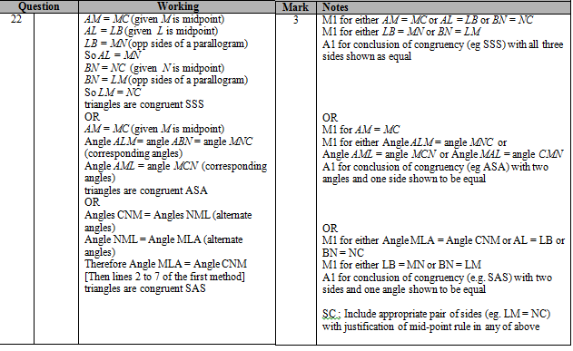
Notes:
https://www.drfrostmaths.com/

Slide 13
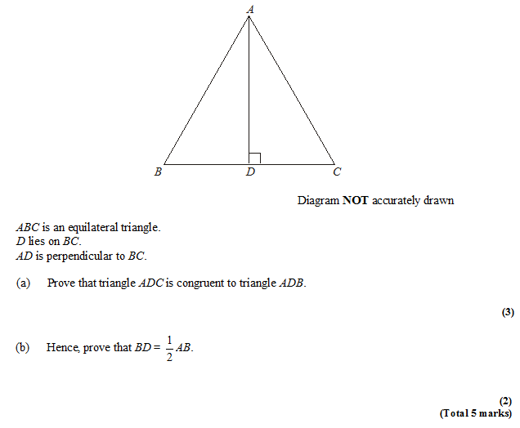
?
?
Notes:
https://www.drfrostmaths.com/

Slide 14
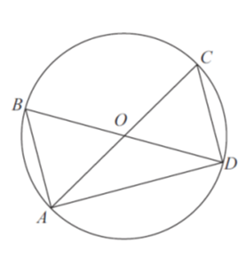
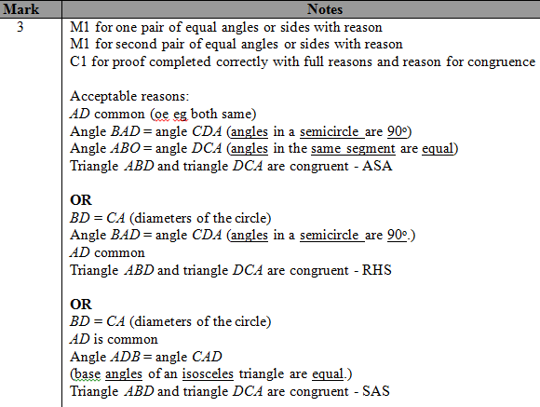
AOC and BOD are diameters of a circle, centre O.
Prove that triangle ABD and triangle DCA are congruent.
?
Notes:
https://www.drfrostmaths.com/

Slide 15
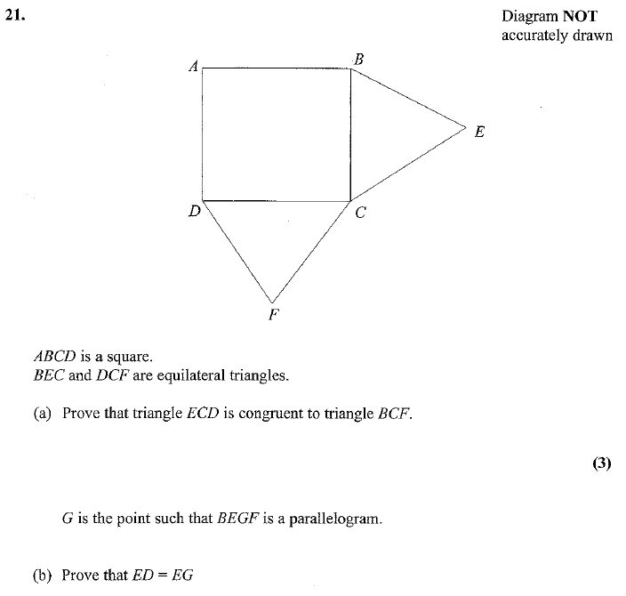
BC = CE equal sides
CF = CD equal sides
BCF = DCE = 150º
BFC is congruent to ECD by SAS.
?
?
So BF=ED (congruent triangles)
BF = EG ( opp sides of parallelogram)
(2)
Notes:
https://www.drfrostmaths.com/

Slide 16
Check Your Understanding
What are the four types of congruent triangle proofs?
SSS, SAS, ASA (equivalent to AAS) and RHS.
What should be the structure of our proof?
Justification of each of the three letters, followed
by conclusion in which we state which proof type
we used.
What kinds of justifications can be used for sides and angles?
Circle Theorems, ‘common’ sides, alternate/corresponding angles, properties of parallelograms, sides/angles of regular polygon are equal.
?
?
?
Notes:
https://www.drfrostmaths.com/

Slide 17
Exam Style Questions
Complete the exam style questions.
Solutions
Notes:
Corbett Maths

Slide 18

PQRS is a parallelogram.
Prove that triangle PRS is
congruent to triangle RPQ.
P
Q
S
R
AB and DE are parallel
lines of equal length.
Prove that ABC is
congruent to EDC.
A
B
C
D
E
LMNO is a rectangle.
X is the mid-point of LM and Z
is the mid-point of ON.
Prove that triangle LXY and NZY
are congruent.
L
X
M
Y
O
Z
N
Notes:
https://whiterosemaths.com/resources/schemes-of-learning/secondary-sols/
Year 10 Autumn

Slide 19
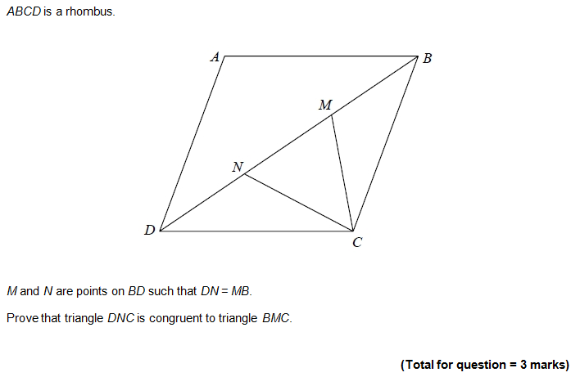
Challenge
Notes:
Edexcel

Slide 20
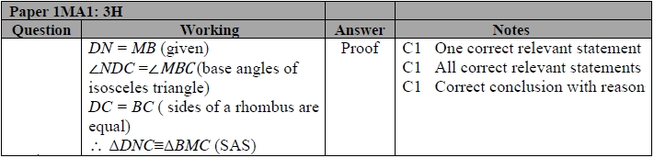
Challenge
Notes:
Edexcel

Slide 21
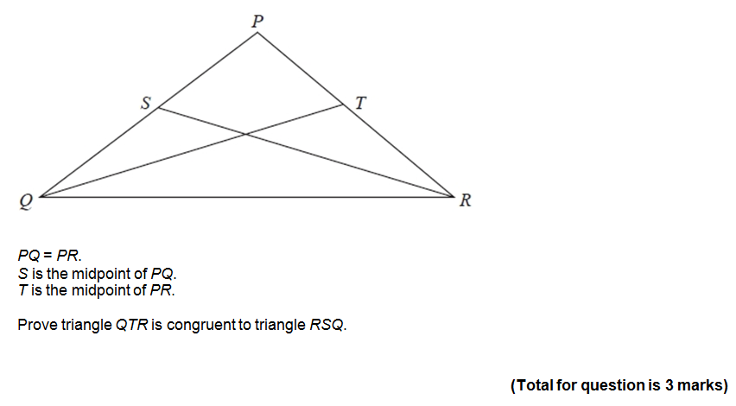
Challenge
Notes:
Edexcel

Slide 22
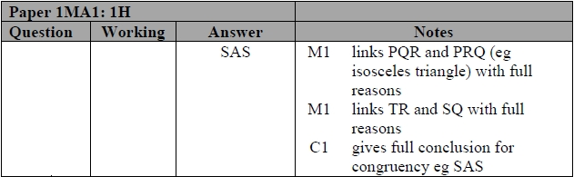
Challenge
Notes:
Edexcel

Slide 23
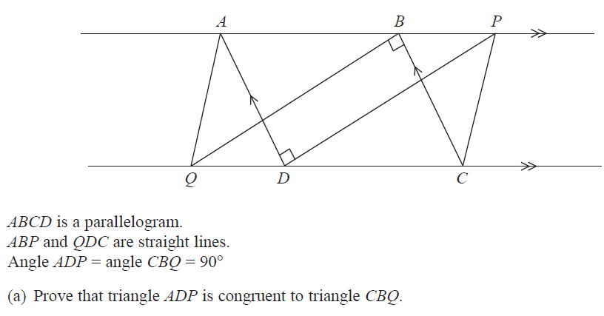

Challenge
Notes:
Edexcel

Slide 24
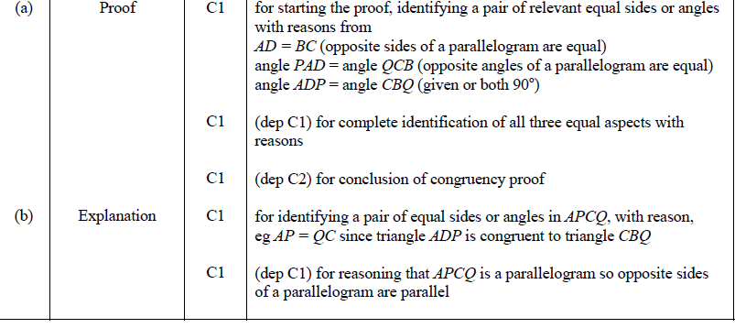
Challenge
Notes:
Edexcel

