Slide 1
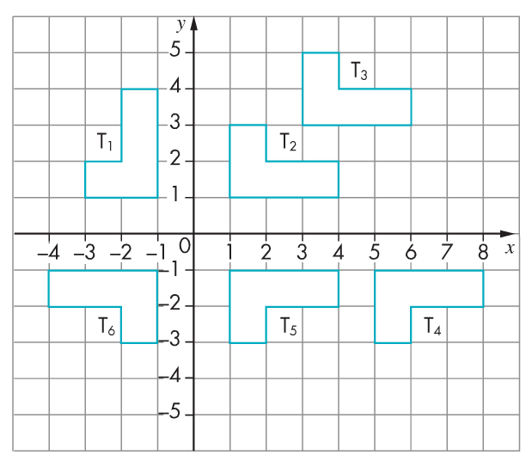
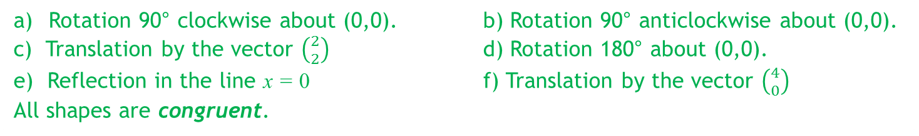



Describe fully the transformations that will result in the first shape being mapped to the second:
T₁ to T₂
T₁ to T₆
T₂ to T₃
T₆ to T₂
T₆ to T₅
T₅ to T₄
What do you
notice about all
of the shapes?
$$3$$
$$2$$
$$1$$
Rotation 90° clockwise about (0,0). b) Rotation 90° anticlockwise about (0,0).
c) Translation by the vector $\left({2 \atop 2}\right)$ d) Rotation 180° about (0,0).
e) Reflection in the line x = 0 f) Translation by the vector $\left({4 \atop 0}\right)$
All shapes are congruent.
Notes:
Timed spaced retrieval – non calculator

Slide 2
Congruence
Two shapes are said to be congruent if they are the same shape and size
The shapes may be a reflection of each other, or be rotated or translated
All of the angles and side lengths are the same
Notes:
Tes: Dannytheref

Slide 3
Which shapes are congruent?

Slide 4
Notes:
Tes: Dannytheref
Clicking a correct shape will remove it from the screen. Clicking an incorrect one will bring up the red circle.

Slide 5
Congruent Triangles
Suppose two triangles have the same side lengths.
Do the triangles have to be congruent?
Yes, because the all the angles are determined by the sides.
Would the same be true if two quadrilaterals had the same lengths?
No. A square and a rhombus can have the same side lengths but are different shapes.
?
?
Notes:
https://www.drfrostmaths.com/

Slide 6
Congruent Triangles
In pairs, determine whether comparing the following pieces of information would be sufficient to show the triangles are congruent.
3 sides the same.
✓ Congruent
a
b
c
d
Two sides the same and angle between them.
Two sides the same and angle not between them.
All angles the same.
Two angles the same and a side the same.
Click to reveal
Click to reveal
Click to reveal
✓Congruent
Click to reveal
✓Congruent
Not necessarily Congruent
(but Similar)
× Not necessarily Congruent (we’ll see why)
Notes:
https://www.drfrostmaths.com/

Slide 7
Proving Congruence
GCSE papers will often ask for you to prove that two triangles are congruent.
There’s 4 different ways in which we could show this:
!
a
?
SAS
Two sides and the included angle.
b
?
ASA
Two angles and a side.
c
?
SSS
Three sides.
?
d
RHS
Right-angle, hypotenuse and another side.
Notes:
https://www.drfrostmaths.com/

Slide 8
Proving Congruence
Why is it not sufficient to show two sides are the same and an angle are the same if the side is not included?
Try and draw a triangle with the same side lengths and indicated angle, but that is not congruent to this one.
Click to Reveal
Notes:
https://www.drfrostmaths.com/

Slide 9
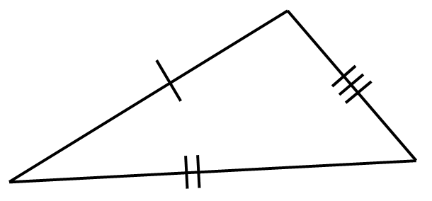
If two triangles both had the same properties indicated, would they be congruent? If so, which congruence test would prove this?
⎦
SSS
SAS
ASA
RHS
Notes:
https://www.drfrostmaths.com/
Ask why the features not sufficient for congruence are not sufficient.

Slide 10
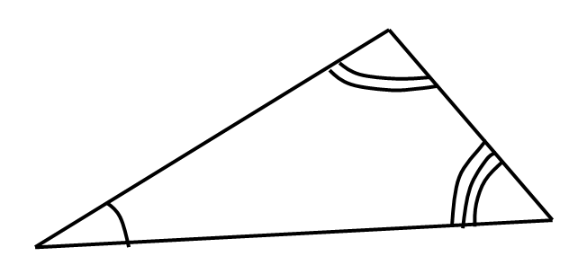
If two triangles both had the same properties indicated, would they be congruent? If so, which congruence test would prove this?
⎦
SSS
SAS
ASA
RHS
Notes:
https://www.drfrostmaths.com/
Ask why the features not sufficient for congruence are not sufficient.

Slide 11
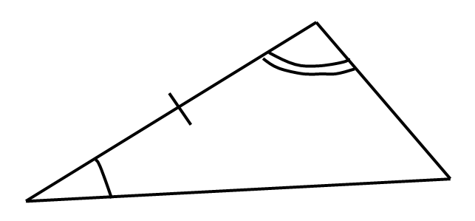
If two triangles both had the same properties indicated, would they be congruent? If so, which congruence test would prove this?
⎦
SSS
SAS
ASA
RHS
Notes:
https://www.drfrostmaths.com/
Ask why the features not sufficient for congruence are not sufficient.

Slide 12
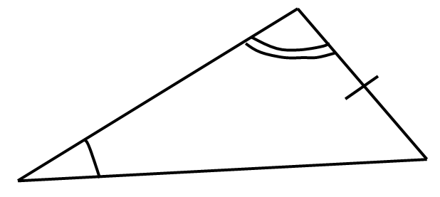
If two triangles both had the same properties indicated, would they be congruent? If so, which congruence test would prove this?
⎦
SSS
SAS
ASA
RHS
This angle is known from the other two.
This angle is known from the other two.
Notes:
https://www.drfrostmaths.com/
Ask why the features not sufficient for congruence are not sufficient.

Slide 13
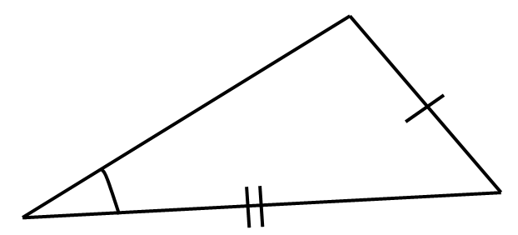
If two triangles both had the same properties indicated, would they be congruent? If so, which congruence test would prove this?
⎦
SSS
SAS
ASA
RHS
Notes:
https://www.drfrostmaths.com/
Ask why the features not sufficient for congruence are not sufficient.

Slide 14
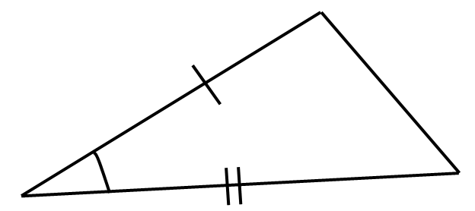
If two triangles both had the same properties indicated, would they be congruent? If so, which congruence test would prove this?
⎦
SSS
SAS
ASA
RHS
Notes:
https://www.drfrostmaths.com/
Ask why the features not sufficient for congruence are not sufficient.

Slide 15
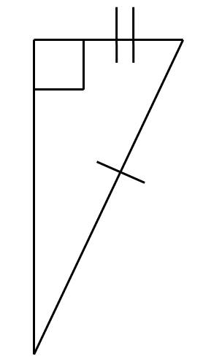
If two triangles both had the same properties indicated, would they be congruent? If so, which congruence test would prove this?
⎦
SSS
SAS
ASA
RHS
Notes:
https://www.drfrostmaths.com/
Ask why the features not sufficient for congruence are not sufficient.

Slide 16
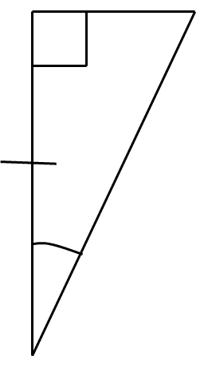
If two triangles both had the same properties indicated, would they be congruent? If so, which congruence test would prove this?
⎦
SSS
SAS
ASA
RHS
Notes:
https://www.drfrostmaths.com/
Ask why the features not sufficient for congruence are not sufficient.

Slide 17
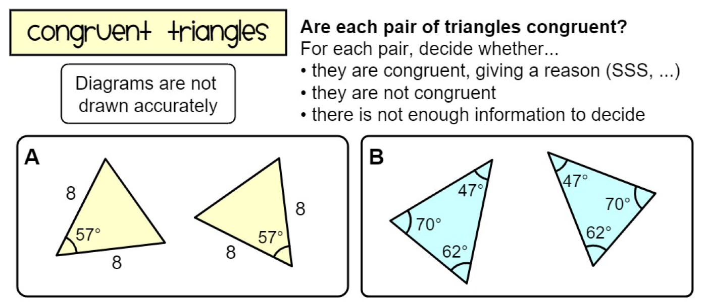
Worksheet
Notes:
https://www.mathspad.co.uk/

Slide 18
Solutions
A | Congruent – SAS | K | Not enough information
B | Not enough information | L | Congruent – ASA
C | Not congruent | M | Congruent – SAS
D | Congruent – RHS | N | Not congruent
E | Not enough information | O | Not enough information
F | Congruent – ASA | P | Congruent - SSS
G | Not enough information | Q | Not enough information
H | Not congruent | R | Not congruent
I | Congruent – SSS | S | Not enough information (ambiguous case – SSA)
J | Not congruent | T | Congruent - SAS
Notes:
https://www.mathspad.co.uk/

Slide 19
Show what you know
Use your whiteboards to write down the answers to each question.
Is it A, B, C, D or E?
Notes:
https://www.transum.org/Maths/Activity/Congruent/Default.asp?Level=1

Slide 20
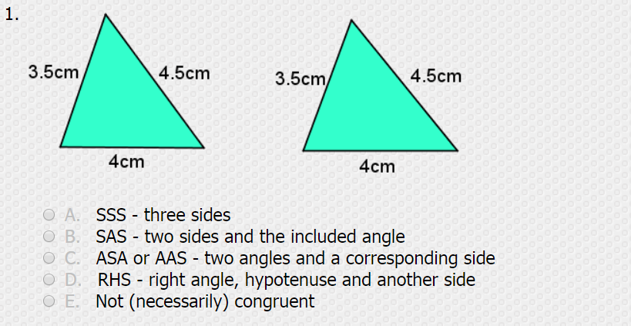

Show what you know
Notes:
https://www.transum.org/Maths/Activity/Congruent/Default.asp?Level=1

Slide 21
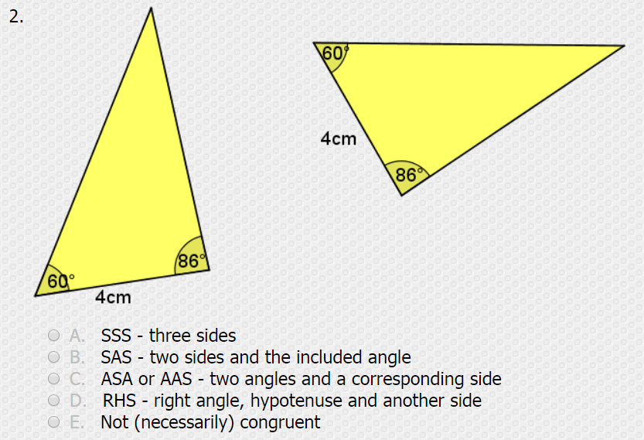
Show what you know
Notes:
https://www.transum.org/Maths/Activity/Congruent/Default.asp?Level=1

Slide 22
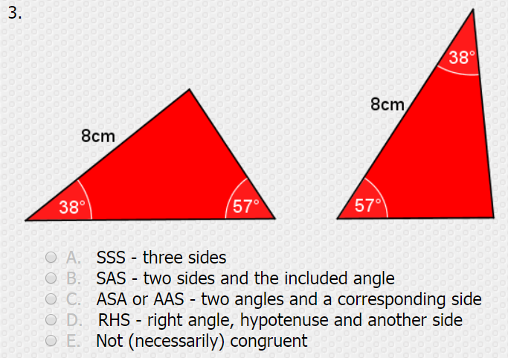
Show what you know
Notes:
https://www.transum.org/Maths/Activity/Congruent/Default.asp?Level=1

Slide 23
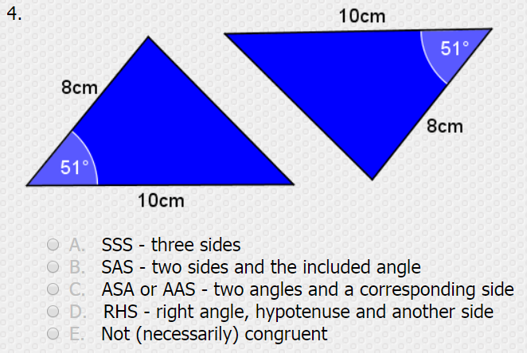
Show what you know
Notes:
https://www.transum.org/Maths/Activity/Congruent/Default.asp?Level=1

Slide 24
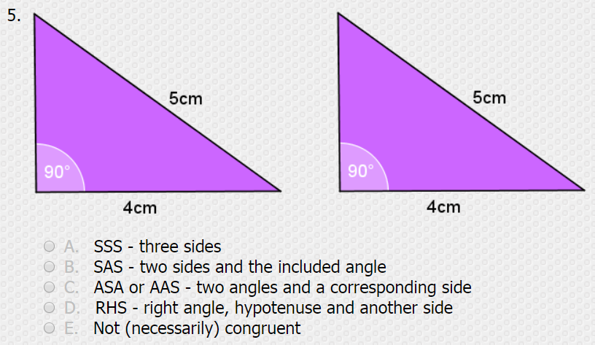
Show what you know
Notes:
https://www.transum.org/Maths/Activity/Congruent/Default.asp?Level=1

Slide 25
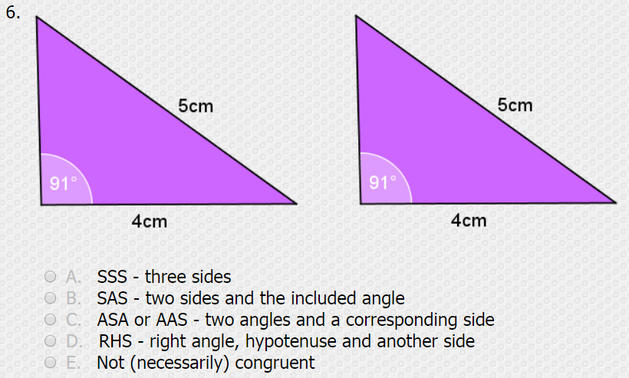
Show what you know
Notes:
https://www.transum.org/Maths/Activity/Congruent/Default.asp?Level=1

Slide 26
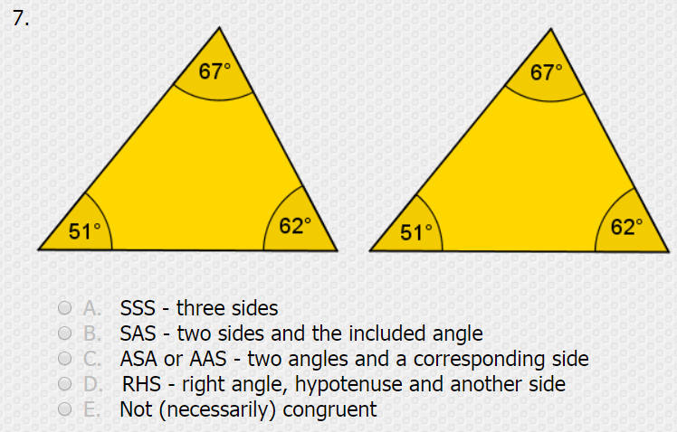
Show what you know
Notes:
https://www.transum.org/Maths/Activity/Congruent/Default.asp?Level=1

Slide 27
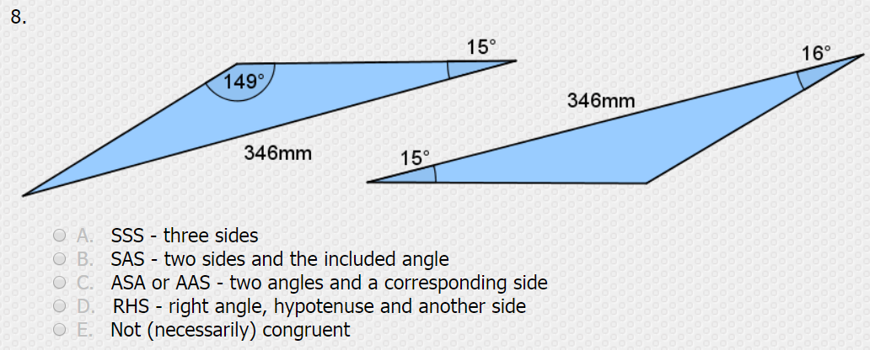

Show what you know
Notes:
https://www.transum.org/Maths/Activity/Congruent/Default.asp?Level=1

Slide 28
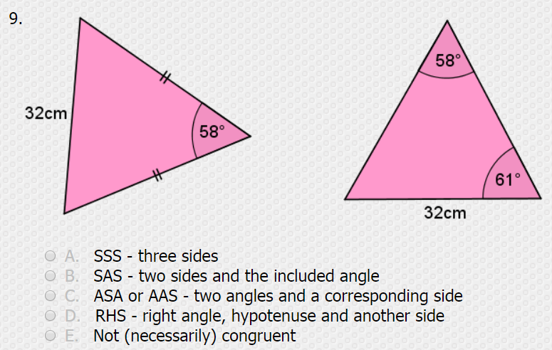
Show what you know
Notes:
https://www.transum.org/Maths/Activity/Congruent/Default.asp?Level=1

Slide 29
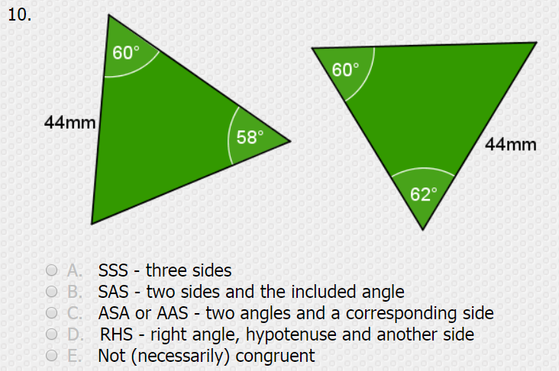
Show what you know
Notes:
https://www.transum.org/Maths/Activity/Congruent/Default.asp?Level=1

