Slide 1
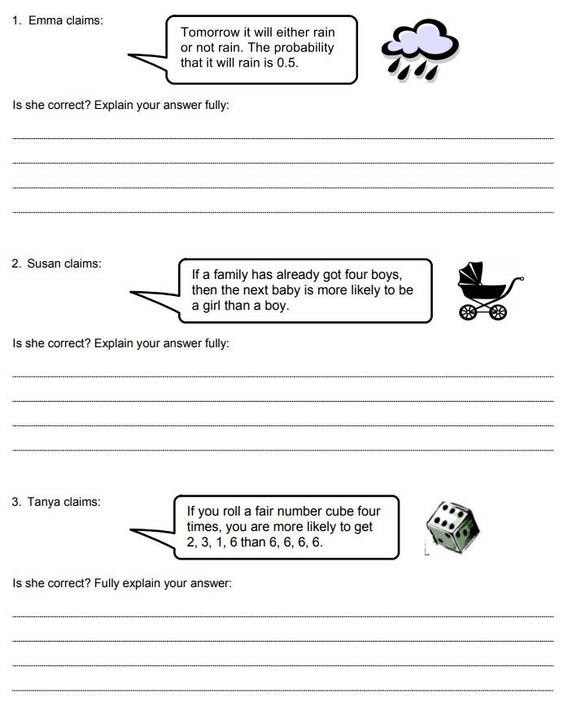
Are they correct?
Read through each statement.
Try and answer each question as carefully as you can.
Show all of your work so that your reasoning can be understood.
Notes:
Acknowledgements: Evaluating Statements About Probability S-1 © 2015 MARS, Shell Center, University of Nottingham
Ask students to complete this task independently. Try not to assist pupils. These questions are designed to challenge misconceptions students have about events being dependent when they are not.

Slide 2
Are they correct?
Swap your answers with your partner.
Read your partners work carefully.
Do you agree? Have they written anything that has changed your mind?

Slide 3
Two events are independent if the outcome of one event does not effect the outcome of the other.
Which of these scenarios involve a series of independent events?
This statement is incorrect.
Not all events are equally likely.
There are many factors that will influence the change of it raining tomorrow.
This statement is incorrect.
The chance of having a boy or a girl is 0.5 each time regardless of the gender of earlier babies.
This statement is incorrect.
The probability of rolling any number on a fair dice is equal each time.

Slide 4
On your whiteboards:
Give an example of two of independent events.
Notes:
Discuss student responses

Slide 5
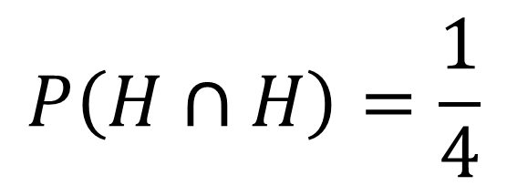
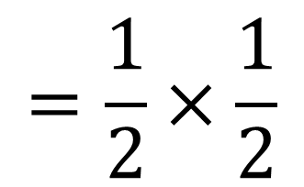
On your whiteboards:
What is the probability of getting two heads when flipping a coin?
Independent Events
 | H | T
H | H, H | T, H
T | H, T | T, T
$$P\left(H∩H\right)=\frac{1}{4}$$
$$=\frac{1}{2}×\frac{1}{2}$$

Slide 6
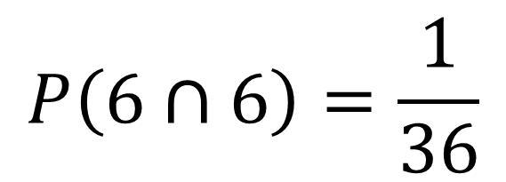
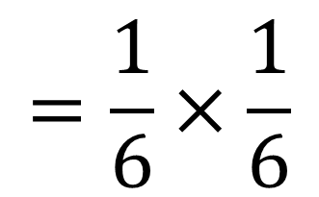
On your whiteboards:
What is the probability of getting two sixes when rolling a fair dice?
Independent Events
$$P\left(6∩6\right)=\frac{1}{36}$$
 | 1 | 2 | 3 | 4 | 5 | 6
1
2
3
4
5
6 |  |  |  |  |  | 6, 6
$$=\frac{1}{6}×\frac{1}{6}$$

Slide 7
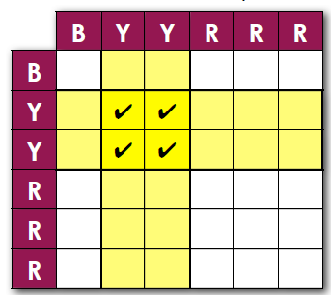
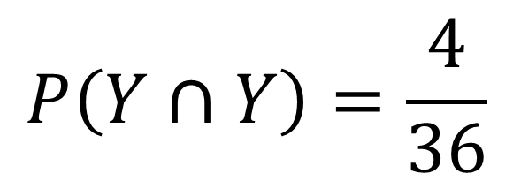
On your whiteboards:
A spinner has six sections of equal size. The spinner is spun twice. What is the probability of spinning yellow and yellow?
Independent Events
$$P\left(Y∩Y\right)=\frac{4}{36}$$
How could this be calculated without using a table?

Slide 8

On your whiteboards:
A spinner has six sections of equal size. The spinner is spun twice. What is the probability of spinning yellow and yellow?
$$P\left(Y∩Y\right)=\frac{4}{36}$$
$$\frac{2}{6}×\frac{2}{6}$$

Slide 9
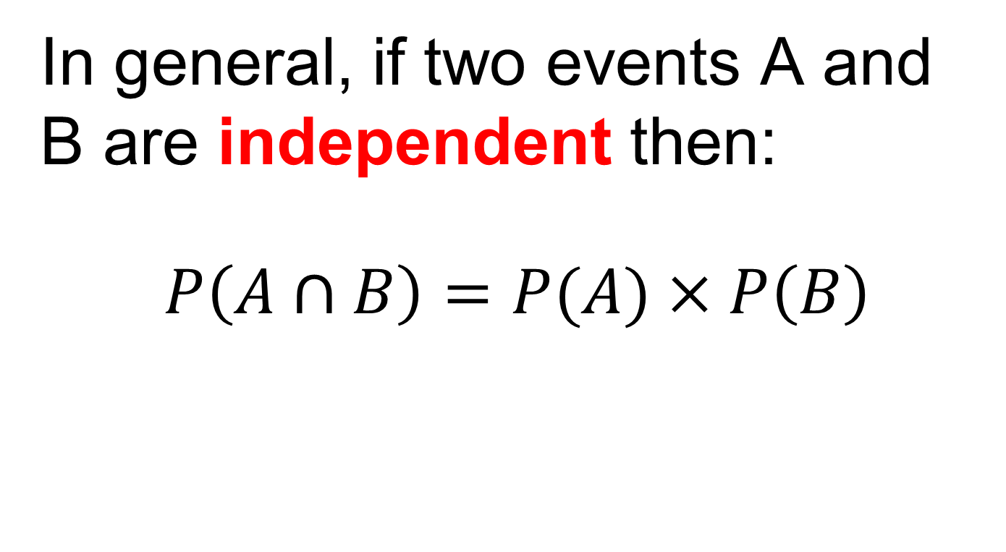
In general, if two events A and B are independent then:
$$P\left(A∩B\right)=P(A)×P\left(B\right)$$

Slide 10
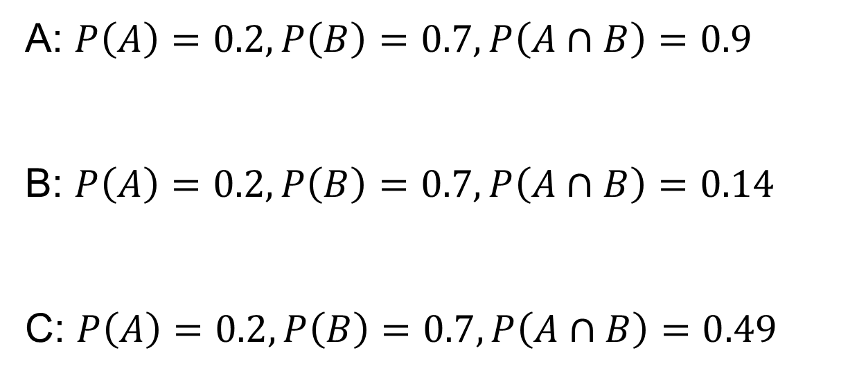
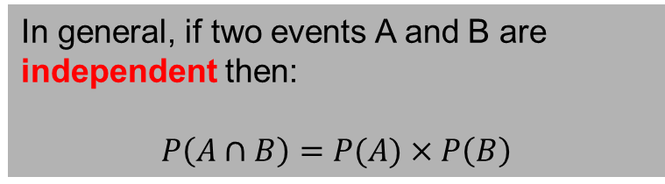
Which set of events are independent?
In general, if two events A and B are independent then:
$$P\left(A∩B\right)=P(A)×P\left(B\right)$$
A: $P\left(A\right)=0.2, P\left(B\right)=0.7, P\left(A∩B\right)=0.9$
B: $P\left(A\right)=0.2, P\left(B\right)=0.7, P\left(A∩B\right)=0.14$
C: $P\left(A\right)=0.2, P\left(B\right)=0.7, P\left(A∩B\right)=0.49$

Slide 11

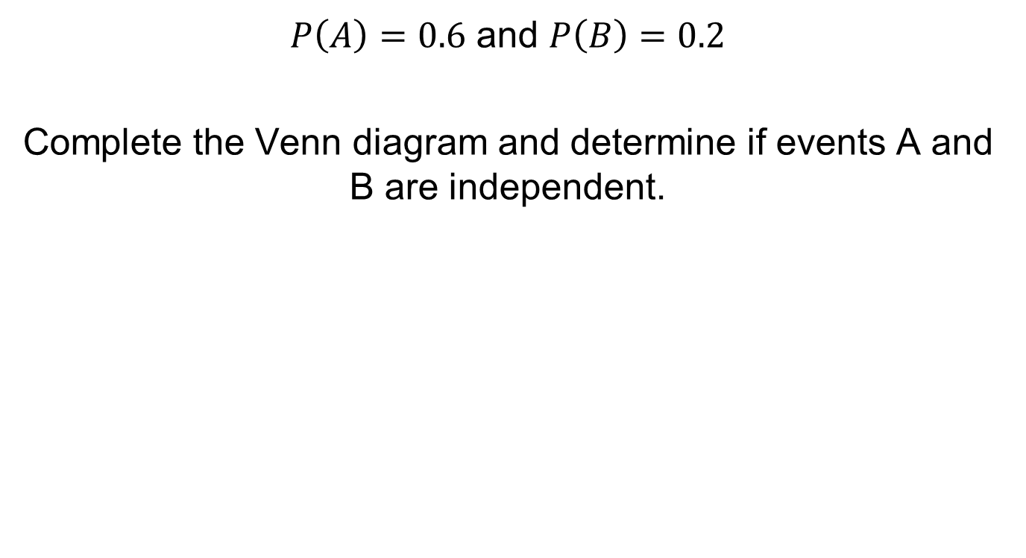





Worked Example
$P\left(A\right)=0.6$ and $P\left(B\right)=0.2$
Complete the Venn diagram and determine if events A and B are independent.
$$A$$
$$B$$
$$0.48$$
$$?$$
$$?$$
$$?$$

Slide 12

Worked Example
$P\left(A\right)=0.6$ and $P\left(B\right)=0.2$
Complete the Venn diagram and determine if events A and B are independent.
$$A$$
$$B$$
$$0.48$$
$$0.12$$
$$?$$
$$?$$

Slide 13

Worked Example
$P\left(A\right)=0.6$ and $P\left(B\right)=0.2$
Complete the Venn diagram and determine if events A and B are independent.
$$A$$
$$B$$
$$0.48$$
$$0.12$$
$$0.08$$
$$?$$

Slide 14

Worked Example
$P\left(A\right)=0.6$ and $P\left(B\right)=0.2$
Complete the Venn diagram and determine if events A and B are independent.
$$A$$
$$B$$
$$0.48$$
$$0.12$$
$$0.08$$
$$0.32$$

Slide 15
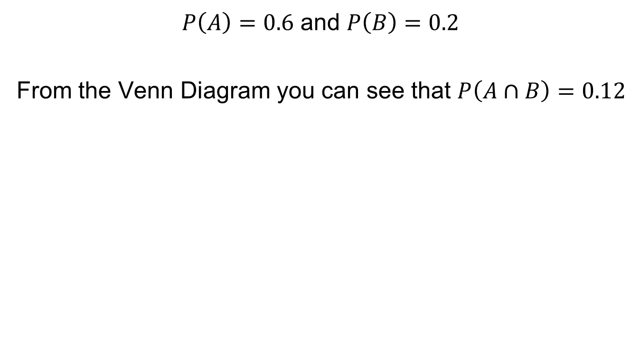
Worked Example
$P\left(A\right)=0.6$ and $P\left(B\right)=0.2$
From the Venn Diagram you can see that $P\left(A∩B\right)=0.12$
$$A$$
$$B$$
$$0.48$$
$$0.12$$
$$0.08$$
$$0.32$$

Slide 16
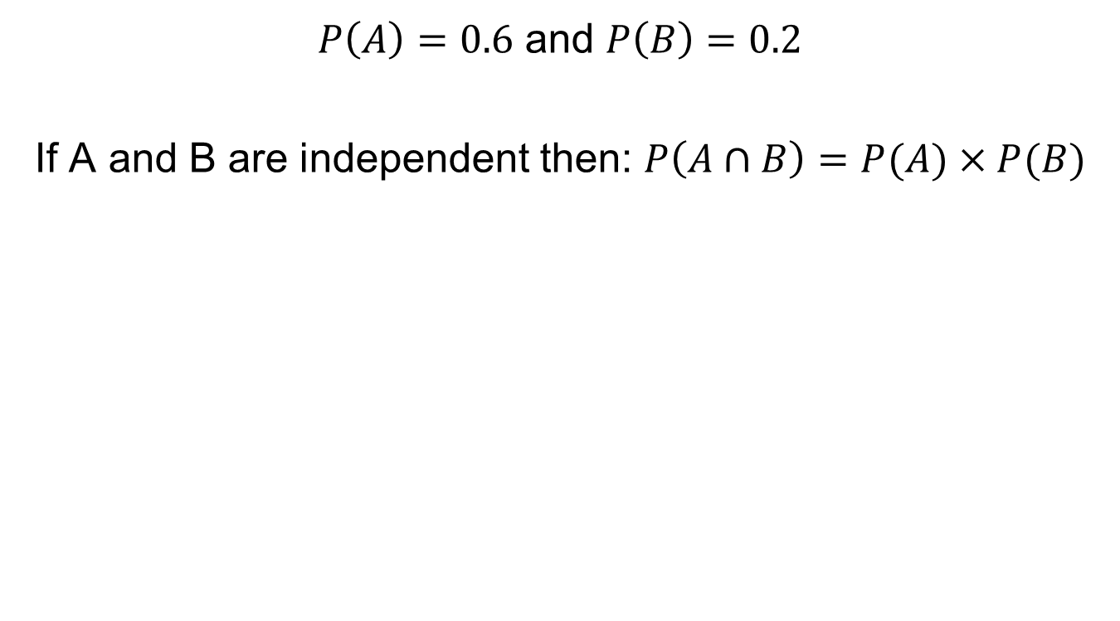
Worked Example
$P\left(A\right)=0.6$ and $P\left(B\right)=0.2$
If A and B are independent then: $P\left(A∩B\right)=P(A)×P(B)$
$$A$$
$$B$$
$$0.48$$
$$0.12$$
$$0.08$$
$$0.32$$

Slide 17
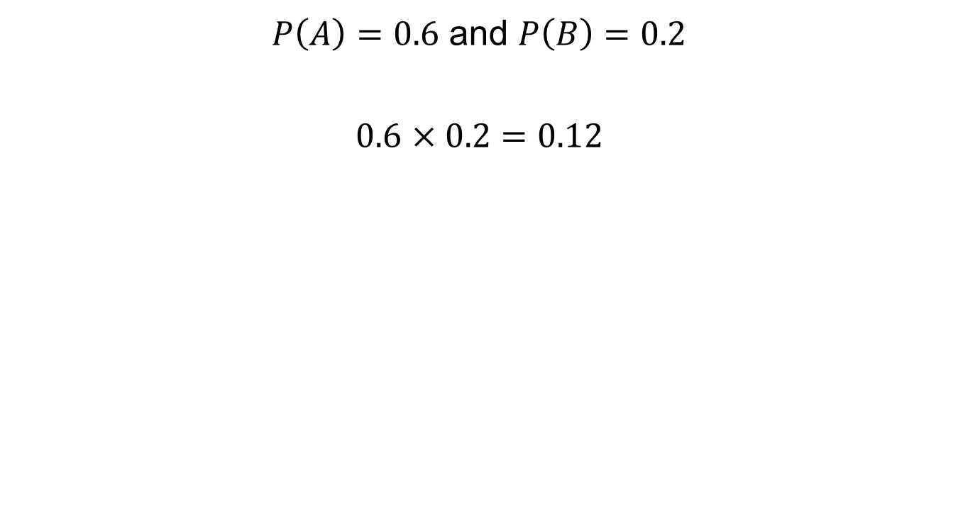
Worked Example
$P\left(A\right)=0.6$ and $P\left(B\right)=0.2$
$0.6$ $×0.2=0.12$
$$A$$
$$B$$
$$0.48$$
$$0.12$$
$$0.08$$
$$0.32$$

Slide 18
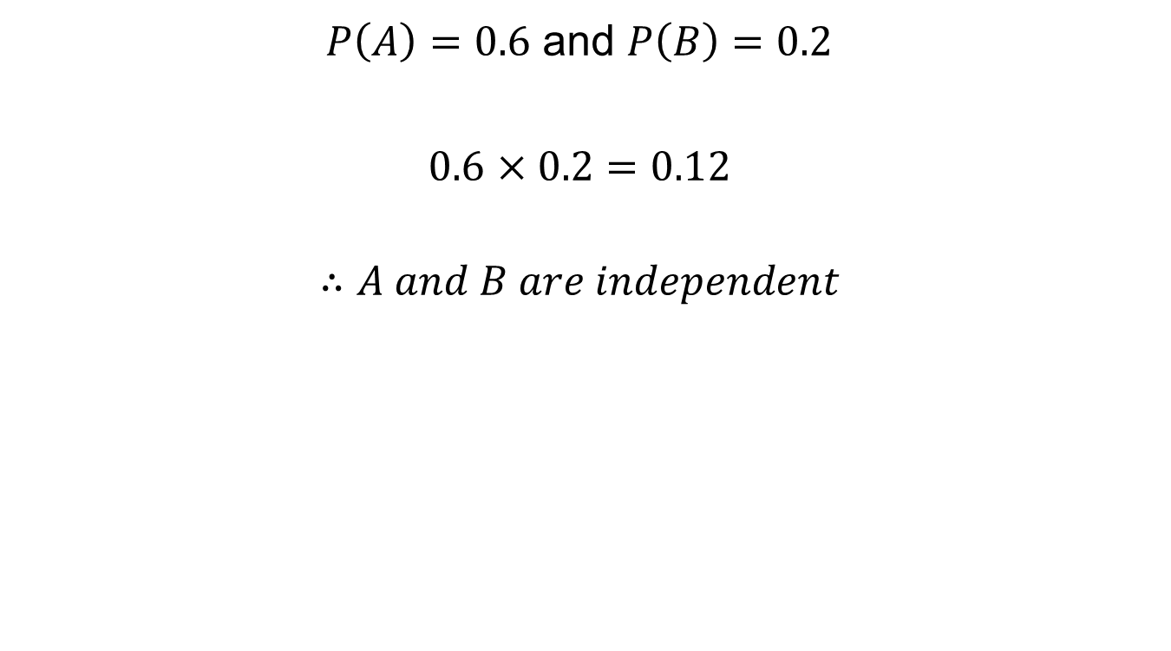
Worked Example
$P\left(A\right)=0.6$ and $P\left(B\right)=0.2$
$0.6$ $×0.2=0.12$
$$∴A and B are independent$$
$$A$$
$$B$$
$$0.48$$
$$0.12$$
$$0.08$$
$$0.32$$

Slide 19






























1. Complete the Venn Diagrams and then determine which events are independent.
$$P\left(A\right)=0.7$$
$$P\left(B\right)=0.3$$
$$P\left(A\right)=0.4$$
$$P\left(B\right)=0.2$$
$$A$$
$$B$$
$$A$$
$$B$$
$$0.49$$
$$?$$
$$0.09$$
$$0.35$$
$$?$$
$$0.15$$
$$0.21$$
$$0.45$$
$$P\left(A\right)= ?$$
$$P\left(B\right)=0.2$$
$$P\left(A\right)=0.9$$
$$P\left(B\right)= ?$$
$$B$$
$$A$$
$$B$$
$$A$$
$$?$$
$$?$$
$$0.16$$
$$0.54$$
$$?$$
$$?$$
$$0.5$$
$$0.06$$

Slide 20














2. Complete the Venn Diagrams and then determine which events are independent.
$$P\left(A\right)=0.7$$
$$P\left(A∪B\right)=0.73$$
$$P\left(A\right)=0.3$$
$$P\left(A∪B\right)′=0.4$$
$$A$$
$$B$$
$$A$$
$$B$$
$$0.63$$
$$?$$
$$?$$
$$?$$
$$0.05$$
$$?$$
$$?$$
$$?$$
$$P\left(A∩B′\right)=P\left(A^{′}∩B\right)=0.24$$
$$P\left(A′\right)=0.04$$
$$P(A∪B)′=0$$
$$B$$
$$A$$
$$B$$
$$A$$
$$?$$
$$0.16$$
$$?$$
$$0.64$$
$$?$$
$$?$$
$$?$$
$$?$$

Slide 21










1. Mark your work
$$P\left(A\right)=0.7$$
$$P\left(B\right)=0.3$$
$$P\left(A\right)=0.4$$
$$P\left(B\right)=0.2$$
$$A$$
$$B$$
$$A$$
$$B$$
$$0.49$$
$$0.21$$
$$0.09$$
$$0.35$$
$$0.05$$
$$0.15$$
$$0.21$$
$$0.45$$
$$Independent as 0.7×0.3=0.21$$
$$Not Independent as 0.4×0.2≠0.05$$
$$P\left(A\right)=0.34$$
$$P\left(B\right)=0.2$$
$$P\left(A\right)=0.9$$
$$P\left(B\right)=0.4$$
$$B$$
$$A$$
$$B$$
$$A$$
$$0.3$$
$$0.04$$
$$0.16$$
$$0.54$$
$$0.36$$
$$0.04$$
$$0.5$$
$$0.06$$
$$Not Independent as 0.34×0.2≠0.04$$
$$Independent as 0.9×0.4=0.36$$

Slide 22













2. Mark your work
$$P\left(A\right)=0.7$$
$$P\left(A∪B\right)=0.73$$
$$P\left(A\right)=0.3$$
$$P\left(A∪B\right)′=0.4$$
$$A$$
$$B$$
$$A$$
$$B$$
$$0.63$$
$$0.07$$
$$0.03$$
$$0.25$$
$$0.05$$
$$0.3$$
$$0.27$$
$$0.4$$
$$Independent as 0.7×0.1=0.07$$
$$Not Independent as 0.3×0.35≠0.05$$
$$P\left(A∩B′\right)=P\left(A^{′}∩B\right)=0.24$$
$$P\left(A′\right)=0.04$$
$$P(A∪B)′=0$$
$$B$$
$$A$$
$$B$$
$$A$$
$$0.24$$
$$0.16$$
$$0.24$$
$$0.64$$
$$0.32$$
$$0.04$$
$$0.36$$
$$0$$
$$Independent as 0.4×0.4=0.16$$
$$Not Independent as 0.96×0.36≠0.32$$

Slide 23


Challenge
In a college of 60 students, 15 study Maths but not English and 10 study English but not Maths.
Assume the event that a students studies Maths to be independent of if a student studies English.
Complete the Venn Diagram.
$$15$$
$$10$$
Notes:
Synoptic Question. Involves forming and solving a quadratic in context.
Solution. 30 study both Maths and English!

