Slide 1
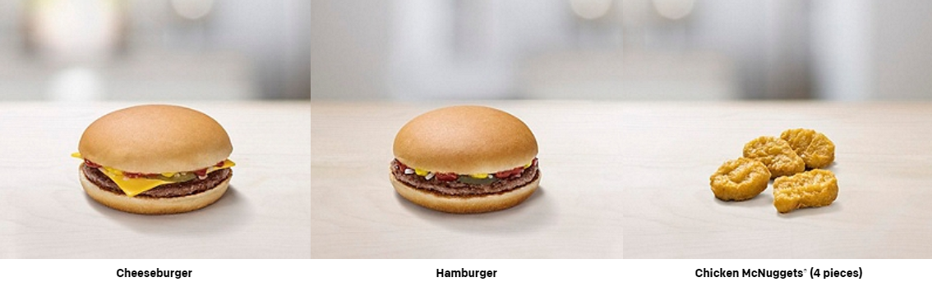
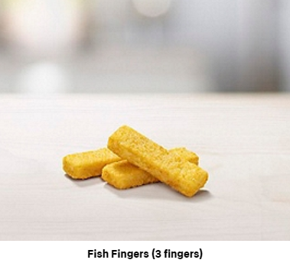
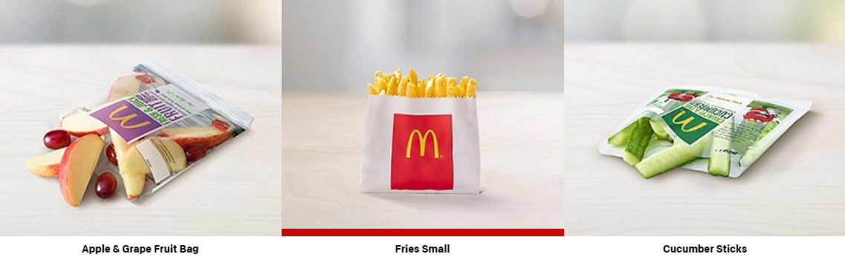
Happy Meals consists of fours choices of main course:
And a side:

Slide 2
Discuss:
How many different Happy Meals are possible?
Notes:
Allow students to work in pairs using a method of their choice.
Compare and share ideas.

Slide 3
How many different Happy Meals are possible?
If we use abbreviations like:
Cheeseburger (C), Hamburger (H), Nuggets (N) and Fish Fingers (F)
Grape Bag (G), Fries (P) and Cucumber Sticks (S)
We could list all the possible combinations like this:
CG, CP, CS
HG, HP, HS
NG, NP, NS
FG, FP, FS
Notes:
Allow students to work in pairs using a method of their choice.
Compare and share ideas.

Slide 4
Or we could use a mapping diagram like this…
Notes:
Allow students to work in pairs using a method of their choice.
Compare and share ideas.

Slide 5




Or we could use a two-way table like this…

Slide 6
With this menu there are 12 different combinations of Happy Meals.

Slide 7
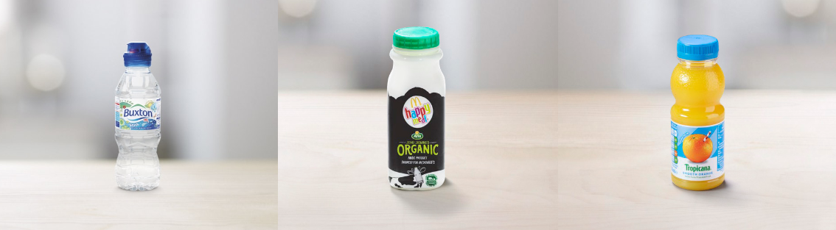
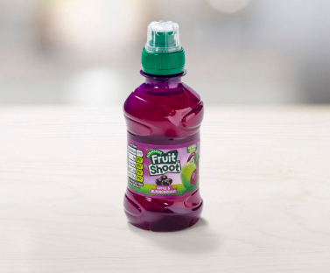
However, Happy Meals also come with a drink:
Discuss: How many different combinations of Happy Meals are there if drinks are also included?

Slide 8



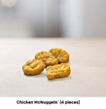




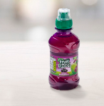
There are 36 different combinations
How can we calculate this without using a two-way table or a listing strategy?

Slide 9
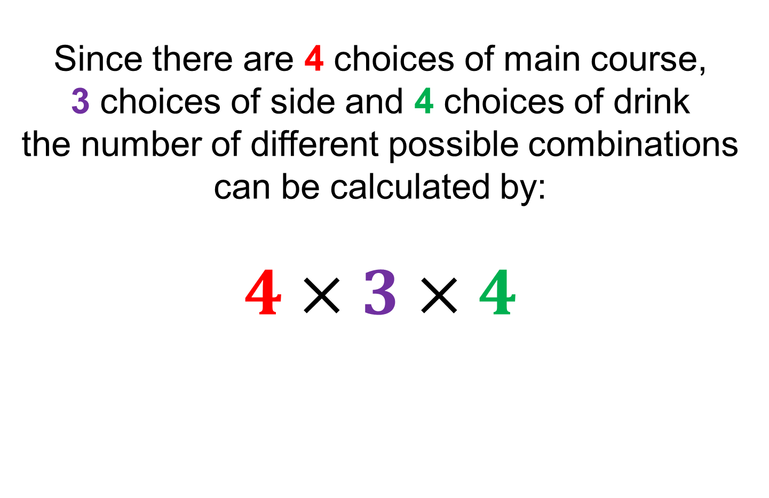
Since there are 4 choices of main course,
3 choices of side and 4 choices of drink
the number of different possible combinations can be calculated by:
$$4×3×4$$

Slide 10

On your whiteboards:
In a group of ballroom dancers there are 11 males and 8 females. One male and one female are to be chosen to demonstrate a waltz.
How many different combinations could be chosen?
Notes:
AfL : have students understood how to find the number of combinations are apply their knowledge to a different problem? Some students may still want to use a listing strategy, compare and share these.

Slide 11
On your whiteboards:
A fair dice is rolled and a fair coin is tossed.
How many possible outcomes are there?
Notes:
AfL : have students understood how to find the number of combinations are apply their knowledge to a different problem? Some students may still want to use a listing strategy, compare and share these.

Slide 12
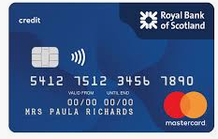
Pin codes consists of 4 digits. Each digit can be any number from 0-9.
How many possible pin codes are there?

Slide 13
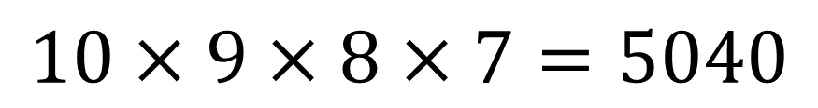
Pin codes consists of 4 digits. Each digit can be any number from 0-9.
Numbers can not be repeated.
How many possible pin codes are there?
$$10×9×8×7=5040$$

Slide 14
On your whiteboards:
How many different two-digit numbers can be formed using these cards?
What makes this problem different from the previous questions we have looked at today?
2
6
3
9
7
Notes:
AfL: can students extend their knowledge to an unfamiliar and more challenging problem?

Slide 15
Combination Problems
Work with your partner to solve these problems.
Make sure you can explain your answer and your working our must be shown.
A. Isla has 5 different pairs of leggings and 8 different t-shirts. How many different combinations of these could she wear? | B. A badminton club has 23 members, 8 of whom are female, In how many ways can the club select a mixed doubles team consisting of one male and one female?
C. On a menu there are 5 different starters, 6 main courses and 4 desserts. For a set price diners can either choose a starter and a main or a main and a dessert. How many different combinations of meal are there? | D. In a class there are n girls. There are three times as many boys than girls. One boy and one girls are to be chosen at random. Write a simplified expression for the number of possible combinations.
E. Two cards are chosen from a deck of 52 cards. How many different possible pairs are there? | F. There are runners 10 in a race. In how many ways could the three medals: gold, silver and bronze be allocated?

Slide 16
Combination Problems
What makes problems E and F different from the other problems?
A. Isla has 5 different pairs of leggings and 8 different t-shirts. How many different combinations of these could she wear? | B. A badminton club has 23 members, 8 of whom are female, In how many ways can the club select a mixed doubles team consisting of one male and one female?
C. On a menu there are 5 different starters, 6 main courses and 4 desserts. For a set price diners can either choose a starter and a main or a main and a dessert. How many different combinations of meal are there? | D. In a class there are n girls. There are three times as many boys than girls. One boy and one girls are to be chosen at random. Write a simplified expression for the number of possible combinations.
E. Two cards are chosen from a deck of 52 cards. How many different possible pairs are there? | F. There are runners 10 in a race. In how many ways could the three medals: gold, silver and bronze be allocated?
Notes:
With/without replacement

Slide 17
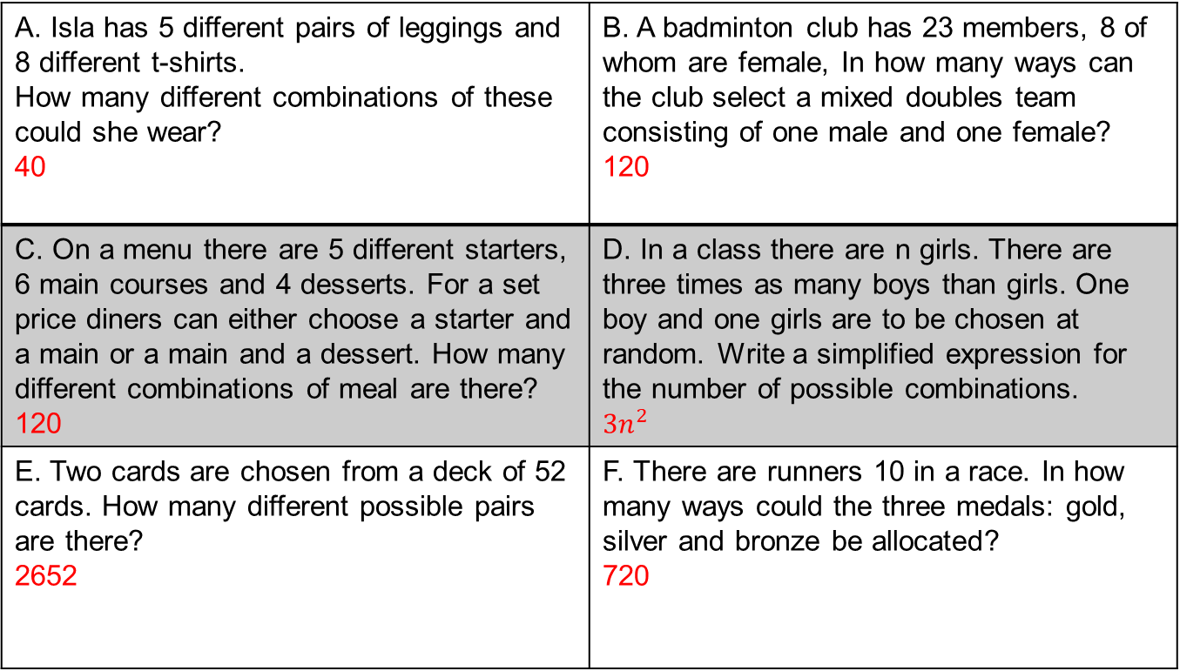
Mark your work
A. Isla has 5 different pairs of leggings and 8 different t-shirts. How many different combinations of these could she wear? 40 | B. A badminton club has 23 members, 8 of whom are female, In how many ways can the club select a mixed doubles team consisting of one male and one female? 120
C. On a menu there are 5 different starters, 6 main courses and 4 desserts. For a set price diners can either choose a starter and a main or a main and a dessert. How many different combinations of meal are there? 120 | D. In a class there are n girls. There are three times as many boys than girls. One boy and one girls are to be chosen at random. Write a simplified expression for the number of possible combinations. $${3n}^{2}$$
E. Two cards are chosen from a deck of 52 cards. How many different possible pairs are there? 2652 | F. There are runners 10 in a race. In how many ways could the three medals: gold, silver and bronze be allocated? 720

Slide 18
Challenge
To win the EuroMillions you must get 5 numbers from 1 to 50 and Two Lucky Stars from 1 to 12.
Which calculation would work out how many different combinations of lottery numbers are there?
Notes:
50 x 49 x 48 x 47 x 46 x 12 x 11

