Slide 1
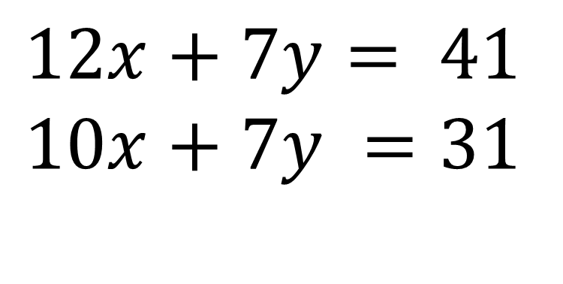


On your whiteboards
$$+$$
$$−$$
Eliminate a variable:
$$12x+7y= 41 \\ 10x+7y =31$$
Notes:
Linking to previous lesson
Anticipate issues with negative number arithmetic

Slide 2
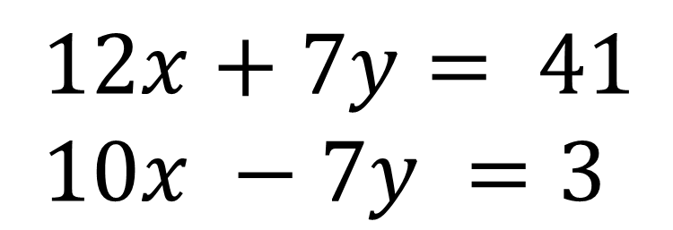
On your whiteboards
$$+$$
$$−$$
Eliminate a variable:
$$12x+7y= 41 \\ 10x −7y =3$$

Slide 3
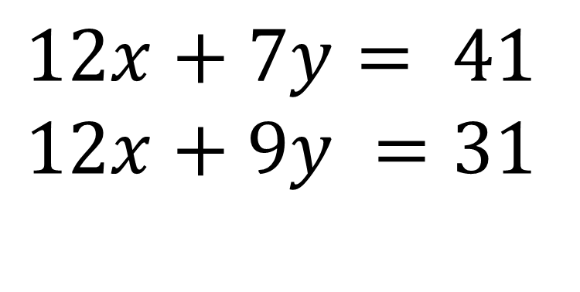
On your whiteboards
$$+$$
$$−$$
Eliminate a variable:
$$12x+7y= 41 \\ 12x+9y =31$$

Slide 4
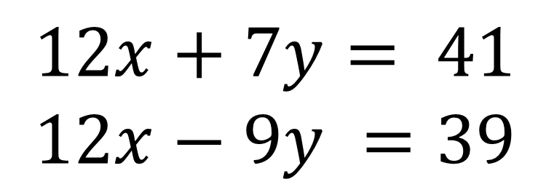
On your whiteboards
$$+$$
$$−$$
Eliminate a variable:
$$12x+7y= 41 \\ 12x−9y =39$$

Slide 5
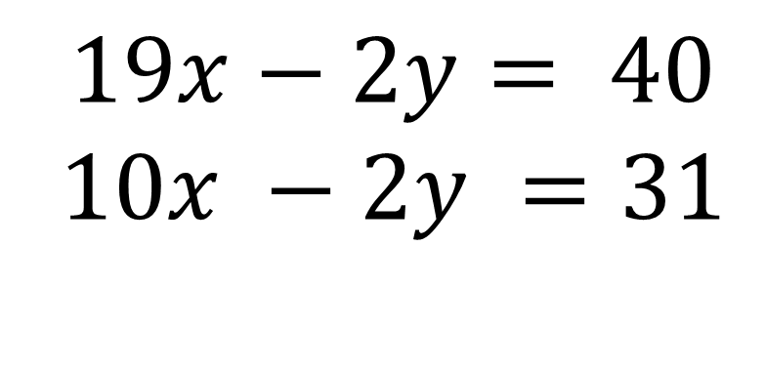
On your whiteboards
$$+$$
$$−$$
Eliminate a variable:
$$19x−2y= 40$$
10$x −2y =31$

Slide 6
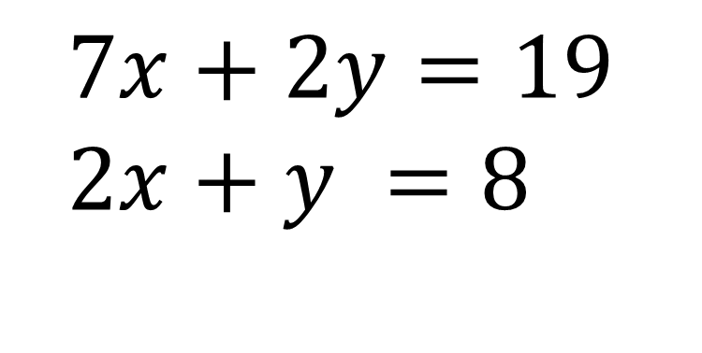
On your whiteboards
$$+$$
$$−$$
Eliminate a variable:
$$7x+2y=19 \\ 2x+y =8$$
Notes:
A non example to create some “cognitive conflict”.

Slide 7
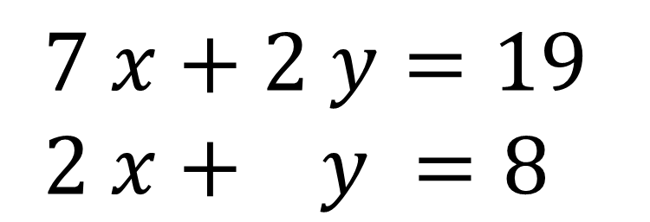
Here a variable can not be eliminated as the coefficients of y (or x) are not the same or the inverse of each other.
$$7 x+2 y=19 \\ 2 x+ y =8$$

Slide 8
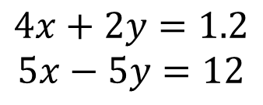


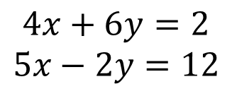
TITLE: SOLVING SIMULTANEOUS EQUATIONS
Worked Example
Your Turn
Eliminate y:
Eliminate y:
$$4x+2y=1.2$$
$$5x−5y=12$$
Equation 1: $×$
Equation 2: $×$
$$4x+6y=2$$
$$5x−2y=12$$
Equation 1: $×$
Equation 2: $×$
Notes:
Silent teacher: Complete worked example. Then question each step.
Your Turn: For students to do on whiteboards to check all are ready for the independent and intelligent practise

Slide 9




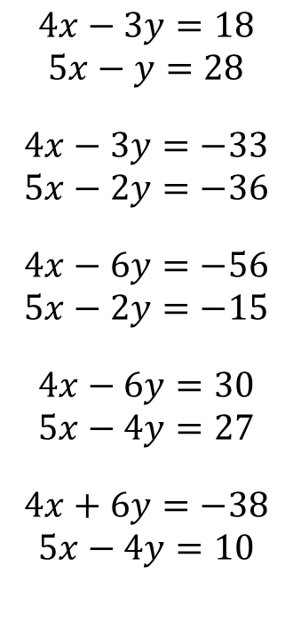

Independent Practise:
Eliminate a variable from the following sets of equations.
1.
$$4x−3y=18$$
$$5x−y=28$$
$$4x−3y=−33$$
$$5x−2y=−36$$
$$4x−6y=−56$$
$$5x−2y=−15$$
$$4x−6y=30$$
$$5x−4y=27$$
$$4x+6y=−38$$
$$5x−4y=10$$
Equation 1: $×$
Equation 2: $×$
Equation 1: $×$
Equation 2: $×$
2.
3.
Equation 1: $×$
Equation 2: $×$
4.
Equation 1: $×$
Equation 2: $×$
5.
Equation 1: $×$
Equation 2: $×$
Extension: Work out the values of $x$ and $y$
Notes:
Acknowledgements: Edited from variationtheory.com

Slide 10






Mark your work
Eliminate a variable from the following sets of equations.
1.
$$4x−3y=18$$
$$5x−y=28$$
$$4x−3y=−33$$
$$5x−2y=−36$$
$$4x−6y=−56$$
$$5x−2y=−15$$
$$4x−6y=30$$
$$5x−4y=27$$
$$4x+6y=−38$$
$$5x−4y=10$$
Equation 1: $×$
Equation 2: $×$
$$x=6, y=2$$
Equation 1: $×$
Equation 2: $×$
$$x=−6, y=3$$
2.
Equation 1: $×$
Equation 2: $×$
$$x=1, y=−10$$
3.
Equation 1: $×$
Equation 2: $×$
$$x=3, y=−3$$
4.
5.
Equation 1: $×$
Equation 2: $×$
$$x=−2, y=−5$$
Extension: Work out the values of $x$ and $y$

