Slide 1
Multiplier
5 % increase
0.965
1 % decrease
0.5
10 % increase
1.005
3.5 % decrease
0.85
15 % increase
1
15 % decrease
1.15
½ % increase
1.1
50 % decrease
0.99
No change
1.05
Match each phrase to the correct percentage multiplier

Slide 2
Simple Interest
vs.
Compound Interest
An investment of £100 offers 5% simple interest per annum.
The investment would grow as follows…
End of Year 1: 100+5=£105
End of Year 2: 105+5=£110
End of Year 3: 110+5=£120
An investment of £100 offers 5% compound interest per annum.
The investment would grow as
follows…
End of Year 1: 100+5=£105
End of Year 2: 105+5.25=£110.25
End of Year 3: 110.25+5.51=£115.76
Compound interest is the result of reinvesting interest so that the interest in the next period is greater.

Slide 3
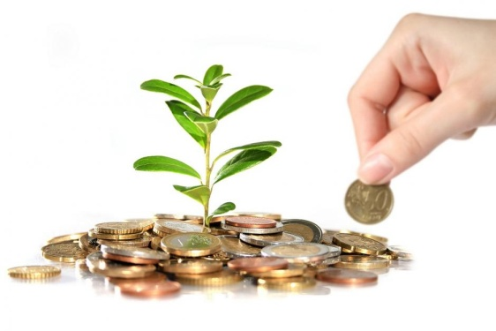




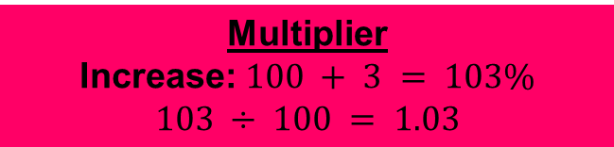
Compound Interest
£4000 is invested at 3% per annum compound interest.
Find the total value of the investment after 2 years.
Multiplier
Increase: $100 + 3 = 103\%$
$$103 ÷ 100 = 1.03$$
Year | Initial | Value at end of year
1
$$4,000$$
$$4000 × 1.03 = 4,120$$
2
$$4,120$$
$$4120 × 1.03 = 4,243.60$$

Slide 4
On your whiteboards:
A man invests £5,000 into a company and expects to make 5% per annum.
How much will his investment be worth in three years?
Multiplier
Increase: 100 + 3 = 103%
103 ÷ 100 = 1.03
Year | Initial | Value at end of year
1
5,000
5000 × 1.05 = 5,250
2
5,250
5250 × 1.05 = 5,512.50
3
5,512.50
5512.50 × 1.05 ≈ 5,788.13

Slide 5
On your whiteboards:
£14,000 is invested at 7.5% per annum compound interest.
Find the total amount at the end of three years.
Multiplier
Increase: 100 + 7.5 = 107.5%
107.5 ÷ 100 = 1.075
Year | Initial | Value at end of year
1
14,000
14000 × 1.075 = 15,050
2
15,050
15050 × 1.075 = 16,178.75
3
16,178.75
16178.75 × 1.075 ≈17,392.16

Slide 6
Compound Interest
£4000 is invested at 3% per annum compound interest.
Find the total value of the investment after 20 years.
Multiplier
Increase: $100 + 3 = 103\%$
$$103 ÷ 100 = 1.03$$
Year | Initial | Value at end of year
1
$$4,000$$
$$4000 × 1.03 = 4,120$$
2
$$4,120$$
$$4120 × 1.03 = 4,243.60$$
This method would be very time consuming for this question!

Slide 7








Compound Interest
£4000 is invested at 3% per annum compound interest.
Find the total value of the investment after 20 years.
Multiplier
Increase: $100 + 3 = 103\%$
$$103 ÷ 100 = 1.03$$
$$(4000×1.03)$$
$$×1.03$$
$$×1.03$$
$$×1.03$$
$$×1.03$$
$×1.03$…
$$…×1.03$$
$$=4000×{1.03}^{20}$$
This calculation is more efficient.

Slide 8
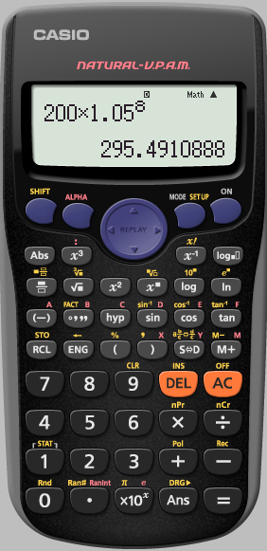
Using boxes
Number of years/months/weeks…
200
X1.05
8
Initial amount
Percentage increase or decrease

Slide 9
Growth and Decay
Worked Example
A house is bought for £160,000. It increases in value at a rate of 1.3%. How much is the house worth after 5 years?
Your Turn
A house is bought for £160,000. It increases in value at a rate of 0.9%. How much is the house worth after 5 years?

Slide 10
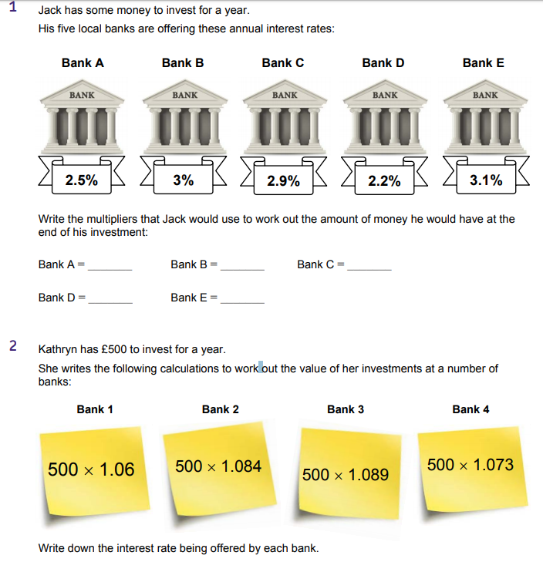
Compound Interest Practise
Notes:
Acknowledgements: AQA https://allaboutmaths.aqa.org.uk/attachments/5626.pdf

Slide 11
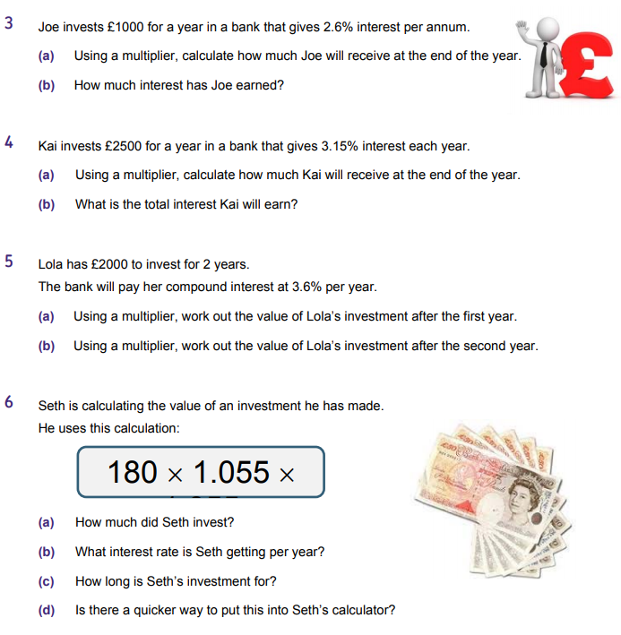

Slide 12
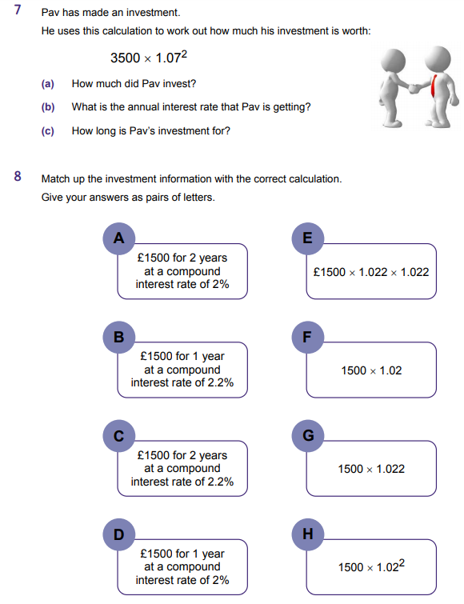

Slide 13
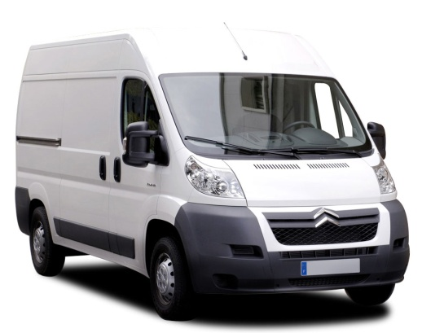
Compound Depreciation
A van is bought for £10,000. It depreciates at a rate of 20%. Find it’s value after 3 years.
Multiplier
Decrease: 100 - 20= 80%
80 ÷ 100 = 0.8
Year | Initial | Value at end of year
1
10,000
10000 × 0.8 = 8,000
2
8,000
8000 × 0.8 = 6,400
3
6,400
6400 × 0.8 = 5,120

Slide 14
On your whiteboards:
The value of machinery in a factory depreciates by 10% each year. The machinery was bought for £74,000.
What was its’ value after 2 years?
Multiplier
Decrease: 100 - 10 = 90%
90 ÷ 100 = 0.9
Year | Initial | Value at end of year
1
74,000
74000 × 0.9 = 66,600
2
66,600
66600 × 0.9 = 59,940

Slide 15
On your whiteboards:
The polar ice cap in the Arctic is 4 metres thick. If the ice is thinning at a rate of 5% per year, how thick will the ice be in two years time?
Multiplier
Decrease: 100 - 5 = 95%
95 ÷ 100 = 0.95
Year | Initial | Thickness at end of year
1
4
4 × 0.95 = 3.8
2
3.8
3.8 × 0.95 = 3.61m

Slide 16
Growth and Decay
Worked Example
A house is bought for £99,000. It depreciates in value at a rate of 1.3%. How much is the house worth after 5 years?
Your Turn
A house is bought for £99,000. It depreciates in value at a rate of 0.9%. How much is the house worth after 5 years?

Slide 17
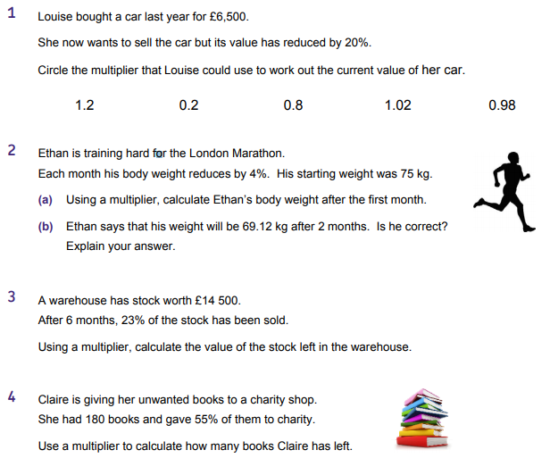
Reductions Practise
Notes:
Acknowledgements: AQA https://allaboutmaths.aqa.org.uk/attachments/5626.pdf

Slide 18
