Slide 1


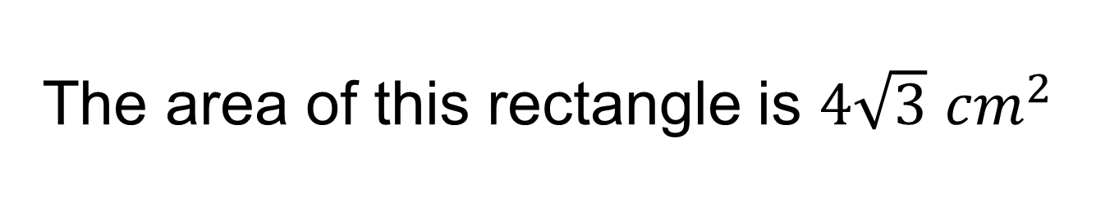
The area of this rectangle is $4\sqrt{3}$ ${cm}^{2}$
$$4x$$
$$30°$$
Work out as many things as you can!
Notes:
Give this to students and allow them 5/10 mins to independently work out as many other details about the rectangle/triangles as they can.
After this time allow students to share what they have worked out with their neighbour, encourage students to then work with their neighbour working out anything else they can.

Slide 2
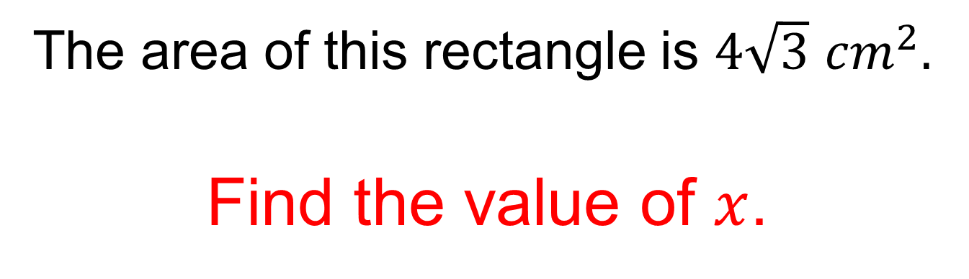


The area of this rectangle is $4\sqrt{3}$ ${cm}^{2}.$
Find the value of $x$.
$$4x$$
$$30°$$
Notes:
Show the students the question that accompanies this synoptic problem and encourage students to use what they have already worked out to answer it (if they haven’t already!)

Slide 3







$$5cm$$
$$B$$
$$2x$$
$$C$$
$$120°$$
$$A$$
$$D$$
ABCD is a rectangle
Work out as many things as you can!
Notes:
Synoptic question requires: trig, pythagoras, various algebraic and surd manipulations.

Slide 4
$$5cm$$
$$B$$
$$2x$$
$$C$$
$$120°$$
$$A$$
$$D$$
ABCD is a rectangle
What proportion of the rectangle is red?
Notes:
Synoptic question requires: trig, pythagoras, various algebraic and surd manipulations.

Slide 5



This is a right-angled triangle
$$60°$$
$$x\left(x+4\right)cm$$
$$6 cm$$
Work out as many things as you can!

Slide 6

This is a right-angled triangle
$$60°$$
$$x\left(x+4\right)cm$$
$$6 cm$$
Work out the value of ${82}^{x}−{18}^{x}$
Notes:
Synoptic question requires: trig, manipulating and solving a quadratic, difference of two squares.

