Slide 1
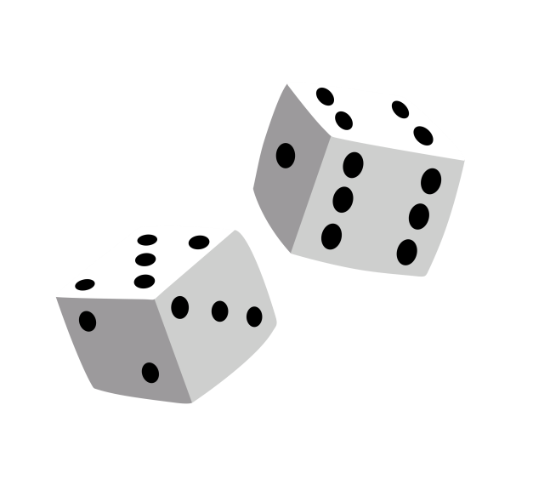
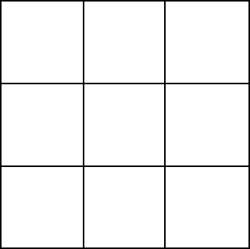
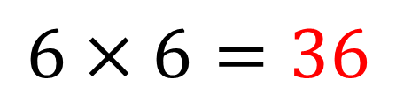


Dice Bingo
Two dice are going to be rolled.
How many possible outcomes are there?
$$Dice 1 :6 equally likely outcomes$$
$$Dice 2 :6 equally likely outcomes$$
$$6×6=36$$
Notes:
Linking to last lesson.

Slide 2
Dice Bingo
The two scores will added and the square containing that value can be crossed out.
Only one square can be crossed out each time.
Draw a 3 x 3 grid and fill it with numbers that could appear.
The winner will cross out all of their numbers first.
Notes:
Whole class game

Slide 3
Dice Bingo
Score | Tally | Frequency
2
3
4
5
6
7
8
9
10
11
12
What proportion of rolls resulted in a score of 5?
This proportion is known as the relative frequency.
Notes:
Record the outcomes as you go here.

Slide 4
Dice Bingo
Score | Tally | Frequency
2
3
4
5
6
7
8
9
10
11
12
What was the mode score?
What was the
relative frequency of scoring this value?
What did you expect the mode score to be? Why?
Notes:
Record the outcomes as you go here.

Slide 5
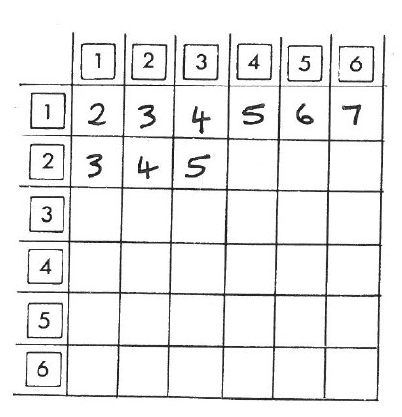
Dice Bingo
A two way table is way to list all possible outcomes.
Explain why we should have expected the mode to be 7.

Slide 6














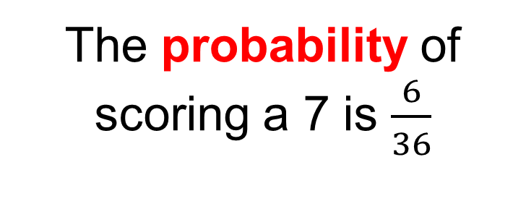



Dice Bingo
The probability of scoring a 7 is $\frac{6}{36}$
$$6$$
$$7$$
$$8$$
The relative frequency of scoring a 7 from our bingo game was:
$$4$$
$$5$$
$$6$$
$$7$$
$$8$$
$$5$$
$$6$$
$$7$$
$$8$$
$$6$$
$$7$$
$$8$$
$$7$$
$$8$$
Discuss: Why are these proportions different?
Notes:
Talk about the difference between theoretical and experimental probability.

Slide 7
Dice Bingo: Round 2
This time the two scores will be multiplied and the square containing that value can be crossed out.
Only one square can be crossed out each time.
Draw a 3 x 3 grid and fill it with numbers that could appear.
The winner will cross out all of their numbers first.
Notes:
Whole class game
Encourage students to think about which values to fill their grids with to increase their chances of winning

Slide 8
Dice Bingo: Round 2
Outcomes:
Which values did you choose for your grid? Why?
Notes:
List the outcomes

Slide 9
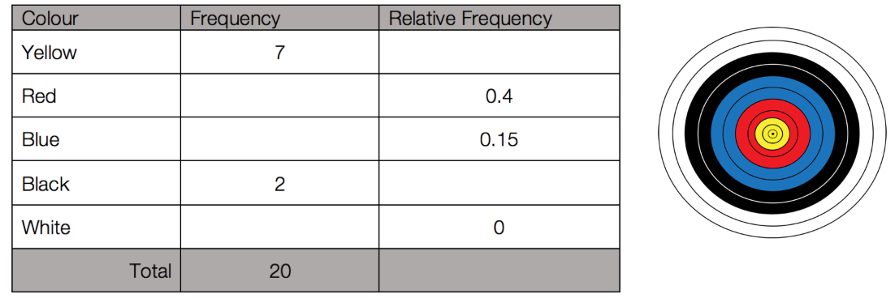

On your whiteboard…
Blessing was doing some archery and recorded his results in the table below.
$$\frac{7}{20}=0.35$$
What is the relative frequency of hitting the yellow?
Notes:
Checking for understanding.
Decimal/Fraction Equivalence etc..

Slide 10



On your whiteboard…
Blessing was doing some archery and recorded his results in the table below.
$$0.35$$
$$0.1$$
$$1$$
What is the sum of the relative frequency values?
Notes:
If we had more trials would the sum of the relative frequencies increase?
Why will the relative frequency values always sum to 1?

Slide 11

On your whiteboard…
Blessing was doing some archery and recorded his results in the table below.
How many times did he his arrow strike in the red area?
Notes:
Working backwards
Some students may find it useful to use a bar model to help them work this out

Slide 12
On your whiteboard…
Blessing was doing some archery and recorded his results in the table below.
If Blessing was to take 200 shots, how many times would you expect him to hit the blue region?
Notes:
Checking for understanding.
Decimal/Fraction Equivalence etc..

Slide 13
On your whiteboard…
Blessing was doing some archery and recorded his results in the table below.
To win a competition Blessing must hit the red or yellow sections.
What is his estimated probability of winning?

Slide 14
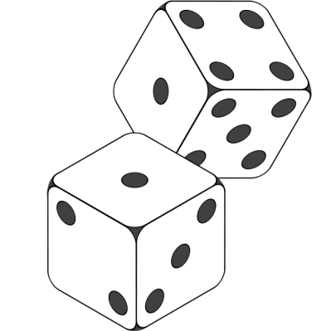
Game 3: What Chance?
If you roll two dice and find the difference between the two numbers what is the largest and smallest difference
you can get?
Notes:
Individual activity, need a lot of dice…

Slide 15

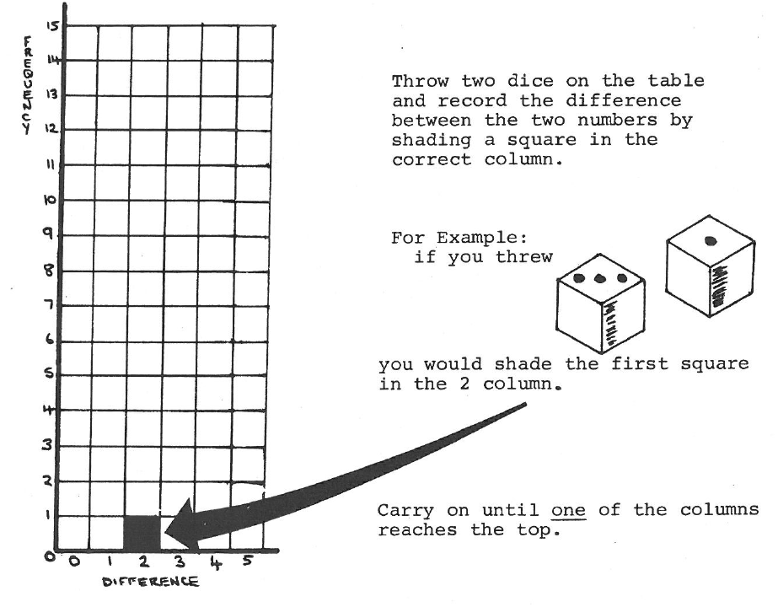
What Chance?
In your books
Notes:
Acknowledgements: Smile Probability Pack 2 (0737)

Slide 16
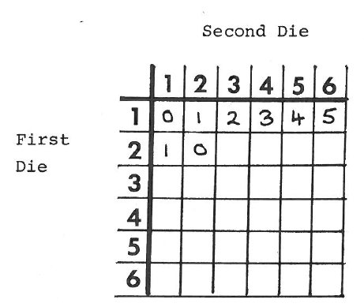
What Chance?
In your books
Copy and complete the two way table.
2. Copy and complete this table for your game.
Difference | 0 | 1 | 2 | 3 | 4 | 5
Relative Frequency
Theoretical Probability

Slide 17
What Chance?
In your books
3. If you rolled the dice 1000 times how many rolls would you expect to result in a difference of 2?
4. What is the relative frequency of rolling a difference which is prime?
5. What is the probability of rolling a difference which is square?
Once you have finished check your work
with a partner.

Slide 18
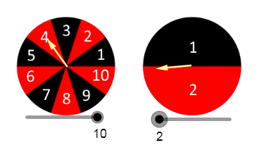
Challenge
Which Spinners?
Notes:
Nrich Problem
Print out the eight bar charts

