Slide 1
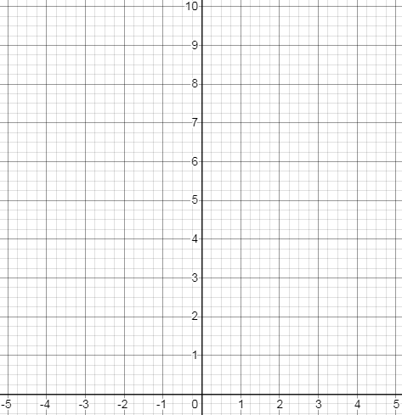
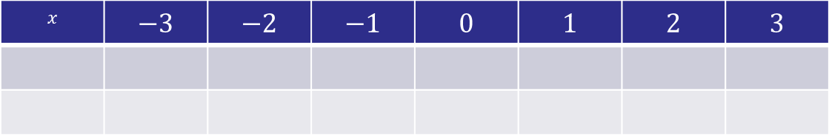
$$x$$ | $$−3$$ | $$−2$$ | $$−1$$ | $$0$$ | $$1$$ | $$2$$ | $$3$$
Notes:
Print out these axes and put in plastic wallets

Slide 2
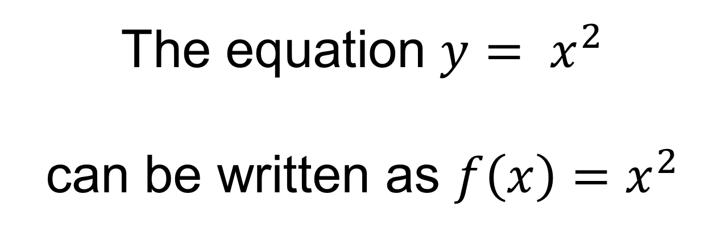
The equation $y= x^{2}$ can be written as $f\left(x\right)=x^{2}$
$f\left(x\right)$ means the function$f$, where $x$ is the input

Slide 3
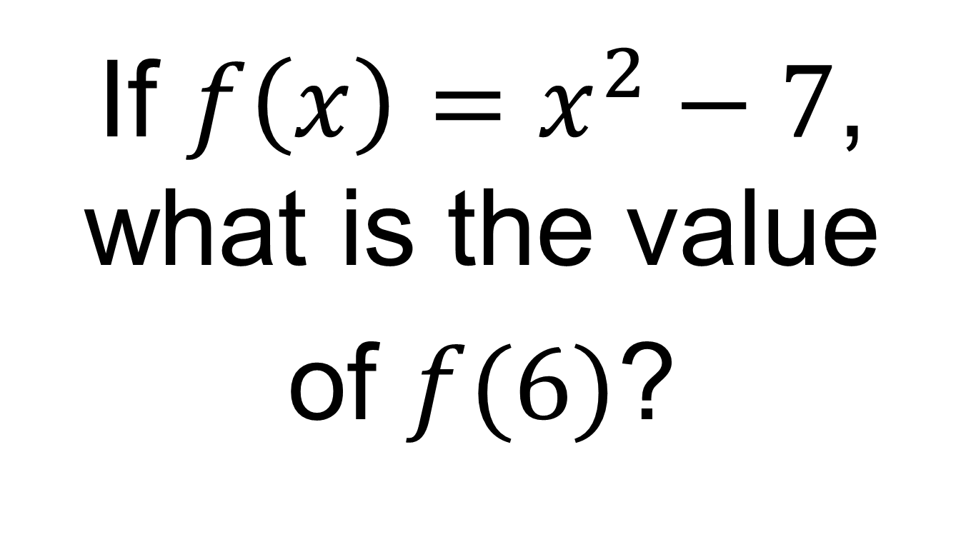
On your whiteboards:
If $f\left(x\right)=x^{2}−7$, what is the value
of $f(6)$?

Slide 4
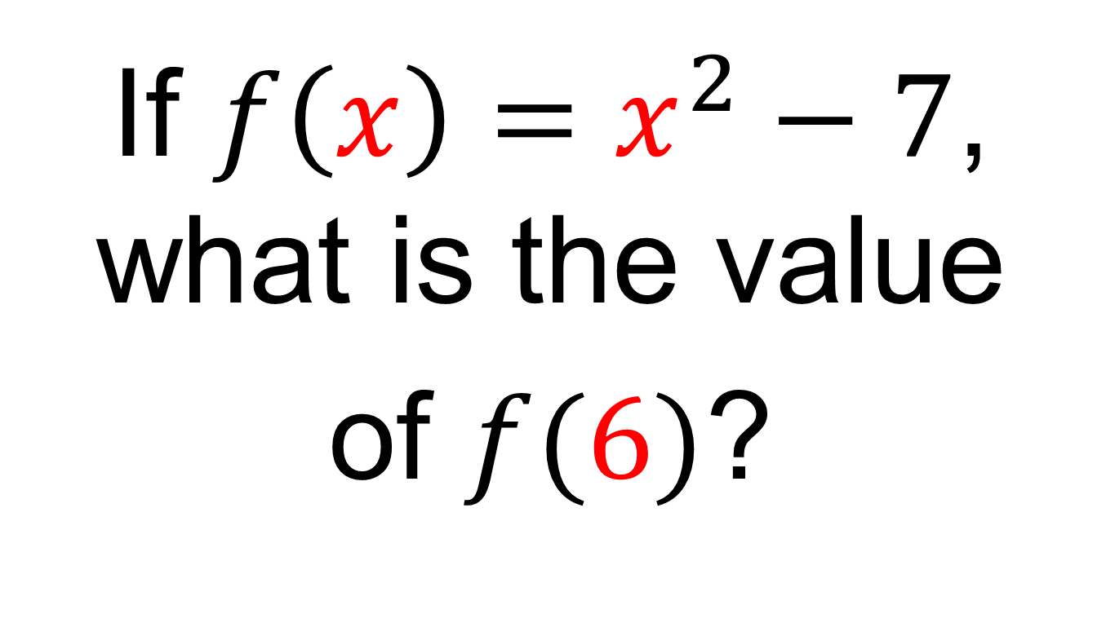
On your whiteboards:
If $f\left(x\right)=x^{2}−7$, what is the value
of $f(6)$?

Slide 5
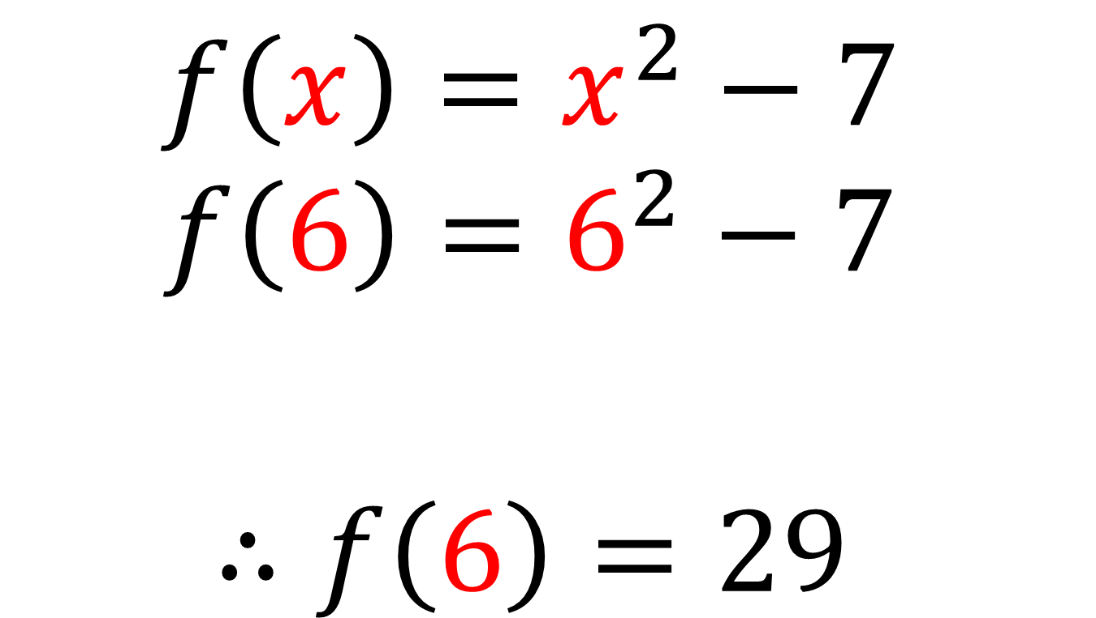
$$f\left(x\right)=x^{2}−7$$
$$f\left(6\right)=6^{2}−7$$
$$∴f\left(6\right)=29$$

Slide 6
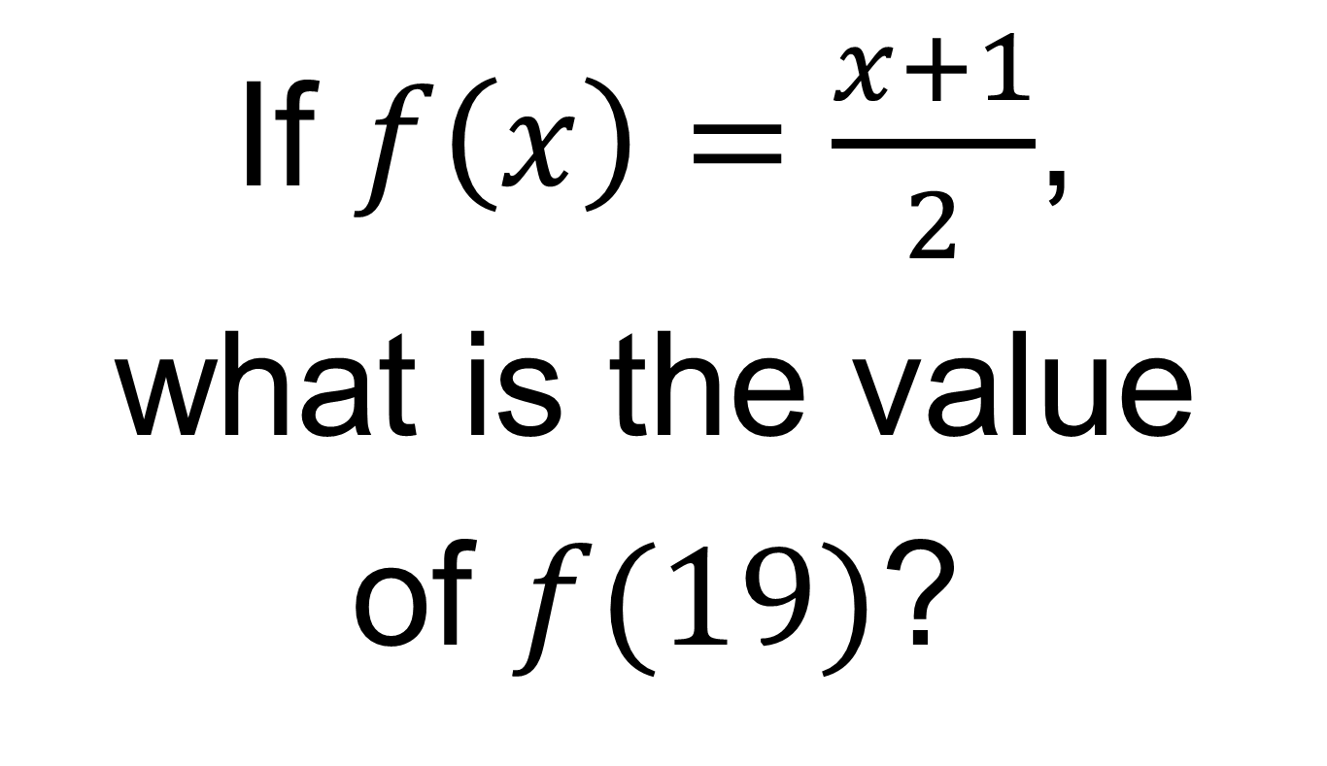
On your whiteboards:
If $f\left(x\right)=\frac{x+1}{2}$,
what is the value
of $f(19)$?

Slide 7
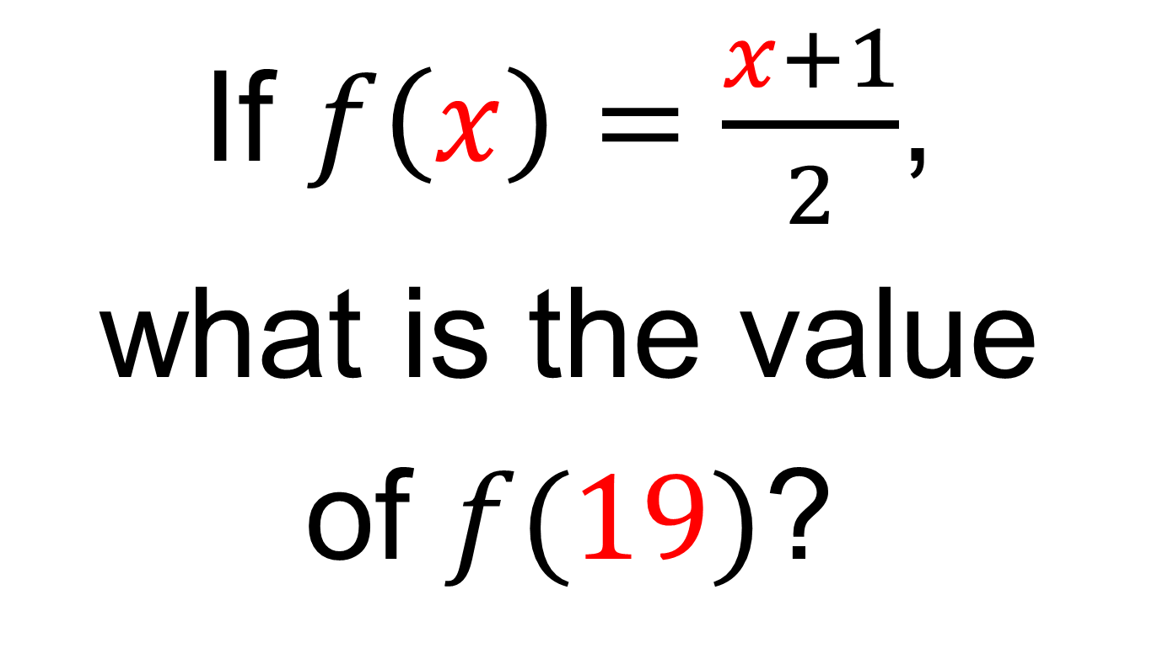
On your whiteboards:
If $f\left(x\right)=\frac{x+1}{2}$,
what is the value
of $f(19)$?

Slide 8
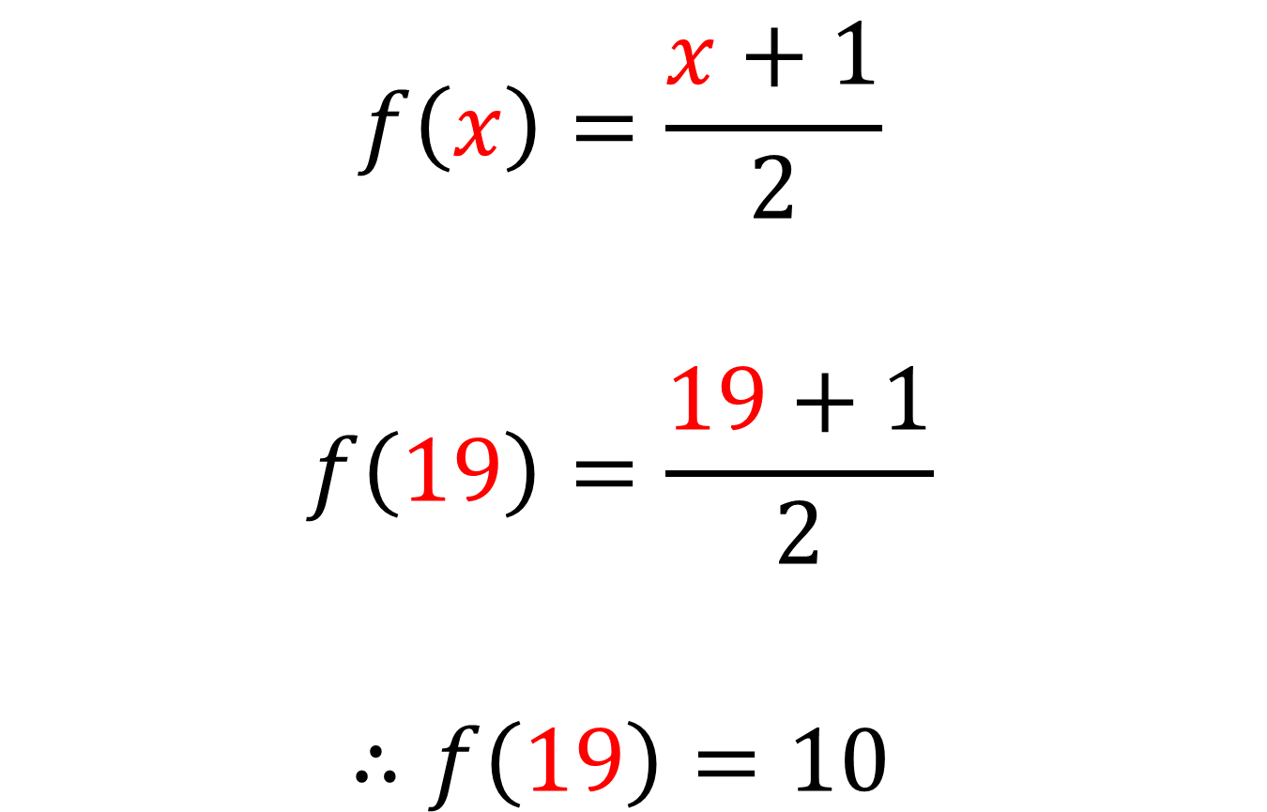
$$f\left(x\right)=\frac{x+1}{2}$$
$$f\left(19\right)=\frac{19+1}{2}$$
$$∴f\left(19\right)=10$$

Slide 9
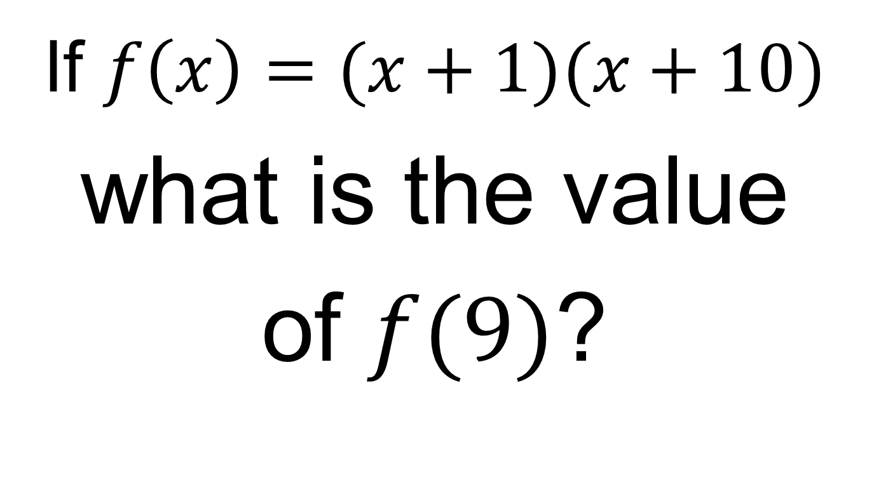
On your whiteboards:
If $f\left(x\right)=(x+1)(x+10)$
what is the value
of $f(9)$?

Slide 10
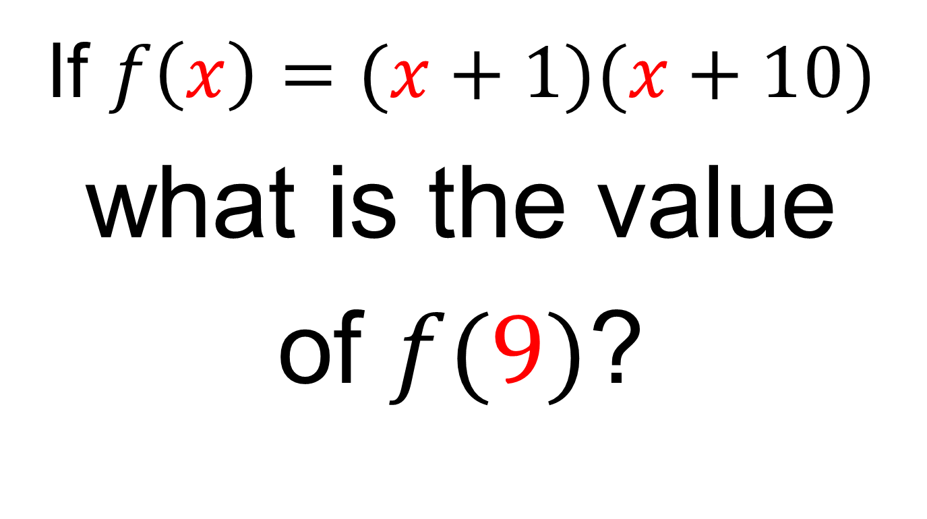
On your whiteboards:
If $f\left(x\right)=(x+1)(x+10)$
what is the value
of $f(9)$?

Slide 11
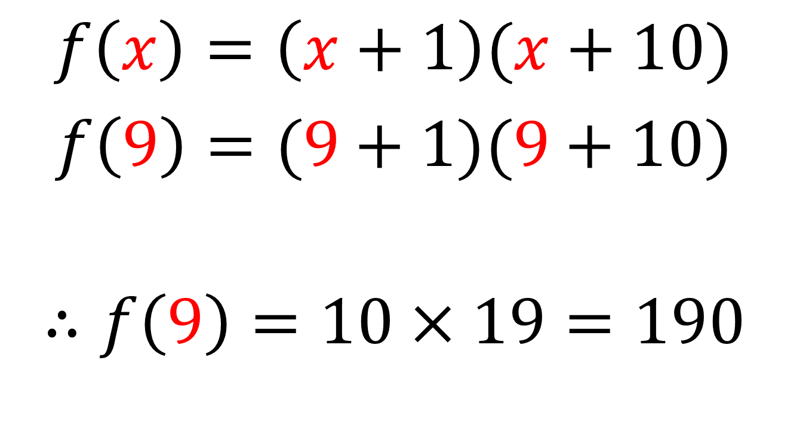
$f\left(x\right)=\left(x+1\right)(x+10)$
$f\left(9\right)=(9+1)(9+10)$
$$∴f\left(9\right)=10×19=190$$

Slide 12
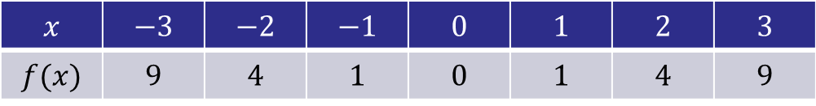
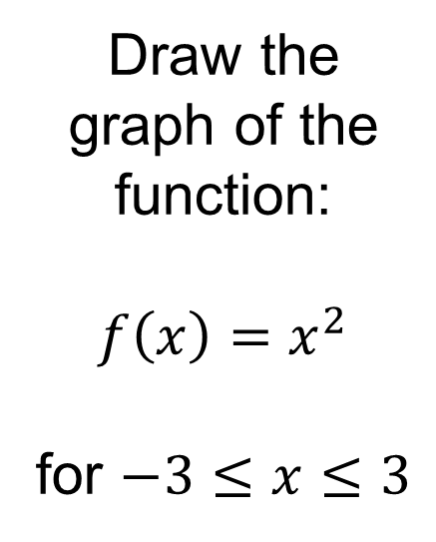
Draw the graph of the function:
$$f\left(x\right)=x^{2}$$
for $−3≤x≤3$
Do not rub out your graph!
$$x$$ | $$−3$$ | $$−2$$ | $$−1$$ | $$0$$ | $$1$$ | $$2$$ | $$3$$
$$f(x)$$ | $$9$$ | $$4$$ | $$1$$ | $$0$$ | $$1$$ | $$4$$ | $$9$$

Slide 13
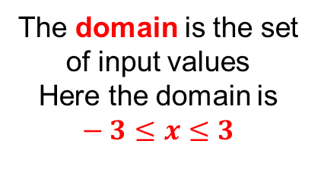
Draw the graph of the function:
$$f\left(x\right)=x^{2}$$
for $−3≤x≤3$
The domain is the set of input values
Here the domain is $−3≤x≤3$
$$x$$ | $$−3$$ | $$−2$$ | $$−1$$ | $$0$$ | $$1$$ | $$2$$ | $$3$$
$$f(x)$$ | $$9$$ | $$4$$ | $$1$$ | $$0$$ | $$1$$ | $$4$$ | $$9$$

Slide 14
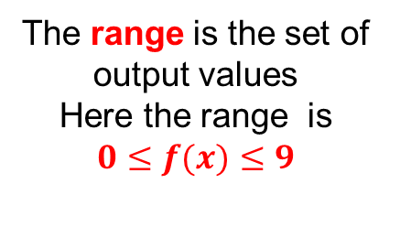
Draw the graph of the function:
$$f\left(x\right)=x^{2}$$
for $−3≤x≤3$
The range is the set of output values
Here the range is $0≤f(x)≤9$
$$x$$ | $$−3$$ | $$−2$$ | $$−1$$ | $$0$$ | $$1$$ | $$2$$ | $$3$$
$$f(x)$$ | $$9$$ | $$4$$ | $$1$$ | $$0$$ | $$1$$ | $$4$$ | $$9$$

Slide 15
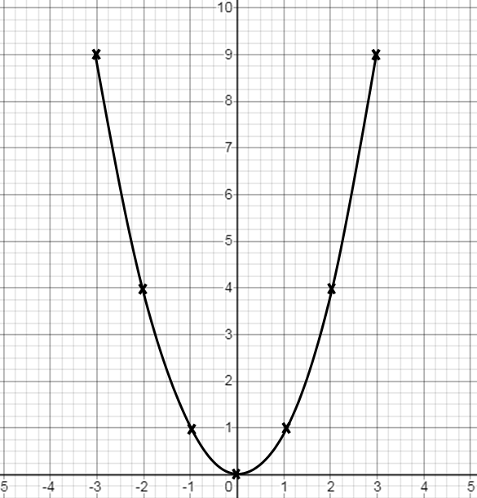
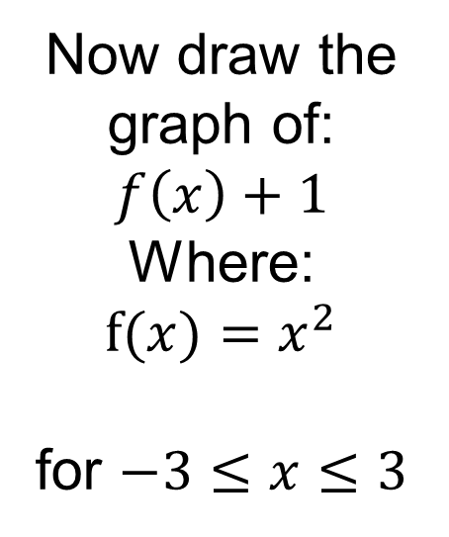
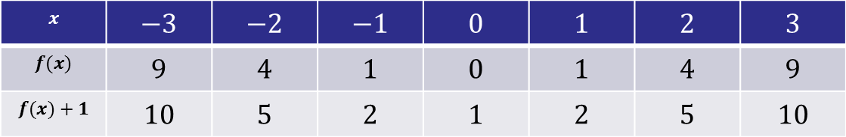
Now draw the graph of:
$$f\left(x\right)+1$$
Where:
$$f(x)=x^{2}$$
for $−3≤x≤3$
$$x$$ | $$−3$$ | $$−2$$ | $$−1$$ | $$0$$ | $$1$$ | $$2$$ | $$3$$
$$f(x)$$ | $$9$$ | $$4$$ | $$1$$ | $$0$$ | $$1$$ | $$4$$ | $$9$$
$$f(x)+1$$ | $$10$$ | $$5$$ | $$2$$ | $$1$$ | $$2$$ | $$5$$ | $$10$$

Slide 16
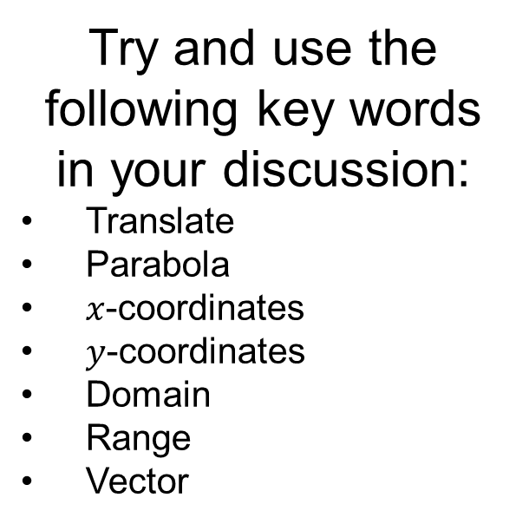
What do you notice?
Try and use the following key words in your discussion:
Translate
Parabola
$x$-coordinates
$y$-coordinates
Domain
Range
Vector
$$x$$ | $$−3$$ | $$−2$$ | $$−1$$ | $$0$$ | $$1$$ | $$2$$ | $$3$$
$$f(x)$$ | $$9$$ | $$4$$ | $$1$$ | $$0$$ | $$1$$ | $$4$$ | $$9$$
$$f(x)+1$$ | $$10$$ | $$5$$ | $$2$$ | $$1$$ | $$2$$ | $$5$$ | $$10$$

Slide 17

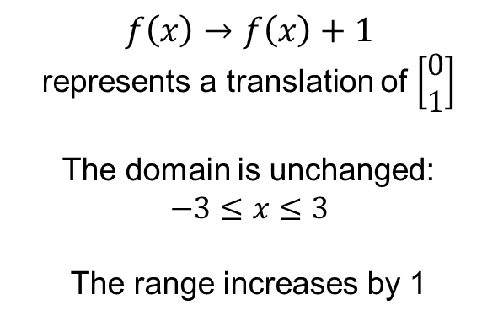
$$f\left(x\right)→f\left(x\right)+1$$
represents a translation of $\left[\begin{matrix}0 \\ 1\end{matrix}\right]$
The domain is unchanged:
$$−3≤x≤3$$
The range increases by 1
$$1≤f\left(x\right)+1≤10$$
$$x$$ | $$−3$$ | $$−2$$ | $$−1$$ | $$0$$ | $$1$$ | $$2$$ | $$3$$
$$f(x)$$ | $$9$$ | $$4$$ | $$1$$ | $$0$$ | $$1$$ | $$4$$ | $$9$$
$$f(x)+1$$ | $$10$$ | $$5$$ | $$2$$ | $$1$$ | $$2$$ | $$5$$ | $$10$$

Slide 18
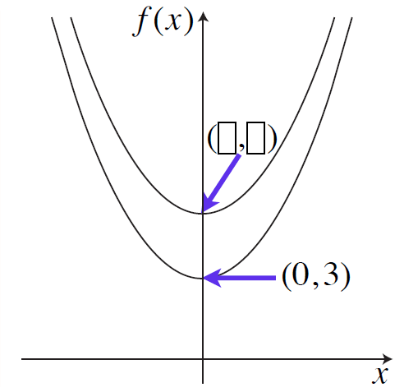
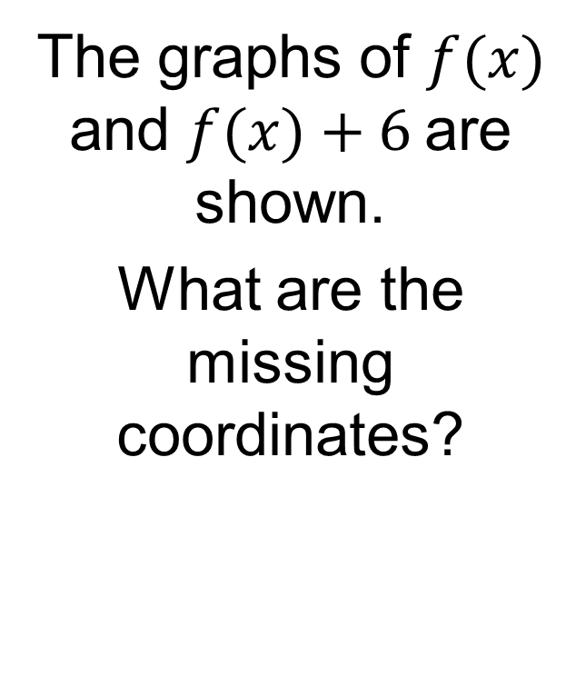

On your whiteboards:
The graphs of $f(x)$ and $f(x)+6$are shown.
What are the missing coordinates?
$$(0, 9)$$

Slide 19
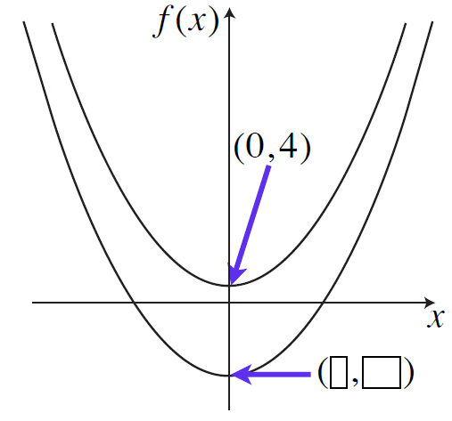
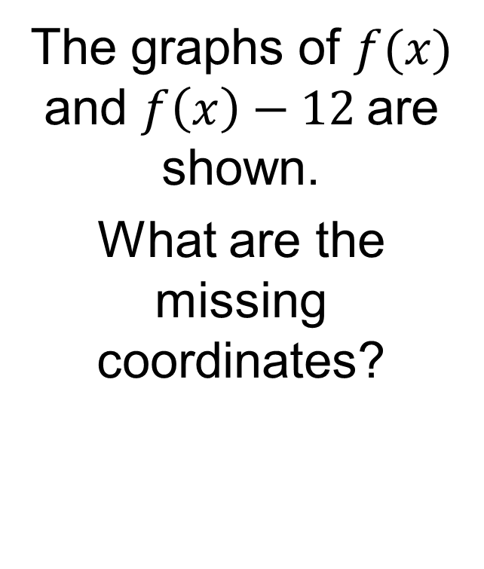

On your whiteboards:
The graphs of $f(x)$ and $f\left(x\right)−12$are shown.
What are the missing coordinates?
$$(0, −8)$$

Slide 20
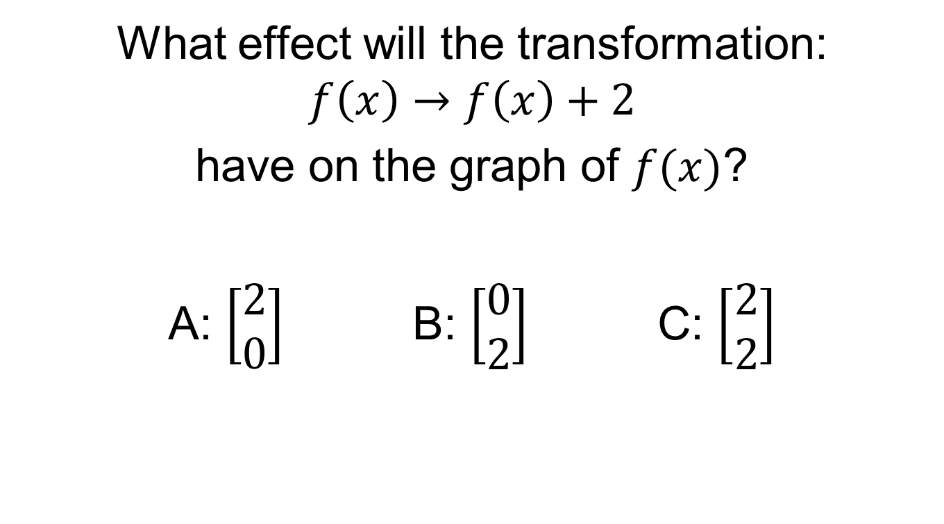
On your whiteboards:
What effect will the transformation:
$$f\left(x\right)→f\left(x\right)+2$$
have on the graph of $f(x)$?
A: $\left[\begin{matrix}2 \\ 0\end{matrix}\right]$ B: $\left[\begin{matrix}0 \\ 2\end{matrix}\right]$ C: $\left[\begin{matrix}2 \\ 2\end{matrix}\right]$

Slide 21
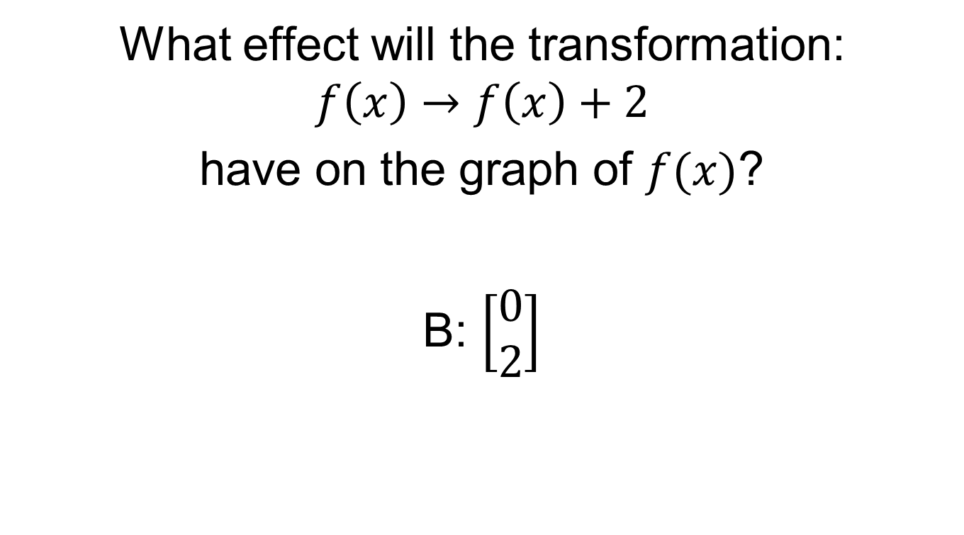
On your whiteboards:
What effect will the transformation:
$$f\left(x\right)→f\left(x\right)+2$$
have on the graph of $f(x)$?
B: $\left[\begin{matrix}0 \\ 2\end{matrix}\right]$

Slide 22
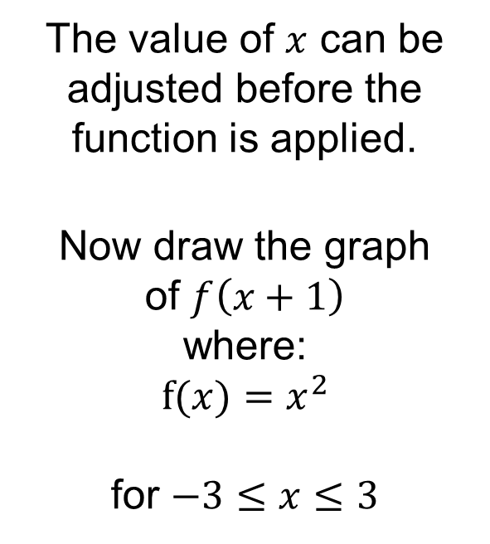
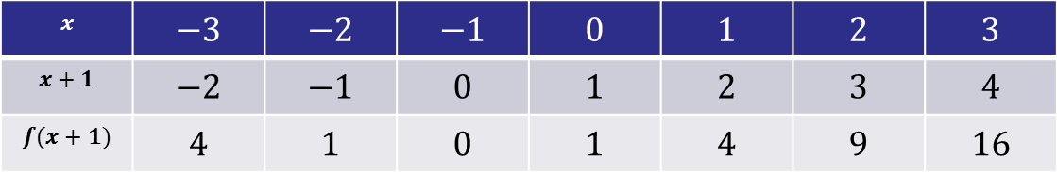
00
The value of $x$ can be adjusted before the function is applied.
Now draw the graph
of $f\left(x+1\right)$
where:
$$f(x)=x^{2}$$
for $−3≤x≤3$
$$x$$ | $$−3$$ | $$−2$$ | $$−1$$ | $$0$$ | $$1$$ | $$2$$ | $$3$$
$$x+1$$ | $$−2$$ | $$−1$$ | $$0$$ | $$1$$ | $$2$$ | $$3$$ | $$4$$
$$f(x+1)$$ | $$4$$ | $$1$$ | $$0$$ | $$1$$ | $$4$$ | $$9$$ | $$16$$

Slide 23
00
What do you notice?
Try and use the following key words in your discussion:
Translate
Parabola
$x$-coordinates
$y$-coordinates
Domain
Range
Vector
$$x$$ | $$−3$$ | $$−2$$ | $$−1$$ | $$0$$ | $$1$$ | $$2$$ | $$3$$
$$x+1$$ | $$−2$$ | $$−1$$ | $$0$$ | $$1$$ | $$2$$ | $$3$$ | $$4$$
$$f(x+1)$$ | $$4$$ | $$1$$ | $$0$$ | $$1$$ | $$4$$ | $$9$$ | $$16$$

Slide 24
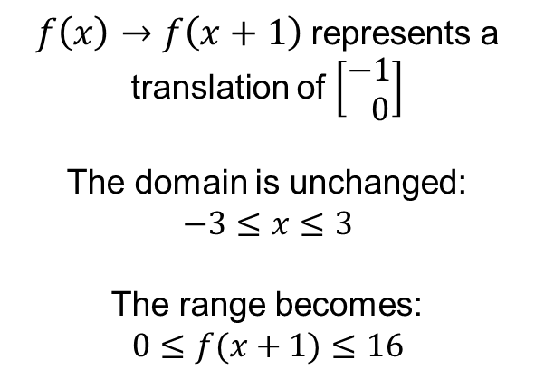
00
$f\left(x\right)→f\left(x+1\right)$represents a translation of $\left[\begin{matrix}−1 \\ 0\end{matrix}\right]$
The domain is unchanged:
$$−3≤x≤3$$
The range becomes:
$$0≤f(x+1)≤16$$
$$x$$ | $$−3$$ | $$−2$$ | $$−1$$ | $$0$$ | $$1$$ | $$2$$ | $$3$$
$$x+1$$ | $$−2$$ | $$−1$$ | $$0$$ | $$1$$ | $$2$$ | $$3$$ | $$4$$
$$f(x+1)$$ | $$4$$ | $$1$$ | $$0$$ | $$1$$ | $$4$$ | $$9$$ | $$16$$

Slide 25
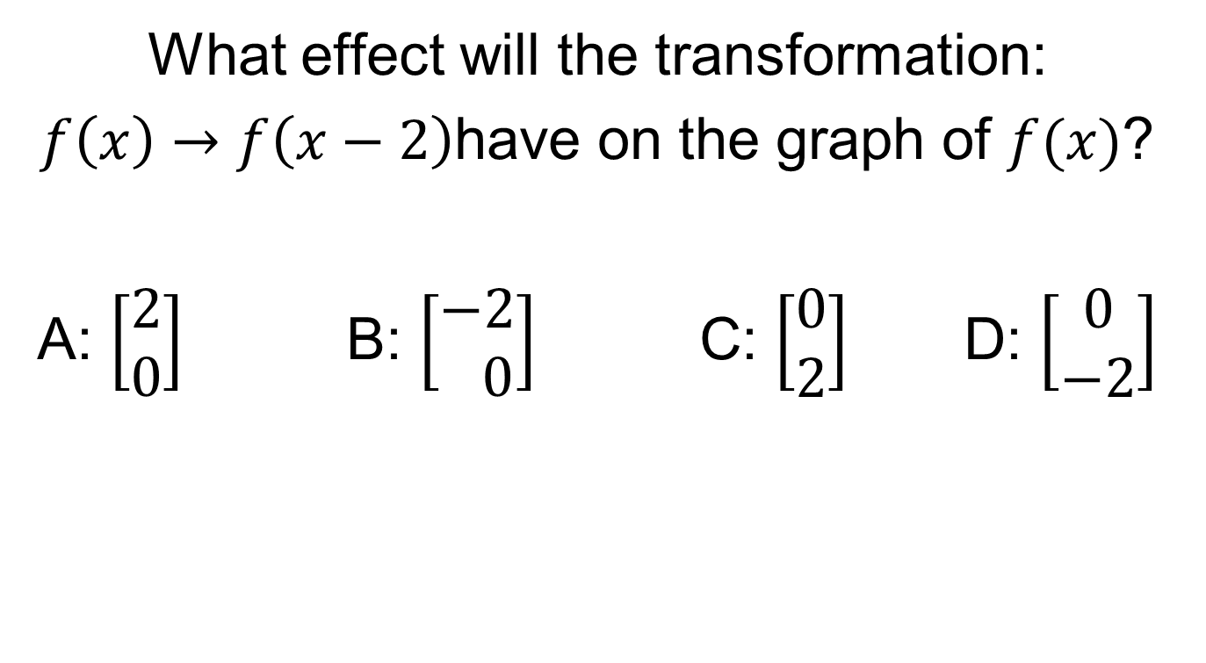
On your whiteboards:
What effect will the transformation:
$f\left(x\right)→f\left(x−2\right)$have on the graph of $f(x)$?
A: $\left[\begin{matrix}2 \\ 0\end{matrix}\right]$ B: $\left[\begin{matrix}−2 \\ 0\end{matrix}\right]$ C: $\left[\begin{matrix}0 \\ 2\end{matrix}\right]$ D: $\left[\begin{matrix}0 \\ −2\end{matrix}\right]$

Slide 26
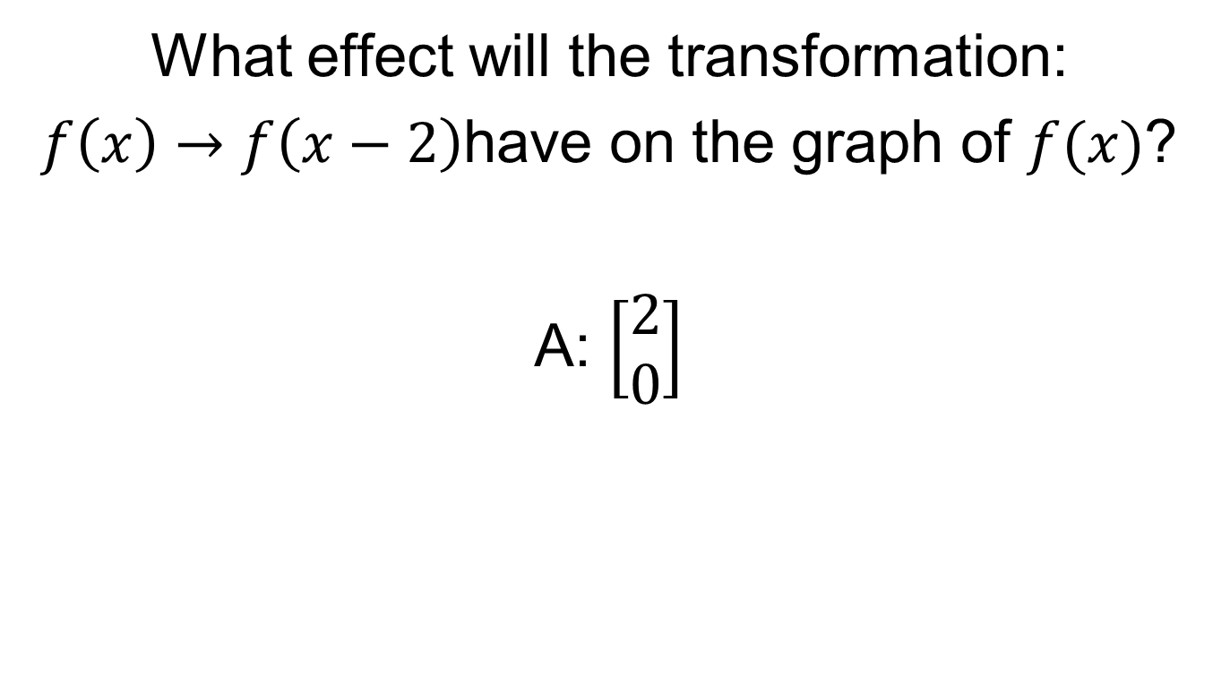
On your whiteboards:
What effect will the transformation:
$f\left(x\right)→f\left(x−2\right)$have on the graph of $f(x)$?
A: $\left[\begin{matrix}2 \\ 0\end{matrix}\right]$

Slide 27
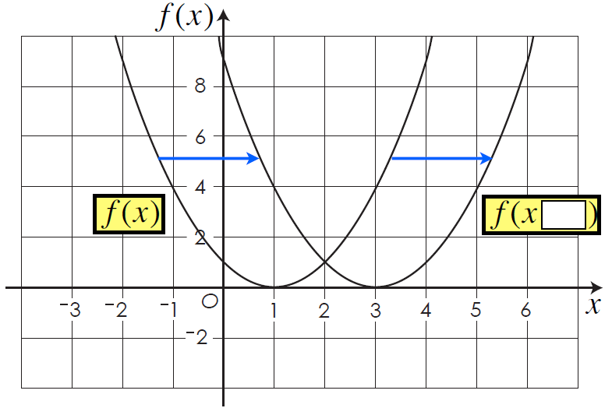


On your whiteboards:
Fill in the box to match the transformation shown.
$$(0, 9)$$
$$−2$$

Slide 28
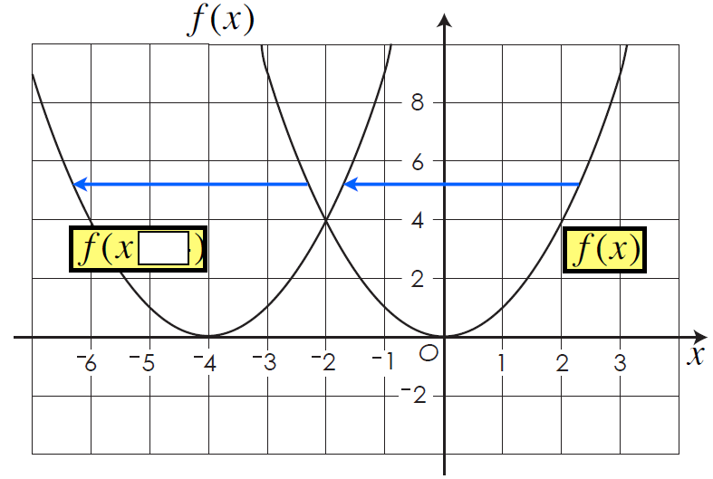

On your whiteboards:
Fill in the box to match the transformation shown.
$$+4$$
$$(0, 9)$$
$$−2$$

Slide 29
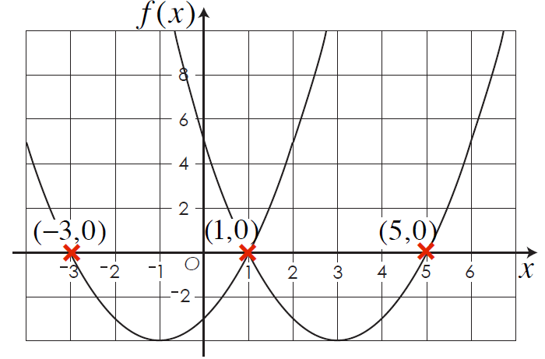
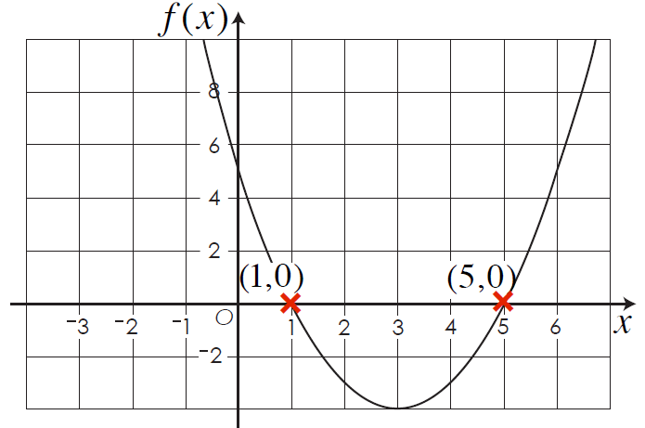
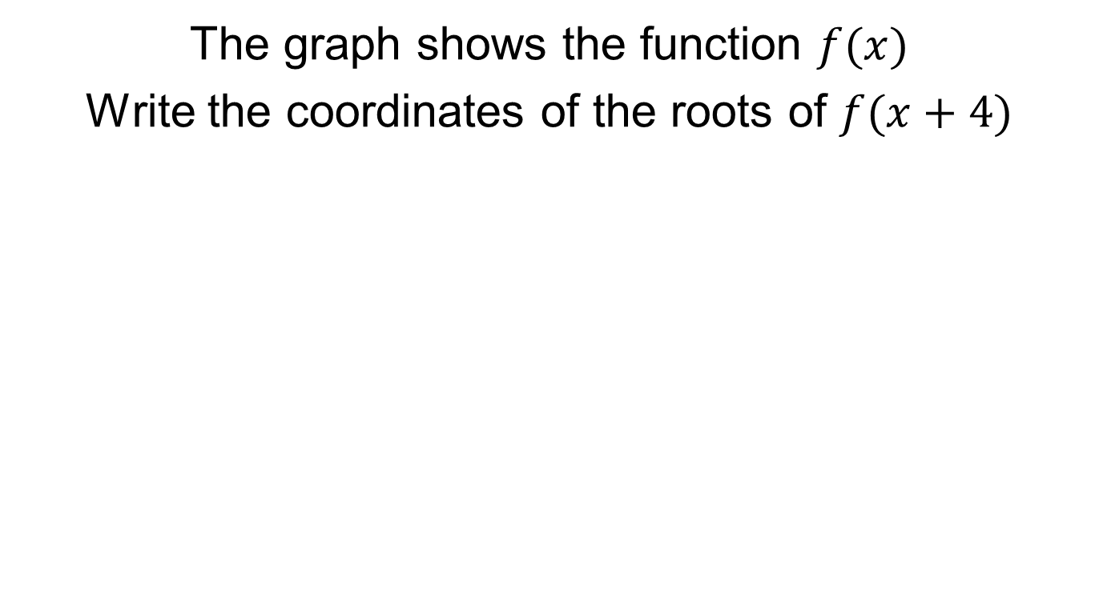
On your whiteboards:
The graph shows the function $f(x)$
Write the coordinates of the roots of $f(x+4)$

Slide 30
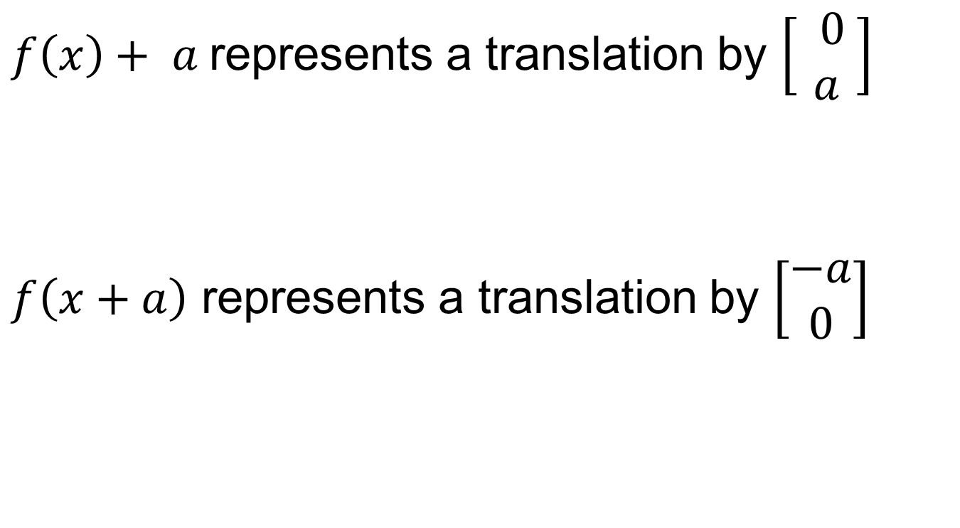
Title: Translating Functions
$f\left(x\right)+ a$represents a translation by $\left[\begin{matrix} 0 \\ a \end{matrix}\right]$
$f\left(x+a\right)$ represents a translation by $\left[\begin{matrix}−a \\ 0\end{matrix}\right]$

Slide 31
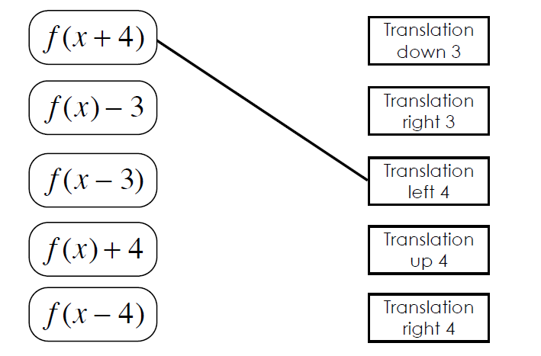
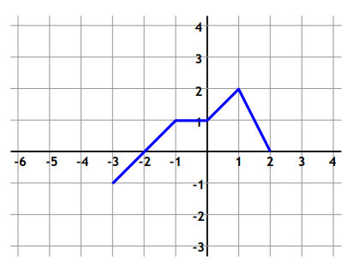
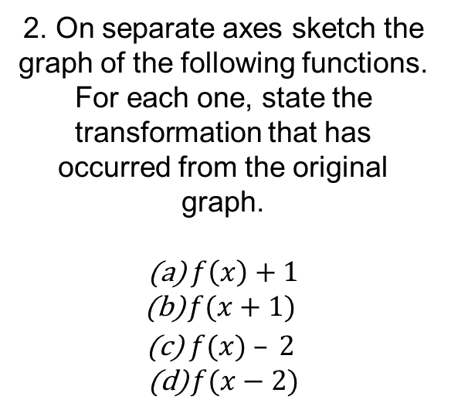
Match the transformations to the descriptions.
The first one is done for you.
2. On separate axes sketch the graph of the following functions. For each one, state the transformation that has occurred from the original graph.
$f\left(x\right)+1$
$f(x+1)$
$f(x) – 2$
$f(x−2)$

Slide 32
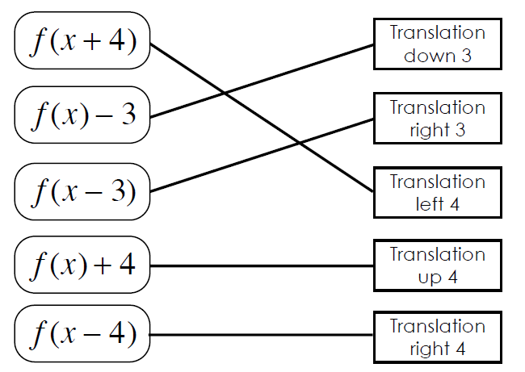
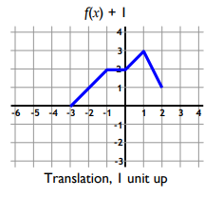
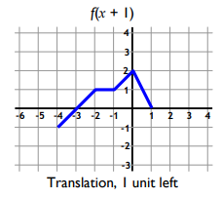
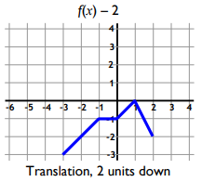
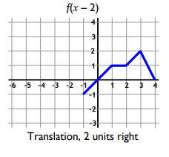
Mark your work

