Slide 1
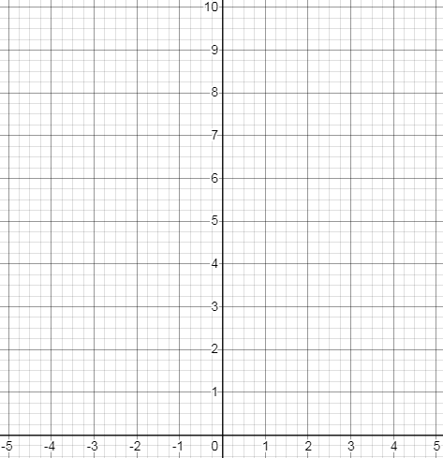
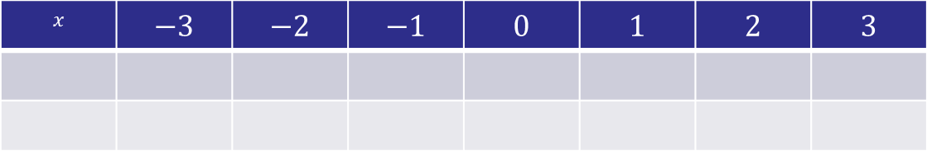
$$x$$ | $$−3$$ | $$−2$$ | $$−1$$ | $$0$$ | $$1$$ | $$2$$ | $$3$$
Notes:
Print out these axes and put in plastic wallets (using these from the previous lesson)

Slide 2
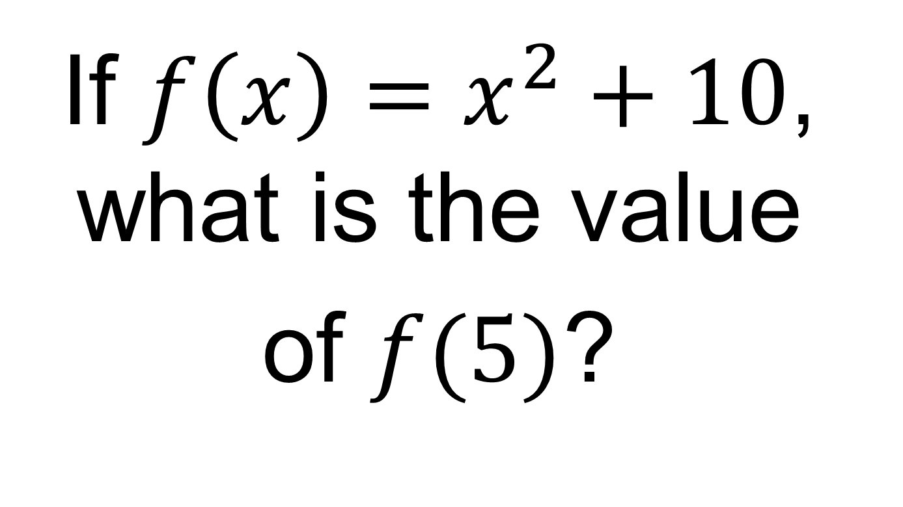
On your whiteboards:
If $f\left(x\right)=x^{2}+10$, what is the value
of $f(5)$?

Slide 3
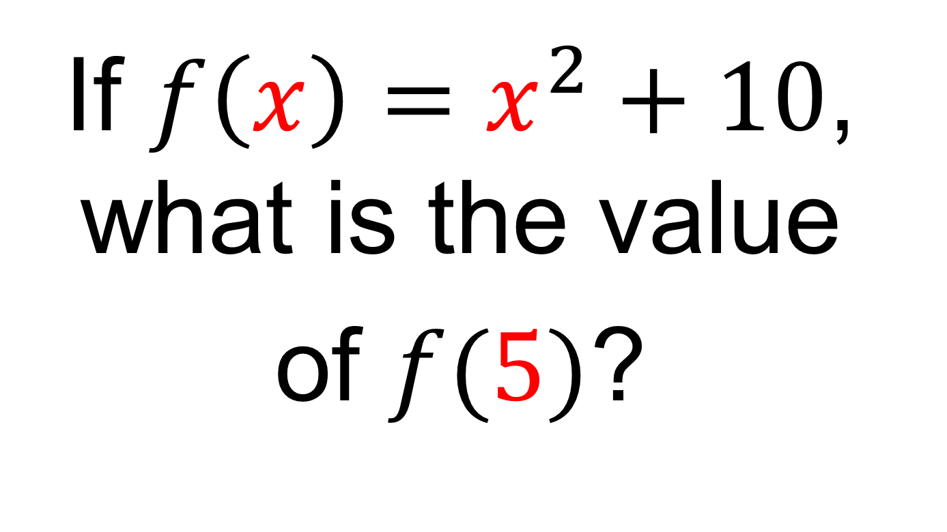
On your whiteboards:
If $f\left(x\right)=x^{2}+10$, what is the value
of $f(5)$?

Slide 4
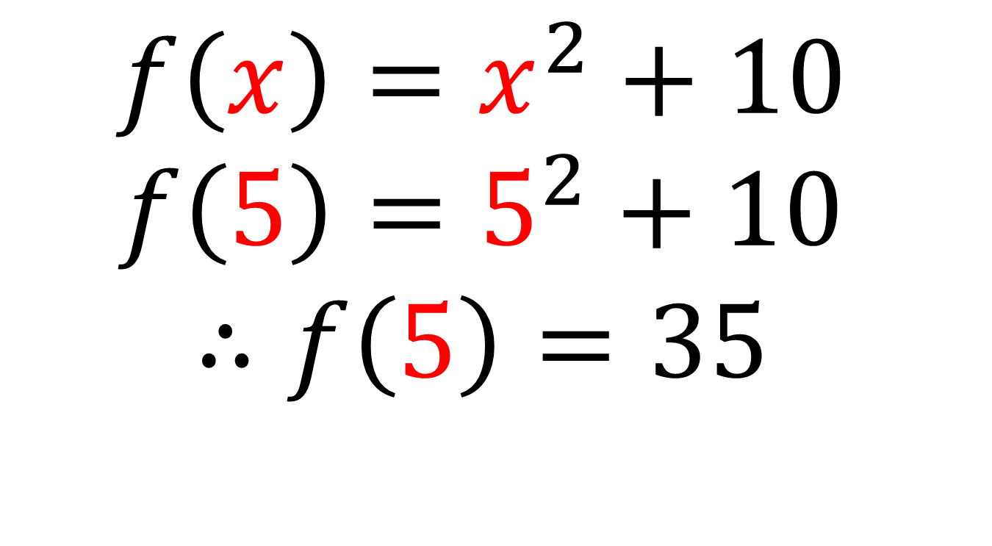
$$f\left(x\right)=x^{2}+10$$
$$f\left(5\right)=5^{2}+10$$
$$∴f\left(5\right)=35$$

Slide 5
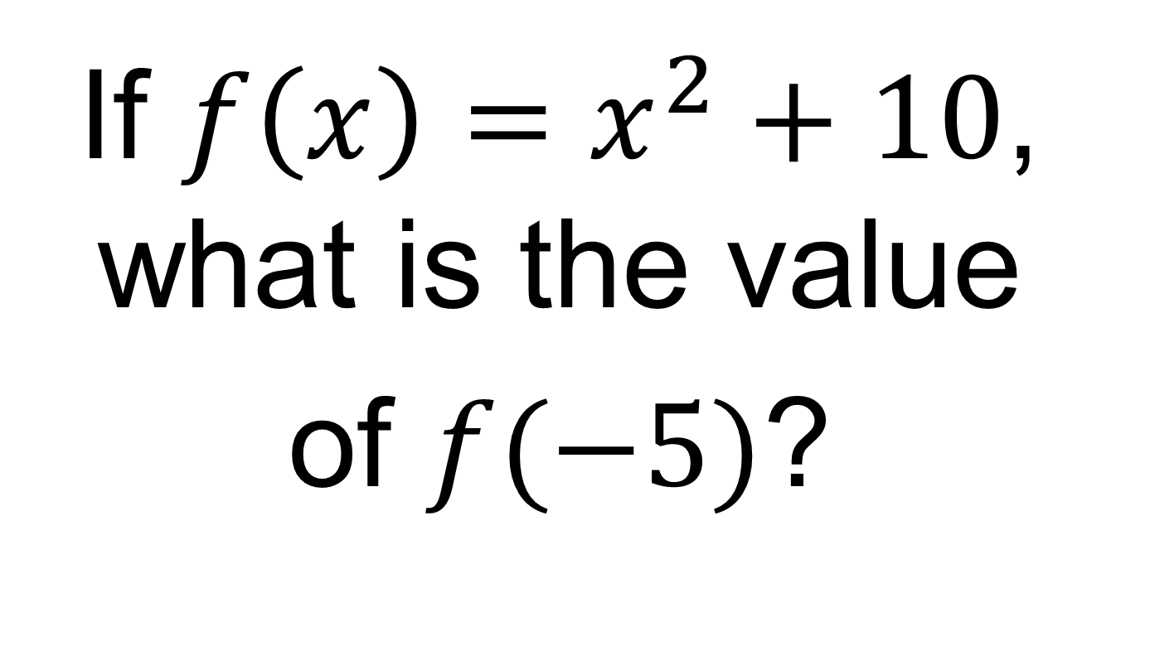
On your whiteboards:
If $f\left(x\right)=x^{2}+10$, what is the value
of $f(−5)$?

Slide 6
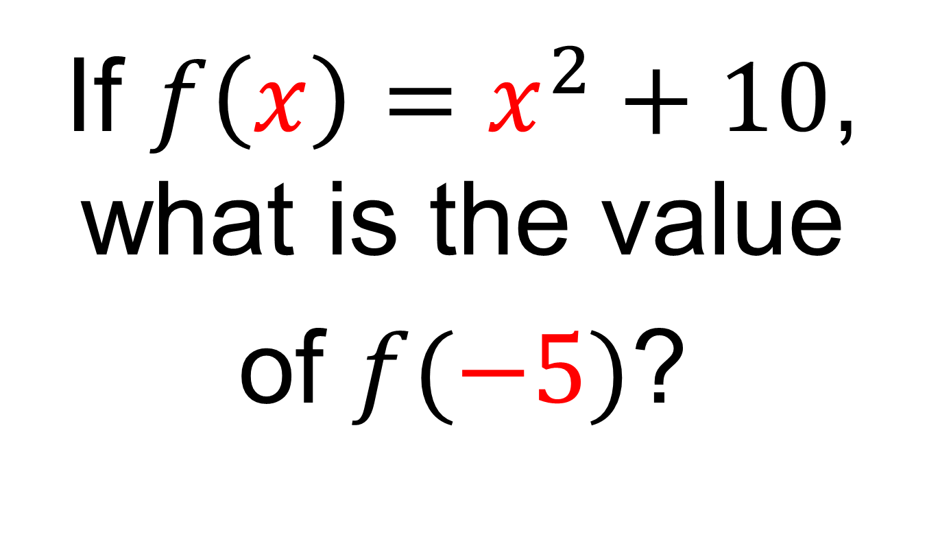
On your whiteboards:
If $f\left(x\right)=x^{2}+10$, what is the value
of $f(−5)$?

Slide 7
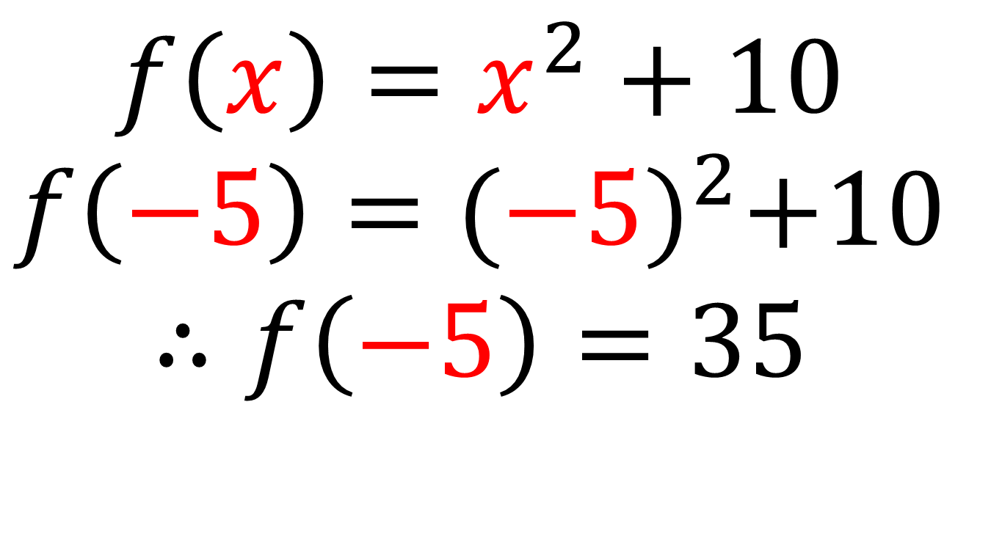
$$f\left(x\right)=x^{2}+10$$
$$f\left(−5\right)={(−5)}^{2}+10$$
$$∴f\left(−5\right)=35$$

Slide 8
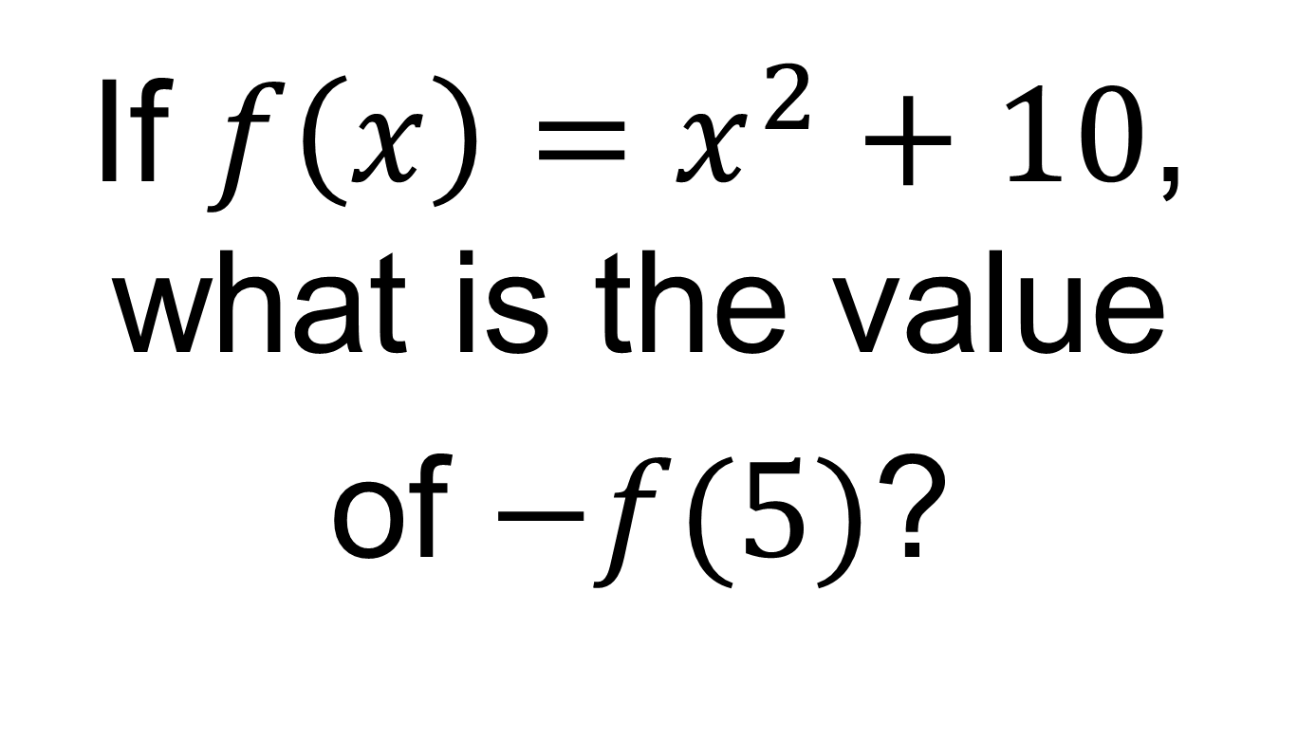
On your whiteboards:
If $f\left(x\right)=x^{2}+10$, what is the value
of $−f(5)$?

Slide 9
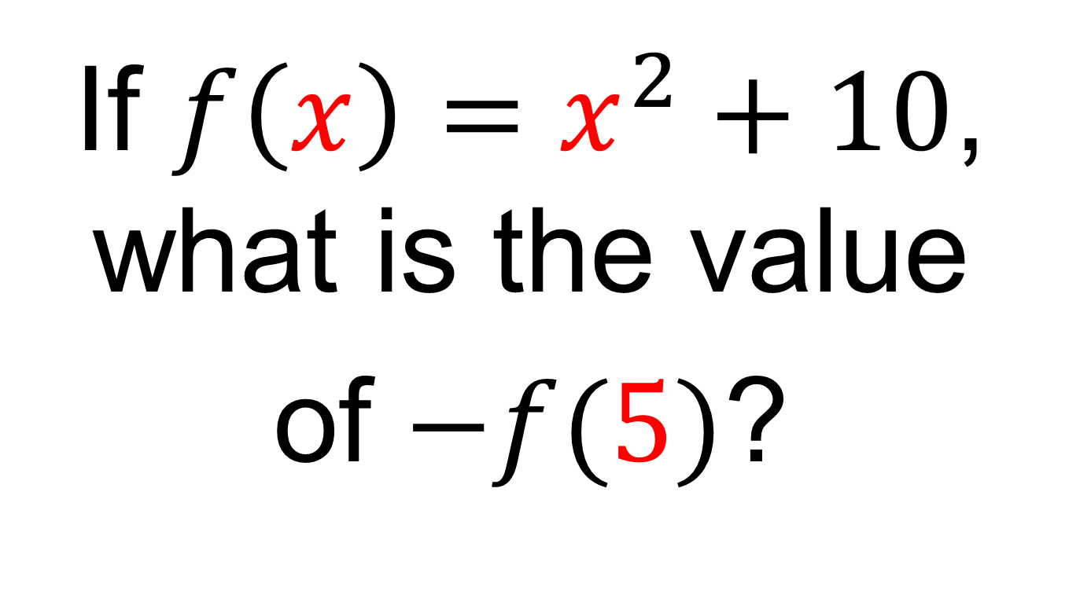
On your whiteboards:
If $f\left(x\right)=x^{2}+10$, what is the value
of $−f(5)$?

Slide 10
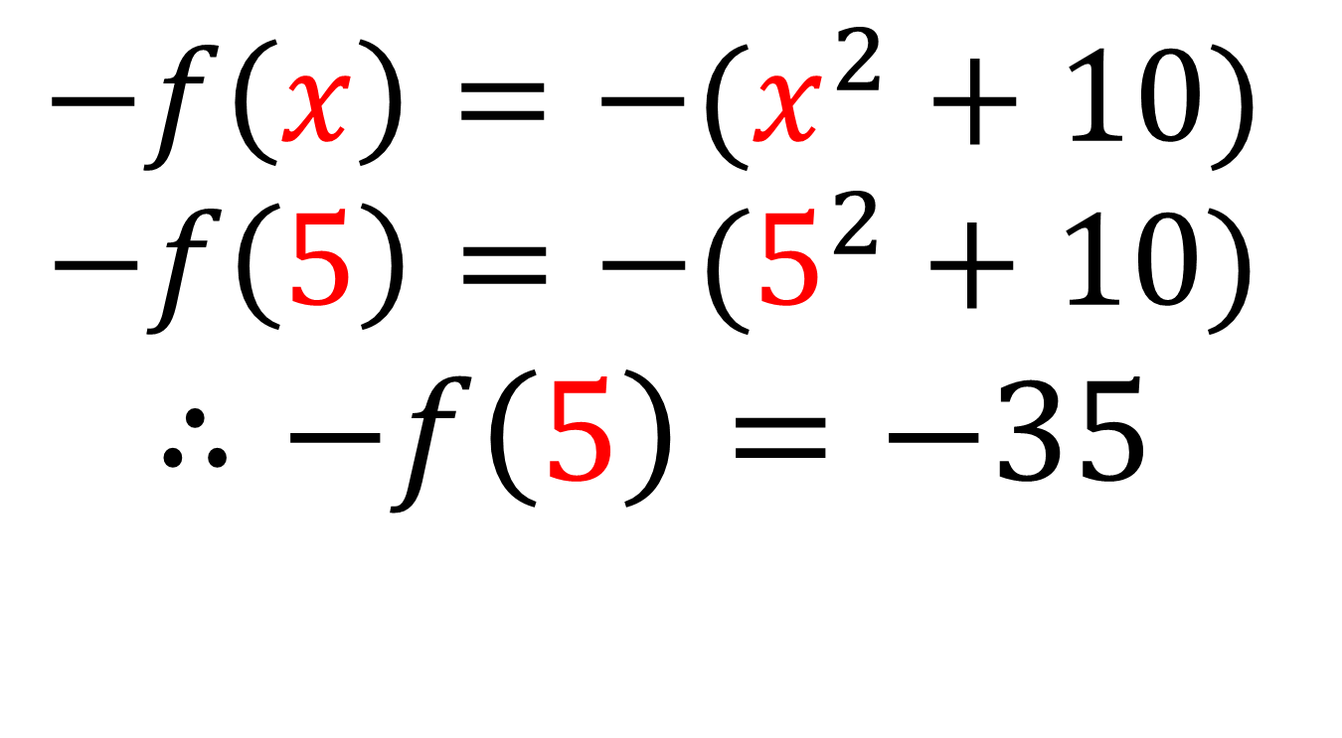
$$−f\left(x\right)=−(x^{2}+10)$$
$$−f\left(5\right)=−(5^{2}+10)$$
$$∴−f\left(5\right)=−35$$

Slide 11






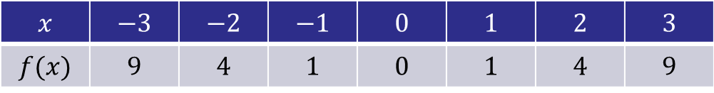

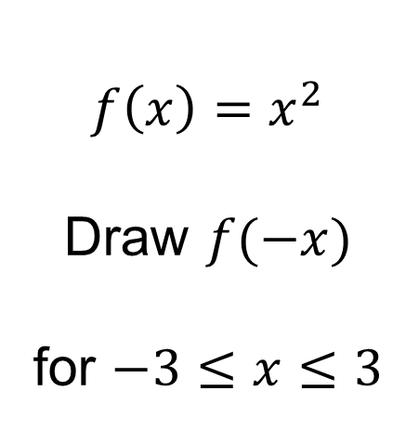

$$f\left(x\right)=x^{2}$$
Draw $f(−x)$
for $−3≤x≤3$
What do you notice?
$$x$$ | $$−3$$ | $$−2$$ | $$−1$$ | $$0$$ | $$1$$ | $$2$$ | $$3$$
$$f(x)$$ | $$9$$ | $$4$$ | $$1$$ | $$0$$ | $$1$$ | $$4$$ | $$9$$
$$−x$$
$$3$$
$$2$$
$$1$$
$$0$$
$$−1$$
$$−2$$
$$−3$$
?
?
?
?
?
?
?

Slide 12
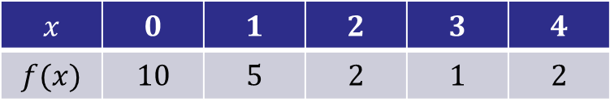
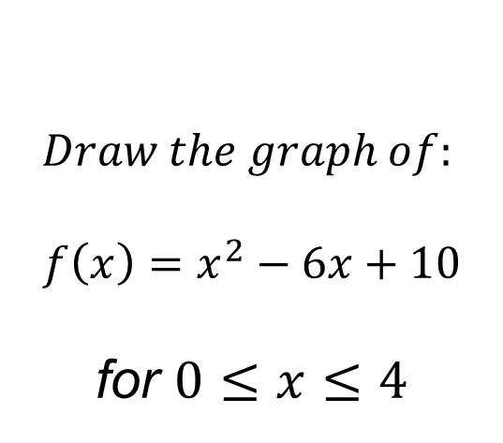
$$Draw the graph of:$$
$$f\left(x\right)=x^{2}−6x+10$$
for $0≤x≤4$
$$x$$ | $$0$$ | $$1$$ | $$2$$ | $$3$$ | $$4$$
$$f(x)$$ | $$10$$ | $$5$$ | $$2$$ | $$1$$ | $$2$$
?
?
?
?
?

Slide 13



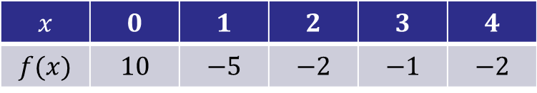

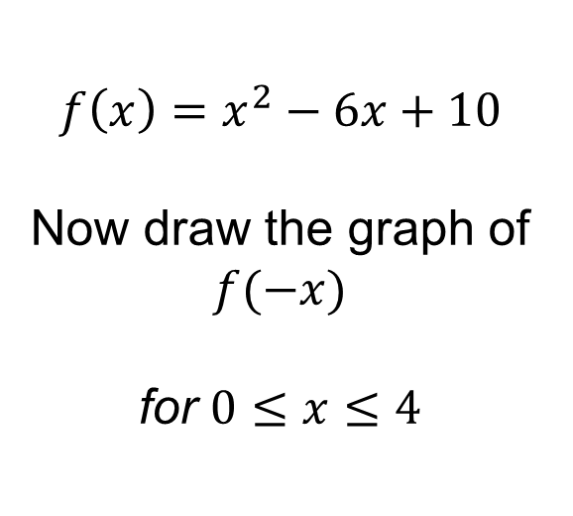

$$f\left(x\right)=x^{2}−6x+10$$
Now draw the graph of $f(−x)$
for $0≤x≤4$
What do you notice?
$$x$$ | $$0$$ | $$1$$ | $$2$$ | $$3$$ | $$4$$
$$f(x)$$ | $$10$$ | $$−5$$ | $$−2$$ | $$−1$$ | $$−2$$
$$−x$$
$$0$$
$$−1$$
$$−2$$
$$−3$$
$$−4$$
?
?
?
?
?

Slide 14
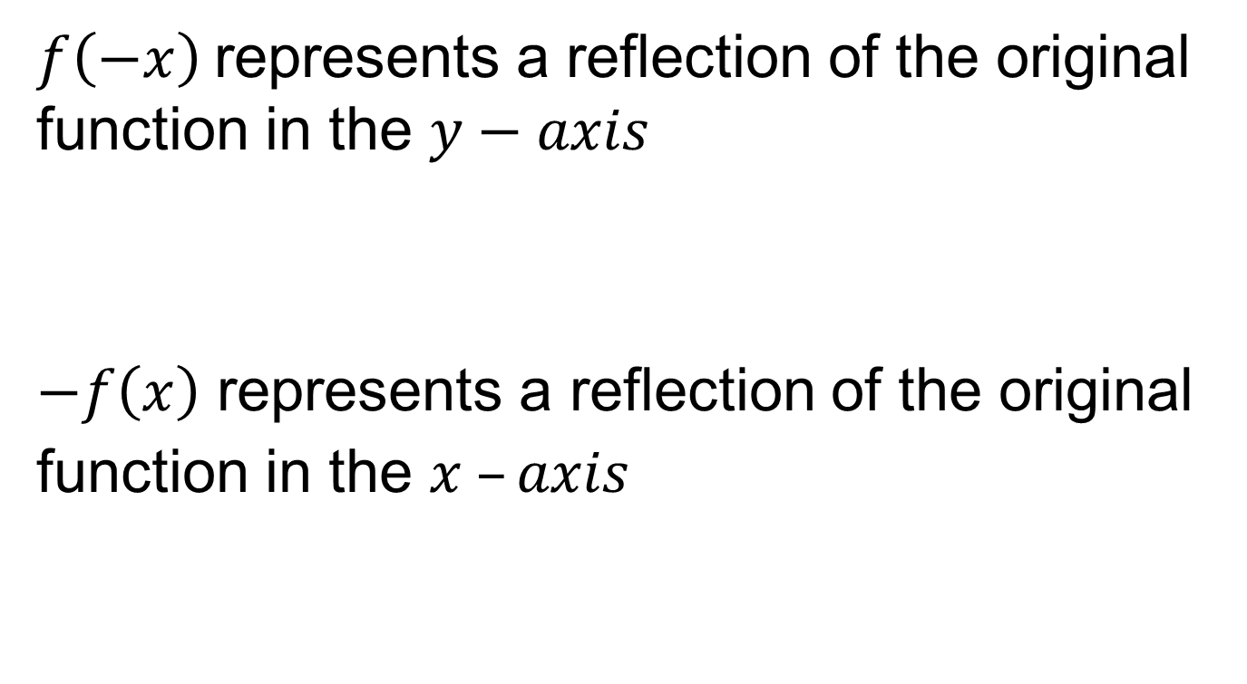
Title: Reflecting Functions
$f\left(−x\right)$represents a reflection of the original function in the $y−axis$
$−f\left(x\right)$ represents a reflection of the original function in the $x –axis$

Slide 15
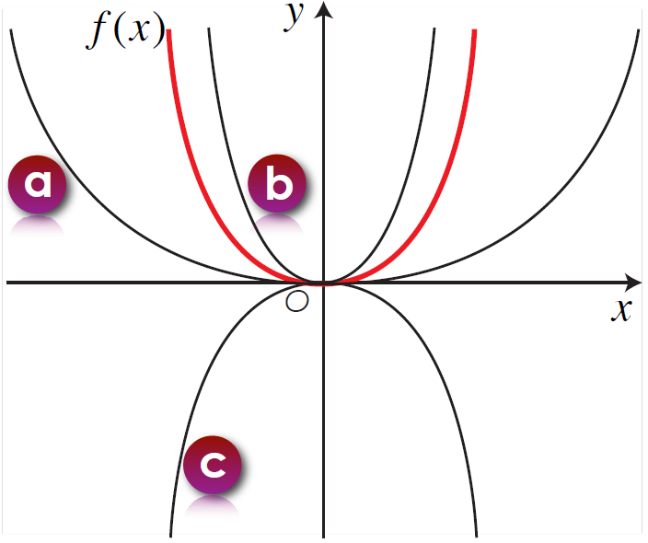
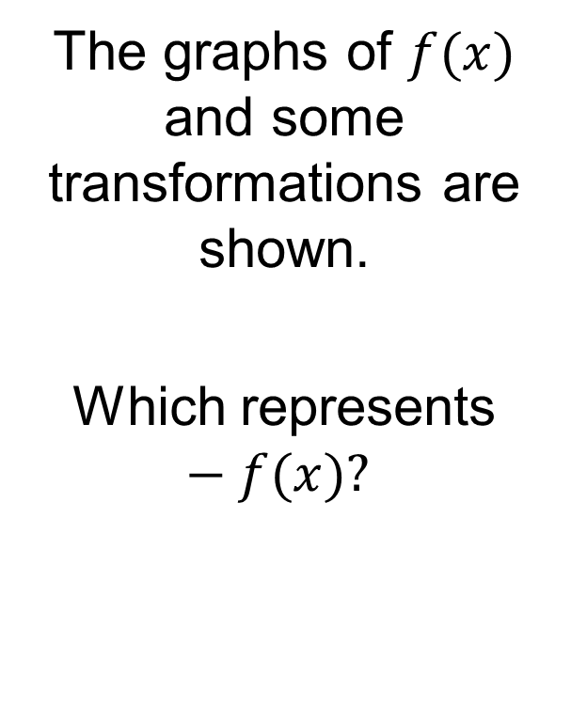
On your whiteboards:
The graphs of $f(x)$ and some transformations are shown.
Which represents $−f(x)?$

Slide 16
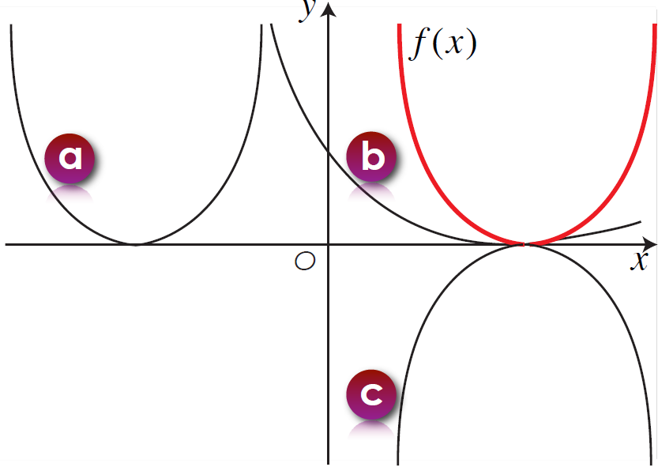
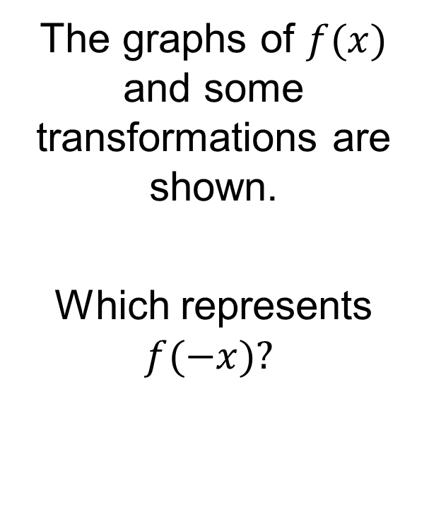
On your whiteboards:
The graphs of $f(x)$ and some transformations are shown.
Which represents $f(−x)?$

Slide 17
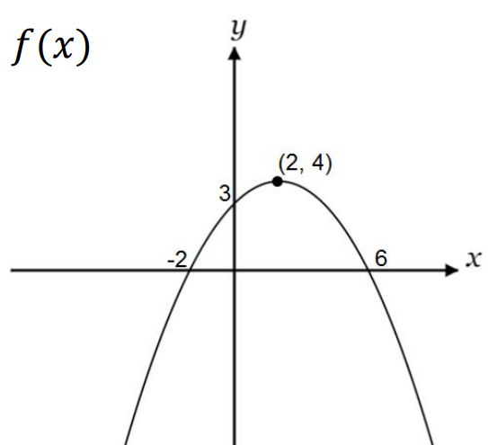
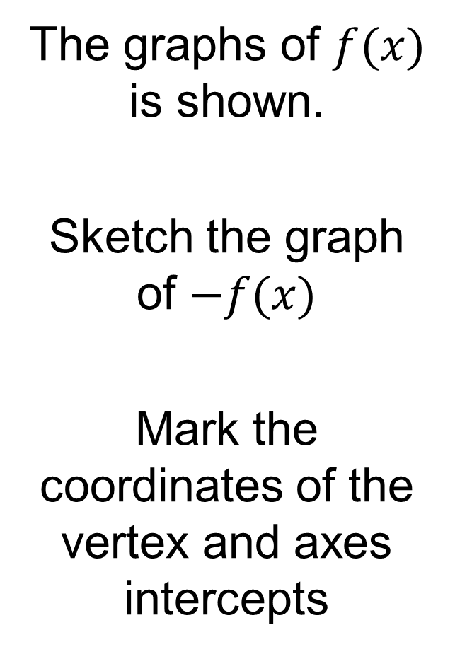
On your whiteboards:
The graphs of $f(x)$ is shown.
Sketch the graph of $−f(x)$
Mark the coordinates of the vertex and axes intercepts

Slide 18
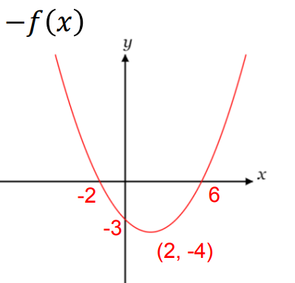
On your whiteboards:
The graphs of $f(x)$ is shown.
Sketch the graph of $−f(x)$
Mark the coordinates of the vertex and axes intercepts

Slide 19
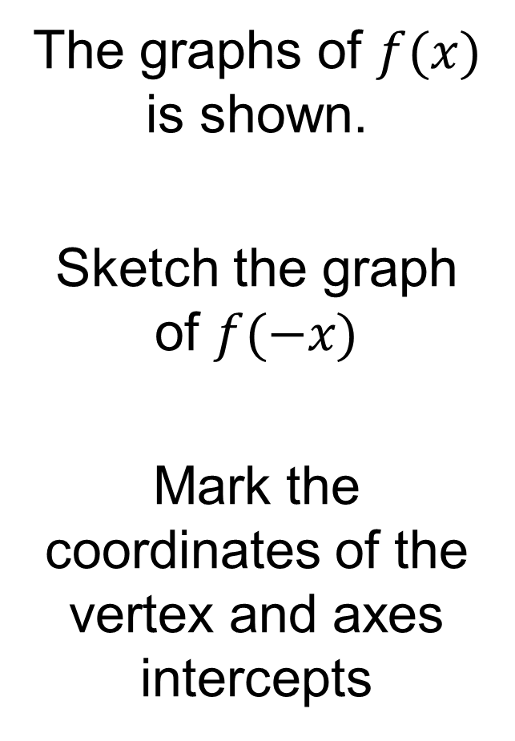
On your whiteboards:
The graphs of $f(x)$ is shown.
Sketch the graph of $f(−x)$
Mark the coordinates of the vertex and axes intercepts

Slide 20
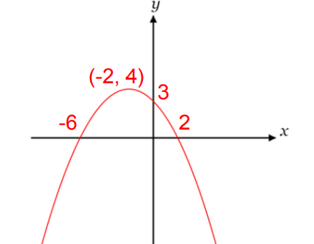
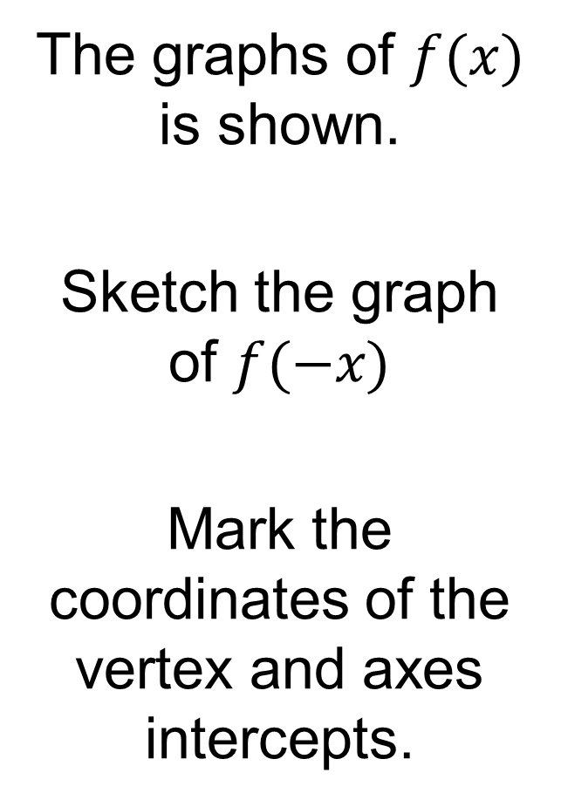
On your whiteboards:
The graphs of $f(x)$ is shown.
Sketch the graph of $f(−x)$
Mark the coordinates of the vertex and axes intercepts.

Slide 21
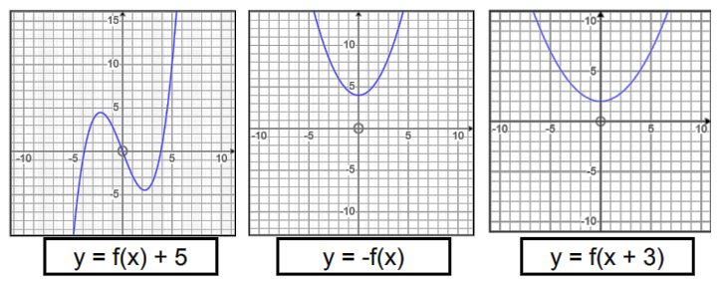
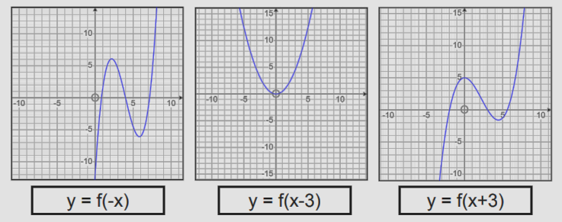
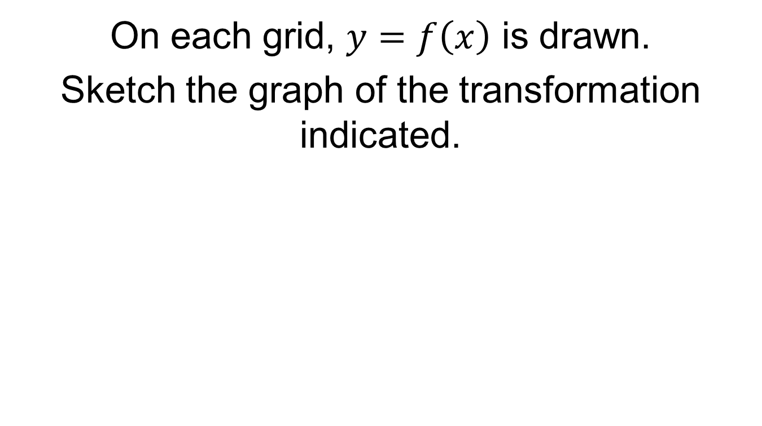
On each grid, $y=f\left(x\right)$ is drawn.
Sketch the graph of the transformation indicated.
Notes:
Independent Practice

Slide 22
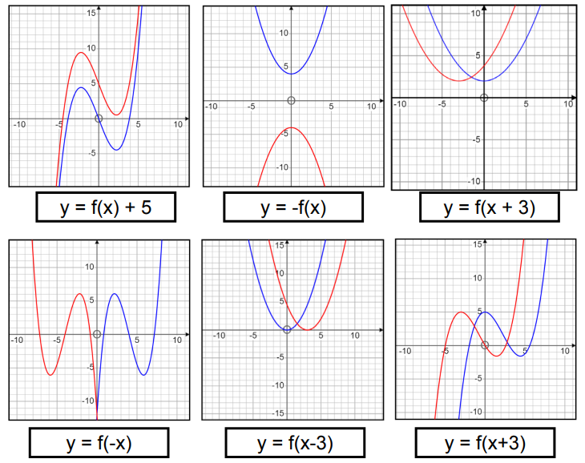
Mark your work

Slide 23
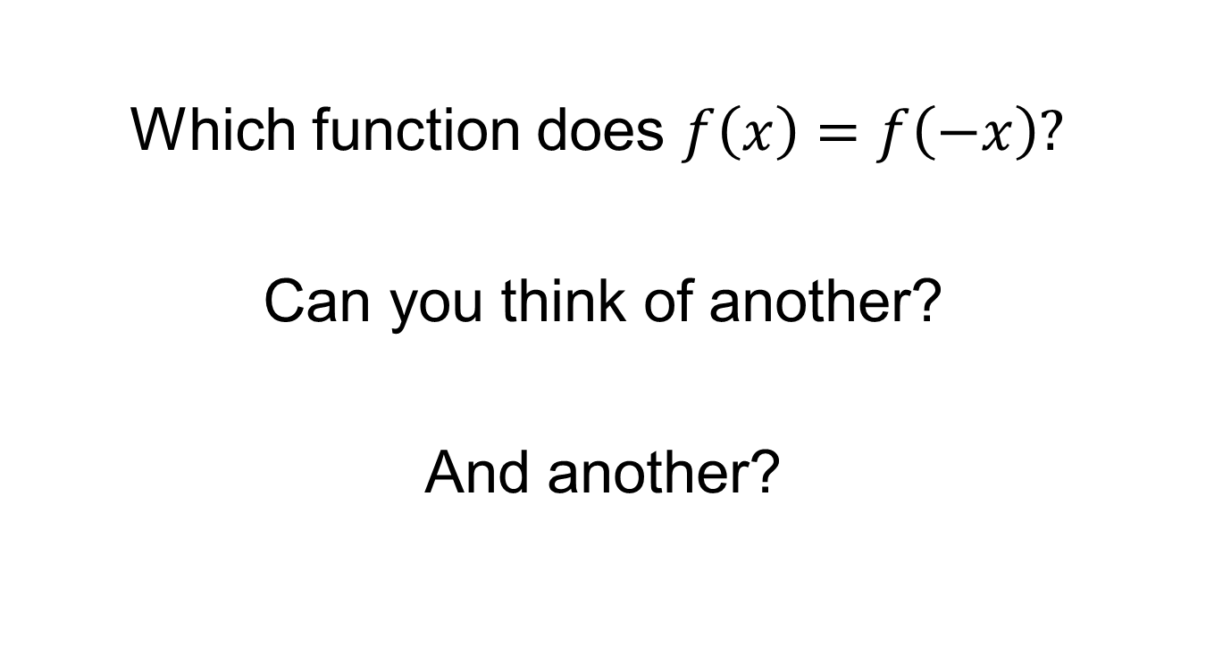
Challenge
Which function does $f\left(x\right)=f\left(−x\right)?$
Can you think of another?
And another?

