Slide 1
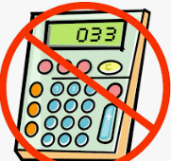
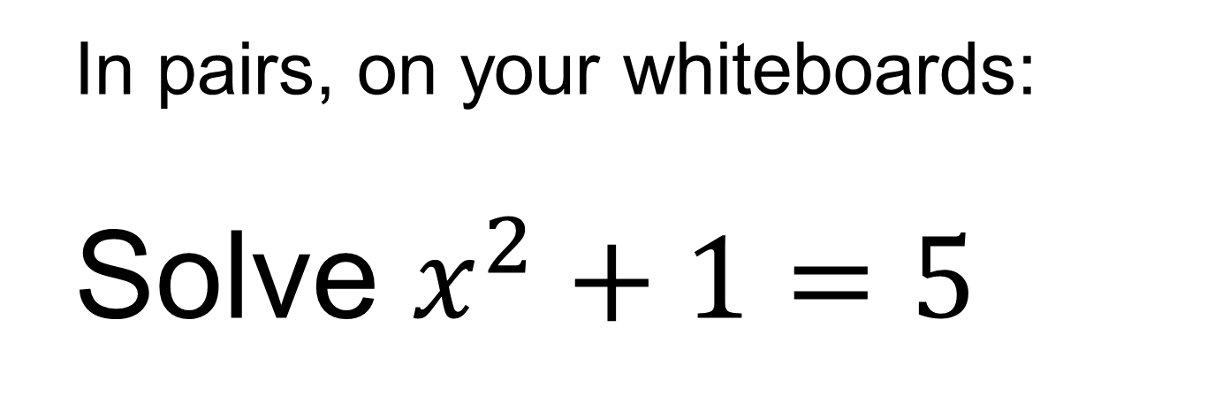
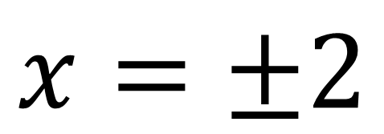
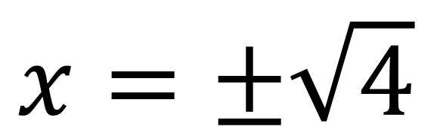
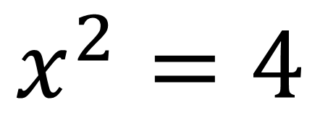
In pairs, on your whiteboards:
Solve $x^{2}+1=5$
$$x^{2}=4$$
$$x=±\sqrt{4}$$
$$x=±2$$

Slide 2
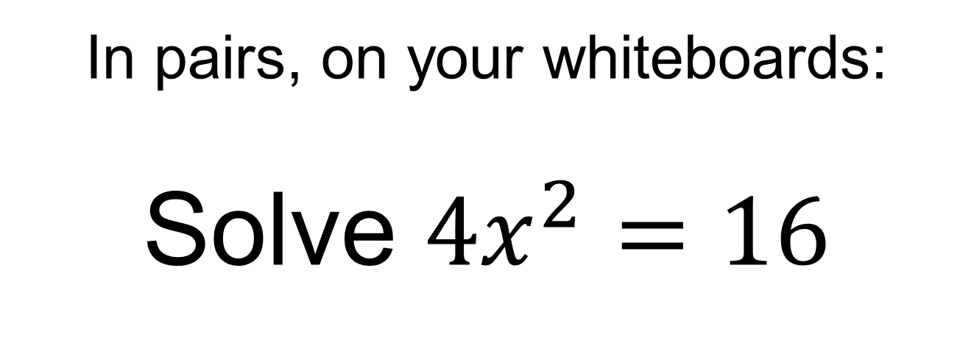
In pairs, on your whiteboards:
Solve ${4x}^{2}=16$
Can you think of a different way to solve this equation?

Slide 3
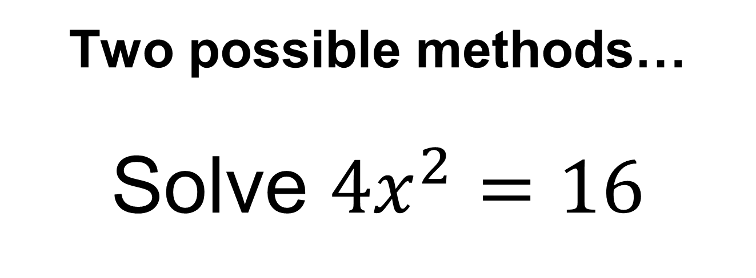




Two possible methods…
Solve ${4x}^{2}=16$
$$x^{2}=4$$
$$2x=±4$$
$$x=±2$$
$$x=±2$$
Dividing both sides by 4 first
Taking the square root of both sides first

Slide 4
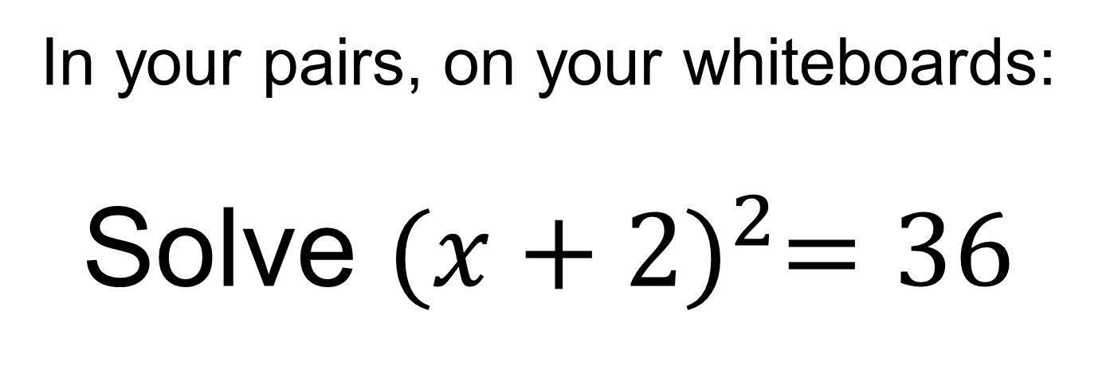
In your pairs, on your whiteboards:
Solve ${(x+2)}^{2}=36$
Can you think of a different way to solve this equation?

Slide 5


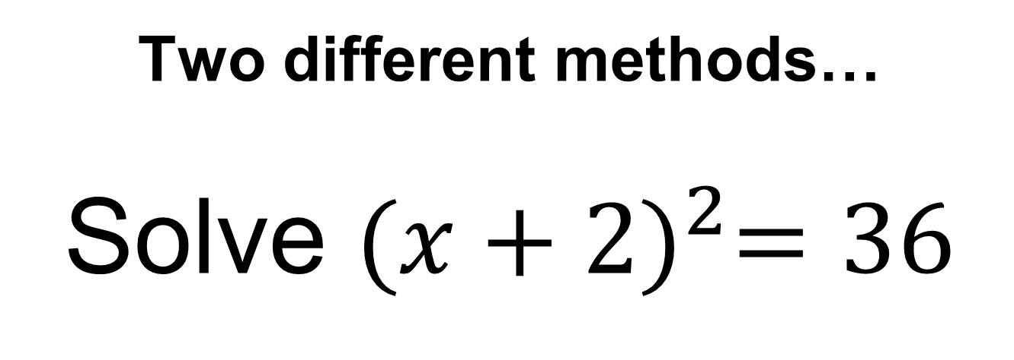








Two different methods…
Solve ${(x+2)}^{2}=36$
$$x+2=±6$$
$$x^{2}+4x+4=36$$
$$x^{2}+4x−32=0$$
$$x=6−2$$
$$x=−6−2$$
$$\left(x+8\right)\left(x−4\right)=0$$
$$x=4$$
$$x=−8$$
$$x=−8$$
$$x=4$$
Notes:
Talk through both methods.
Which is the most efficient method?

Slide 6
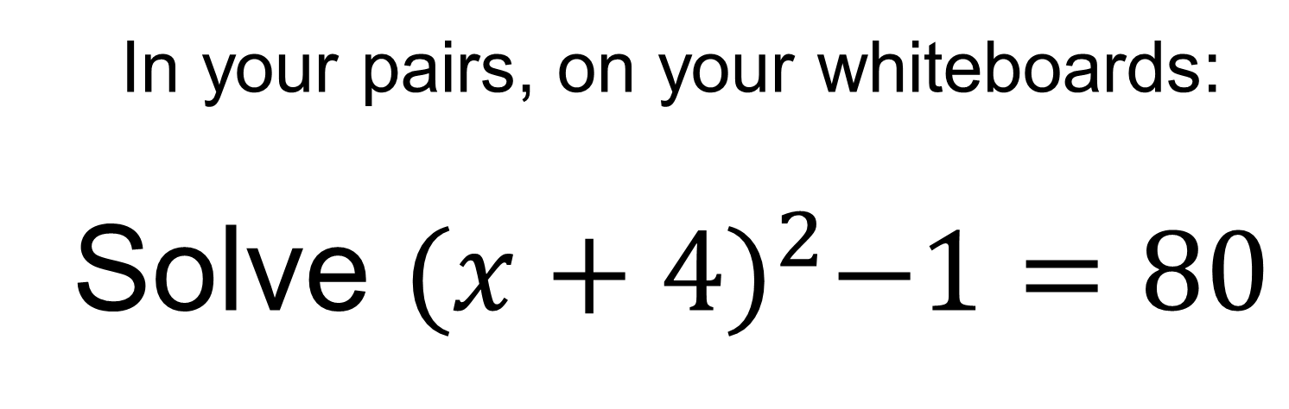
In your pairs, on your whiteboards:
Solve ${(x+4)}^{2}−1=80$
Use the most efficient method

Slide 7
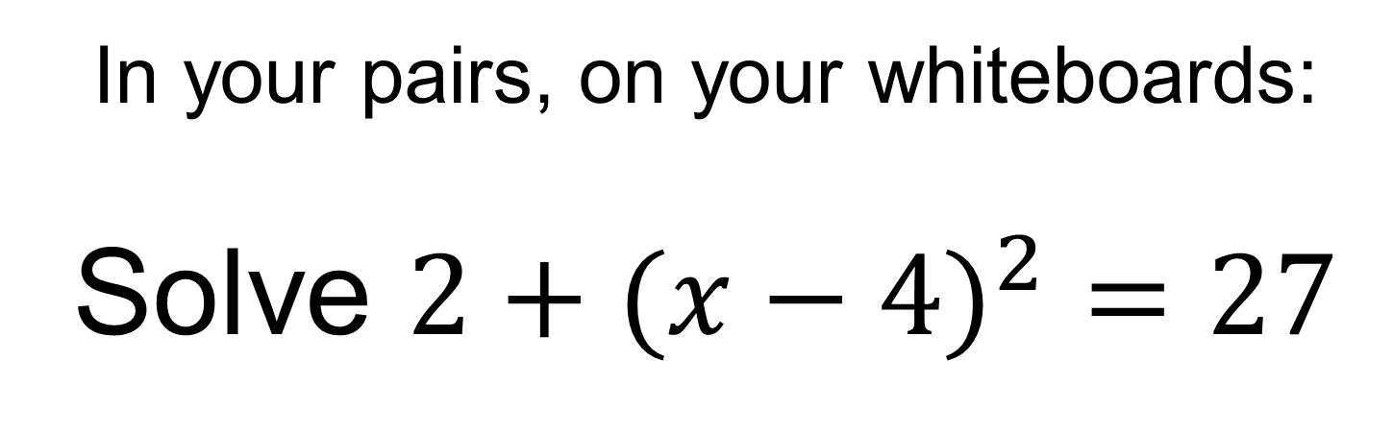
In your pairs, on your whiteboards:
Solve ${2+(x−4)}^{2}=27$
Use the most efficient method

Slide 8
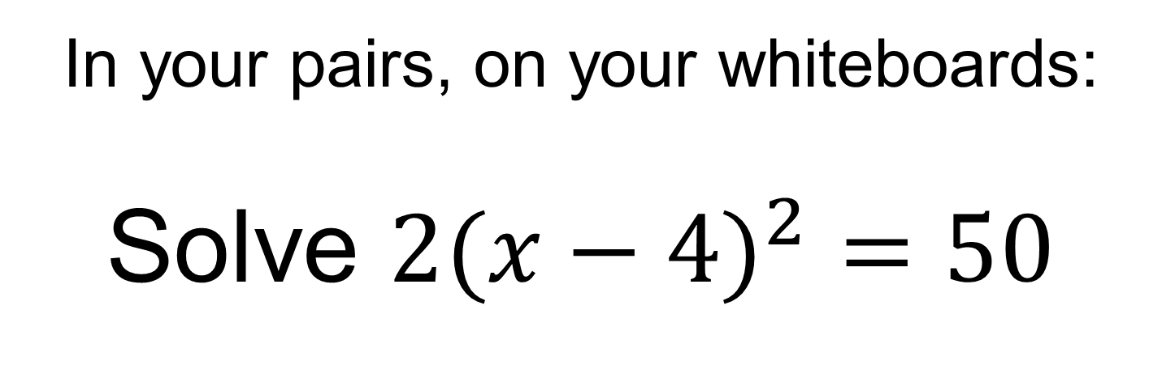
In your pairs, on your whiteboards:
Solve ${2(x−4)}^{2}=50$
Use the most efficient method

Slide 9
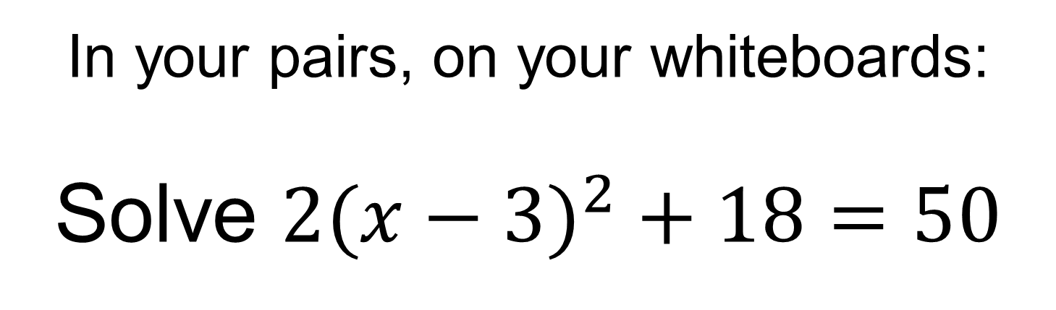
In your pairs, on your whiteboards:
Solve ${2(x−3)}^{2}+18=50$
Use the most efficient method

Slide 10





What do these questions have in common?
$${(x+2)}^{2}=36$$
$${2(x−3)}^{2}+18=50$$
$${2+(x−4)}^{2}=27$$
$${(x+4)}^{2}−1=80$$
$${2(x−4)}^{2}=50$$
We can use completing the square to help solve quadratic equations

Slide 11
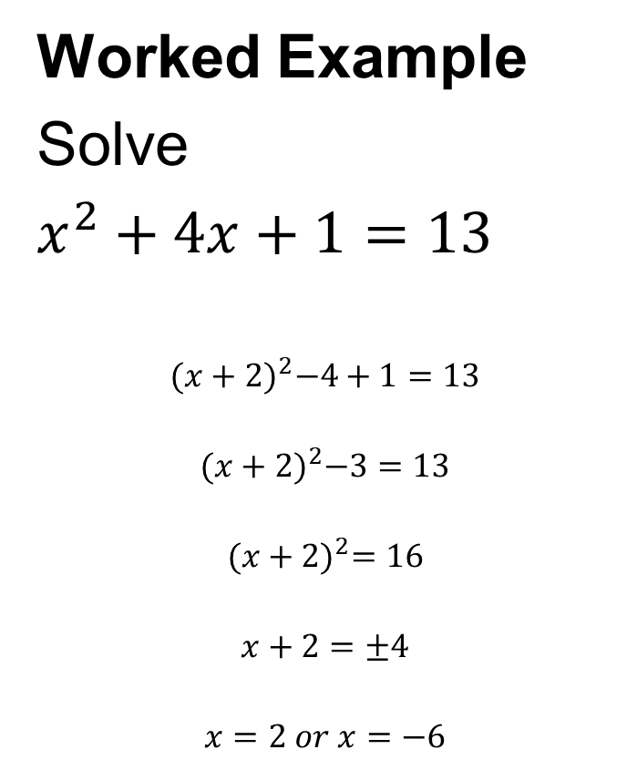
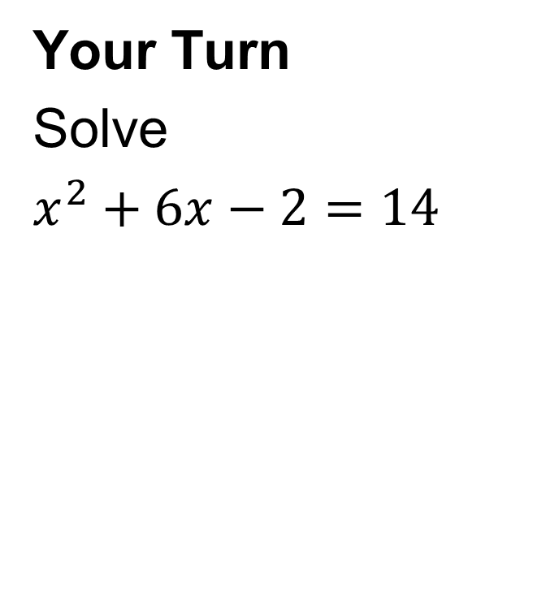
Title: Solving Quadratic Equations by Completing the Square
Worked Example
Solve
$x^{2}+4x+1=13$
$${(x+2)}^{2}−4+1=13$$
$${(x+2)}^{2}−3=13$$
$${(x+2)}^{2}=16$$
$$x+2=±4$$
$$x=2 or x=−6$$
Your Turn
Solve
$x^{2}+6x−2=14$
Notes:
Model the working out in silence then question students about each step of the solution

Slide 12
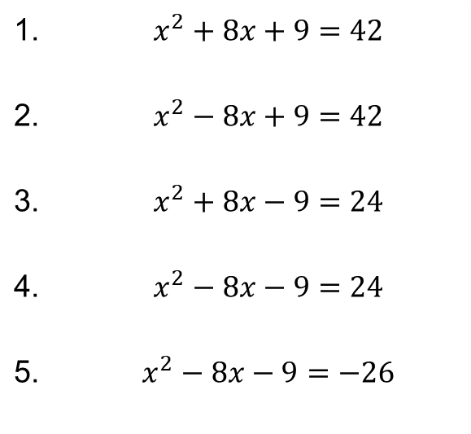
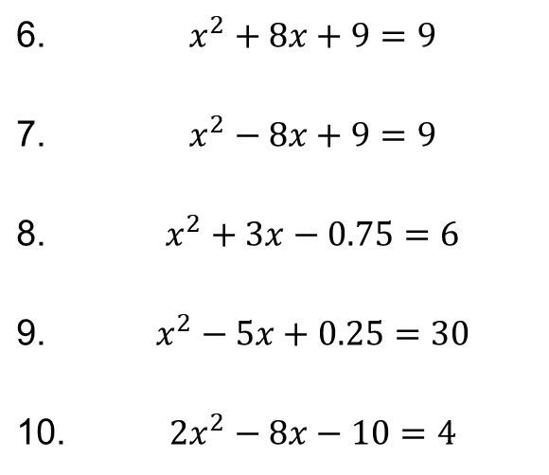
In your books:
Solve the following equations by completing the square.
1. | $$x^{2}+8x+9=42$$
2. | $$x^{2}−8x+9=42$$
3. | $$x^{2}+8x−9=24$$
4. | $$x^{2}−8x−9=24$$
5. | $$x^{2}−8x−9=−26$$
6. | $$x^{2}+8x+9=9$$
7. | $$x^{2}−8x+9=9$$
8. | $$x^{2}+3x−0.75=6$$
9. | $$x^{2}−5x+0.25=30$$
10. | $${2x}^{2}−8x−10=4$$

Slide 13
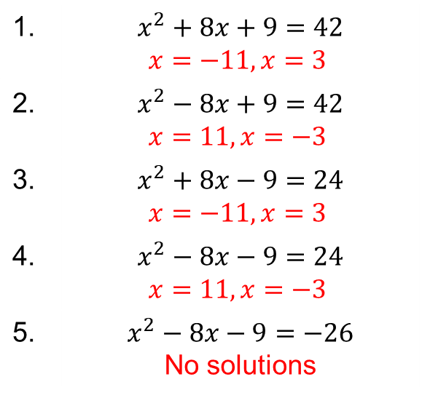
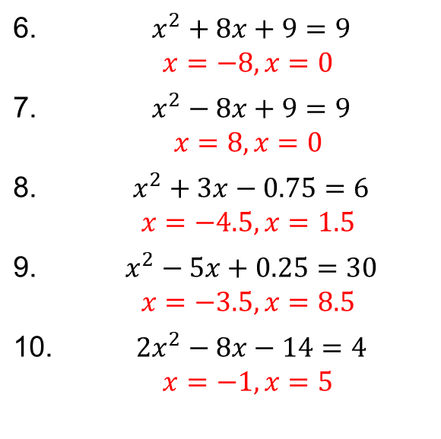
Mark your work
1. | $$x^{2}+8x+9=42$$ $$x=−11, x=3$$
2. | $$x^{2}−8x+9=42$$ $$x=11, x=−3$$
3. | $$x^{2}+8x−9=24$$ $$x=−11, x=3$$
4. | $$x^{2}−8x−9=24$$ $$x=11, x=−3$$
5. | $$x^{2}−8x−9=−26$$ No solutions
6. | $$x^{2}+8x+9=9$$ $$x=−8, x=0$$
7. | $$x^{2}−8x+9=9$$ $$x=8, x=0$$
8. | $$x^{2}+3x−0.75=6$$ $$x=−4.5, x=1.5$$
9. | $$x^{2}−5x+0.25=30$$ $$x=−3.5, x=8.5$$
10. | $${2x}^{2}−8x−14=4$$ $$x=−1, x=5$$

Slide 14
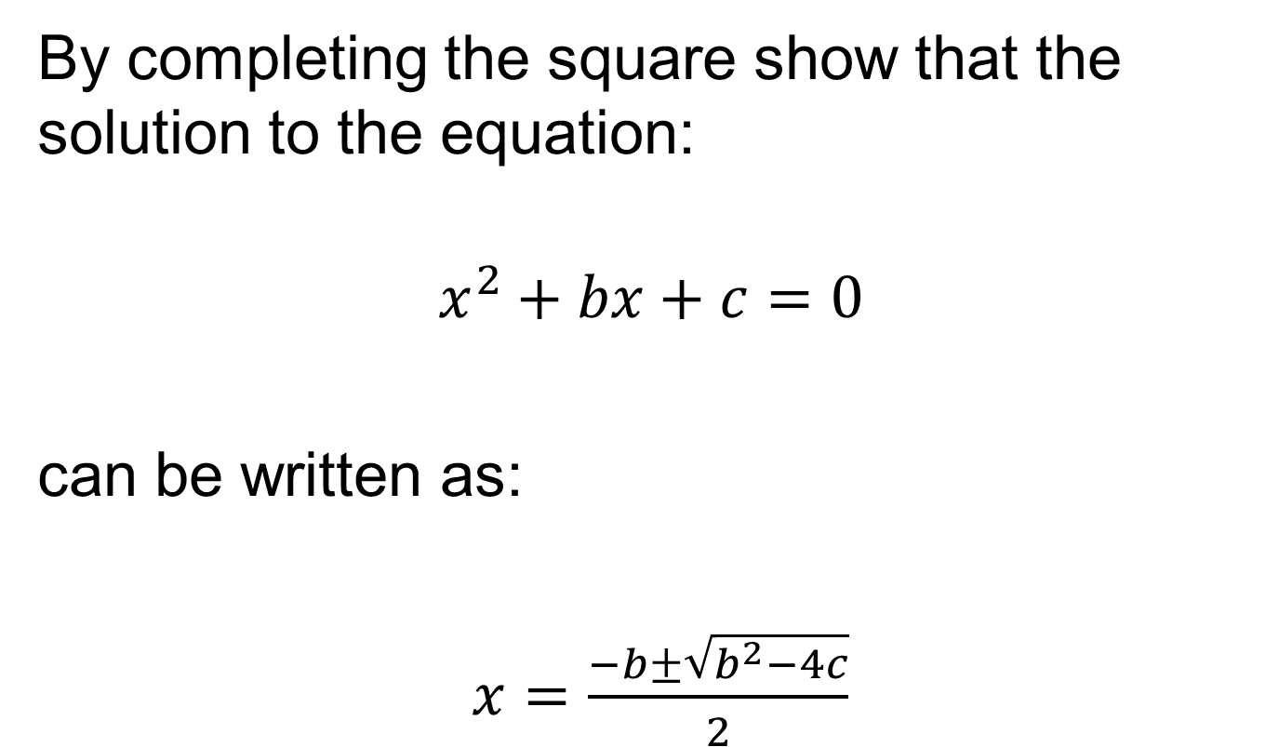
Challenge
By completing the square show that the solution to the equation:
$$x^{2}+bx+c=0$$
can be written as:
$x=\frac{−b±\sqrt{b^{2}−4c}}{2}$

