Slide 1
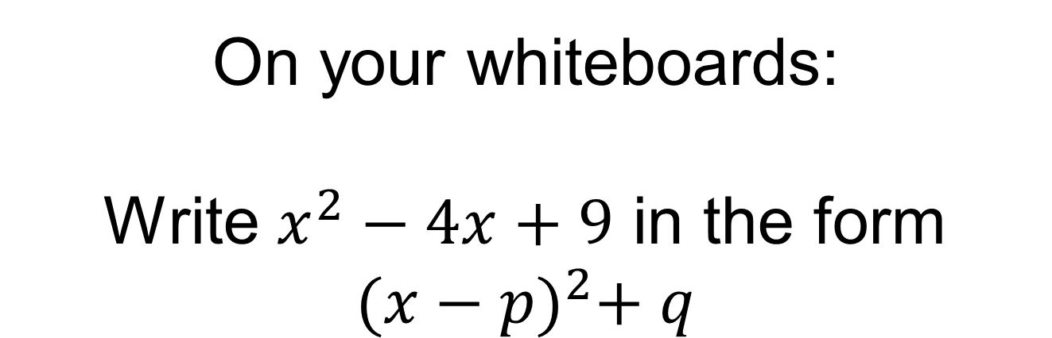
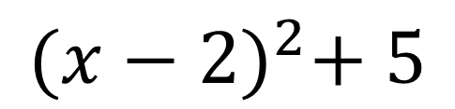
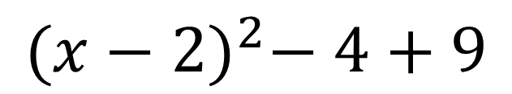
On your whiteboards:
Write $x^{2}−4x+9$ in the form ${(x−p)}^{2}+ q$
$${(x−2)}^{2}− 4+9$$
$${(x−2)}^{2}+ 5$$

Slide 2
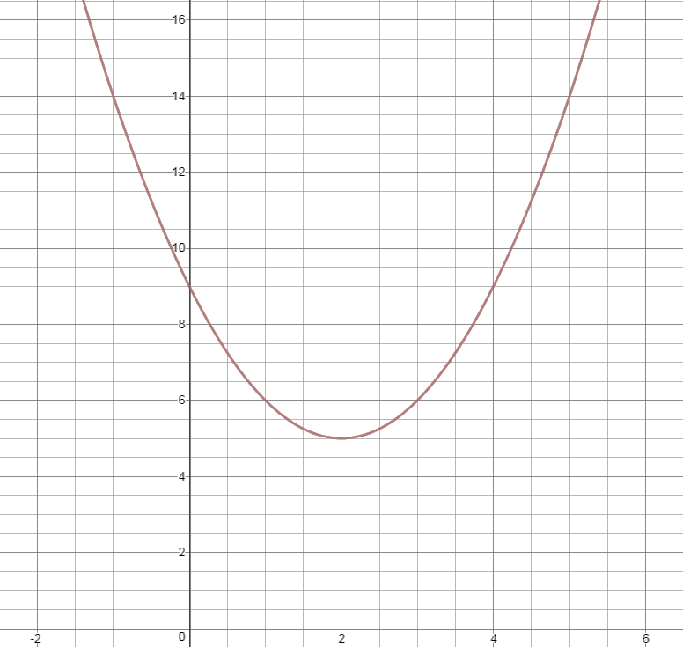

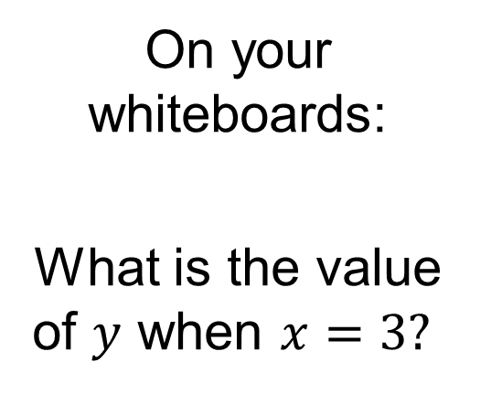
Here is the graph of $y={(x−2)}^{2}+5$
On your whiteboards:
What is the value of $y$ when $x=3?$

Slide 3
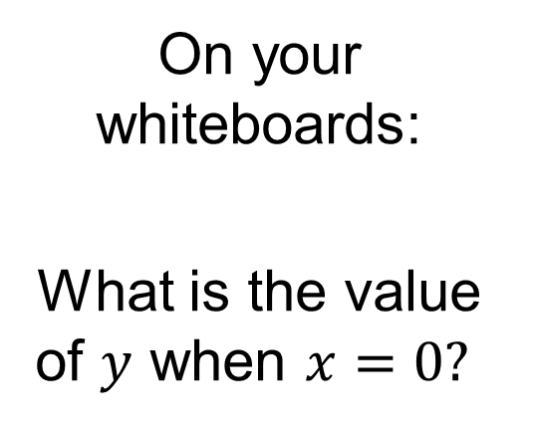
Here is the graph of $y={(x−2)}^{2}+5$
On your whiteboards:
What is the value of $y$ when $x=0?$

Slide 4
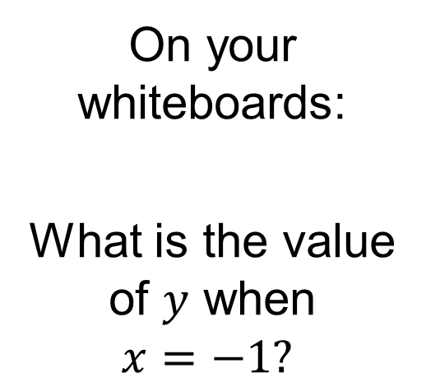
Here is the graph of $y={(x−2)}^{2}+5$
On your whiteboards:
What is the value of $y$ when $x=−1?$

Slide 5
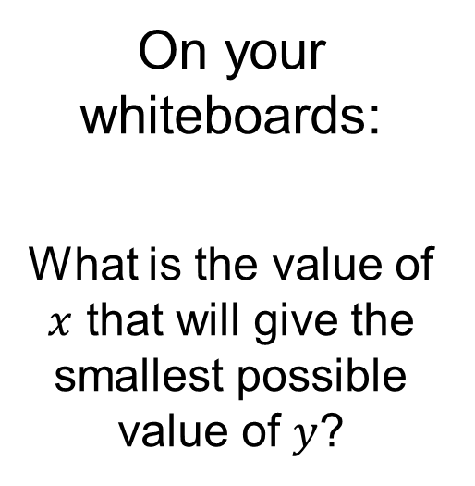
Here is the graph of $y={(x−2)}^{2}+5$
On your whiteboards:
What is the value of $x$ that will give the smallest possible value of $y$?

Slide 6

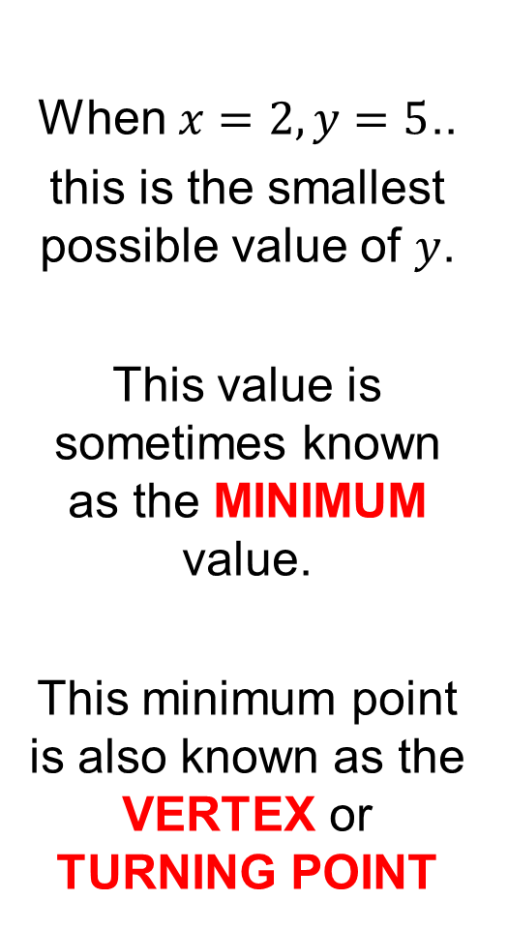
Here is the graph of $y={(x−2)}^{2}+ 5$
When $x=2, y=5$..
this is the smallest possible value of $y$.
This value is sometimes known as the MINIMUM value.
This minimum point is also known as the VERTEX or TURNING POINT

Slide 7
Here is the graph of $y={(x−2)}^{2}+ 5$
The coordinates of the vertex are (2, 5)
What do you notice?

Slide 8
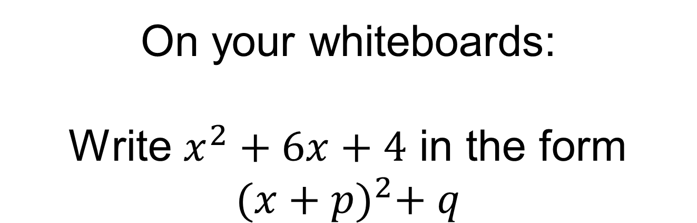
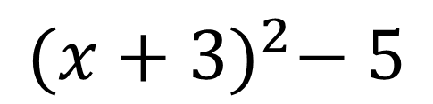
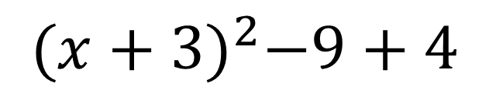
On your whiteboards:
Write $x^{2}+6x+4$ in the form ${(x+p)}^{2}+ q$
$${(x+3)}^{2}−9+4$$
$${(x+3)}^{2}− 5$$

Slide 9
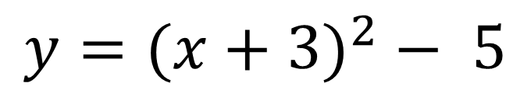
$${y=(x+3)}^{2}− 5$$
Without drawing the graph…
What do you think the coordinates of the vertex are?

Slide 10
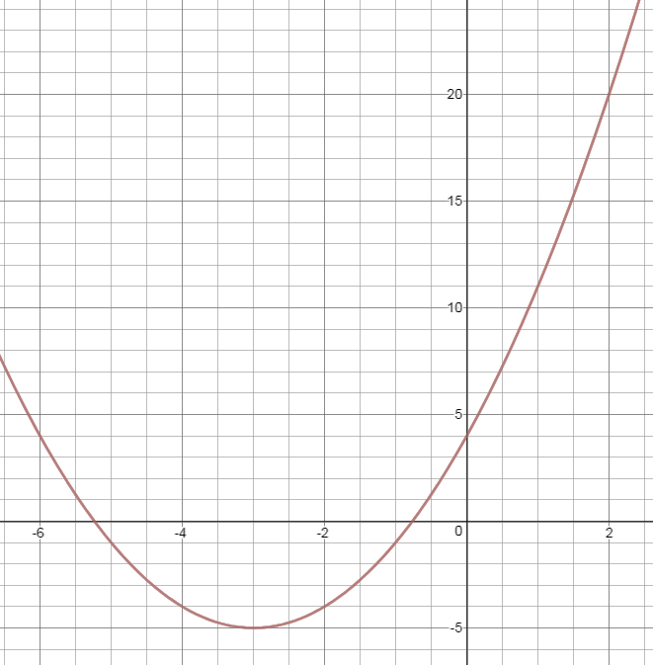
$${Here is the graph of y=(x+3)}^{2}− 5$$
$$The coordinates of the vertex are \left(−3, −5\right)$$

Slide 11
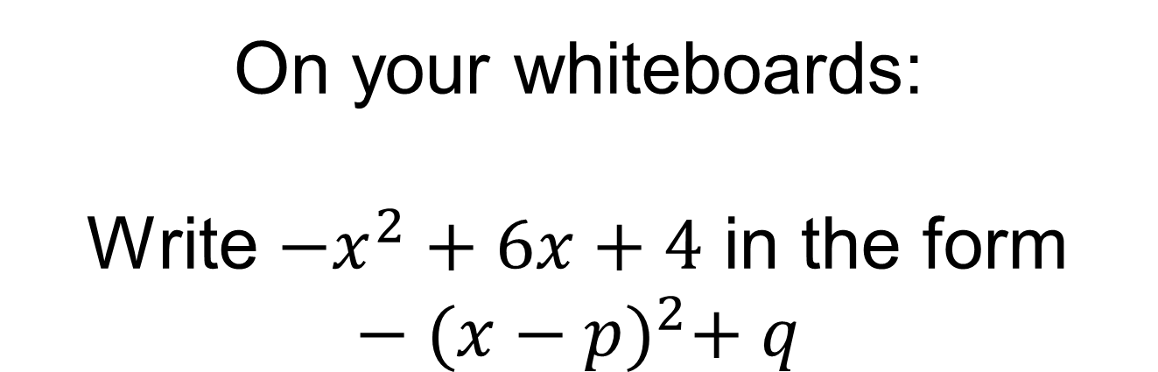
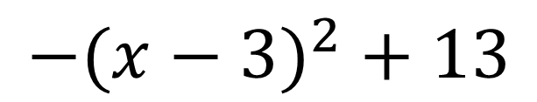
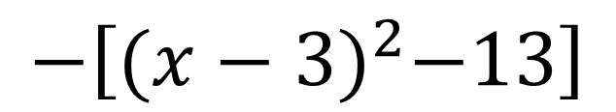
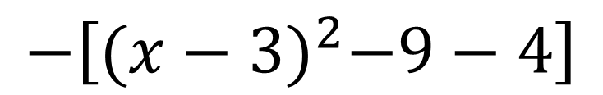
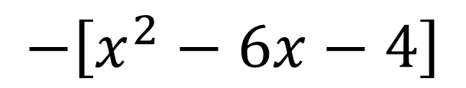
On your whiteboards:
Write ${−x}^{2}+6x+4$ in the form $−{(x−p)}^{2}+ q$
$$−\left[x^{2}−6x−4\right]$$
$$−\left[{(x−3)}^{2}−9−4\right]$$
$$−\left[{(x−3)}^{2}−13\right]$$
$$−(x−3)^{2}+13$$

Slide 12
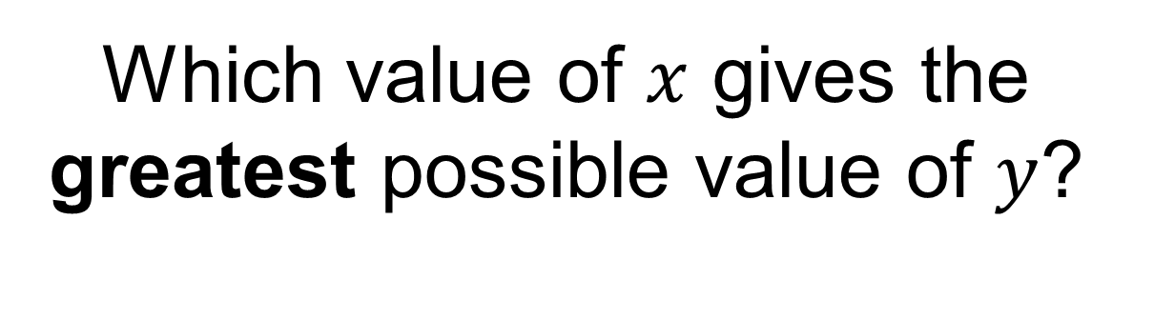
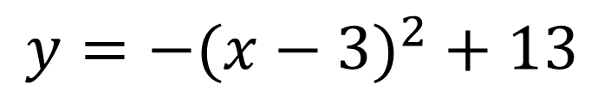
$$y=−(x−3)^{2}+13$$
Which value of $x$ gives the greatest possible value of $y$?

Slide 13
$$y=−(x−3)^{2}+13$$
Without drawing the graph…
What do you think the coordinates of the vertex are?

Slide 14
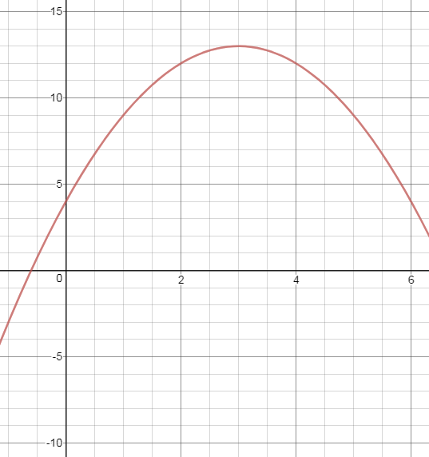
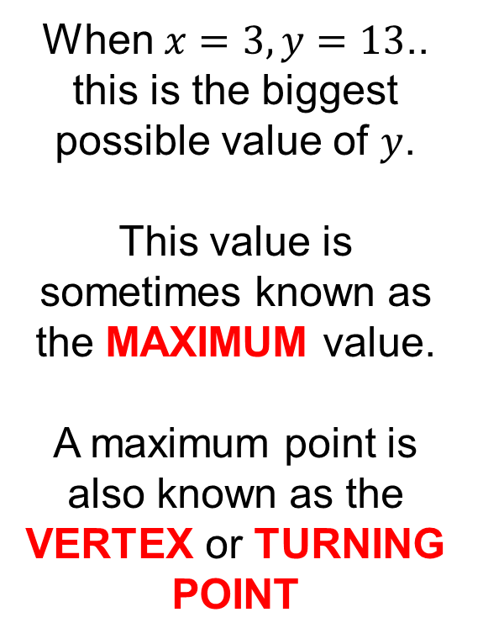

Here is the graph of$y=−(x−3)^{2}+13$
When $x=3, y=13$..
this is the biggest possible value of $y$.
This value is sometimes known as the MAXIMUM value.
A maximum point is also known as the VERTEX or TURNING POINT

Slide 15
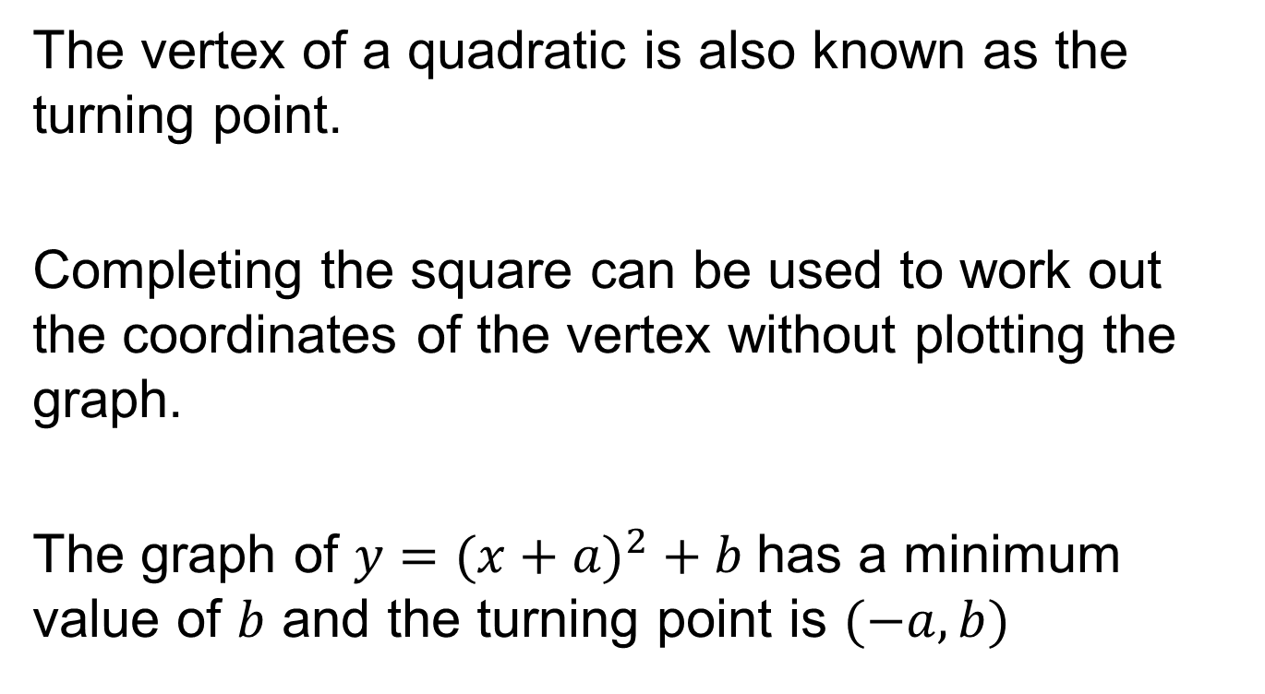
Title – The Vertex of a Quadratic
The vertex of a quadratic is also known as the turning point.
Completing the square can be used to work out the coordinates of the vertex without plotting the graph.
The graph of $y=(x+a)^{2}+b$has a minimum value of $b$ and the turning point is $(−a, b)$

Slide 16
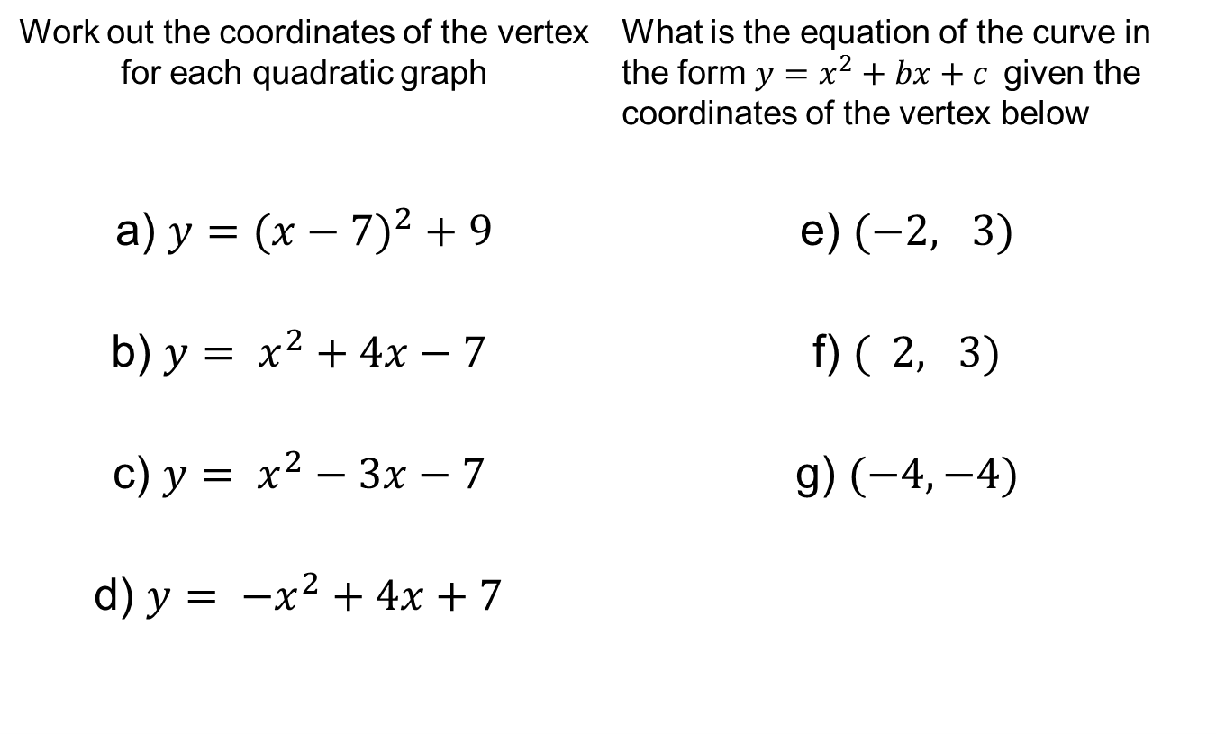
Your turn:
Work out the coordinates of the vertex for each quadratic graph | What is the equation of the curve in the form $y=x^{2}+bx+c$given the coordinates of the vertex below
a) $y=(x−7)^{2}+9$ | e) $(−2, 3)$
b) $y= x^{2}+4x−7$ | f) $( 2, 3)$
c) $y= x^{2}−3x−7$ | g) $(−4, −4)$
d) $y= {−x}^{2}+4x+7$

Slide 17
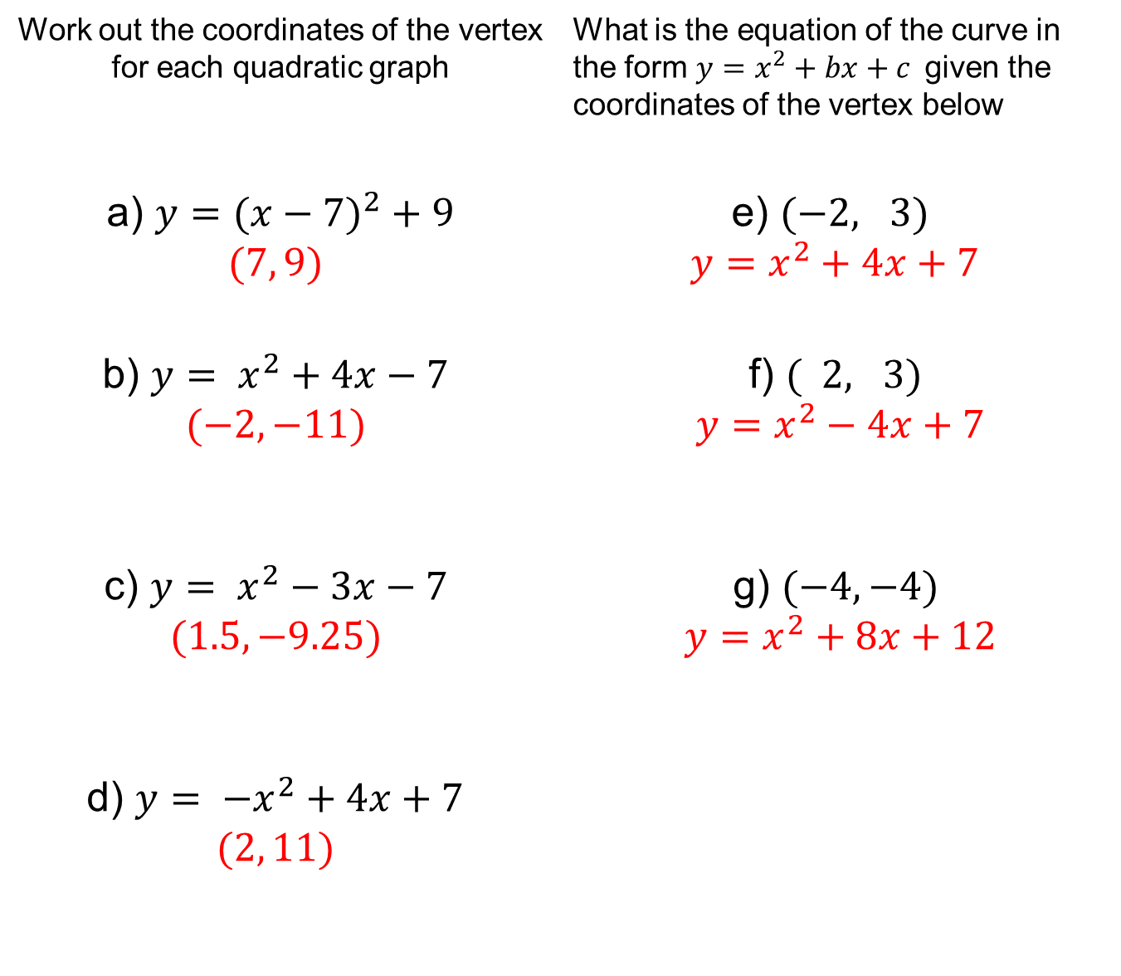
Work out the coordinates of the vertex for each quadratic graph | What is the equation of the curve in the form $y=x^{2}+bx+c$given the coordinates of the vertex below
a) $y=(x−7)^{2}+9$ $$(7, 9)$$ | e) $(−2, 3)$ $$y=x^{2}+4x+7$$
b) $y= x^{2}+4x−7$ $$(−2, −11)$$ | f) $( 2, 3)$ $$y=x^{2}−4x+7$$
c) $y= x^{2}−3x−7$ $$(1.5, −9.25)$$ | g) $(−4, −4)$ $$y=x^{2}+8x+12$$
d) $y= {−x}^{2}+4x+7$ $$(2, 11)$$

Slide 18
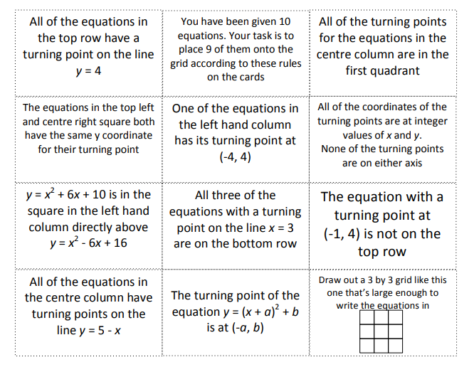
Completing the Square Puzzle
Notes:
Acknowledgements: NCETM
Instructions for the puzzle are also in the puzzle itself! Print out this slide to allow students to mark off each clue as they use it.

Slide 19
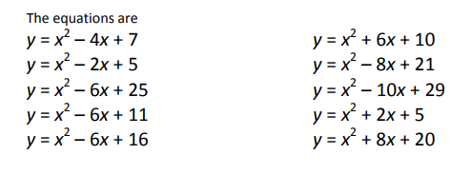
Completing the Square Puzzle Solution

