Slide 1
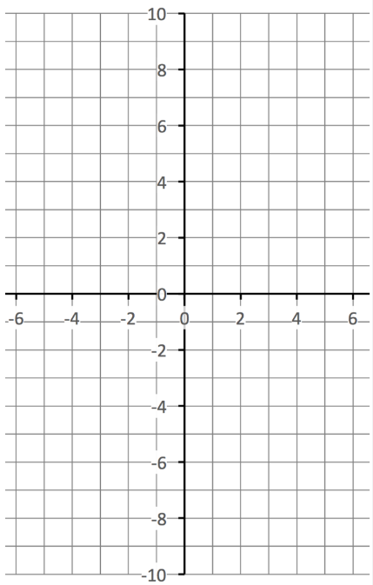
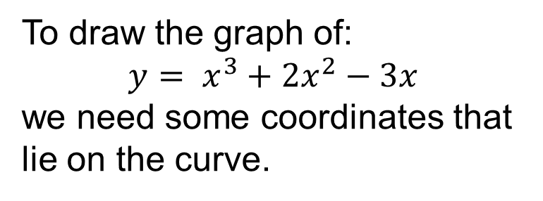

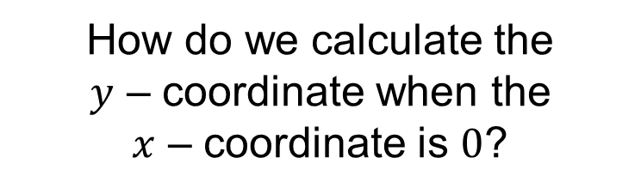
To draw the graph of:
$$y= x^{3}+2x^{2}−3x$$
we need some coordinates that lie on the curve.
How do we calculate the
$y$ – coordinate when the
$x$ – coordinate is $0$?
Substitute $x=0$into the equation of the curve

Slide 2
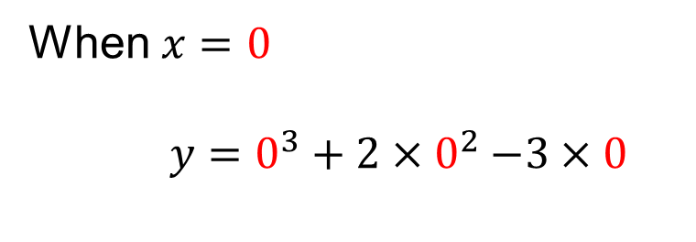

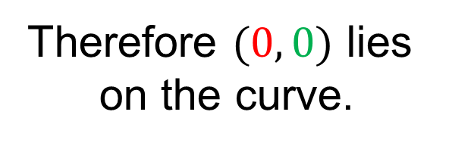
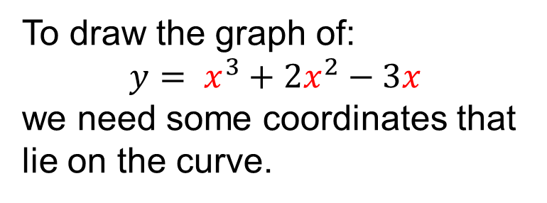
To draw the graph of:
$$y= x^{3}+2x^{2}−3x$$
we need some coordinates that lie on the curve.
When $x=0$
$y=$ $0^{3}+2{×0}^{2}−3×0$
$$y=0$$
Therefore $(0, 0)$ lies
on the curve.

Slide 3
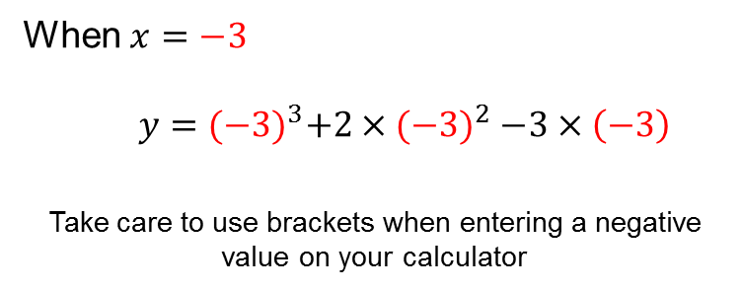
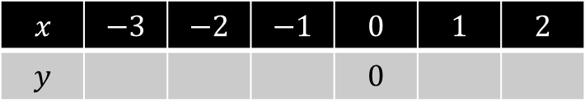
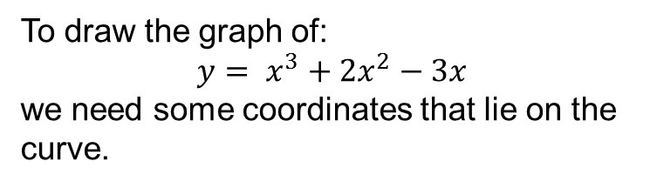
To draw the graph of:
$$y= x^{3}+2x^{2}−3x$$
we need some coordinates that lie on the curve.
Complete the table of values and plot the curve
$$x$$ | $$−3$$ | $$−2$$ | $$−1$$ | $$0$$ | $$1$$ | $$2$$
$$y$$ |  |  |  | $$0$$
When $x=−3$
$y=$ ${(−3)}^{3}+2{×(−3)}^{2}−3×\left(−3\right)$
Take care to use brackets when entering a negative value on your calculator

Slide 4
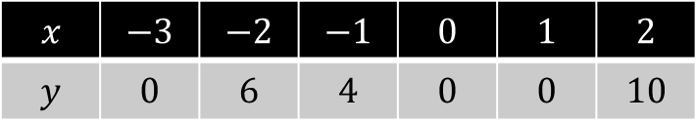
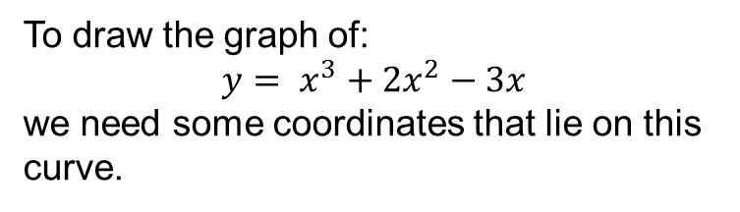
To draw the graph of:
$$y= x^{3}+2x^{2}−3x$$
we need some coordinates that lie on this curve.
Complete the table of values and plot the curve
$$x$$ | $$−3$$ | $$−2$$ | $$−1$$ | $$0$$ | $$1$$ | $$2$$
$$y$$ | $$0$$ | $$6$$ | $$4$$ | $$0$$ | $$0$$ | $$10$$
Why shouldn’t we join the coordinates like this?

Slide 5
To draw the graph of:
$$y= x^{3}+2x^{2}−3x$$
we need some coordinates that lie on this curve.
Complete the table of values and plot the curve
$$x$$ | $$−3$$ | $$−2$$ | $$−1$$ | $$0$$ | $$1$$ | $$2$$
$$y$$ | $$0$$ | $$6$$ | $$4$$ | $$0$$ | $$0$$ | $$10$$
The curve should look like this.
This is a cubic graph

Slide 6
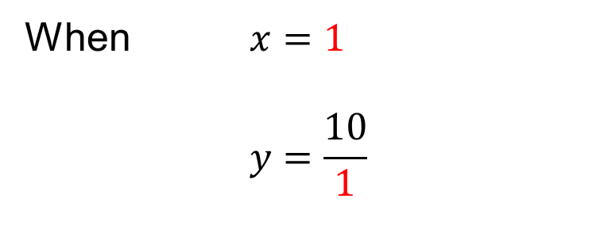

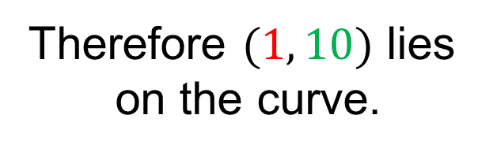
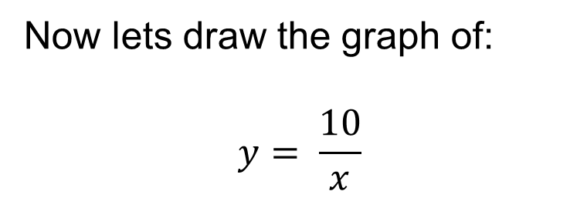
Now lets draw the graph of:
$$y= \frac{10}{x}$$
When $x=1$
$$y=\frac{10}{1}$$
$$y=10$$
Therefore $(1, 10)$ lies
on the curve.

Slide 7
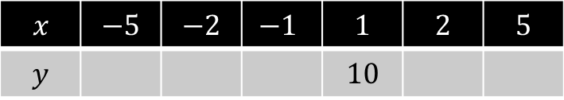

Now lets draw the graph of:
$$y= \frac{10}{x}$$
Complete the table of values and plot the curve
$$x$$ | $$−5$$ | $$−2$$ | $$−1$$ | $$1$$ | $$2$$ | $$5$$
$$y$$ |  |  |  | $$10$$

Slide 8
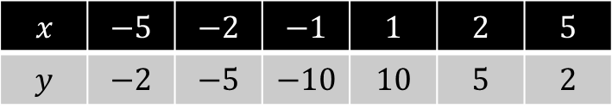
Now lets draw the graph of:
$$y= \frac{10}{x}$$
Complete the table of values and plot the curve
$$x$$ | $$−5$$ | $$−2$$ | $$−1$$ | $$1$$ | $$2$$ | $$5$$
$$y$$ | $$−2$$ | $$−5$$ | $$−10$$ | $$10$$ | $$5$$ | $$2$$
Why shouldn’t we join the coordinates like this?

Slide 9
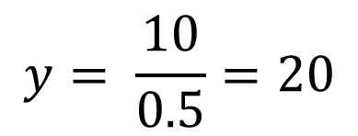
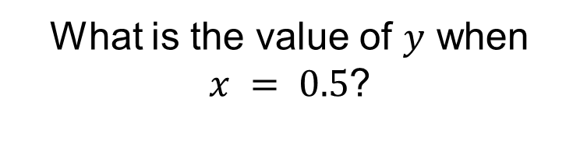
Now lets draw the graph of:
$$y= \frac{10}{x}$$
What is the value of $y$ when $x = 0.5$?
$$y= \frac{10}{0.5}=20$$

Slide 10
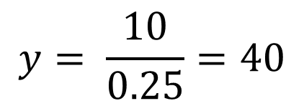
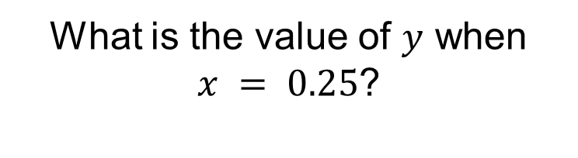
Now lets draw the graph of:
$$y= \frac{10}{x}$$
What is the value of $y$ when $x = 0.25$?
$$y= \frac{10}{0.25}=40$$

Slide 11
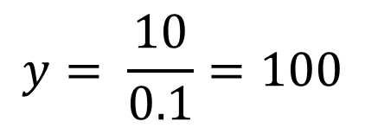
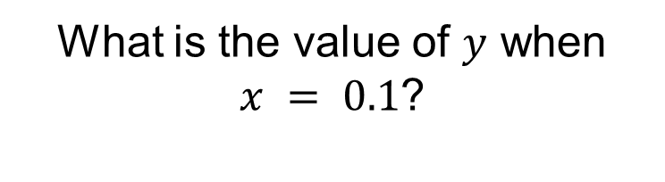
Now lets draw the graph of:
$$y= \frac{10}{x}$$
What is the value of $y$ when $x = 0.1$?
$$y= \frac{10}{0.1}=100$$
What do you notice?

Slide 12
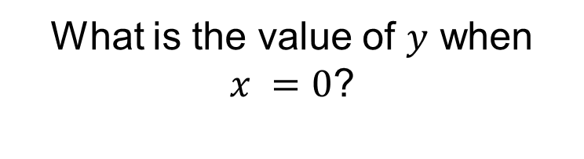
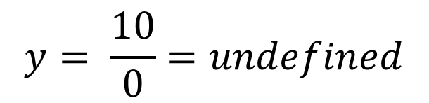
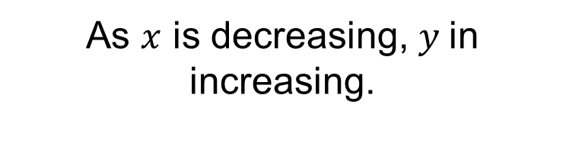
Now lets draw the graph of:
$$y= \frac{10}{x}$$
As $x$ is decreasing, $y$in increasing.
What is the value of $y$ when $x =0$?
$$y= \frac{10}{0}=undefined$$

Slide 13
Now lets draw the graph of:
$$y= \frac{10}{x}$$
Complete the table of values and plot the curve
$$x$$ | $$−5$$ | $$−2$$ | $$−1$$ | $$1$$ | $$2$$ | $$5$$
$$y$$ | $$−2$$ | $$−5$$ | $$−10$$ | $$10$$ | $$5$$ | $$2$$
So the curve should look like this.
This is a reciprocal graph

Slide 14
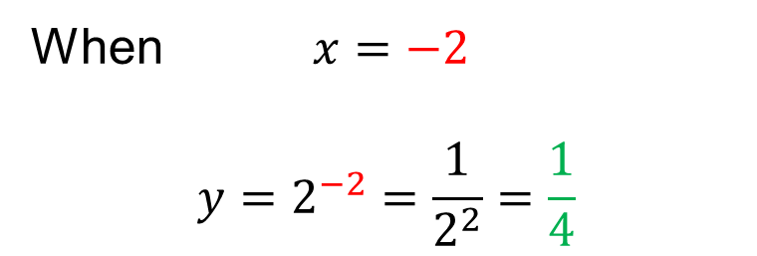
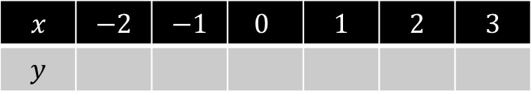
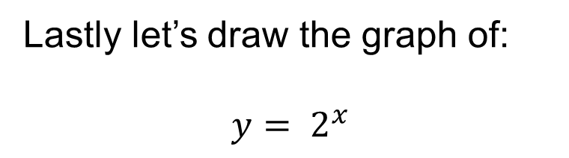
Lastly let’s draw the graph of:
$$y= 2^{x}$$
Complete the table of values and plot the curve
$$x$$ | $$−2$$ | $$−1$$ | $$0$$ | $$1$$ | $$2$$ | $$3$$
$$y$$
When $x=−2$
$$y=2^{−2}=\frac{1}{2^{2}}=\frac{1}{4}$$

Slide 15
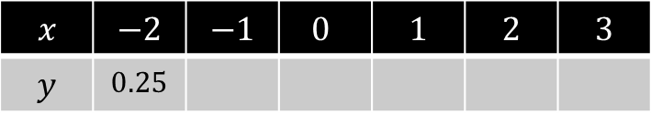
Lastly let’s draw the graph of:
$$y= 2^{x}$$
Complete the table of values and plot the curve
$$x$$ | $$−2$$ | $$−1$$ | $$0$$ | $$1$$ | $$2$$ | $$3$$
$$y$$ | $$0.25$$

Slide 16
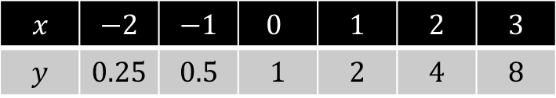
Lastly let’s draw the graph of:
$$y= 2^{x}$$
Complete the table of values and plot the curve
$$x$$ | $$−2$$ | $$−1$$ | $$0$$ | $$1$$ | $$2$$ | $$3$$
$$y$$ | $$0.25$$ | $$0.5$$ | $$1$$ | $$2$$ | $$4$$ | $$8$$
So the curve should look like this.
This is an exponential graph

Slide 17
Mini whiteboards ready!
Which equation matches to each graph?

Slide 18
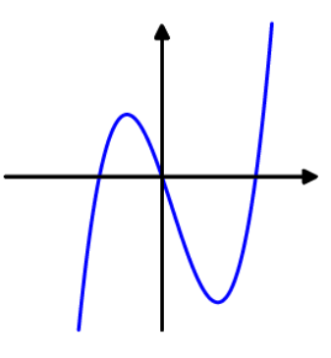



Which equation matches to this graph?
$$A: y= x^{3}+5x^{2}$$
$$C: y=\sin{x}$$
$$B: y=3x^{2}$$
Notes:
Mini Whiteboards

Slide 19
Which equation matches to this graph?
$$A: y= x^{3}+5x^{2}$$
This is a cubic graph
What is the y-intercept of this cubic graph?

Slide 20
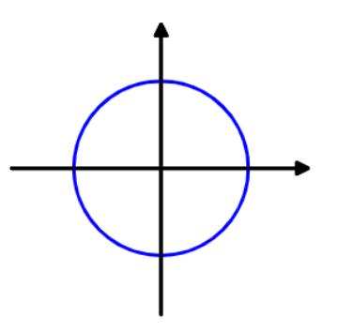


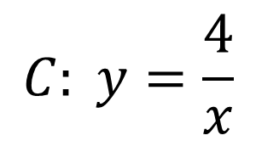
Which equation matches to this graph?
$$A: y= x^{2}+4$$
$$C: y=\frac{4}{x}$$
$$B: x^{2}+y^{2}=4$$

Slide 21
Which equation matches to this graph?
This is a graph of a circle.
What is the radius of
this circle?
$$B: x^{2}+y^{2}=4$$

Slide 22
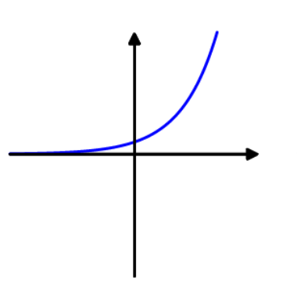



Which equation matches to this graph?
$$A: y= 5x+1$$
$$C: y=x^{5}$$
$$B: y=5^{x}$$

Slide 23
Which equation matches to this graph?
This is an exponential graph
What is the y-intercept of this graph?
$$B: y=5^{x}$$

Slide 24
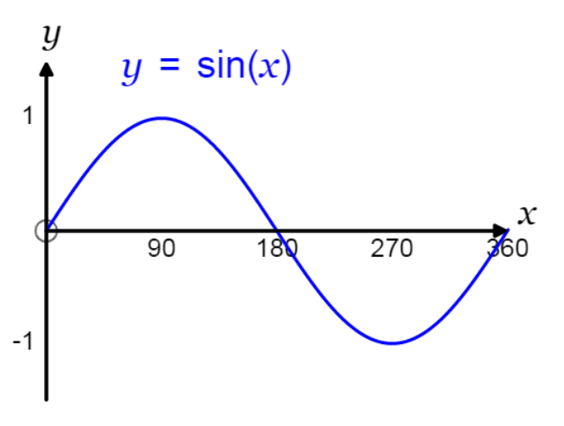
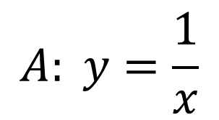


Which equation matches to this graph?
$$A: y=\frac{1}{x}$$
$$C: y=\sin{x}$$
$$B: y= x^{2}+x^{3}$$

Slide 25

Which equation matches to this graph?
$$C: y=\sin{x}$$
What is the value of $sin⁡180°$?

Slide 26
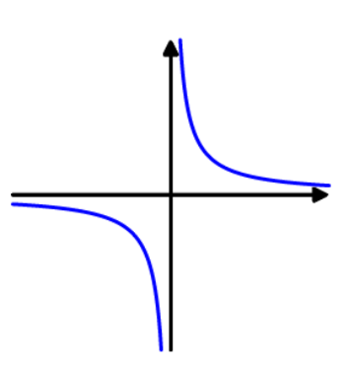
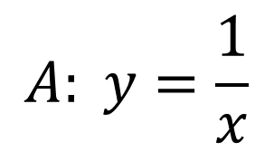


Which equation matches to this graph?
$$A: y=\frac{1}{x}$$
$$C: y=\tan{x}$$
$$B: y=x+1$$

Slide 27
Which equation matches to this graph?
$$A: y=\frac{1}{x}$$
This is a reciprocal graph

Slide 28
Shapes of Graphs
Match each graph with its’ equation.
When you are sure you have the correct match stick the graph with its’ equation in your Maths book.
Notes:
Encourage students to test coordinates if they are unsure about matching a graph to its’ equation.

Slide 29
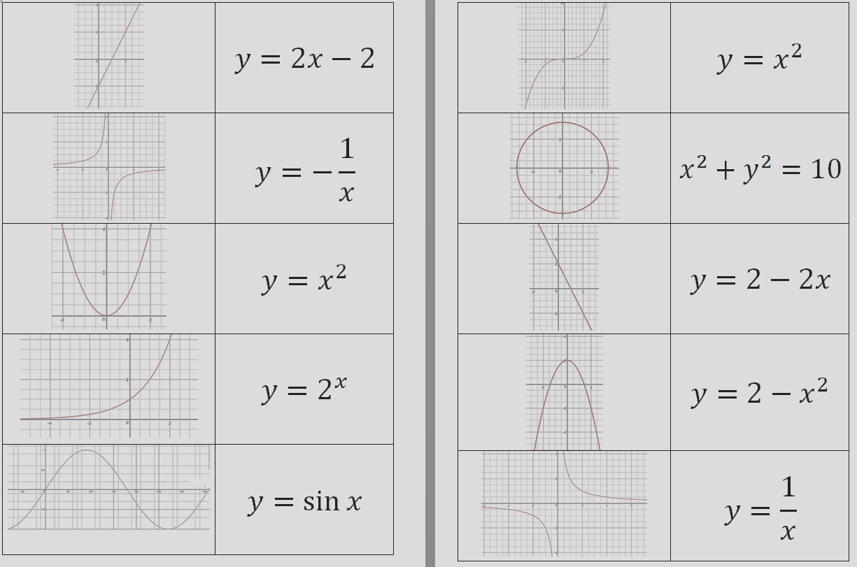
Mark your work

Slide 30
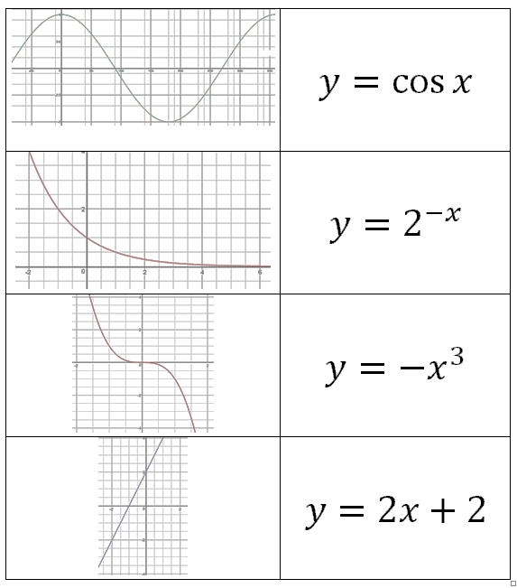
Mark your work

