Slide 1

$$x^{2}>16$$
What does this inequality say?

Slide 2

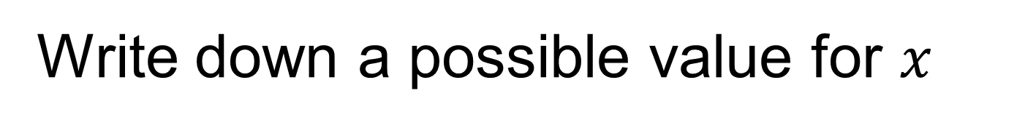
$$x^{2}>16$$
Write down a possible value for $x$
And another…
And another…

Slide 3
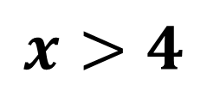

$$x^{2}>16$$
$5^{2}=25$, $25>16$ so $x$ could be $5$
${4.1}^{2}=16.81$, $16.81>16$ so $x$ could be $4.1$
What do all these values have in common?
They are all greater than 4.
How can this be written mathematically?
$$x>4$$
Notes:
Share students positive answers with the whole class and record them on the whiteboard

Slide 4
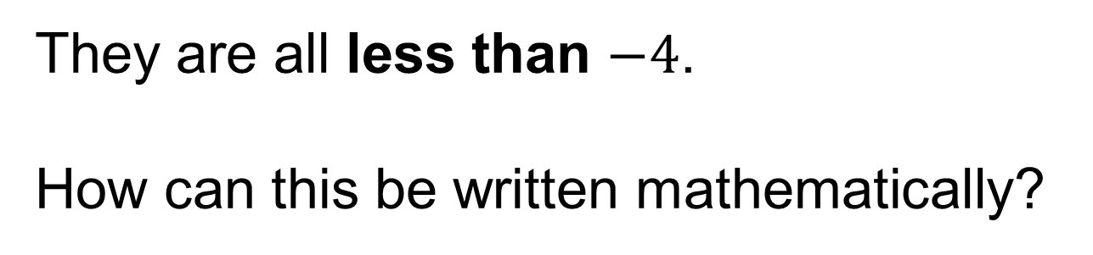
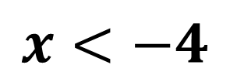
$$x^{2}>16$$
${(−13)}^{2}=169$, $169>16$ so $x$ could be $13$
${(−4.1)}^{2}=16.81$, $16.81>16$ so $x$ could be $4.1$
What do all these values have in common?
They are all less than $−4$.
How can this be written mathematically?
$$x<−4$$
Notes:
Share any responses that are negative

Slide 5

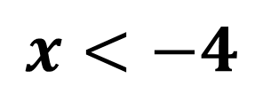
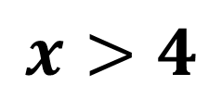
Solve
$$x^{2}>16$$
The solution for this inequality is:
$$x<−4$$
,
$$x>4$$
Notes:
Share students positive answers with the whole class and record them on the whiteboard

Slide 6
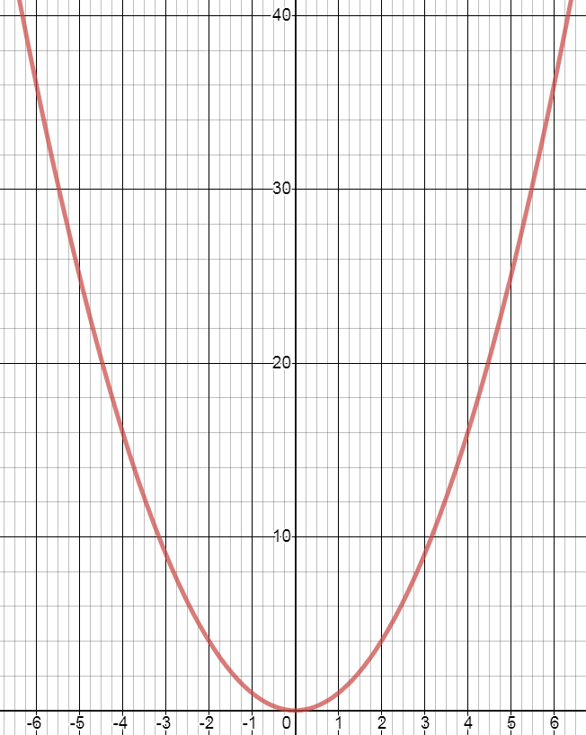
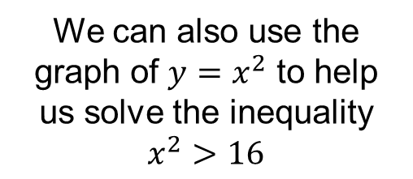


We can also use the graph of $y=x^{2}$ to help us solve the inequality $x^{2}>16$
$$x>4$$
or
$$x<−4$$
Take care not to write “and” here.
A value cannot be both greater than 4 and less than 4

Slide 7







Solve
$${3x}^{2}+1>28$$
$$−1$$
$$−1$$
$${3x}^{2}>27$$
$$÷3$$
$$÷3$$
$$x^{2}>9$$
On your whiteboards, complete this solution
Notes:
Backwards Fading Example

Slide 8
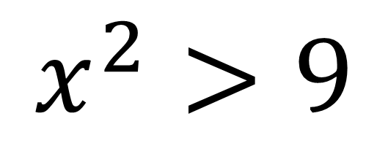


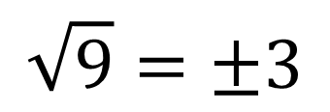
$$x^{2}>9$$
$$\sqrt{9}=±3$$
$$x<−3$$
$$x>3$$

Slide 9







Solve
$${3+2x}^{2}≥53$$
$$−3$$
$$−3$$
$${2x}^{2}≥50$$
$$÷2$$
$$÷2$$
$$x^{2}≥25$$
On your whiteboards, complete this solution
Notes:
Backwards Fading Example – only one step shared before students are expected to finish the solution

Slide 10
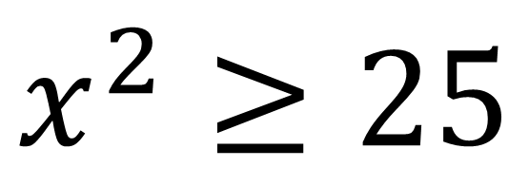


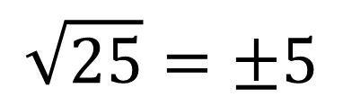
$$x^{2}≥25$$
$$\sqrt{25}=±5$$
$$x<−5$$
$$x>5$$

Slide 11

On your whiteboards, solve:
$${3x}^{2}−10>2$$
Notes:
First step removed, allow students to answer on whiteboards and share student attempts displaying the “best” solution last.

Slide 12

What is the same? What is different?
Solve
$${3x}^{2}−10<2$$

Slide 13
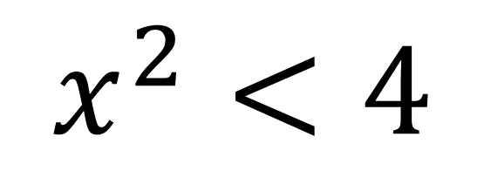
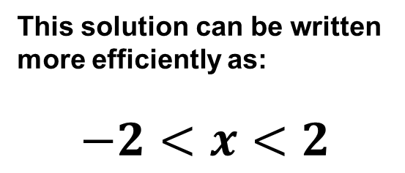


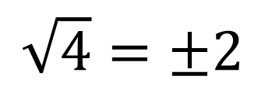
$$x^{2}<4$$
$$\sqrt{4}=±2$$
$$x>−2$$
AND
$$x<2$$
This solution can be written more efficiently as:
$$−2<x<2$$

Slide 14
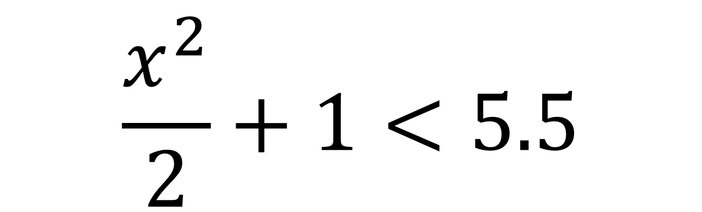
On your whiteboards, solve:
$$\frac{x^{2}}{2}+1<5.5$$
Notes:
Write the solution to this inequality on the whiteboard and leave it as it is useful to refer to for the next question

Slide 15
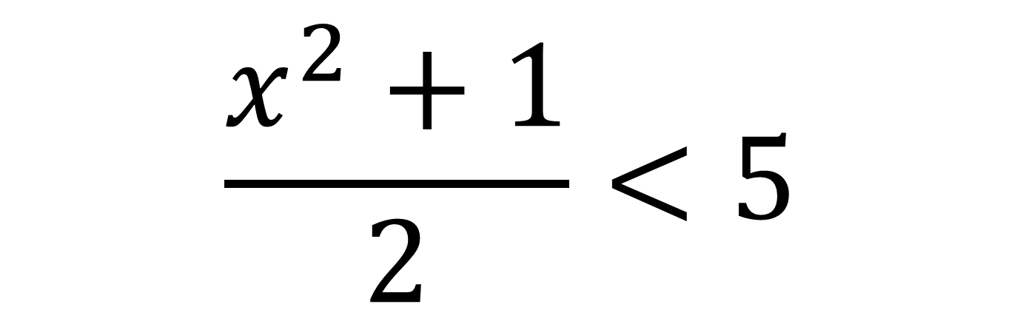
What is the same? What is different?
On your whiteboards, solve:
$$\frac{x^{2}+1}{2}<5$$

Slide 16
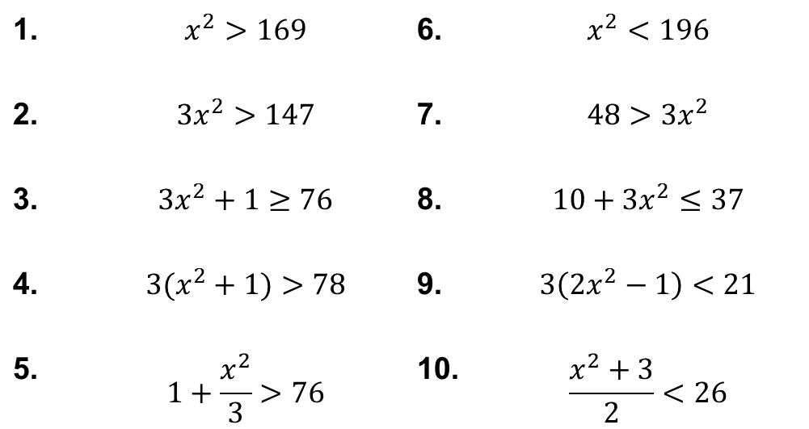
Title: Solving Quadratic Inequalities
In your books:
Solve the following inequalities
1. | $$x^{2}>169$$ | 6. | $$x^{2}<196$$
2. | $${3x}^{2}>147$$ | 7. | $$48>3x^{2}$$
3. | $$3x^{2}+1≥76$$ | 8. | $$10+{3x}^{2}≤37$$
4. | $$3(x^{2}+1)>78$$ | 9. | $$3\left({2x}^{2}−1\right)<21$$
5. | $$1+\frac{x^{2}}{3}>76$$ | 10. | $$\frac{x^{2}+3}{2}<26$$

Slide 17
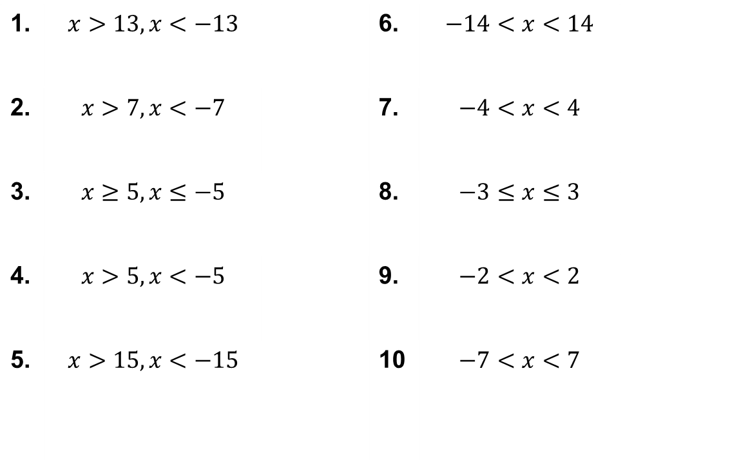
Mark your work
1. | $$x>13, x<−13$$ |  | 6. | $$−14<x<14$$
2. | $$x>7, x<−7$$ |  | 7. | $$−4<x<4$$
3. | $$x≥5, x≤−5$$ |  | 8. | $$−3≤x≤3$$
4. | $$x>5, x<−5$$ |  | 9. | $$−2<x<2$$
5. | $$x>15, x<−15$$ |  | 10 | $$−7<x<7$$

Slide 18
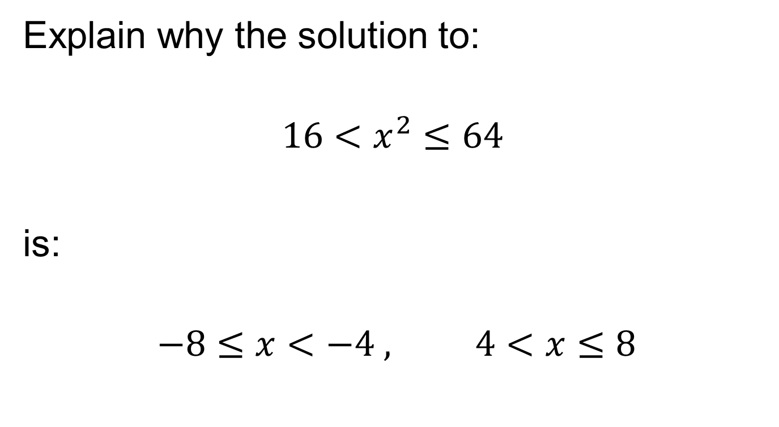
Challenge
Explain why the solution to:
$$16<x^{2}≤64$$
is:
$$−8≤x<−4 , 4<x≤8$$

