Slide 1



Slide 2
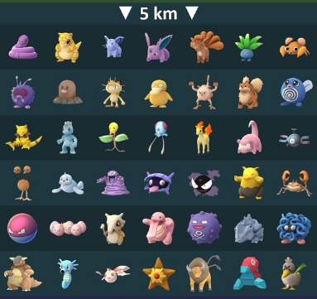
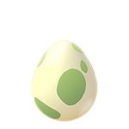
5km egg

Slide 3
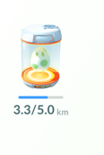
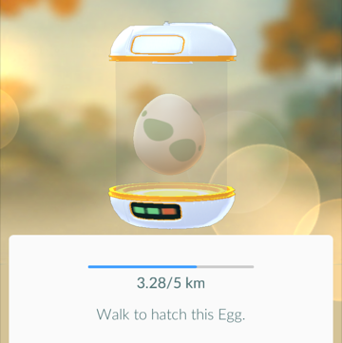
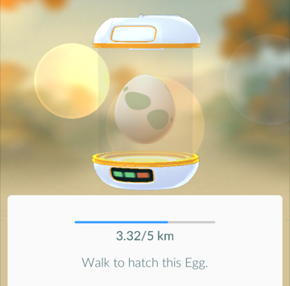
After walking for a while, I decide to check the progress of the egg…
When I clicked on the egg it gave me more detail. The first time I clicked it showed this.
The second time showed this.

Slide 4
Both 3.28km and 3.32km have been rounded to 3.3km
What other distances would be rounded off to 3.3km?

Slide 5
Which of the lengths shown will round to 3.3 km?

a

b
c

d
e

f
3.1
3.2
3.3
3.4
km
All 4 strips that measured 3.3 km were within the range 3.25 to 3.35 cm.

Slide 6
Which of the lengths shown will round to 3.3 km?

a

b
c

d
e

f
3.1
3.2
3.3
3.4
km
The lowest value that a measurement can take is sometimes referred to as the lower bound.
The highest value that a measurement can take is sometimes referred to as the Upper bound.
Lower bound = 3.25 km
Upper bound = 3.35 km

Slide 7

Anything that falls between 3.25 km (including 3.25) and 3.35 km (not including 3.35) rounds off to 3.3km
3.1
3.2
3.3
3.4
km
Lower bound = 3.25 km
Upper bound = 3.35 km
The Error Interval is:
3.25$≤$ $x<$ 3.35

Slide 8
Title : Upper and Lower Bounds
Copy and complete:
If a value is rounded to 3.3 we know that the actual value could be anything bigger than or equal to 3.25 but less than 3.35.
These values are called the lower and upper bounds or limits.

Slide 9
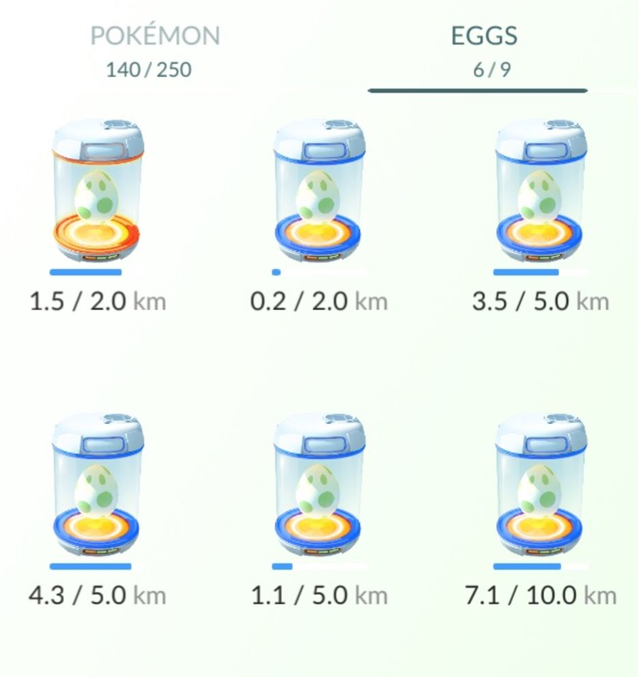
Answer the following questions on your worksheet.
For each incubator:
Plot the distance on the number line
Write the upper and lower bounds
Write three values that round off to the distance.
a
b
c
d
e
f

Slide 10
Mark your work

Slide 11
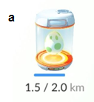
1.4
1.5
1.6
km
LB
UB
1.45
1.55
Three possible values that round off to 1.5 km:

Slide 12
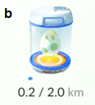
0.1
0.2
0.3
km
LB
UB
0.15
0.25
Three possible values that round off to 0.2 km:

Slide 13
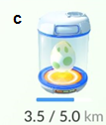
3.4
3.5
3.6
km
LB
UB
3.45
3.55
Three possible values that round off to 3.5 km:

Slide 14
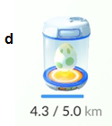
4.2
4.3
4.4
km
LB
UB
4.25
4.35
Three possible values that round off to 4.3 km:

Slide 15
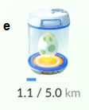
1.0
1.1
1.2
km
LB
UB
1.05
1.15
Three possible values that round off to 1.1 km:

Slide 16
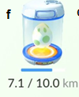
7.0
7.1
7.2
km
LB
UB
7.05
7.15
Three possible values that round off to 7.1 km:

Slide 17
Challenge

Slide 18
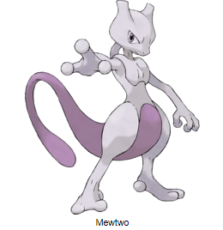
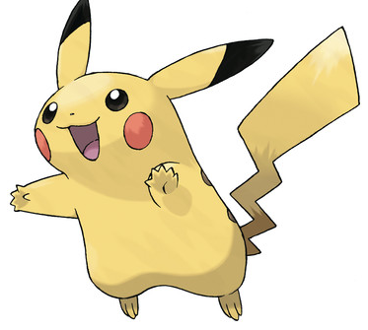
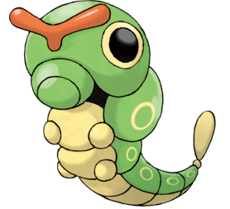
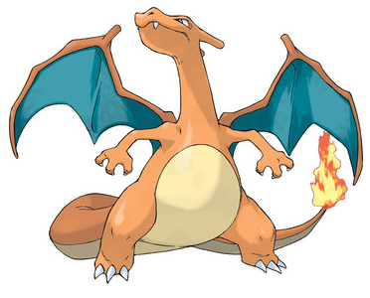








$$Height:2.3m$$
$$Height:0.4m$$
What is the smallest possible combined weight of these Pokemon?
Pikachu
$$Weight:33 kg$$
$$Weight:6 kg$$
What is the greatest possible height difference between these Pokemon?
$$Height:0.21m$$
$$Height:1.77m$$
Caterpie
Pikachu
$$Weight:0.5 kg$$
$$Weight:90.5 kg$$
Notes:
Smallest possible weight = 32.5 + 5.5 + 0.45 + 90.45 = 128.9 kg
Greatest height difference = 2.35 – 0.205 = 2.145 m

