Slide 1
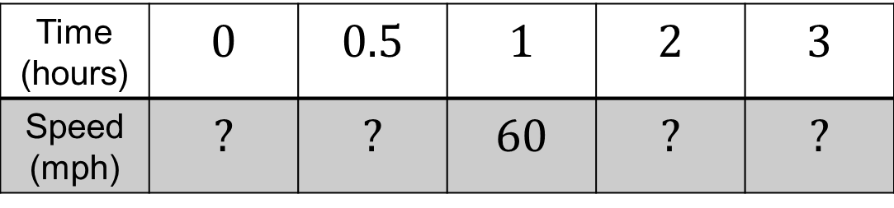



To travel from Nottingham to Coventry in an hour an average speed of 60 mph is required.
What average speed would be required to travel to Coventry in 3 hours?
Time (hours) | $$0$$ | $$0.5$$ | $$1$$ | $$2$$ | $$3$$
Speed (mph) | $$?$$ | $$?$$ | $$60$$ | $$?$$ | $$?$$
$$120$$
$$30$$
$$20$$
Notes:
Allow students to attempt this problem before collecting in methods from the class and sharing a few examples

Slide 2
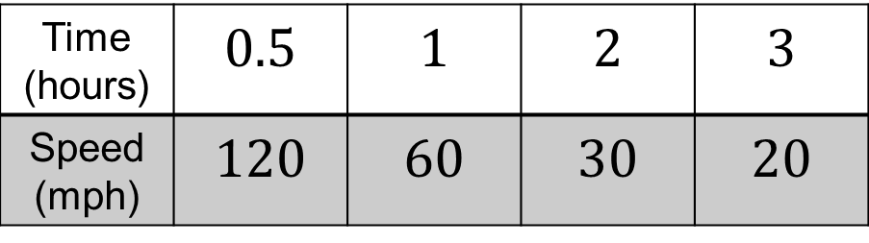


The time taken is
inversely proportional to the average speed
$$×2$$
Time (hours) | $$0.5$$ | $$1$$ | $$2$$ | $$3$$
Speed (mph) | $$120$$ | $$60$$ | $$30$$ | $$20$$
$$÷2$$
Which other relationships can you spot?
Notes:
Give students 2/3 minutes and then bring class together and share other relationships from the class on the board.

Slide 3




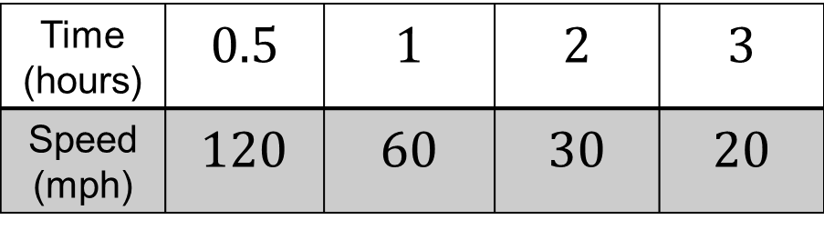
Notice that:
$$0.5×120=60$$
$$1×60=60$$
$$2×30=60$$
$$3×20=60$$
Time (hours) | $$0.5$$ | $$1$$ | $$2$$ | $$3$$
Speed (mph) | $$120$$ | $$60$$ | $$30$$ | $$20$$
Notes:
Give students 2/3 minutes and then bring class together and share other relationships from the class on the board.

Slide 4




Also notice that:
$$60÷0.5=120$$
$$60÷1=60$$
$$60÷2=30$$
$$60÷3=20$$
Time (hours) | $$0.5$$ | $$1$$ | $$2$$ | $$3$$
Speed (mph) | $$120$$ | $$60$$ | $$30$$ | $$20$$
Notes:
Give students 2/3 minutes and then bring class together and share other relationships from the class on the board.

Slide 5
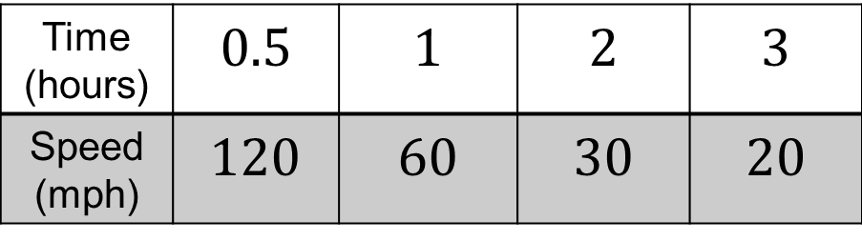
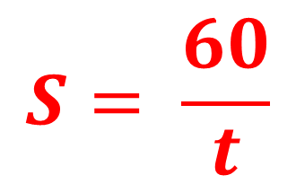
What is the formula that calculates the speed (S) for any given
time (t) for this problem?
Time (hours) | $$0.5$$ | $$1$$ | $$2$$ | $$3$$
Speed (mph) | $$120$$ | $$60$$ | $$30$$ | $$20$$
$$S= \frac{60}{t}$$
Notes:
Give students 2/3 minutes and then bring class together and share suggestions on the board and evaluate them by substitution.

Slide 6
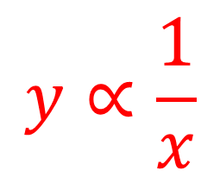
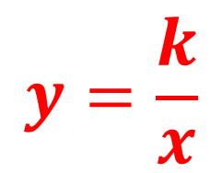
Two variables are inversely proportional if one increases at the same rate as the other decreases.
$$y∝\frac{1}{x}$$
$$y=\frac{k}{x}$$

Slide 7
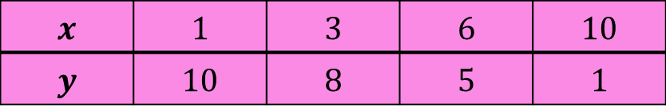
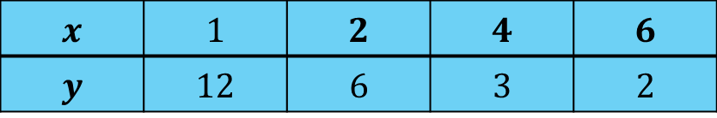
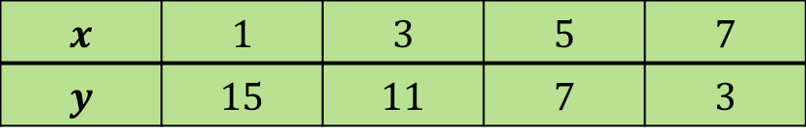
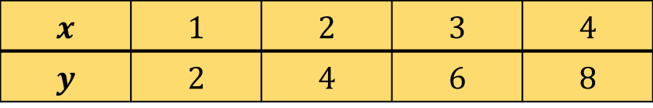
Which table of values is $y$ inversely proportional to $x$?
A
$$x$$ | $$1$$ | $$3$$ | $$6$$ | $$10$$
$$y$$ | $$10$$ | $$8$$ | $$5$$ | $$1$$
B
$$x$$ | $$1$$ | $$2$$ | $$3$$ | $$4$$
$$y$$ | $$2$$ | $$4$$ | $$6$$ | $$8$$
C
$$x$$ | $$1$$ | $$3$$ | $$5$$ | $$7$$
$$y$$ | $$15$$ | $$11$$ | $$7$$ | $$3$$
D
$$x$$ | $$1$$ | $$2$$ | $$4$$ | $$6$$
$$y$$ | $$12$$ | $$6$$ | $$3$$ | $$2$$
How do you know?

Slide 8
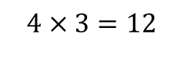

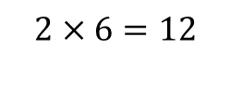
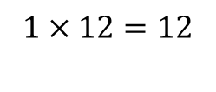
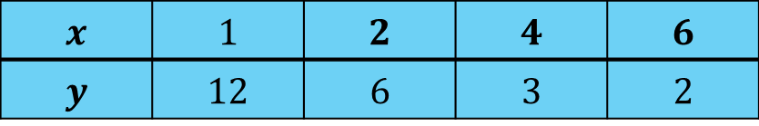
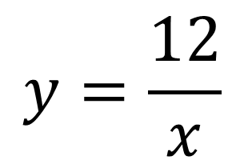
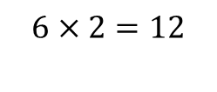
$y∝\frac{1}{x}$ $∴ y=\frac{k}{x}$
D
$$x$$ | $$1$$ | $$2$$ | $$4$$ | $$6$$
$$y$$ | $$12$$ | $$6$$ | $$3$$ | $$2$$
$$1×12=12$$
$$y=\frac{12}{x}$$
$$2×6=12$$
$$4×3=12$$
$$6×2=12$$

Slide 9

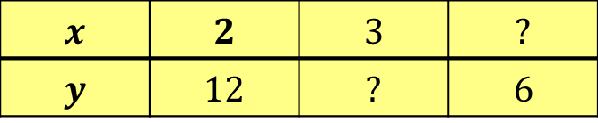

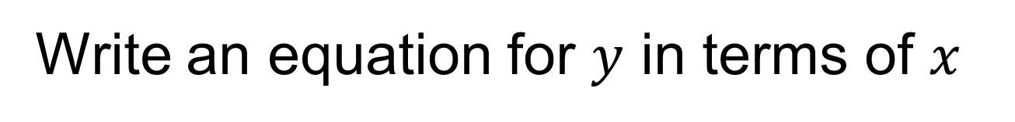
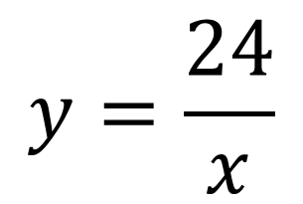

$$y∝\frac{1}{x}$$
$$x$$ | $$2$$ | $$3$$ | $$?$$
$$y$$ | $$12$$ | $$?$$ | $$6$$
$$4$$
$$8$$
What are the missing values?
Write an equation for $y$ in terms of $x$
$$y=\frac{24}{x}$$

Slide 10
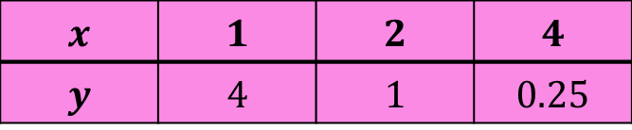


$$y∝\frac{1}{x^{2}}$$
$$x$$ | $$1$$ | $$2$$ | $$4$$
$$y$$ | $$4$$ | $$1$$ | $$0.25$$
What is the value of $k$?

Slide 11

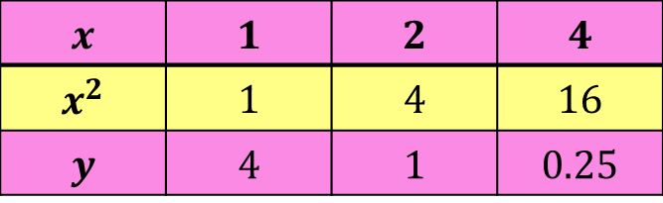





$$y=\frac{k}{x^{2}}$$
$$x$$ | $$1$$ | $$2$$ | $$4$$
$$x^{2}$$ | $$1$$ | $$4$$ | $$16$$
$$y$$ | $$4$$ | $$1$$ | $$0.25$$
What is the value of $k$?
$$1×4=4$$
$$k=4$$
$$4×1=4$$
$$16×0.25=4$$

Slide 12
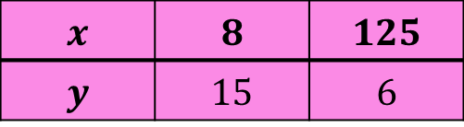
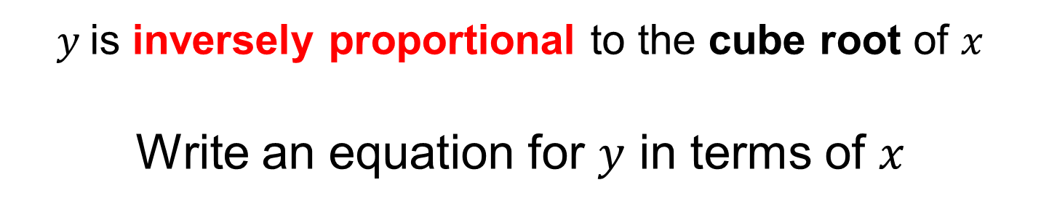
$y$is inversely proportional to the cube root of $x$
Write an equation for $y$ in terms of $x$
$$x$$ | $$8$$ | $$125$$
$$y$$ | $$15$$ | $$6$$

Slide 13


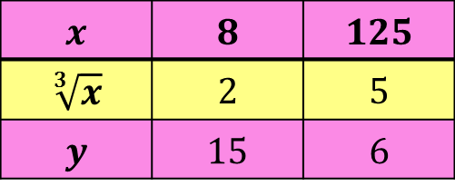


$y$is inversely proportional to the cube root of $x$
Write an equation for $y$ in terms of $x$
$$x$$ | $$8$$ | $$125$$
$$\sqrt[3]{x}$$ | $$2$$ | $$5$$
$$y$$ | $$15$$ | $$6$$
$$2×15=30$$
$$5×6=30$$
$$y=\frac{30}{\sqrt[3]{x}}$$

Slide 14

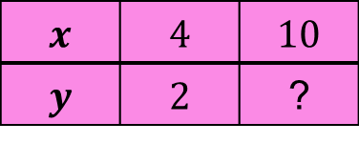

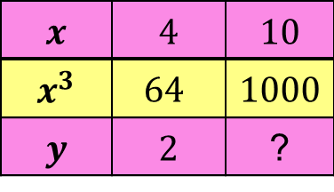

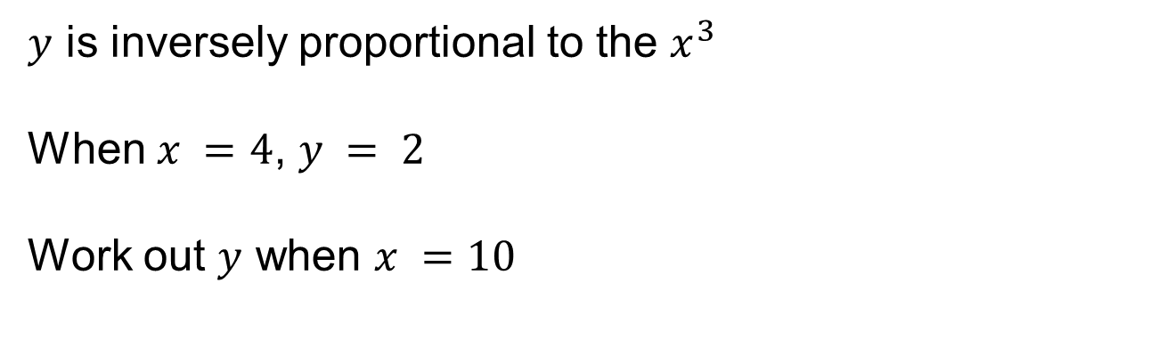

$y$ is inversely proportional to the $x^{3}$
When $x =4$, $y = 2$
Work out $y$ when $x =10$
A table of values can help…
The equation is:
$$y=\frac{128}{x^{3}}$$
$$x$$ | $$4$$ | $$10$$
$$y$$ | $$2$$ | ?
$$y=\frac{128}{{10}^{3}}$$
$$x$$ | $$4$$ | $$10$$
$$x^{3}$$ | $$64$$ | $$1000$$
$$y$$ | $$2$$ | ?
$$y=0.128$$
$$64×2=128$$
Notes:
Mini Whiteboards

Slide 15
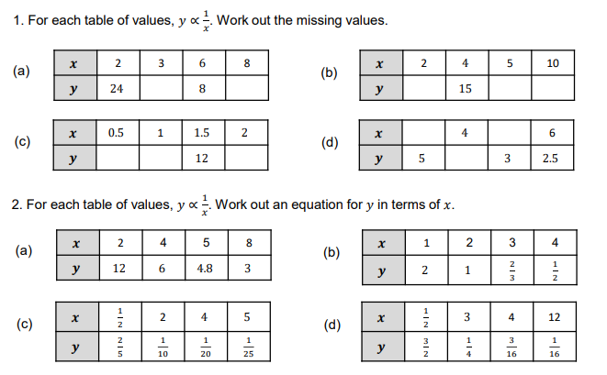
Independent Practice
Notes:
Use Inverse Proportion Worksheet

Slide 16
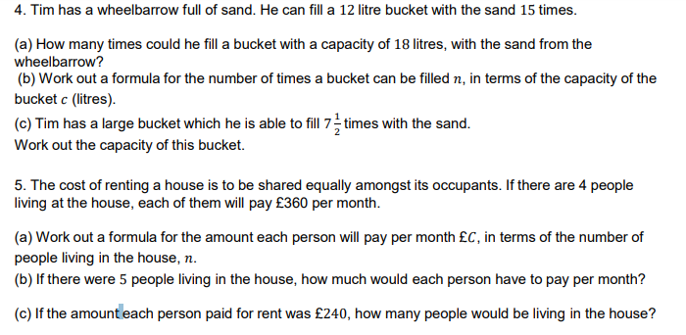
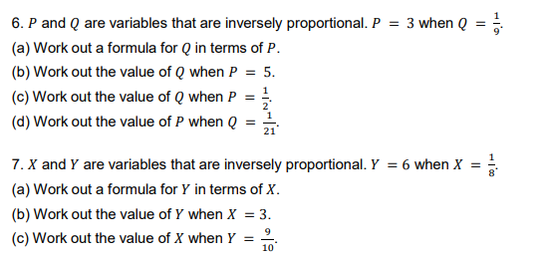

Slide 17
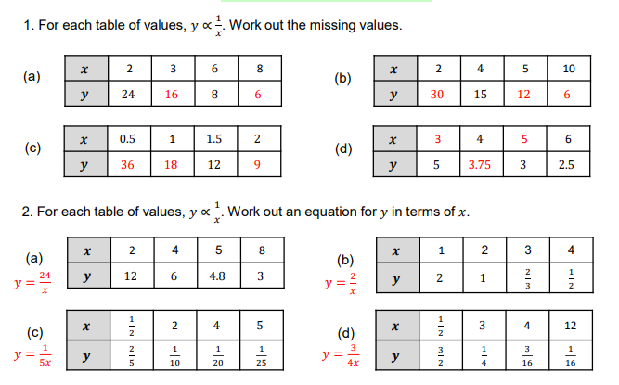
Mark your work
Notes:
Acknowledgements – MathsPad

