Slide 1
In a shop, yogurts are sold individually.
The total cost of 3 yogurts is £1.65.
How can we work out the cost of 7 yogurts?
Notes:
Allow students to attempt this problem before collecting in methods from the class and sharing a few examples

Slide 2
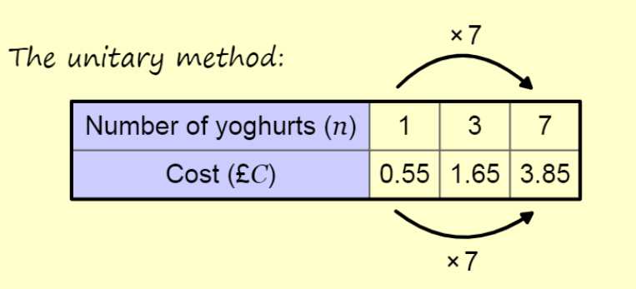
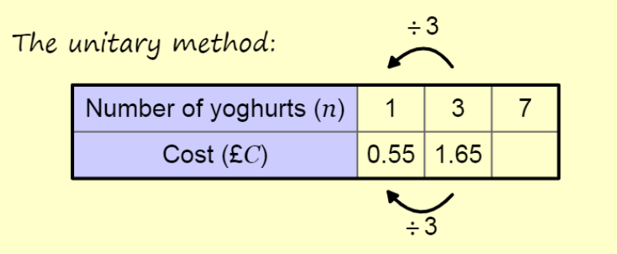
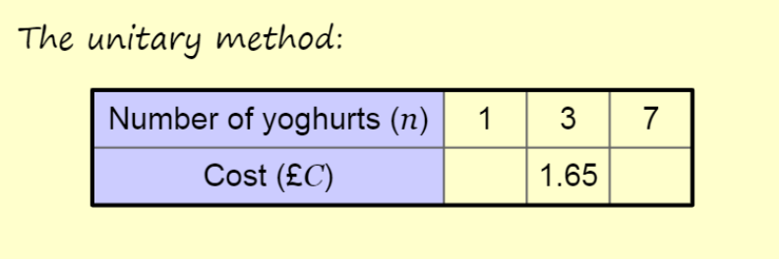
To work out the cost of 7 yogurts we could work out the cost of 1 yogurt first, then use this to calculate the cost of 7 yogurts. This is called the “unitary method”
The cost is directly proportional to the number of yogurts purchased.
Notes:
Allow students to attempt this problem before collecting in methods from the class and sharing a few examples
Linking concept to prior learning from Autumn 1 Year 8

Slide 3
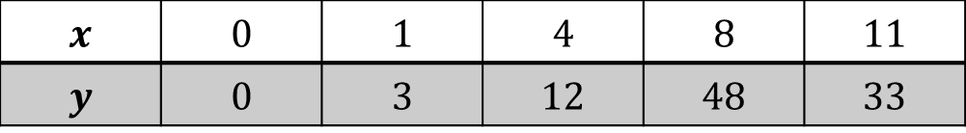
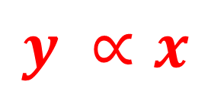


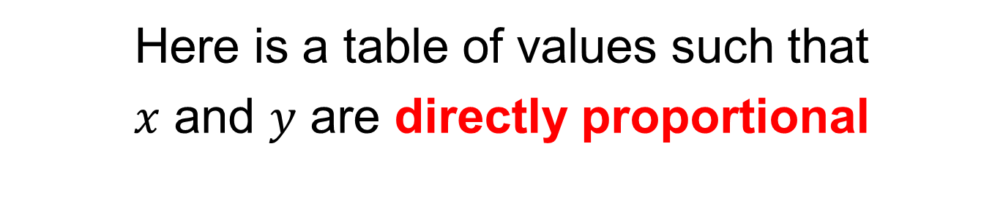
Here is a table of values such that
$x$ and $y$ are directly proportional
$$×2$$
$$x$$ | $$0$$ | $$1$$ | $$4$$ | $$8$$ | $$11$$
$$y$$ | $$0$$ | $$3$$ | $$12$$ | $$48$$ | $$33$$
$$×2$$
Which other relationships can you spot?
$$y ∝x$$
Notes:
Give students 2/3 minutes and then bring class together and share other relationships from the class on the board.

Slide 4
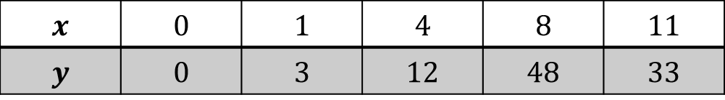
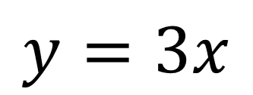

Notice how the $y$ values are the $x$ values multiplied by 3
$$x$$ | $$0$$ | $$1$$ | $$4$$ | $$8$$ | $$11$$
$$y$$ | $$0$$ | $$3$$ | $$12$$ | $$48$$ | $$33$$
$$×3$$
How could we write this relationship algebraically?
$$y=3x$$
This value is called the “proportionality constant”
Notes:
Give students 2/3 minutes and then bring class together and share other relationships from the class on the board.

Slide 5
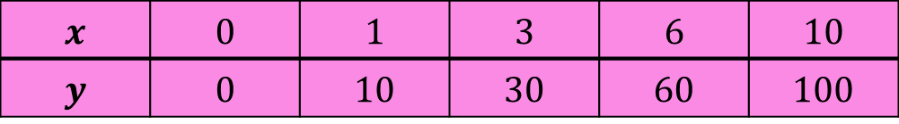
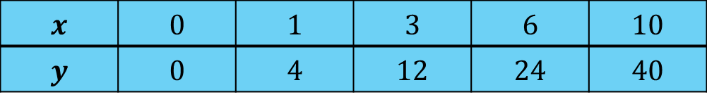
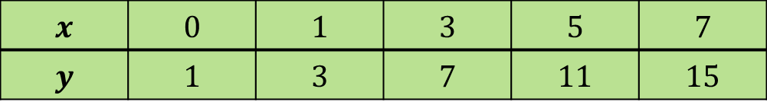
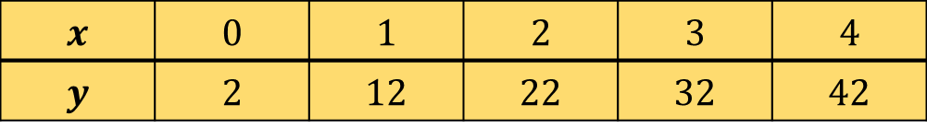
Which table of values have $y$ directly proportion to $x$?
A
$$x$$ | $$0$$ | $$1$$ | $$3$$ | $$6$$ | $$10$$
$$y$$ | $$0$$ | $$10$$ | $$30$$ | $$60$$ | $$100$$
B
$$x$$ | $$0$$ | $$1$$ | $$2$$ | $$3$$ | $$4$$
$$y$$ | $$2$$ | $$12$$ | $$22$$ | $$32$$ | $$42$$
C
$$x$$ | $$0$$ | $$1$$ | $$3$$ | $$5$$ | $$7$$
$$y$$ | $$1$$ | $$3$$ | $$7$$ | $$11$$ | $$15$$
D
$$x$$ | $$0$$ | $$1$$ | $$3$$ | $$6$$ | $$10$$
$$y$$ | $$0$$ | $$4$$ | $$12$$ | $$24$$ | $$40$$

Slide 6
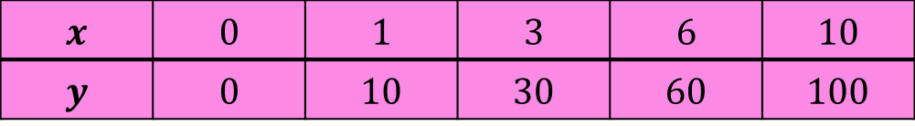
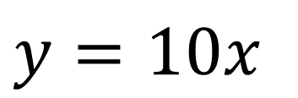

$y∝x$ $∴ y=kx$
A
$$x$$ | $$0$$ | $$1$$ | $$3$$ | $$6$$ | $$10$$
$$y$$ | $$0$$ | $$10$$ | $$30$$ | $$60$$ | $$100$$
$$×10$$
What is the value of $k$ for this table of values?
$y=10x$

Slide 7
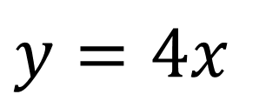
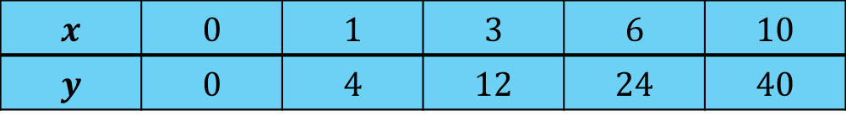

$y∝x$ $∴ y=kx$
D
$$x$$ | $$0$$ | $$1$$ | $$3$$ | $$6$$ | $$10$$
$$y$$ | $$0$$ | $$4$$ | $$12$$ | $$24$$ | $$40$$
$$×4$$
What is the value of $k$ for this table of values?
$y=4x$

Slide 8

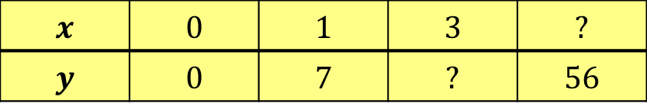
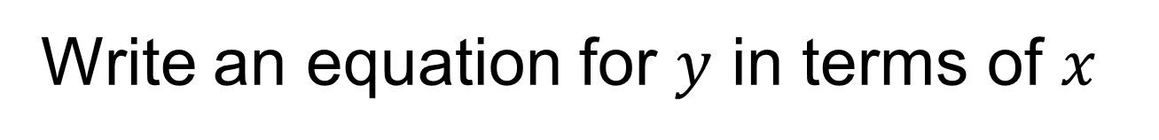
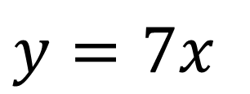


$$y∝x$$
$$x$$ | $$0$$ | $$1$$ | $$3$$ | $$?$$
$$y$$ | $$0$$ | $$7$$ | $$?$$ | $$56$$
$$6$$
$$×7$$
$$21$$
What are the missing values?
Write an equation for $y$ in terms of $x$
$y=7x$

Slide 9
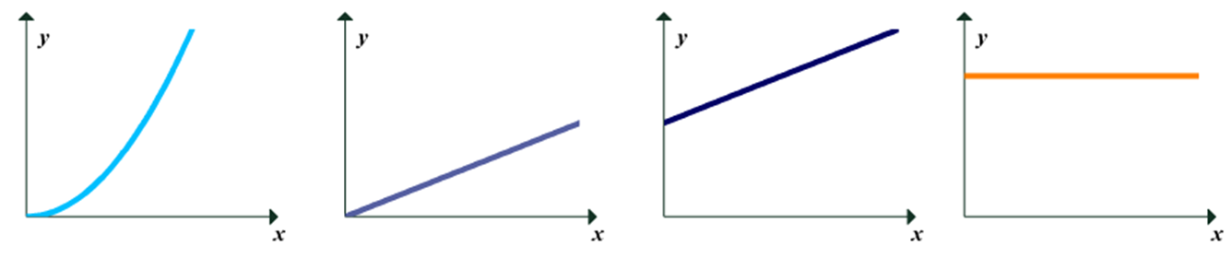
Which graph matches this table of values?
$$x$$ | $$0$$ | $$1$$ | $$3$$ | $$6$$ | $$10$$
$$y$$ | $$0$$ | $$10$$ | $$30$$ | $$60$$ | $$100$$
A
B
C
D

Slide 10
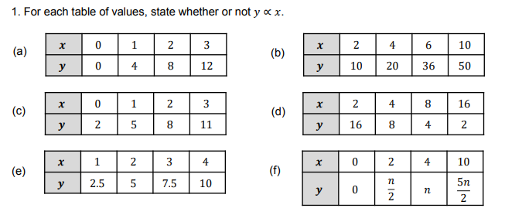
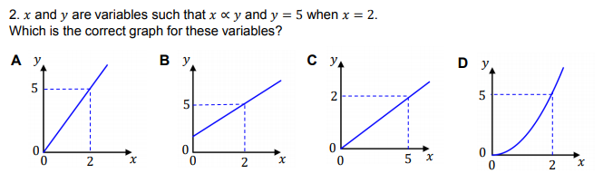
Title: Direct Proportion
Notes:
Use MathsPad worksheet – independent practice (not all classes will require this independent practice)

Slide 11
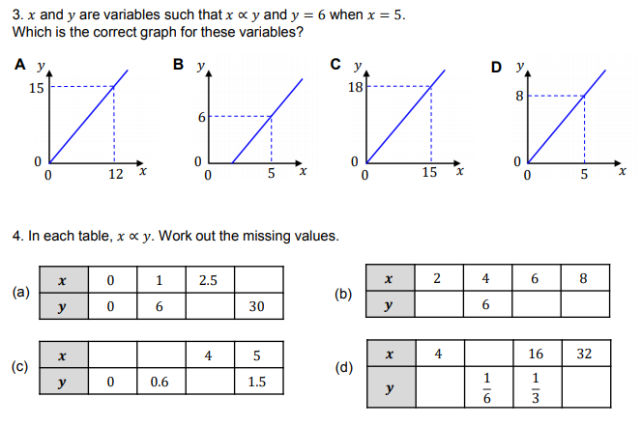
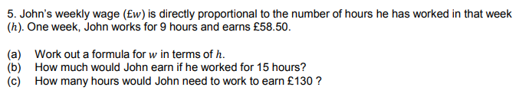

Slide 12
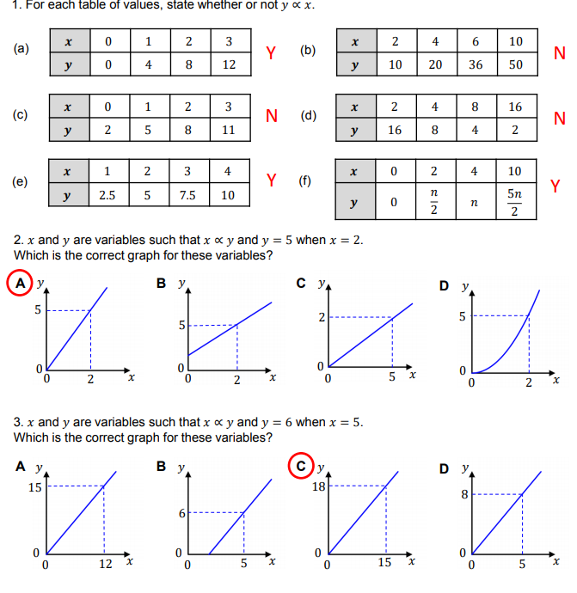
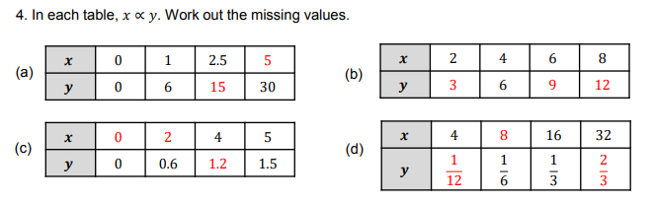
Mark your work

Slide 13
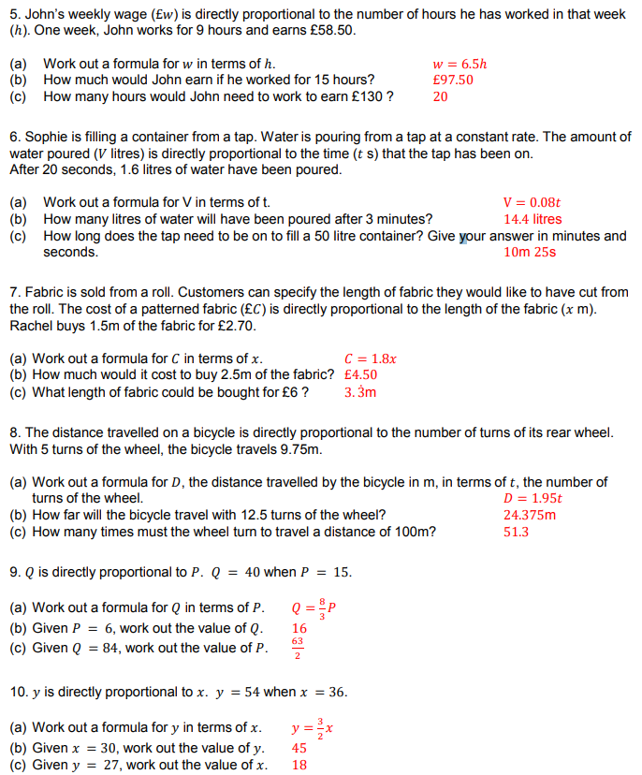

Slide 14
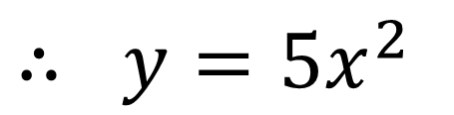
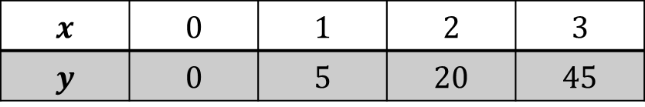

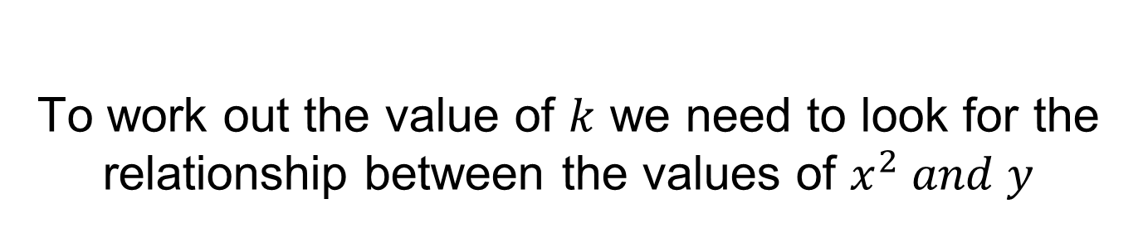
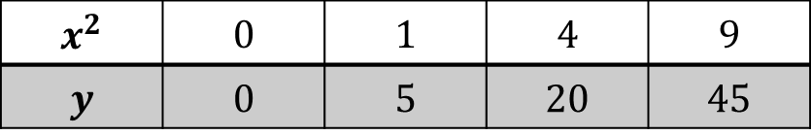
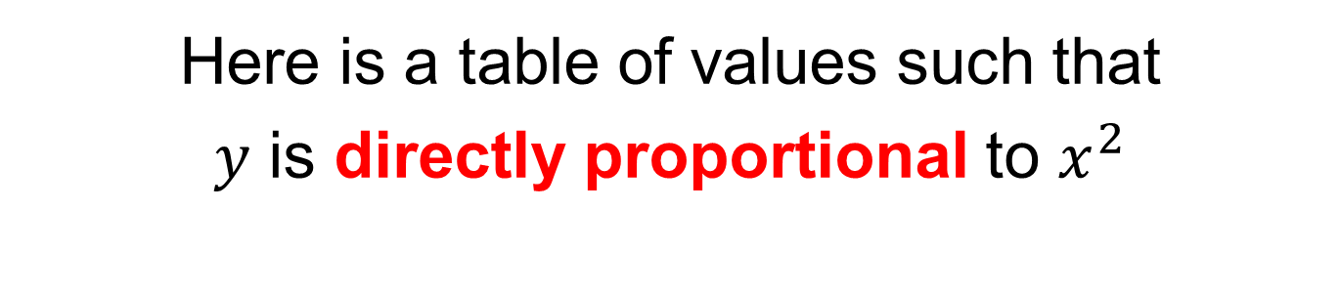
Here is a table of values such that
$y$ is directly proportional to $x^{2}$
$$x$$ | $$0$$ | $$1$$ | $$2$$ | $$3$$
$$y$$ | $$0$$ | $$5$$ | $$20$$ | $$45$$
To work out the value of $k$ we need to look for the relationship between the values of $x^{2} and y$
$$x^{2}$$ | $$0$$ | $$1$$ | $$4$$ | $$9$$
$$y$$ | $$0$$ | $$5$$ | $$20$$ | $$45$$
$$×5$$
$∴ y=5x^{2}$
Notes:
Give students 2/3 minutes and then bring class together and share other relationships from the class on the board.

Slide 15
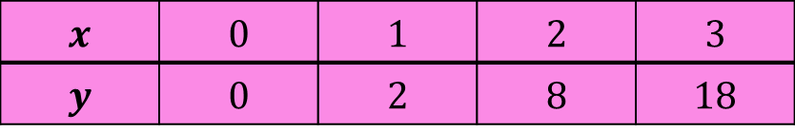
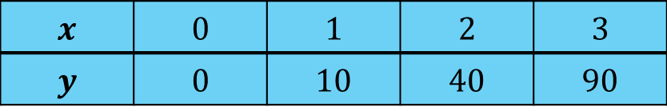
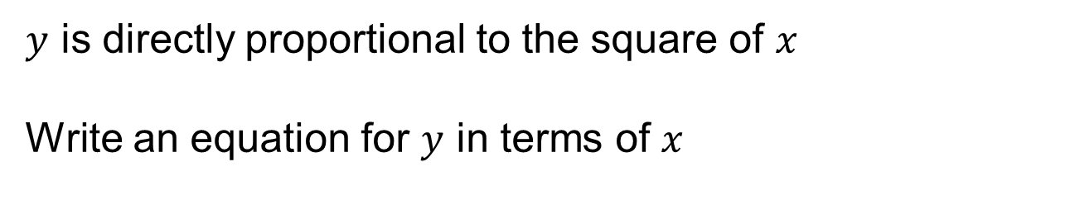
$y$ is directly proportional to the square of $x$
Write an equation for $y$ in terms of $x$
A
$$x$$ | $$0$$ | $$1$$ | $$2$$ | $$3$$
$$y$$ | $$0$$ | $$2$$ | $$8$$ | $$18$$
B
$$x$$ | $$0$$ | $$1$$ | $$2$$ | $$3$$
$$y$$ | $$0$$ | $$10$$ | $$40$$ | $$90$$
Notes:
Mini whiteboards

Slide 16
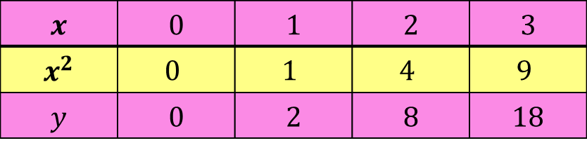
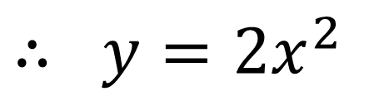

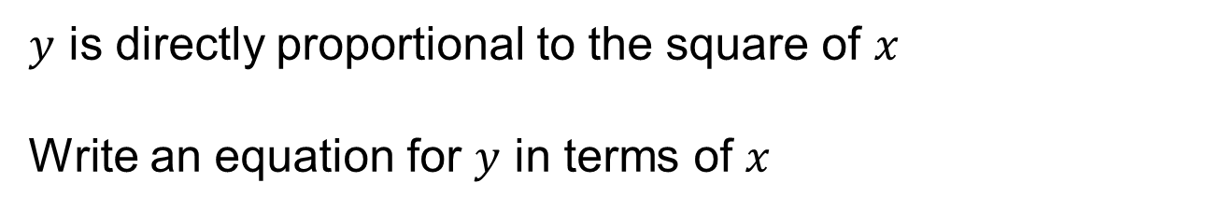
$y$ is directly proportional to the square of $x$
Write an equation for $y$ in terms of $x$
A
$$x$$ | $$0$$ | $$1$$ | $$2$$ | $$3$$
$$x^{2}$$ | $$0$$ | $$1$$ | $$4$$ | $$9$$
$$y$$ | $$0$$ | $$2$$ | $$8$$ | $$18$$
$$×2$$
$∴ y=2x^{2}$

Slide 17
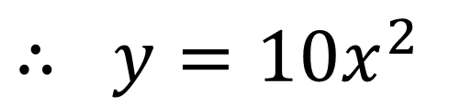

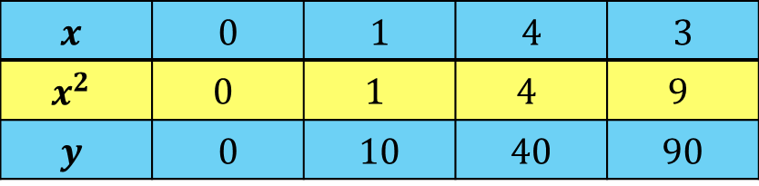
$y$ is directly proportional to the square of $x$
Write an equation for $y$ in terms of $x$
B
$$x$$ | $$0$$ | $$1$$ | $$4$$ | $$3$$
$$x^{2}$$ | $$0$$ | $$1$$ | $$4$$ | $$9$$
$$y$$ | $$0$$ | $$10$$ | $$40$$ | $$90$$
$$×10$$
$∴ y=10x^{2}$

Slide 18
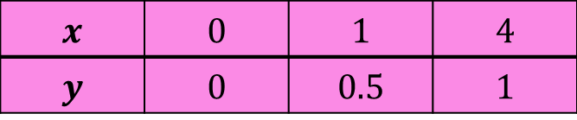
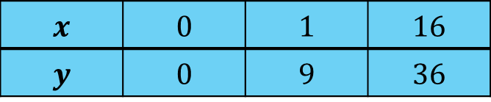
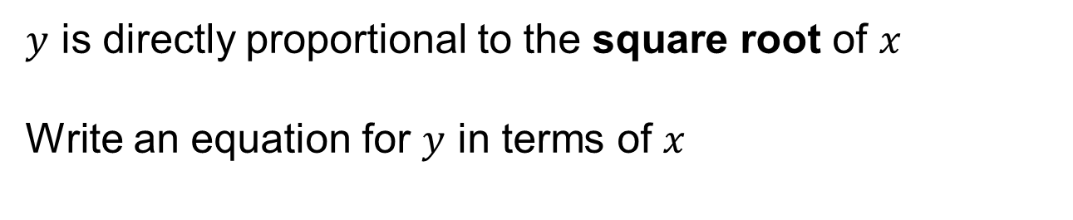
$y$ is directly proportional to the square root of $x$
Write an equation for $y$ in terms of $x$
A
$$x$$ | $$0$$ | $$1$$ | $$4$$
$$y$$ | $$0$$ | $$0.5$$ | $$1$$
B
$$x$$ | $$0$$ | $$1$$ | $$16$$
$$y$$ | $$0$$ | $$9$$ | $$36$$
Notes:
Mini whiteboards

Slide 19
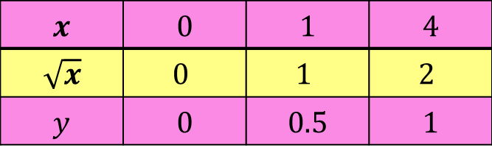
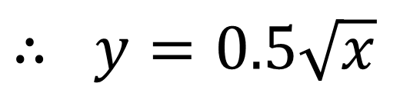

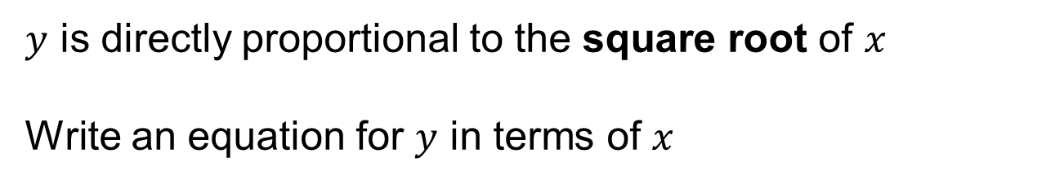
$y$ is directly proportional to the square root of $x$
Write an equation for $y$ in terms of $x$
A
$$x$$ | $$0$$ | $$1$$ | $$4$$
$$\sqrt{x}$$ | $$0$$ | $$1$$ | $$2$$
$$y$$ | $$0$$ | $$0.5$$ | $$1$$
$$×0.5$$
$∴ y=0.5\sqrt{x}$

Slide 20
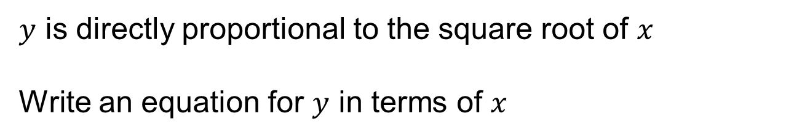
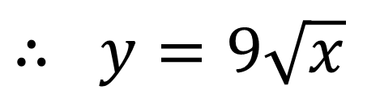

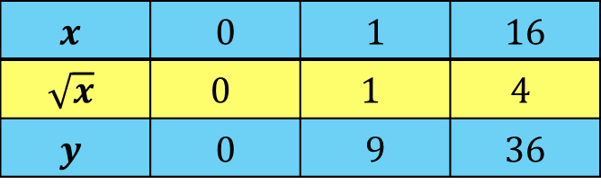
$y$ is directly proportional to the square root of $x$
Write an equation for $y$ in terms of $x$
B
$$x$$ | $$0$$ | $$1$$ | $$16$$
$$\sqrt{x}$$ | $$0$$ | $$1$$ | $$4$$
$$y$$ | $$0$$ | $$9$$ | $$36$$
$$×9$$
$∴ y=9\sqrt{x}$

Slide 21
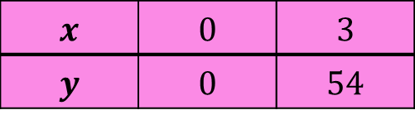


$y$ is directly proportional to the cube of $x$
Write an equation for $y$ in terms of $x$
A
$$x$$ | $$0$$ | $$3$$
$$y$$ | $$0$$ | $$54$$
B
$$x$$ | $$0$$ | $$5$$
$$y$$ | $$0$$ | $$12.5$$
Notes:
Mini Whiteboards

Slide 22




$y$ is directly proportional to the cube of $x$
Write an equation for $y$ in terms of $x$
A
$$x$$ | $$0$$ | $$3$$
$$x^{3}$$ | $$0$$ | $$27$$
$$y$$ | $$0$$ | $$54$$
$$×2$$
$$∴ y=2x^{3}$$

Slide 23




$y$ is directly proportional to the cube of $x$
Write an equation for $y$ in terms of $x$
B
$$x$$ | $$0$$ | $$5$$
$$x^{3}$$ | $$0$$ | $$125$$
$$y$$ | $$0$$ | $$12.5$$
$$×0.1$$
$$∴ y=\frac{x^{3}}{10}$$
$$∴ y=0.1x^{3}$$

Slide 24




$y$ is directly proportional to the $x^{5}$
When $y =320, x =2$
Work out $y$ when $x =10$
A table of values can help…
$$x$$ | $$0$$ | $$2$$ | $$10$$
$$y$$ | $$0$$ | $$320$$ | ?
$$x$$ | $$0$$ | $$2$$ | $$10$$
$$x^{5}$$ | $$0$$ | 32
$$y$$ | $$0$$ | $$320$$ | ?
100000
$$×10$$
1000000
Notes:
Mini Whiteboards

Slide 25

Independent Practice
Notes:
Use DirectProportionWorksheet2

Slide 26

Mark your work
Notes:
Acknowledgements – MathsPad

