Slide 1
Angle Chase

Slide 2
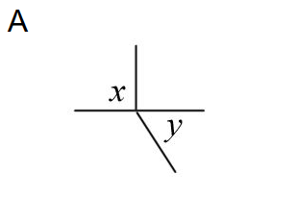
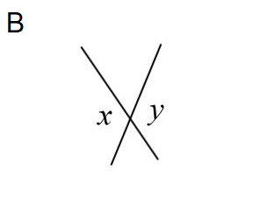
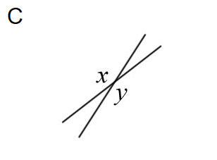
Which of these pairs of angles are NOT vertically opposite?
Notes:
Nonexamples.com/oddoneout

Slide 3
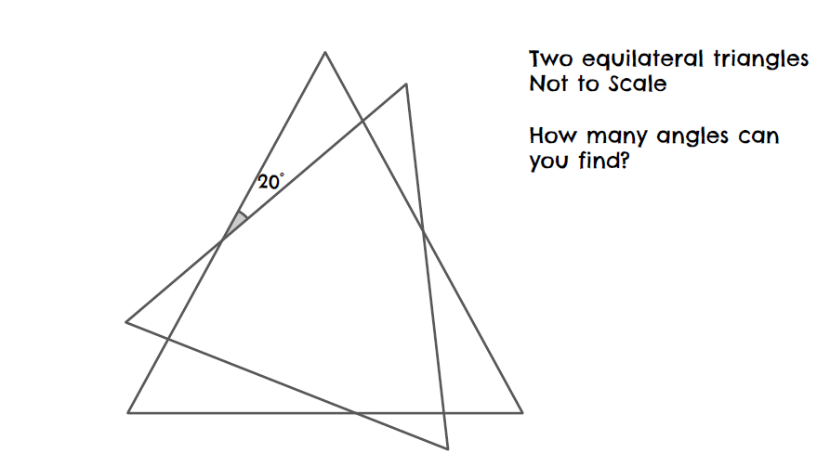

Slide 4
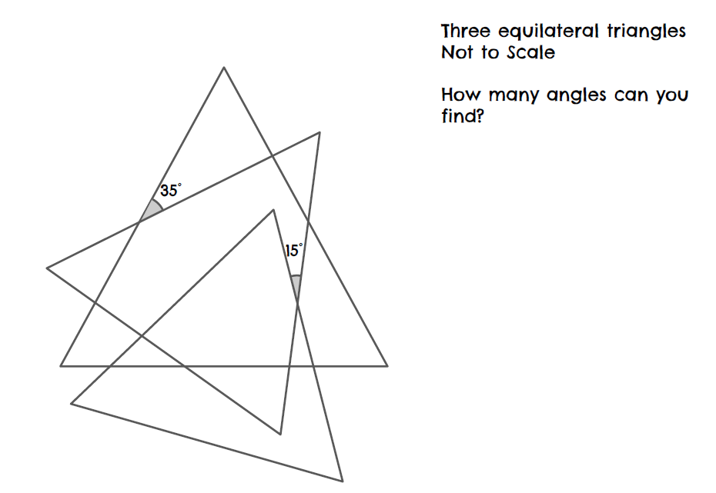

Slide 5
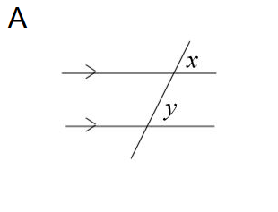
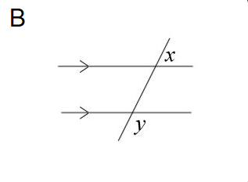
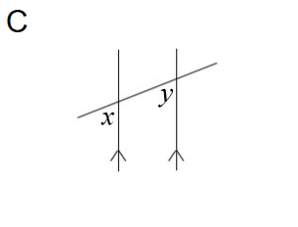
Which of these pairs of angles are NOT corresponding angles?
Notes:
Nonexamples.com/oddoneout

Slide 6
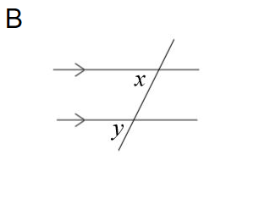
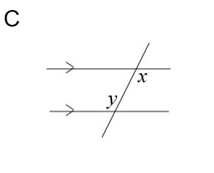
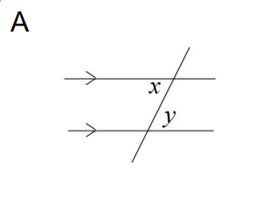
Which of these pairs of angles are NOT alternate angles?
Notes:
Nonexamples.com/oddoneout

Slide 7
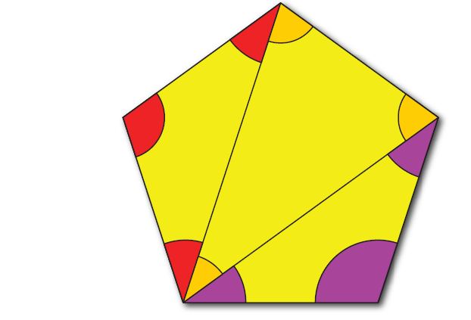
What do the interior angles of a PENTAGON sum to?

Slide 8
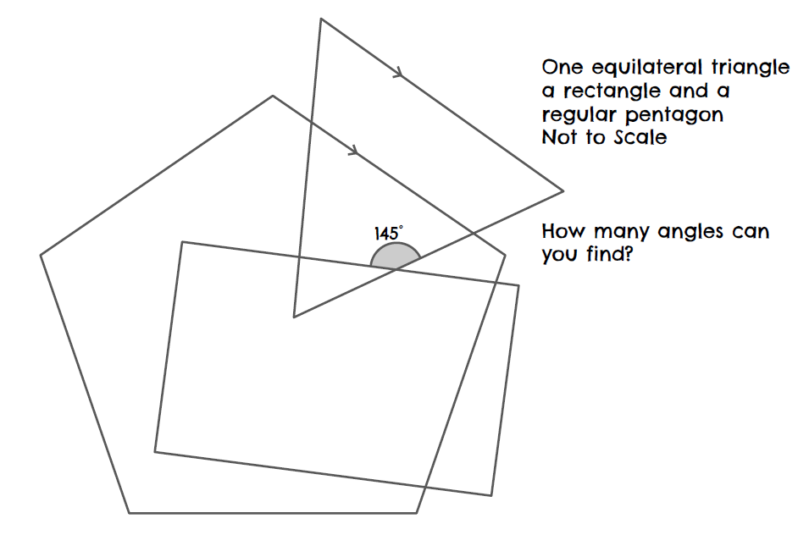

Slide 9
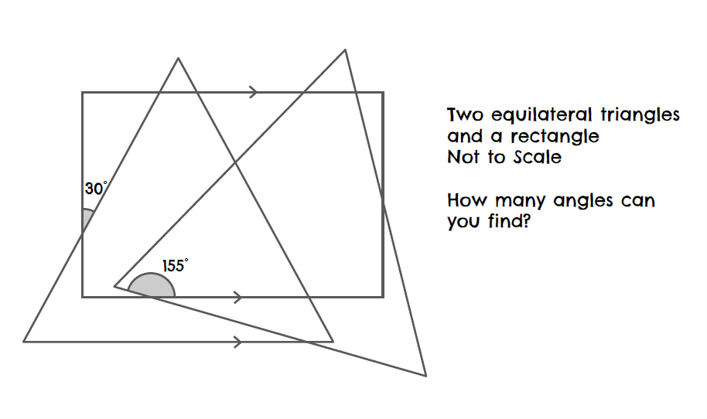

Slide 10


Which angle is NOT 50$°$?
C
B
$$50°$$
A
Notes:
Nonexamples.com/oddoneout

Slide 11

Which angle is NOT 50$°$?
C
$$50°$$
B
A
Notes:
Nonexamples.com/oddoneout

Slide 12

Which angle is NOT 50$°$?
C
$$50°$$
B
A
Notes:
Nonexamples.com/oddoneout

Slide 13
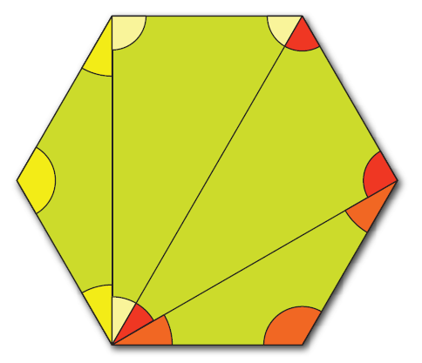
What do the interior angles of a Hexagon sum to?

Slide 14
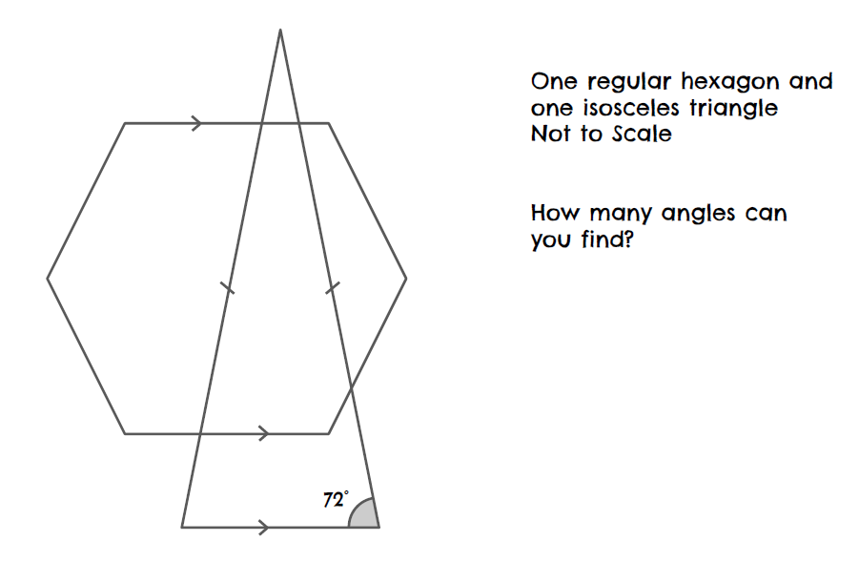

Slide 15
