Slide 1
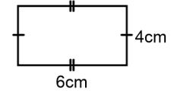
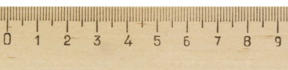
The dimensions of this rectangle have been rounded to the nearest integer
Write down what the actual base of the rectangle could have measured
And another….
And another….
Notes:
Compare and share whiteboards

Slide 2
The dimensions of this rectangle have been rounded to the nearest integer
Write down what the actual height of the rectangle could have been
And another….
And another….
Notes:
Compare and share whiteboards

Slide 3
The dimensions of this rectangle have been rounded to the nearest integer
Write down a calculation that could work out the actual area of this rectangle
And another….
And another….
Notes:
Compare and share whiteboards

Slide 4
The dimensions of this rectangle have been rounded to the nearest integer
A student thinks that the maximum possible area of this rectangle could be calculated by working out $6.4 × 4.4$
Discuss with your partner why this student is wrong

Slide 5
The dimensions of this rectangle have been rounded to the nearest integer
Write a calculation that would work out the
minimum possible area of the rectangle

Slide 6
The dimensions of this rectangle have been rounded to the nearest integer
Work out $5.5 ×3.5$

Slide 7
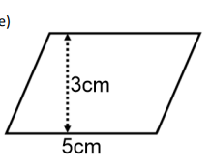
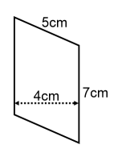
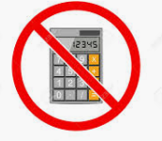

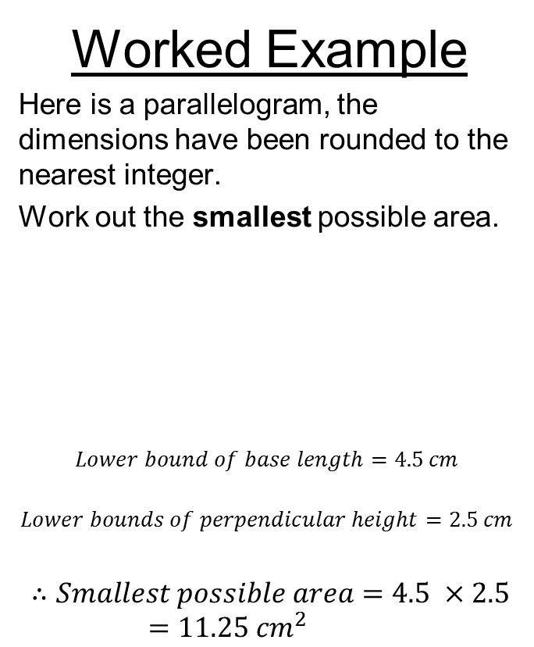
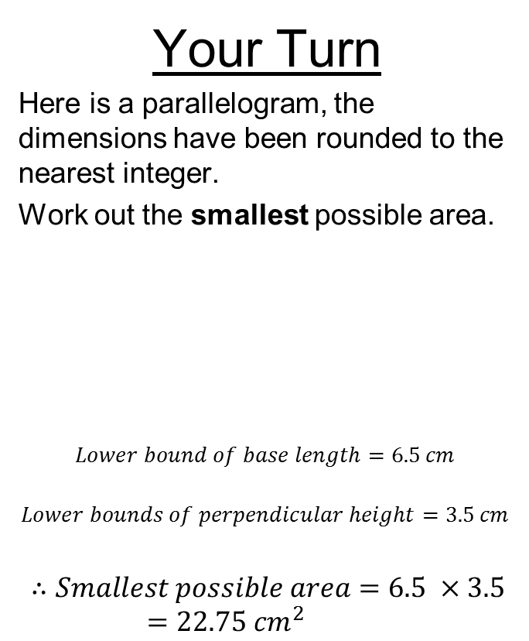
Title: Using upper and lower bounds
Worked Example
Here is a parallelogram, the dimensions have been rounded to the nearest integer.
Work out the smallest possible area.
$$Lower bound of base length=4.5 cm$$
$$Lower bounds of perpendicular height=2.5 cm$$
$$∴Smallest possible area=4.5 ×2.5=11.25 {cm}^{2}$$
Your Turn
Here is a parallelogram, the dimensions have been rounded to the nearest integer.
Work out the smallest possible area.
$$Lower bound of base length=6.5 cm$$
$$Lower bounds of perpendicular height=3.5 cm$$
$$∴Smallest possible area=6.5 ×3.5=22.75 {cm}^{2}$$

Slide 8
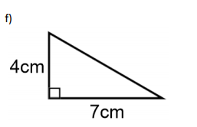
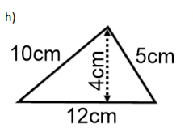
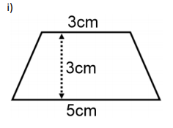
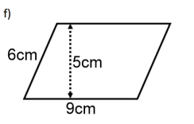
In your books:
Work out the minimum and maximum possible areas of the following shapes.
All dimensions have been rounded to the nearest integer
1.
2.
3.
4.

Slide 9

Mark your work
(all units ${cm}^{2})$
Min. = 11.375 Max. = 16.875
Min. = 20.125 Max. = 28.125
Min. = 8.75 Max. = 15.75
Min. = 38.25 Max. = 52.25

Slide 10
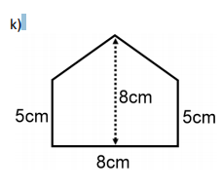
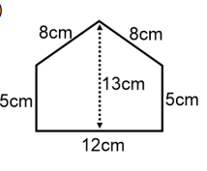
Challenge
Work out the smallest possible difference in area of these two pentagons
a.
b.

