Slide 1
Sequence 1: 1, 2, 4, 8, ….
Sequence 2: 5, 10, 20, 40, ….
Sequence 3: 1000, 500, 250, 125, ….
Sequence 4: 19, 17, 15, 13, ….
Sequence 5: 2, 4, 6, 10, 16, ….
Which sequence is linear? How do you know?

Slide 2
Sequence 4: 19, 17, 15, 13, ….
This is a linear sequence because it decreases by a common difference.
Linear sequences are sometimes known as Arithmetic sequences.

Slide 3
Sequence 1: 1, 2, 4, 8, ….
Sequence 2: 5, 10, 20, 40, ….
Sequence 3: 1000, 500, 250, 125, ….
Sequence 4: 19, 17, 15, 13, ….
Sequence 5: 2, 4, 6, 10, 16, ….
Which sequence is Fibonacci-like? How do you know?

Slide 4
Sequence 5: 2, 4, 6, 10, 16, ….
This sequence is a Fibonacci sequences as the next term is the sum of the two previous terms.

Slide 5
Sequence 1: 1, 2, 4, 8, ….
Sequence 2: 5, 10, 20, 40, ….
Sequence 3: 1000, 500, 250, 125, ….
What do these sequences have in common?

Slide 6
Sequence 1: 1, 2, 4, 8, ….
Sequence 2: 5, 10, 20, 40, ….
Sequence 3: 1000, 500, 250, 125, ….
The next number is found by multiplying or dividing the previous term by a fixed, non-zero number called the common ratio
These sequences are called Geometric sequences or progressions.

Slide 7




Student A | Types of Sequences Tick or Trash | Student B
Arithmetic | 3, 7, 11, 15, 19, 23, … | Geometric
Fibonacci | 1, 4, 9, 16, 25, 36, … | Square Numbers
Arithmetic | 3, 6, 12, 24, 48, … | Geometric
Fibonacci | 1, 1, 2, 3, 5, 8, 13… | Triangle Numbers
Fibonacci | -2, 4, -8, 16, -32, … | Geometric
Geometric | 1, 8, 27, 64, 125, | Cubed Numbers
Notes:
Tick or Trash Activity – In pairs students to decide which student has correctly defined each sequence

Slide 8
Sequence 1: 1, 2, 4, 8, ….
Sequence 2: 5, 10, 20, 40, ….
Sequence 3: 1000, 500, 250, 125, ….
Sequence 4: 19, 17, 15, 13, ….
Sequence 5: 2, 4, 6, 10, 16, ….
Describe how to go from one term to the next term of each sequence
Notes:
After the introduction of iterative notation, iterative formulae will be used to find the approximate solution to an equation in a later lesson. The origins of the iterative formula, through the rearrangement of the original equation, are also considered. Display the following information on the board. Students could work in pairs or small groups to determine the answers.

Slide 9
Sequence 1: 1, 2, 4, 8, …. Multiply the previous term by 2, starting with 1
Sequence 2: 5, 10, 20, 40, …. Multiply the previous term by 2, starting with 5
Sequence 3: 1000, 500, 250, 125, …. Half the previous term, starting with 1000
Sequence 4: 19, 17, 15, 13, …. Subtract 2 from the previous term starting with 19
Sequence 5: 2, 4, 6, 10, 16, …. Add together the two previous terms, starting with 2 and 4 as the first two terms
This rules are known the “term to term” rules
Notes:
After the introduction of iterative notation, iterative formulae will be used to find the approximate solution to an equation. The origins of the iterative formula, through the rearrangement of the original equation, are also considered. Display the following information on the board. Students could work in pairs or small groups to determine the answers.

Slide 10
Sequence 1: 1, 2, 4, 8, …. Multiply the previous term by 2, starting with 1
Sequence 2: 5, 10, 20, 40, …. Multiply the previous term by 2, starting with 5
Sequence 3: 1000, 500, 250, 125, …. Half the previous term, starting with 1000
Sequence 4: 19, 17, 15, 13, …. Subtract 2 from the previous term starting with 19
Sequence 5: 2, 4, 6, 10, 16, …. Add together the two previous terms, starting with 2 and 4 as the first two terms
These term to term rules can written algebraically
Notes:
After the introduction of iterative notation, iterative formulae will be used to find the approximate solution to an equation. The origins of the iterative formula, through the rearrangement of the original equation, are also considered. Display the following information on the board. Students could work in pairs or small groups to determine the answers.

Slide 11
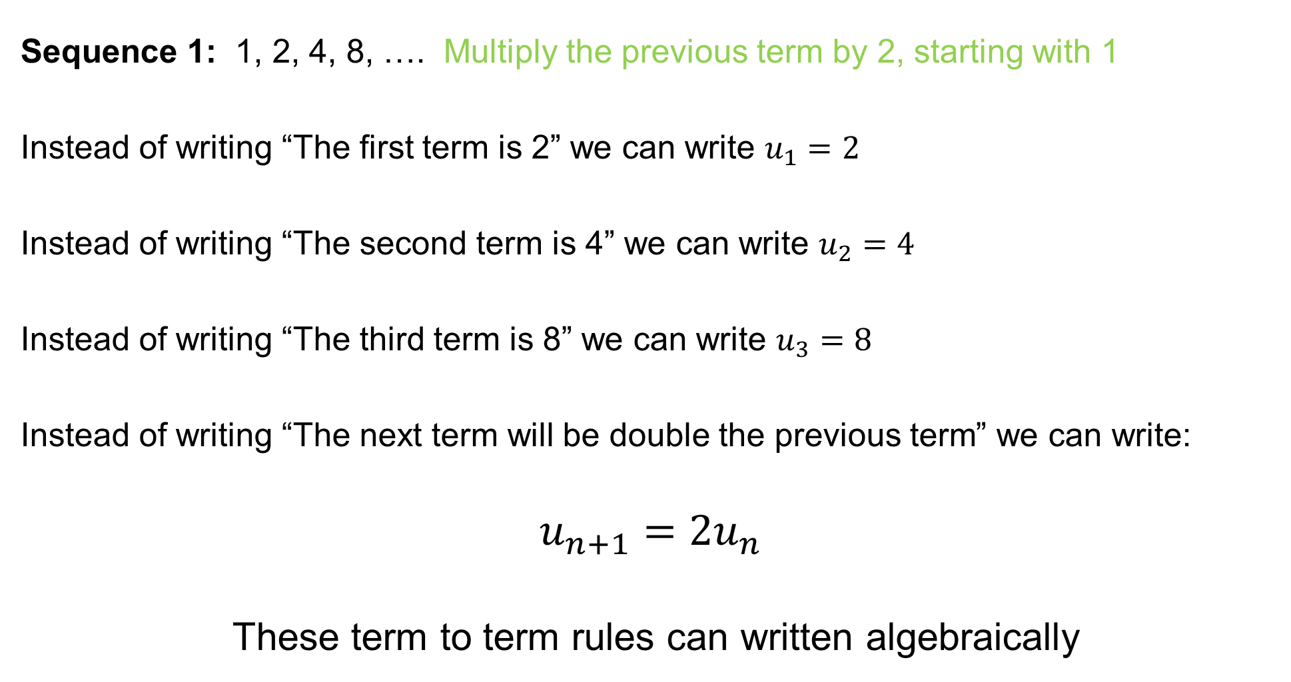
Sequence 1: 1, 2, 4, 8, …. Multiply the previous term by 2, starting with 1
Instead of writing “The first term is 2” we can write $u_{1}=2$
Instead of writing “The second term is 4” we can write $u_{2}=4$
Instead of writing “The third term is 8” we can write $u_{3}=8$
Instead of writing “The next term will be double the previous term” we can write:
$$u_{n+1}=2u_{n}$$
These term to term rules can written algebraically
Notes:
After the introduction of iterative notation, iterative formulae will be used to find the approximate solution to an equation. The origins of the iterative formula, through the rearrangement of the original equation, are also considered. Display the following information on the board. Students could work in pairs or small groups to determine the answers.

Slide 12
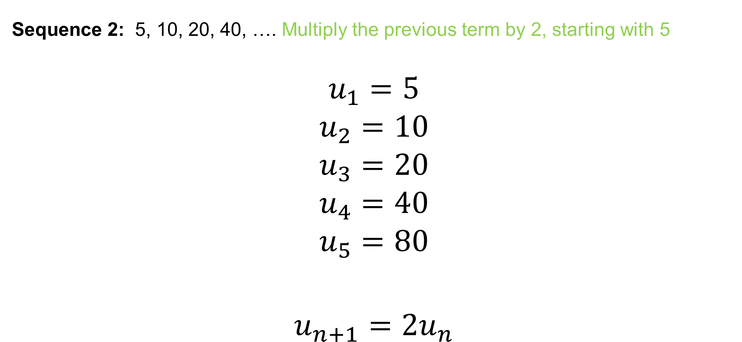
Sequence 2: 5, 10, 20, 40, …. Multiply the previous term by 2, starting with 5
$$u_{1}=5$$
$$u_{2}=10$$
$$u_{3}=20$$
$$u_{4}=40$$
$$u_{5}=80$$
$$u_{n+1}=2u_{n}$$
?
?
?
?
?
?
Notes:
On whiteboards

Slide 13
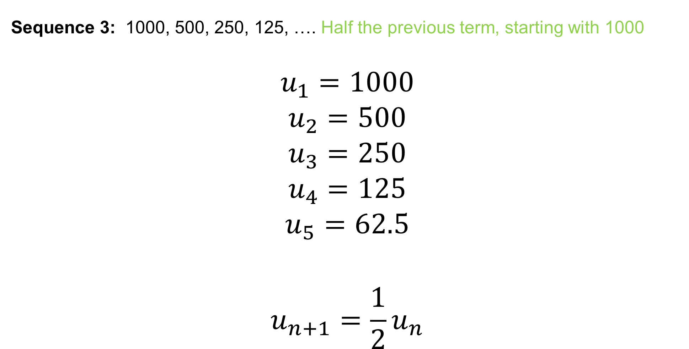
Sequence 3: 1000, 500, 250, 125, …. Half the previous term, starting with 1000
$$u_{1}=1000$$
$$u_{2}=500$$
$$u_{3}=250$$
$$u_{4}=125$$
$$u_{5}=62.5$$
$$u_{n+1}=\frac{1}{2}u_{n}$$
?
?
?
?
?
?
Notes:
On whiteboards

Slide 14
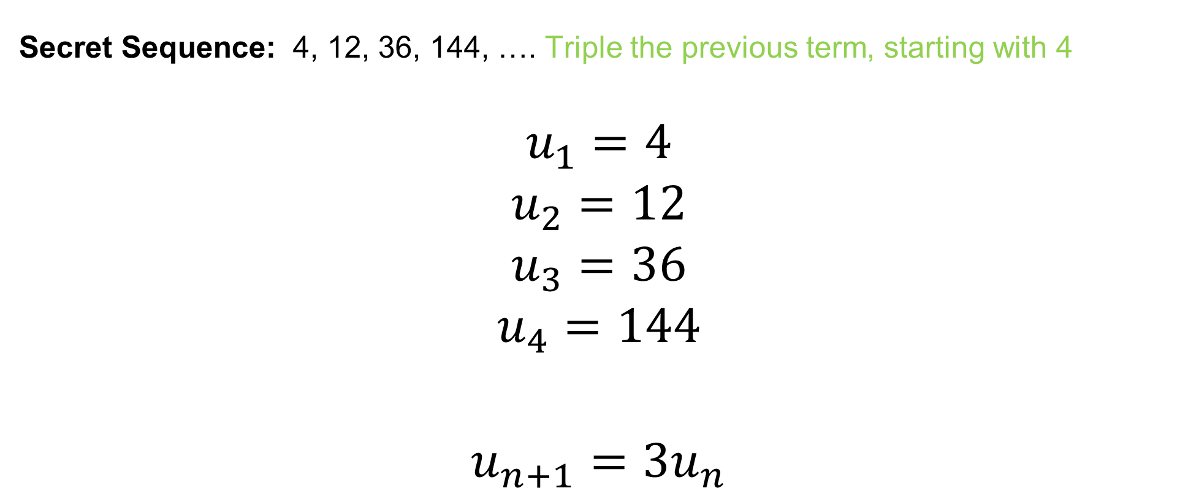
Secret Sequence: 4, 12, 36, 144, …. Triple the previous term, starting with 4
$$u_{1}=4$$
$$u_{2}=12$$
$$u_{3}=36$$
$$u_{4}=144$$
$$u_{n+1}={3u}_{n}$$
?
?
?
?
?
Notes:
On whiteboards

Slide 15
Title: Iterative Formulae
Iteration is the act of repeating a process.
Each repetition of the process is also called an iteration, and the results of one iteration are used as the starting point for the next iteration.
Sequences can be generated using iteration and equations can be solved using iteration.

Slide 16
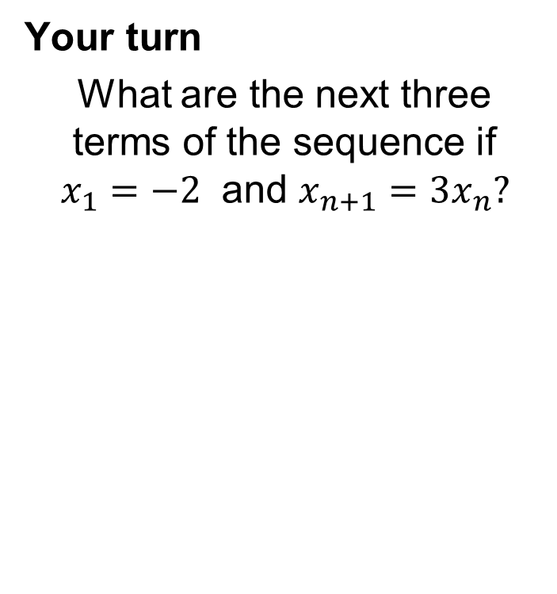
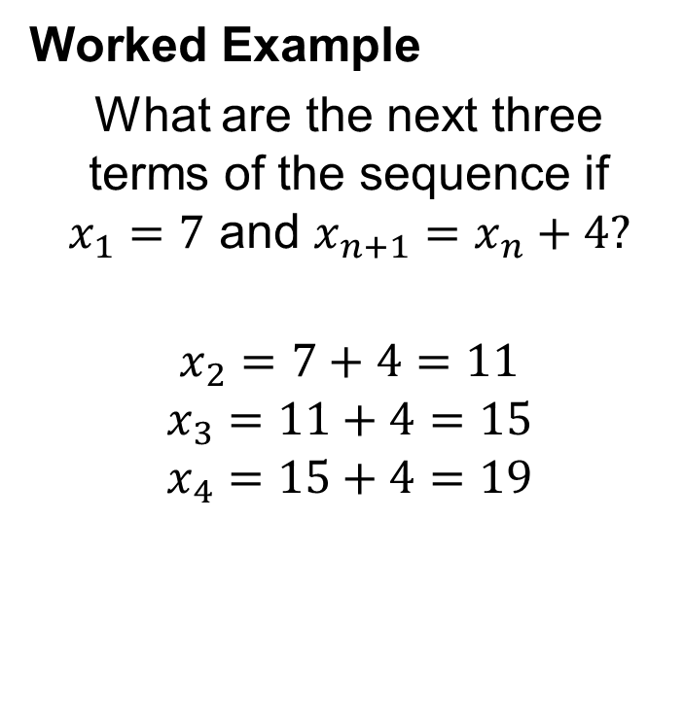
Title: Iterative Formulae
Worked Example
What are the next three terms of the sequence if $x_{1}=7$ and $x_{n+1}=x_{n}+4?$
$$x_{2}=7+4=11$$
$$x_{3}=11+4=15$$
$$x_{4}=15+4=19$$
Your turn
What are the next three terms of the sequence if $x_{1}=−2$ and $x_{n+1}={3x}_{n}?$

Slide 17
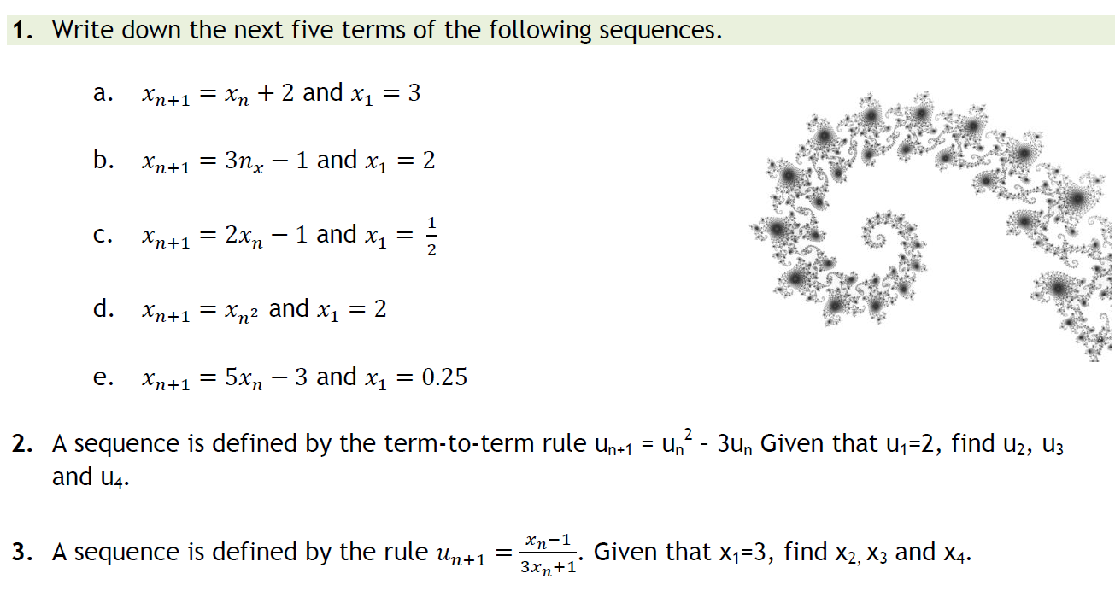
In your books:
.
Notes:
Acknowledgements: teachitmaths.co.uk

Slide 18
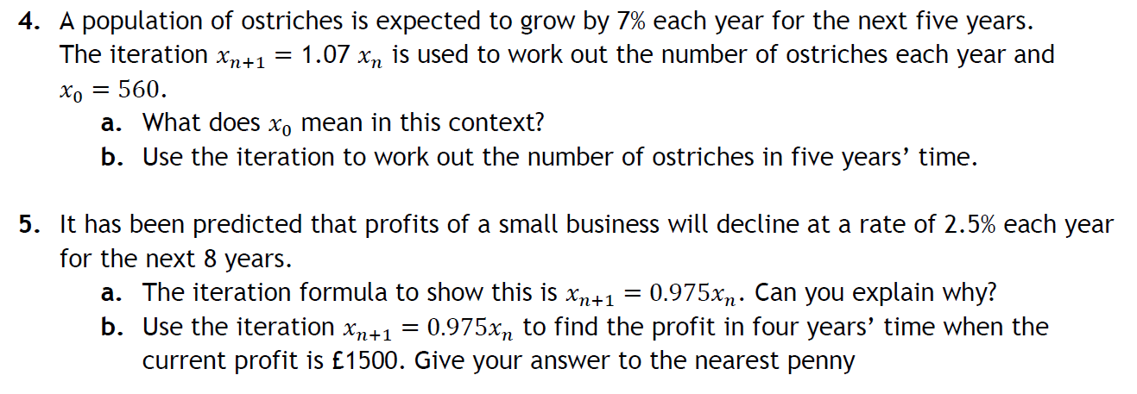
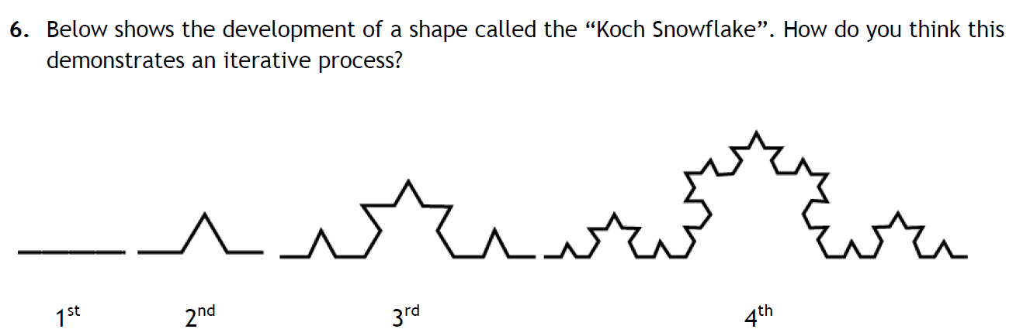

Slide 19
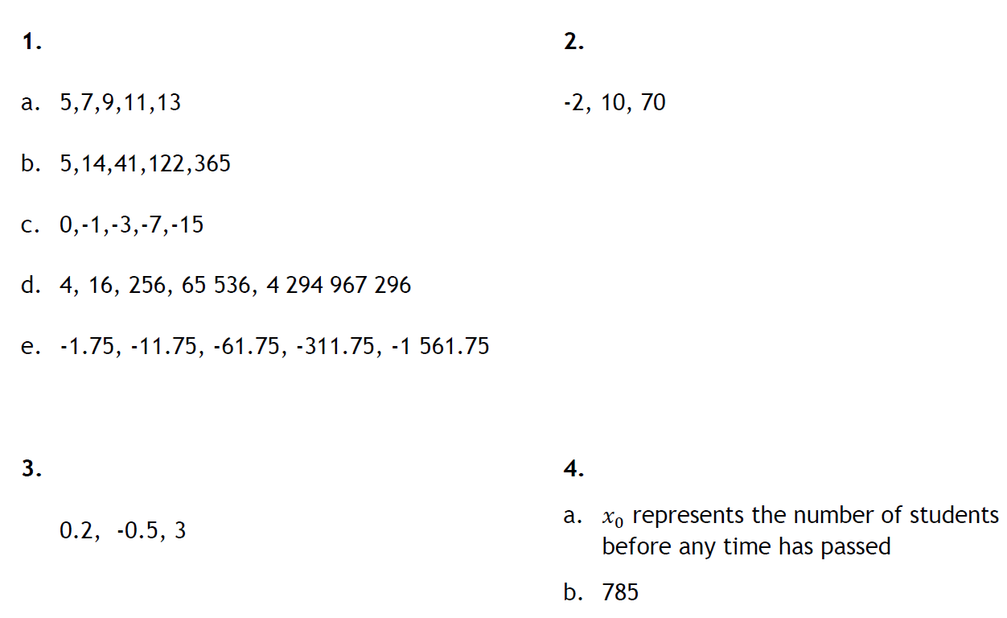
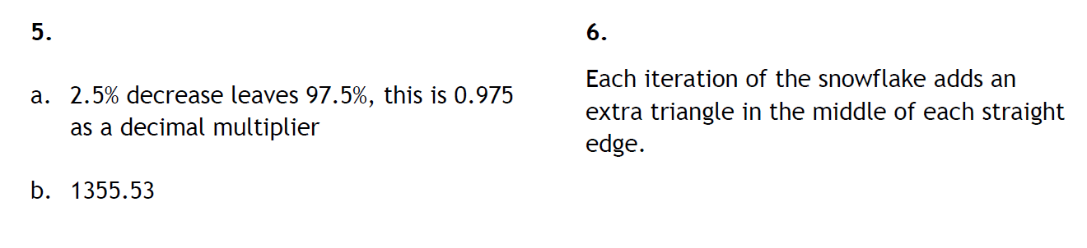
Mark your work

Slide 20
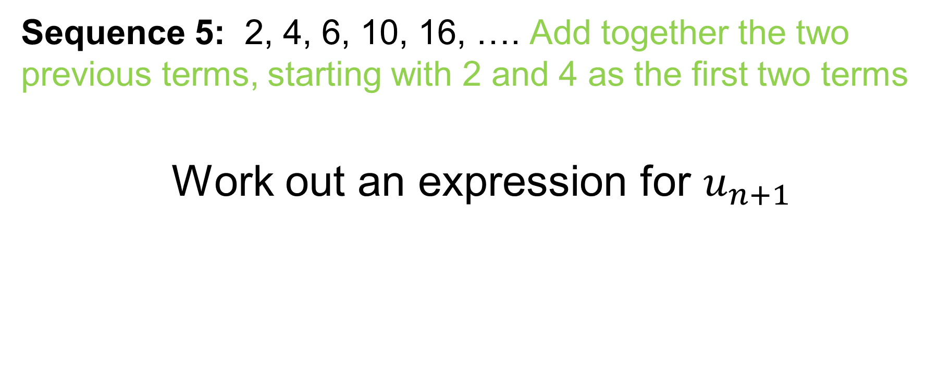
Challenge
Sequence 5: 2, 4, 6, 10, 16, …. Add together the two previous terms, starting with 2 and 4 as the first two terms
Work out an expression for $u_{n+1}$

