Slide 1
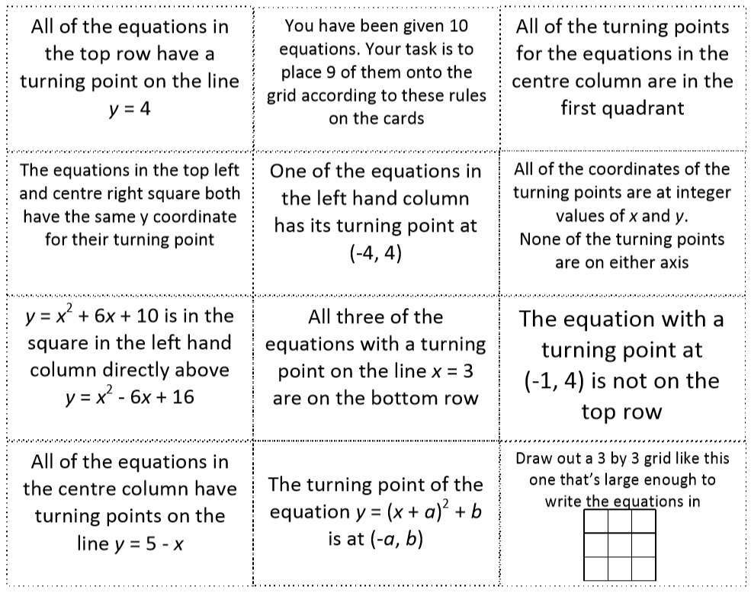

Slide 2
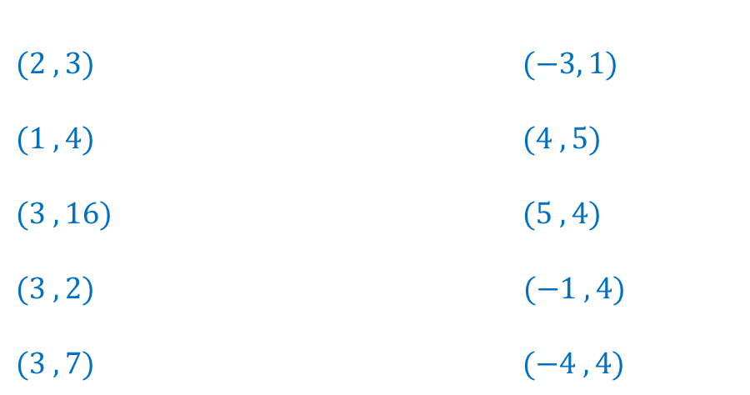
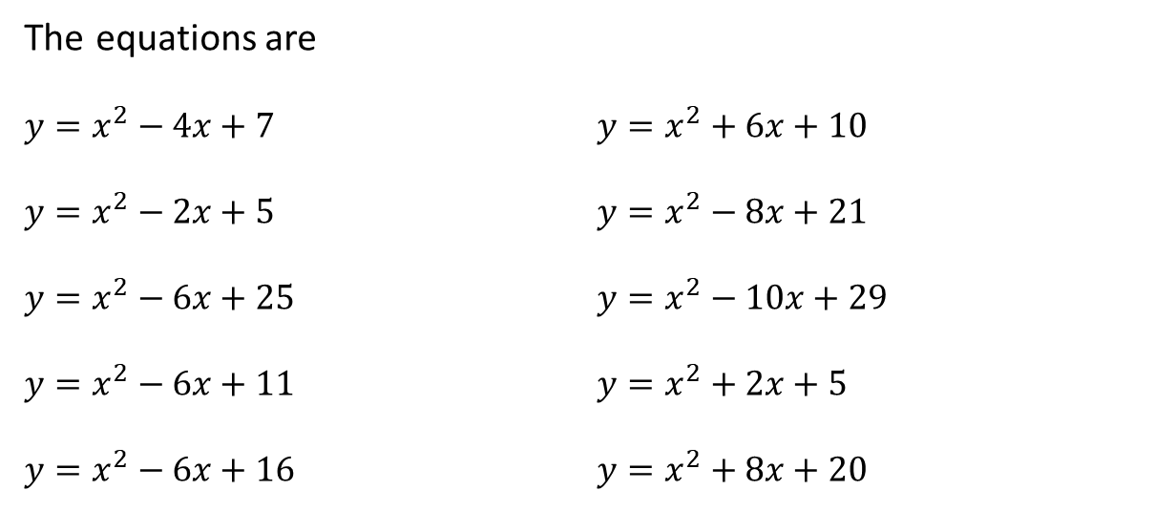
The equations are
${y=x}^{2}−4x+7$ ${y=x}^{2}+6x+10$
${y=x}^{2}−2x+5$ ${y=x}^{2}−8x+21$
${y=x}^{2}−6x+25$ ${y=x}^{2}−10x+29$
${y=x}^{2}−6x+11$ ${y=x}^{2}+2x+5$
${y=x}^{2}−6x+16$ ${y=x}^{2}+8x+20$
The turning points are
$(2 , 3)$ $(−3, 1)$
$(1 ,4)$ $(4 ,5)$
$(3 ,16)$ $(5 , 4)$
$(3 ,2)$ $(−1 , 4)$
$(3 ,7)$ $(−4 , 4)$
A F
B G
C H
D I
E J
There are 10 equations and only 9 spaces.
One of the equations will be left out.
All of the other clues are about turning points.
Find the turning points.

Slide 3
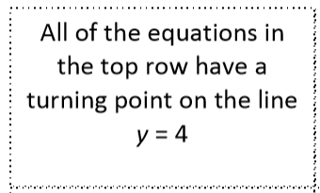
The equations are
${y=x}^{2}−4x+7$ ${y=x}^{2}+6x+10$
${y=x}^{2}−2x+5$ ${y=x}^{2}−8x+21$
${y=x}^{2}−6x+25$ ${y=x}^{2}−10x+29$
${y=x}^{2}−6x+11$ ${y=x}^{2}+2x+5$
${y=x}^{2}−6x+16$ ${y=x}^{2}+8x+20$
The turning points are
$(2 , 3)$ $(−3, 1)$
$(1 ,4)$ $(4 ,5)$
$(3 ,16)$ $(5 , 4)$
$(3 ,2)$ $(−1 , 4)$
$(3 ,7)$ $(−4 , 4)$
A F
B G
C H
D I
E J
B, H, I or J

Slide 4
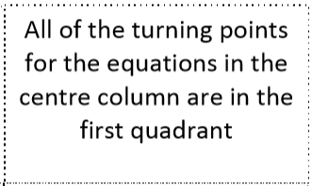
The equations are
${y=x}^{2}−4x+7$ ${y=x}^{2}+6x+10$
${y=x}^{2}−2x+5$ ${y=x}^{2}−8x+21$
${y=x}^{2}−6x+25$ ${y=x}^{2}−10x+29$
${y=x}^{2}−6x+11$ ${y=x}^{2}+2x+5$
${y=x}^{2}−6x+16$ ${y=x}^{2}+8x+20$
The turning points are
$(2 , 3)$ $(−3, 1)$
$(1 ,4)$ $(4 ,5)$
$(3 ,16)$ $(5 , 4)$
$(3 ,2)$ $(−1 , 4)$
$(3 ,7)$ $(−4 , 4)$
A F
B G
C H
D I
E J
A, B, C, D, E, G or H

Slide 5
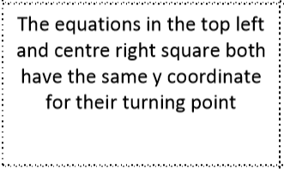
The equations are
${y=x}^{2}−4x+7$ ${y=x}^{2}+6x+10$
${y=x}^{2}−2x+5$ ${y=x}^{2}−8x+21$
${y=x}^{2}−6x+25$ ${y=x}^{2}−10x+29$
${y=x}^{2}−6x+11$ ${y=x}^{2}+2x+5$
${y=x}^{2}−6x+16$ ${y=x}^{2}+8x+20$
The turning points are
$(2 , 3)$ $(−3, 1)$
$(1 ,4)$ $(4 ,5)$
$(3 ,16)$ $(5 , 4)$
$(3 ,2)$ $(−1 , 4)$
$(3 ,7)$ $(−4 , 4)$
A F
B G
C H
D I
E J

Slide 6
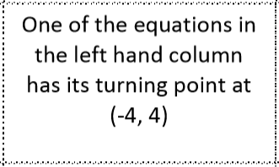
The equations are
${y=x}^{2}−4x+7$ ${y=x}^{2}+6x+10$
${y=x}^{2}−2x+5$ ${y=x}^{2}−8x+21$
${y=x}^{2}−6x+25$ ${y=x}^{2}−10x+29$
${y=x}^{2}−6x+11$ ${y=x}^{2}+2x+5$
${y=x}^{2}−6x+16$ ${y=x}^{2}+8x+20$
The turning points are
$(2 , 3)$ $(−3, 1)$
$(1 ,4)$ $(4 ,5)$
$(3 ,16)$ $(5 , 4)$
$(3 ,2)$ $(−1 , 4)$
$(3 ,7)$ $(−4 , 4)$
A F
B G
C H
D I
E J
J

Slide 7
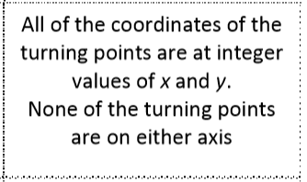
The equations are
${y=x}^{2}−4x+7$ ${y=x}^{2}+6x+10$
${y=x}^{2}−2x+5$ ${y=x}^{2}−8x+21$
${y=x}^{2}−6x+25$ ${y=x}^{2}−10x+29$
${y=x}^{2}−6x+11$ ${y=x}^{2}+2x+5$
${y=x}^{2}−6x+16$ ${y=x}^{2}+8x+20$
The turning points are
$(2 , 3)$ $(−3, 1)$
$(1 ,4)$ $(4 ,5)$
$(3 ,16)$ $(5 , 4)$
$(3 ,2)$ $(−1 , 4)$
$(3 ,7)$ $(−4 , 4)$
A F
B G
C H
D I
E J
Check and confirm

Slide 8
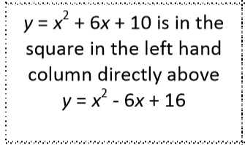
The equations are
${y=x}^{2}−4x+7$ ${y=x}^{2}+6x+10$
${y=x}^{2}−2x+5$ ${y=x}^{2}−8x+21$
${y=x}^{2}−6x+25$ ${y=x}^{2}−10x+29$
${y=x}^{2}−6x+11$ ${y=x}^{2}+2x+5$
${y=x}^{2}−6x+16$ ${y=x}^{2}+8x+20$
The turning points are
$(2 , 3)$ $(−3, 1)$
$(1 ,4)$ $(4 ,5)$
$(3 ,16)$ $(5 , 4)$
$(3 ,2)$ $(−1 , 4)$
$(3 ,7)$ $(−4 , 4)$
A F
B G
C H
D I
E J
J
F
E
In the left hand column F is above E. We also know J is in the left hand column so..

Slide 9
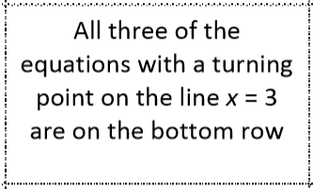
The equations are
${y=x}^{2}−4x+7$ ${y=x}^{2}+6x+10$
${y=x}^{2}−2x+5$ ${y=x}^{2}−8x+21$
${y=x}^{2}−6x+25$ ${y=x}^{2}−10x+29$
${y=x}^{2}−6x+11$ ${y=x}^{2}+2x+5$
${y=x}^{2}−6x+16$ ${y=x}^{2}+8x+20$
The turning points are
$(2 , 3)$ $(−3, 1)$
$(1 ,4)$ $(4 ,5)$
$(3 ,16)$ $(5 , 4)$
$(3 ,2)$ $(−1 , 4)$
$(3 ,7)$ $(−4 , 4)$
A F
B G
C H
D I
E J
J
F
E
C, D and E

Slide 10
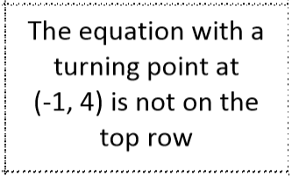
The equations are
${y=x}^{2}−4x+7$ ${y=x}^{2}+6x+10$
${y=x}^{2}−2x+5$ ${y=x}^{2}−8x+21$
${y=x}^{2}−6x+25$ ${y=x}^{2}−10x+29$
${y=x}^{2}−6x+11$ ${y=x}^{2}+2x+5$
${y=x}^{2}−6x+16$ ${y=x}^{2}+8x+20$
The turning points are
$(2 , 3)$ $(−3, 1)$
$(1 ,4)$ $(4 ,5)$
$(3 ,16)$ $(5 , 4)$
$(3 ,2)$ $(−1 , 4)$
$(3 ,7)$ $(−4 , 4)$
A F
B G
C H
D I
E J
J
F
E
I is not in the top row, so the top row contains B, H and J

Slide 11
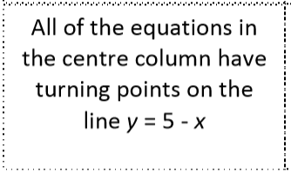
The equations are
${y=x}^{2}−4x+7$ ${y=x}^{2}+6x+10$
${y=x}^{2}−2x+5$ ${y=x}^{2}−8x+21$
${y=x}^{2}−6x+25$ ${y=x}^{2}−10x+29$
${y=x}^{2}−6x+11$ ${y=x}^{2}+2x+5$
${y=x}^{2}−6x+16$ ${y=x}^{2}+8x+20$
The turning points are
$(2 , 3)$ $(−3, 1)$
$(1 ,4)$ $(4 ,5)$
$(3 ,16)$ $(5 , 4)$
$(3 ,2)$ $(−1 , 4)$
$(3 ,7)$ $(−4 , 4)$
A F
B G
C H
D I
E J
J
F
E
A, B, C, D, E, G and H

Slide 12
The equations are
${y=x}^{2}−4x+7$ ${y=x}^{2}+6x+10$
${y=x}^{2}−2x+5$ ${y=x}^{2}−8x+21$
${y=x}^{2}−6x+25$ ${y=x}^{2}−10x+29$
${y=x}^{2}−6x+11$ ${y=x}^{2}+2x+5$
${y=x}^{2}−6x+16$ ${y=x}^{2}+8x+20$
The turning points are
$(2 , 3)$ $(−3, 1)$
$(1 ,4)$ $(4 ,5)$
$(3 ,16)$ $(5 , 4)$
$(3 ,2)$ $(−1 , 4)$
$(3 ,7)$ $(−4 , 4)$
A F
B G
C H
D I
E J
J
F
E
Go back through your clues to eliminate impossible positions

Slide 13
The equations are
${y=x}^{2}−4x+7$ ${y=x}^{2}+6x+10$
${y=x}^{2}−2x+5$ ${y=x}^{2}−8x+21$
${y=x}^{2}−6x+25$ ${y=x}^{2}−10x+29$
${y=x}^{2}−6x+11$ ${y=x}^{2}+2x+5$
${y=x}^{2}−6x+16$ ${y=x}^{2}+8x+20$
The turning points are
$(2 , 3)$ $(−3, 1)$
$(1 ,4)$ $(4 ,5)$
$(3 ,16)$ $(5 , 4)$
$(3 ,2)$ $(−1 , 4)$
$(3 ,7)$ $(−4 , 4)$
A F
B G
C H
D I
E J
J | B | H
F | A | I
E | D | C

