Slide 1

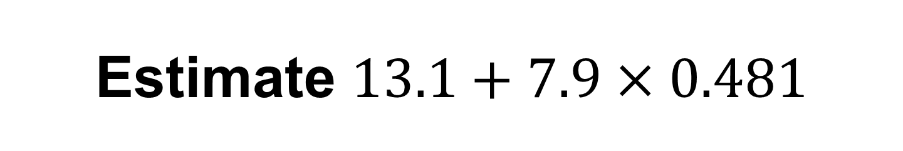
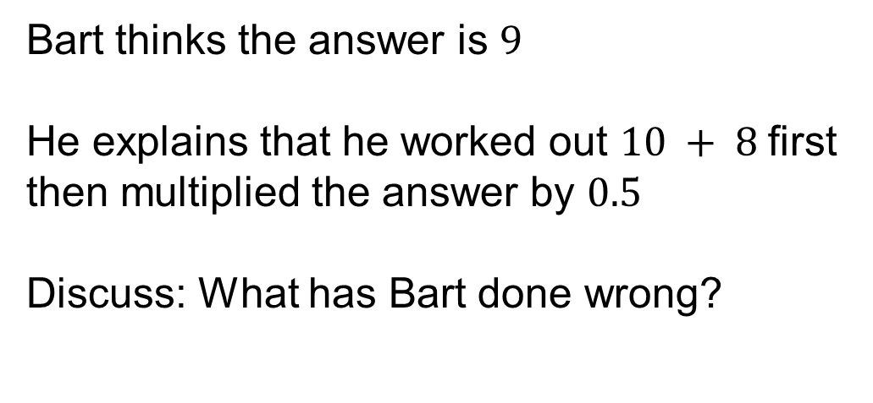
Estimate $13.1+7.9×0.481$
Bart thinks the answer is $9$
He explains that he worked out $10 + 8$first then multiplied the answer by $0.5$
Discuss: What has Bart done wrong?

Slide 2
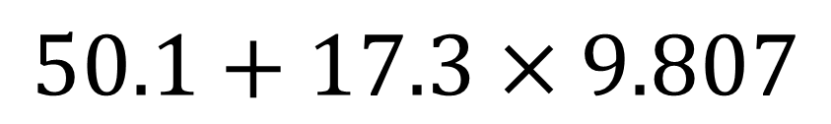
On your whiteboards:
Estimate
$$50.1+17.3×9.807$$

Slide 3
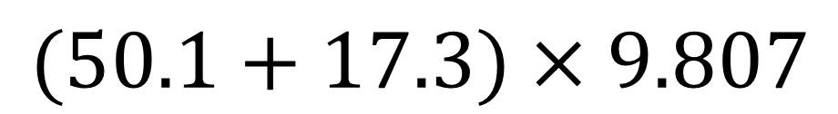
On your whiteboards:
Estimate
$$(50.1+17.3)×9.807$$

Slide 4
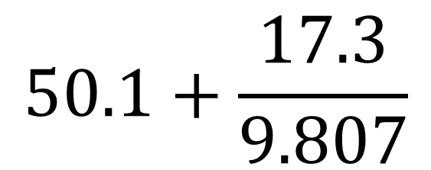
On your whiteboards:
Estimate
$$50.1+\frac{17.3}{9.807}$$

Slide 5
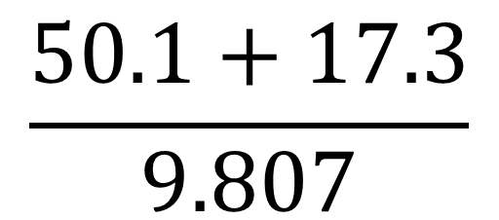
On your whiteboards:
Estimate
$$\frac{50.1+17.3}{9.807}$$

Slide 6
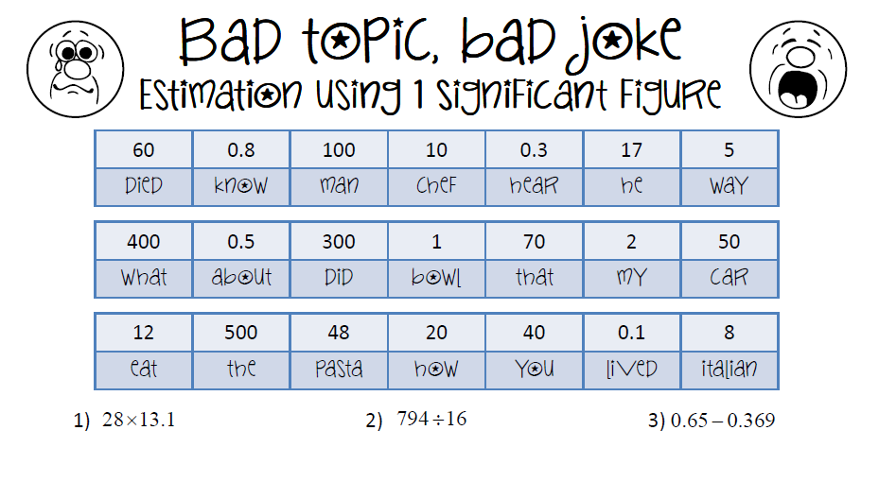
Your turn: Estimate the answers to the questions to reveal the bad joke

Slide 7
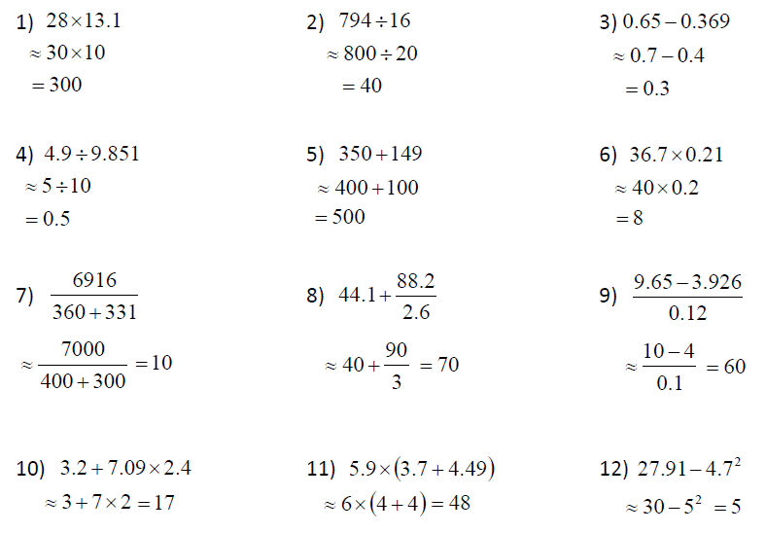
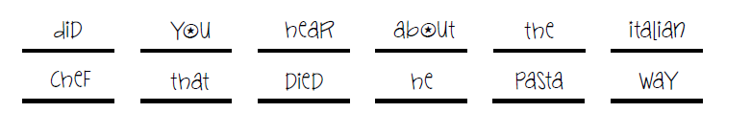
Mark your work

