Slide 1
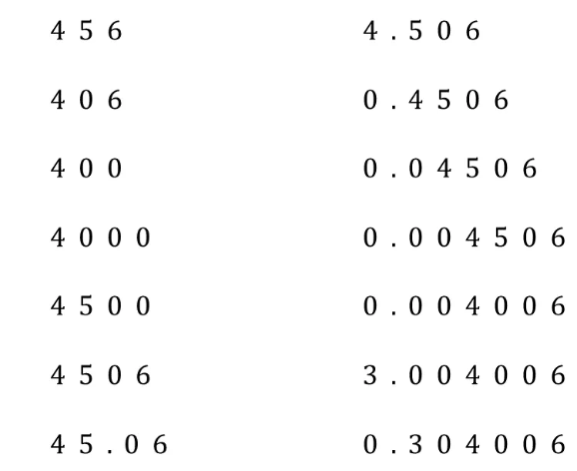
Here are a mixture of integers and decimal values.
I am going to circle the 2nd significant figure in each value
Notes:
Acknowledgements : VariationTheory.com

Slide 2
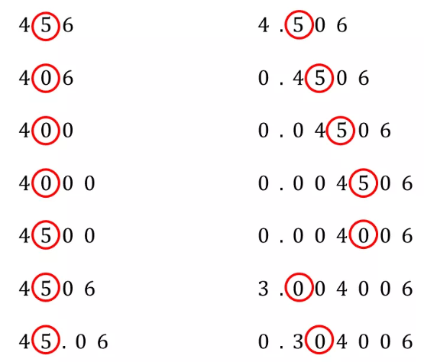
What do you notice?
Discuss with your partner

Slide 3
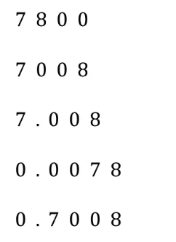
Your Turn
Circle the 2nd significant figure

Slide 4
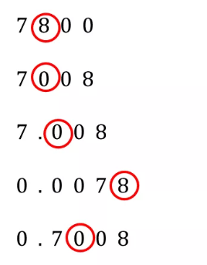
Check your work
Circle the 2nd significant figure

Slide 5
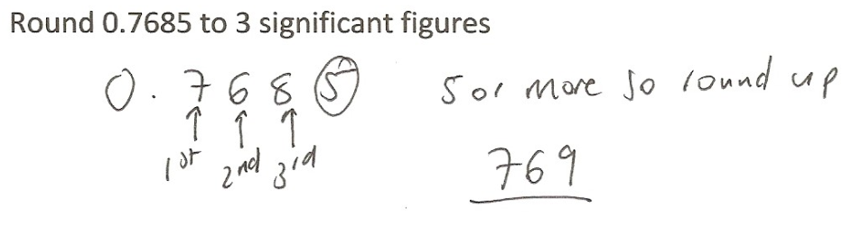




Significant Figures – Can you spot the error?
0.769

Slide 6
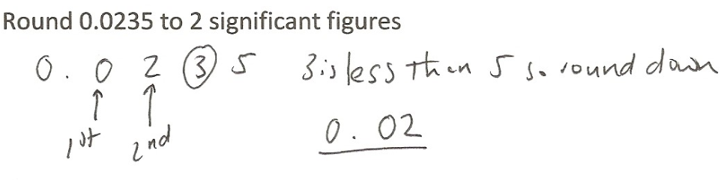

Significant Figures – Can you spot the error?
This is the second significant figure
0.0235
0.024

Slide 7
Round
623 to 1 s.f
600
620
A)
B)
630
700
C)
D)

Slide 8
Round
5328 to 1 s.f
5300
5000
A)
B)
5330
6000
C)
D)

Slide 9
Round
0.005136 to 1 s.f
0
0.0051
A)
B)
0.00514
0.005
C)
D)

Slide 10
Round
426.213 to 2 s.f
426.21
430
A)
B)
400.00
420
C)
D)

Slide 11
Round
3002.01 to 3 s.f
300
3000
A)
B)
3010
3002.0
C)
D)

Slide 12
Round-
983.4 to 1 s.f
100
900
A)
B)
980
1000
C)
D)

Slide 13
Round
0.00456 to 2 s.f
0.0045
0.004
A)
B)
0.0046
0.00
C)
D)

Slide 14
Round
36345.3 to 3 s.f
36300
4000
A)
B)
36000
45300
C)
D)

Slide 15
Round
45.34 to 3 significant figures
50
45.4
A)
B)
45.3
4
C)
D)

Slide 16
Round
37.899 to 4 significant figures
40
38
A)
B)
37.9
38.00
C)
D)

Slide 17
Round
8034.2165 to 6 significant figures
8034.21
8034.22
A)
B)
8034
8000
C)
D)

Slide 18
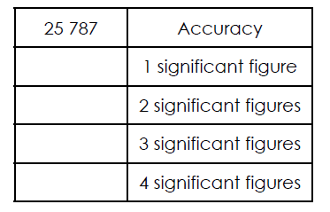
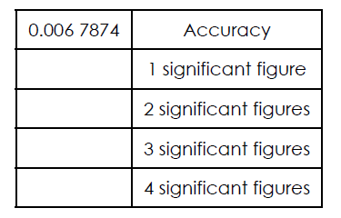


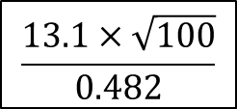
Title: Rounding to significant figures
1. Copy and complete the tables below:
2. Estimate the following by rounding each value to 1 significant figure:
$${19.1}^{2}×0.142$$
$$\frac{13.1×\sqrt{100}}{0.482}$$
$$8.19+0.72×1.402$$

Slide 19
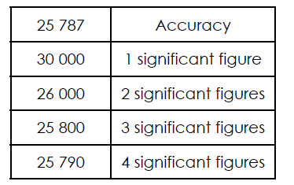
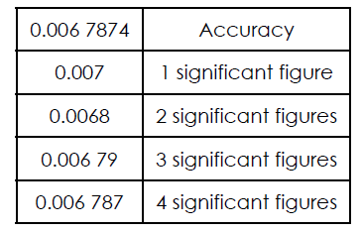

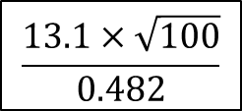




Mark your work
$${19.1}^{2}×0.142$$
$$\frac{13.1×\sqrt{100}}{0.482}$$
$$8.19+0.72×1.402$$
$$40$$
$$200$$
$$8.7$$

Slide 20


Class Challenge
How quickly can your class complete the “Rounding to Significant Figures” loop cards?
Read the question aloud clearly
If you have the answer, say it aloud and then read the next question

Slide 21
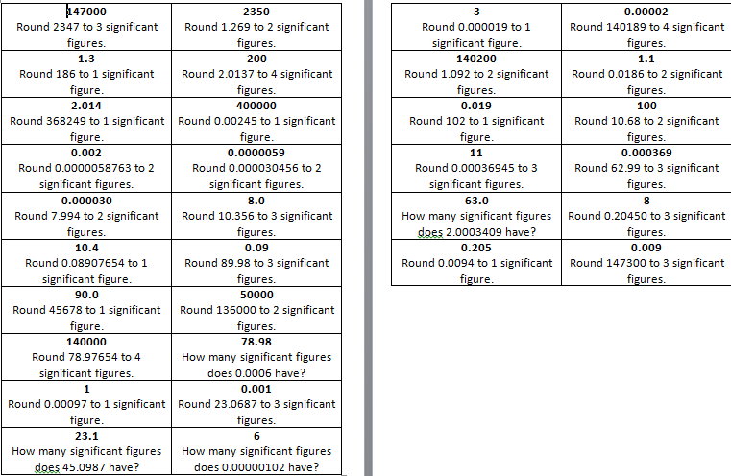
LOOP CARDS
Notes:
Acknowledgements: NES Maths, EME Maths Hub

