Slide 1
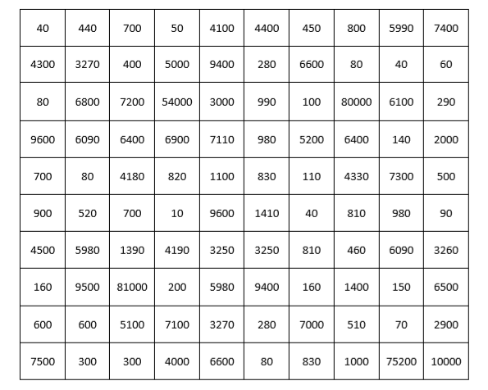
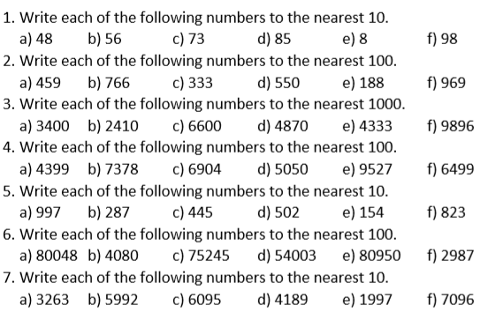
Answer the questions below. Colour in any box that contains the answers in the grid below to reveal a pixel picture.
Notes:
Acknowledgements: Miss Brookes Maths

Slide 2
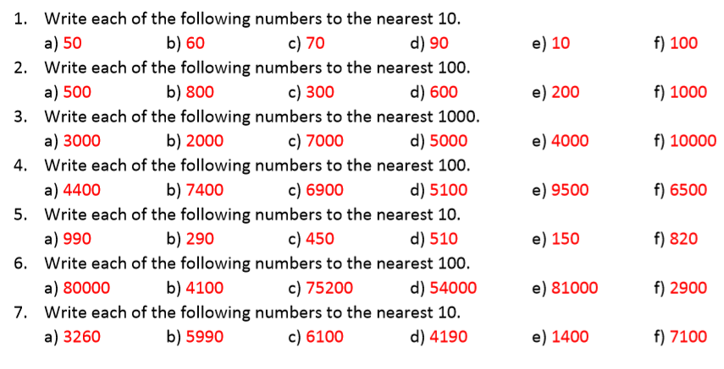
Mark your work

Slide 3
What do these set of answers have in common?
These values are all rounded to “one significant figure”

Slide 4
What do these set of answers have in common?
These values are all rounded to “two significant figures”

Slide 5
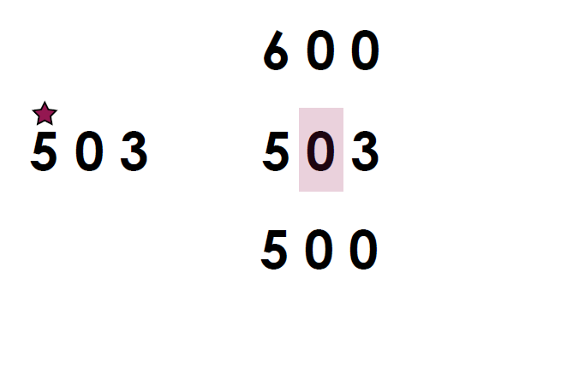
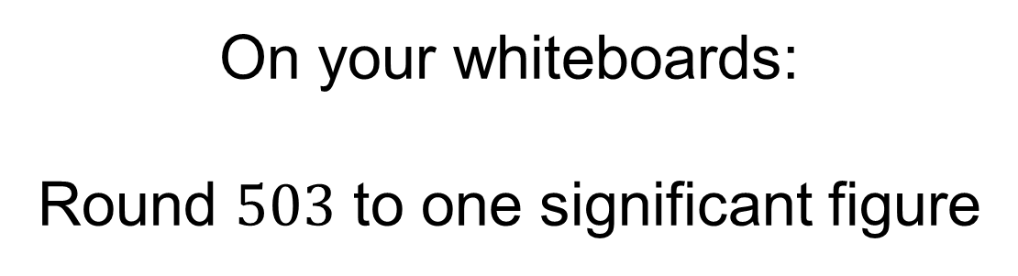
On your whiteboards:
Round $503$ to one significant figure

Slide 6
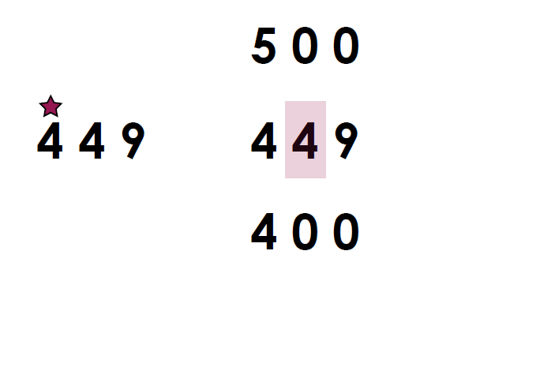
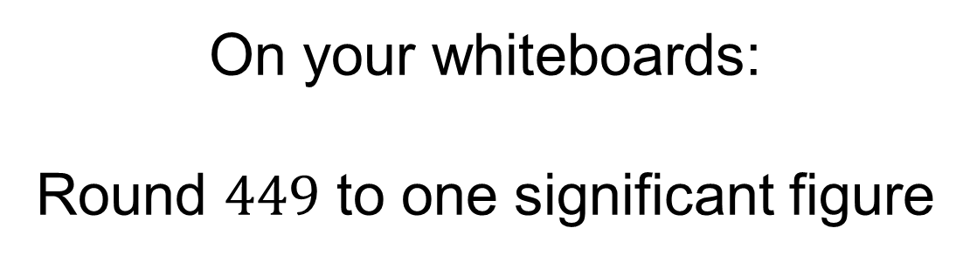
On your whiteboards:
Round $449$ to one significant figure

Slide 7
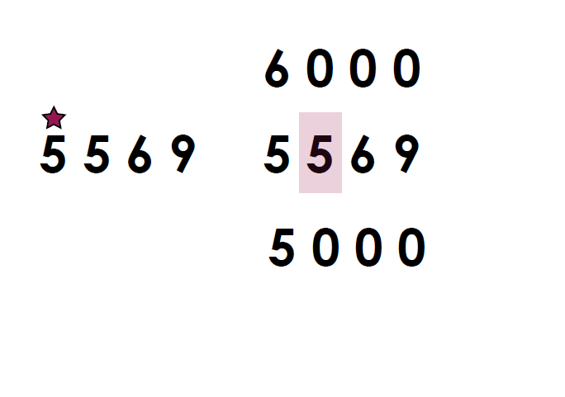
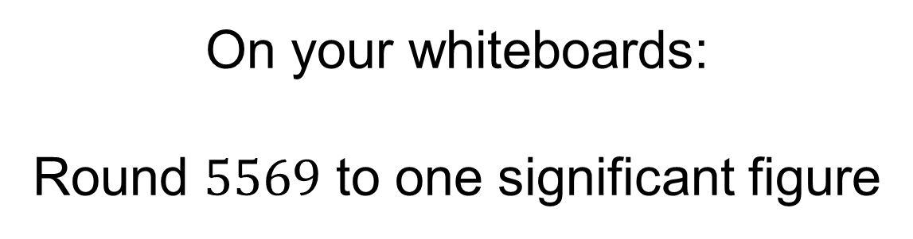
On your whiteboards:
Round $5569$ to one significant figure

Slide 8
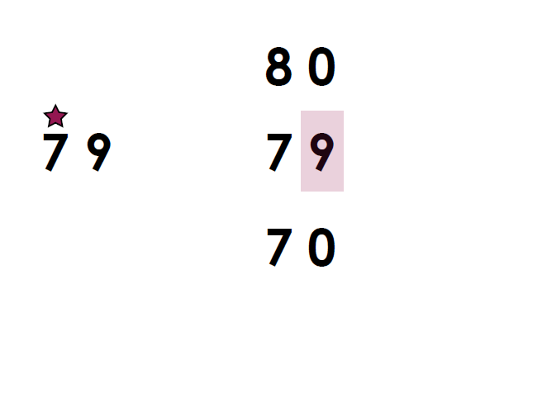
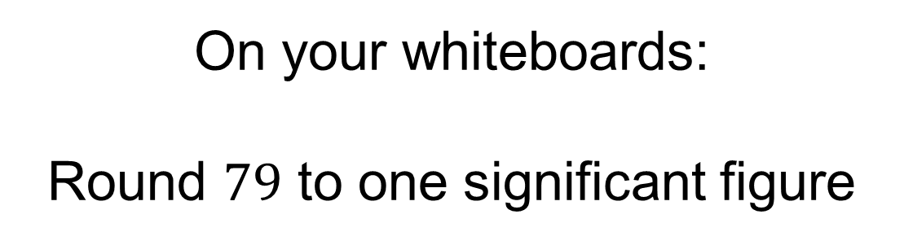
On your whiteboards:
Round $79$ to one significant figure

Slide 9
On your whiteboards:
Amina is rounding to one significant figure.
She says:
“39 is the largest number that will round to 40”
Give an example to show that she is wrong.

Slide 10
Title – Rounding integers to significant figures.
1852 rounded to one significant figure is 2000
?
1852 rounded to two significant figures is 1900
?
?
1852 rounded to three significant figures is 1850
Copy and complete the following sentences

Slide 11
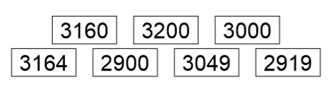
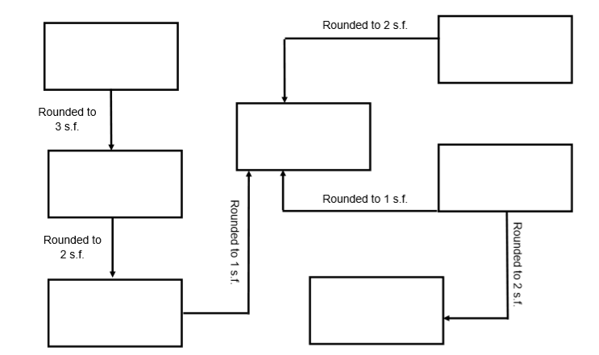
Your Turn:
1. Put the number in the boxes so that arrows indicate a correct rounding

Slide 12
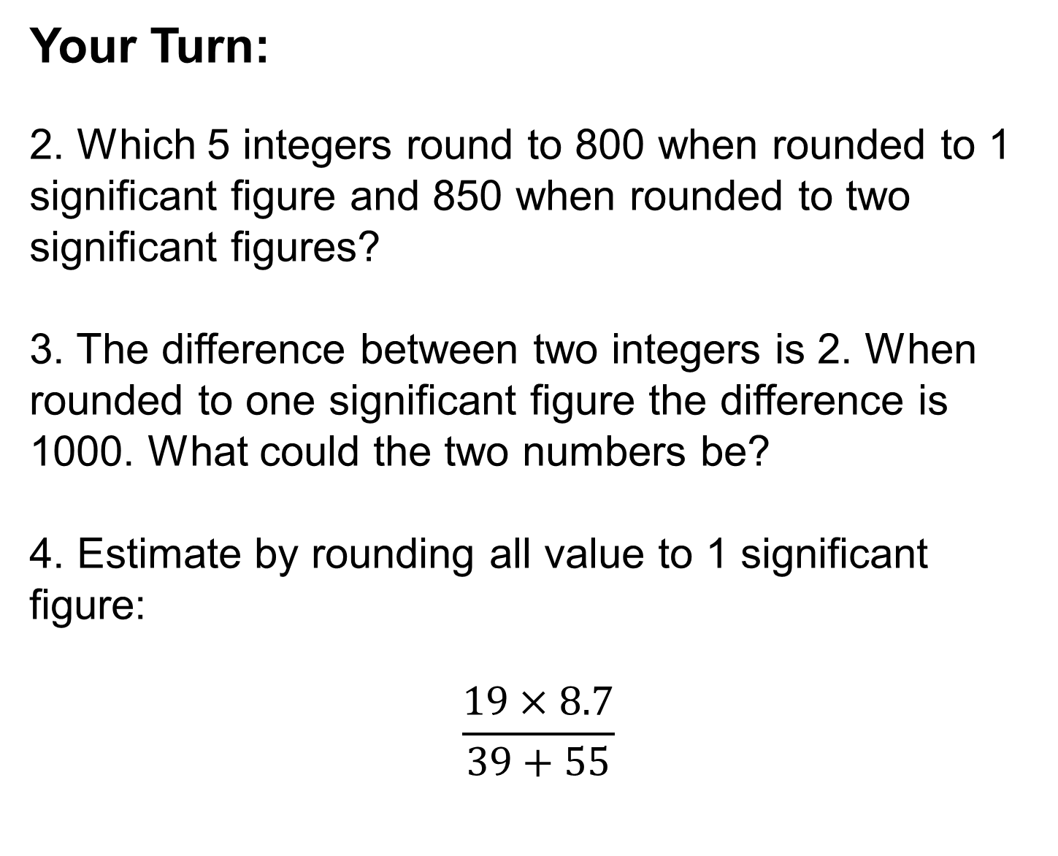
Your Turn:
2. Which 5 integers round to 800 when rounded to 1 significant figure and 850 when rounded to two significant figures?
3. The difference between two integers is 2. When rounded to one significant figure the difference is 1000. What could the two numbers be?
4. Estimate by rounding all value to 1 significant figure:
$$\frac{19×8.7}{39+55}$$

Slide 13
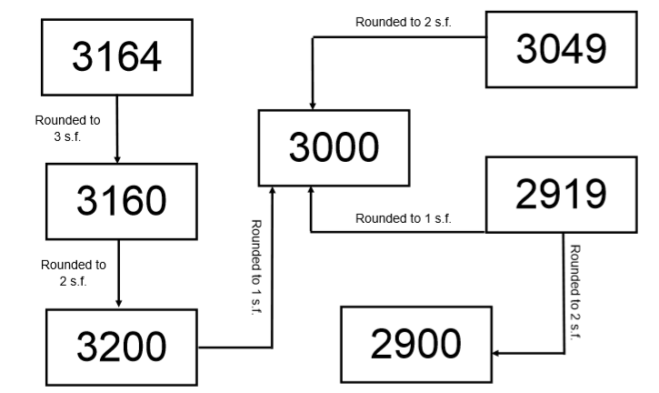
Mark your work
2. 845, 846, 847, 848, 849
3. Check your answers with your neighbour!
4. 1.8

