Slide 1
What do we mean by decimal places?
The position of a digit to the right of a decimal point.
31.654
1st decimal place
3rd decimal place

Slide 2
Mini whiteboards ready!

Slide 3
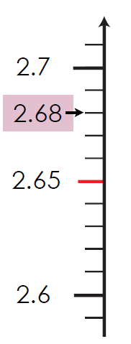

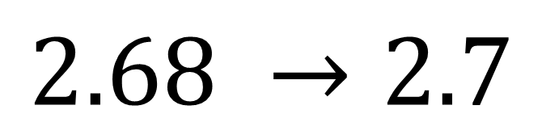
Round $2.68$ to 1 decimal place
?
$$2.68 →2.7$$
?

Slide 4
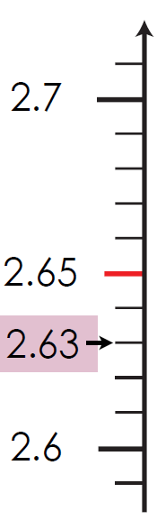

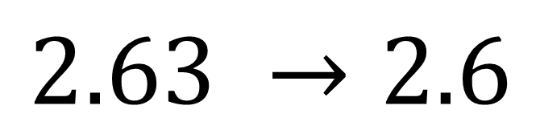
Round $2.63$ to 1 decimal place
?
$$2.63 →2.6$$
?

Slide 5
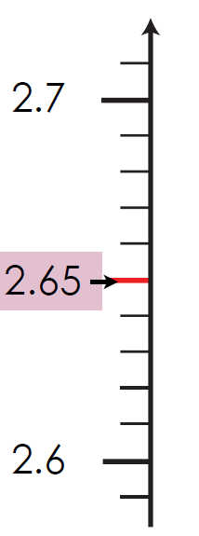

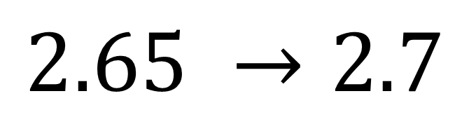
Round $2.65$ to 1 decimal place
$$2.65 →2.7$$

Slide 6
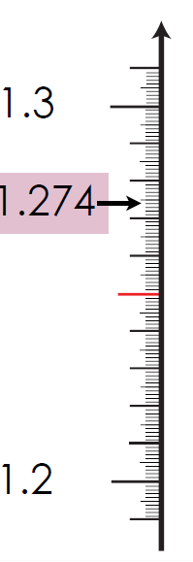
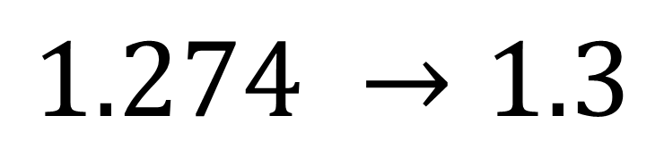
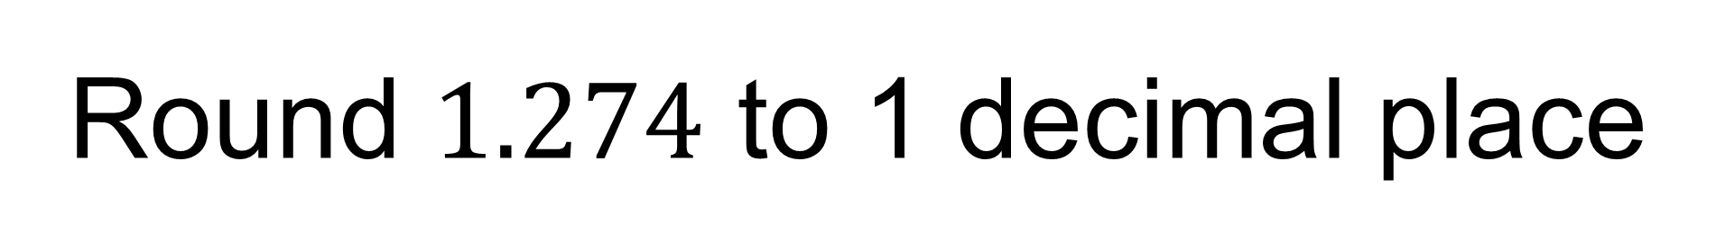
Round $1.274$ to 1 decimal place
?
$$1.274 →1.3$$
?

Slide 7
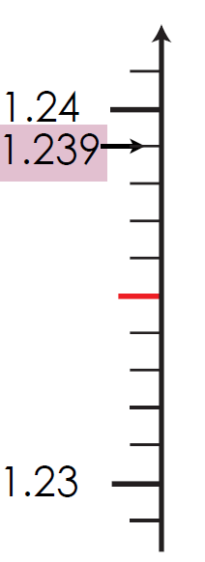
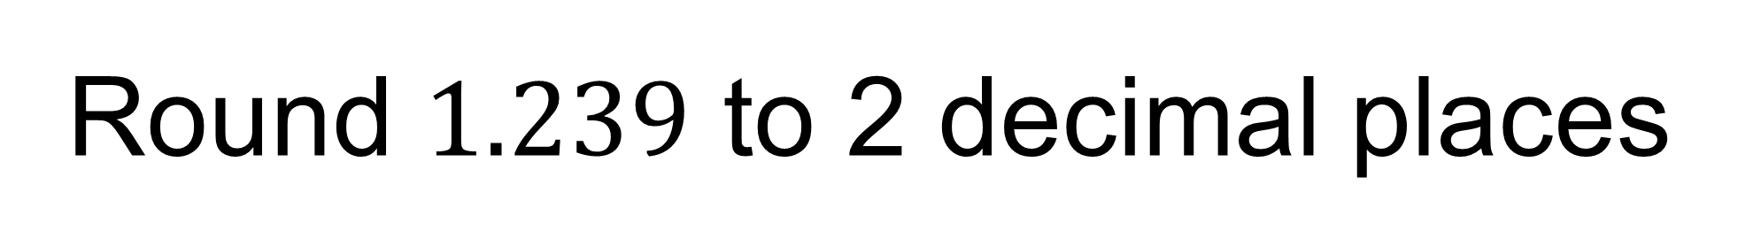
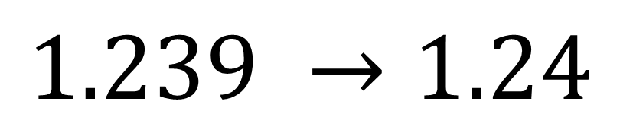
Round $1.239$ to 2 decimal places
?
$$1.239 →1.24$$
?

Slide 8
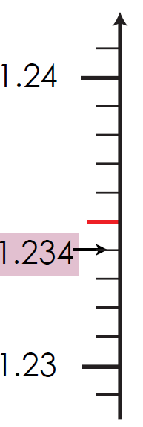
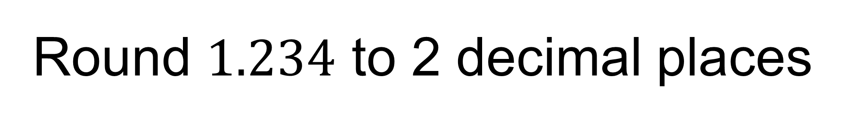
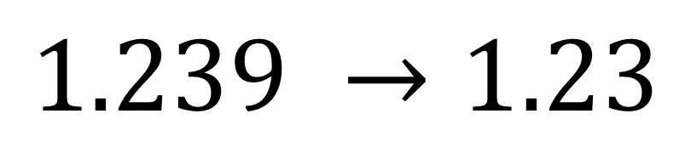
Round $1.234$ to 2 decimal places
?
$$1.239 →1.23$$
?

Slide 9
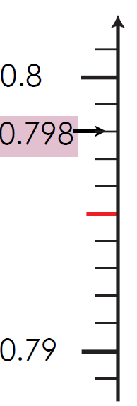
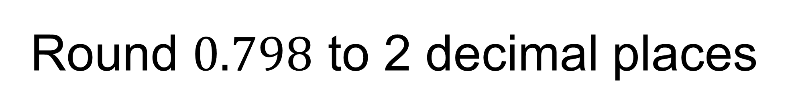
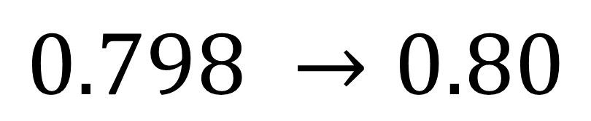
Round $0.798$ to 2 decimal places
?
$$0.798 →0.80$$
?

Slide 10
Title – Rounding to decimal places
1.5193 rounded to the nearest integer is 2
1.5193 rounded to one decimal place is 1.5
1.5193 rounded to two decimal places is 1.52
1.5193 rounded to three decimal places is 1.519
Copy and complete

Slide 11
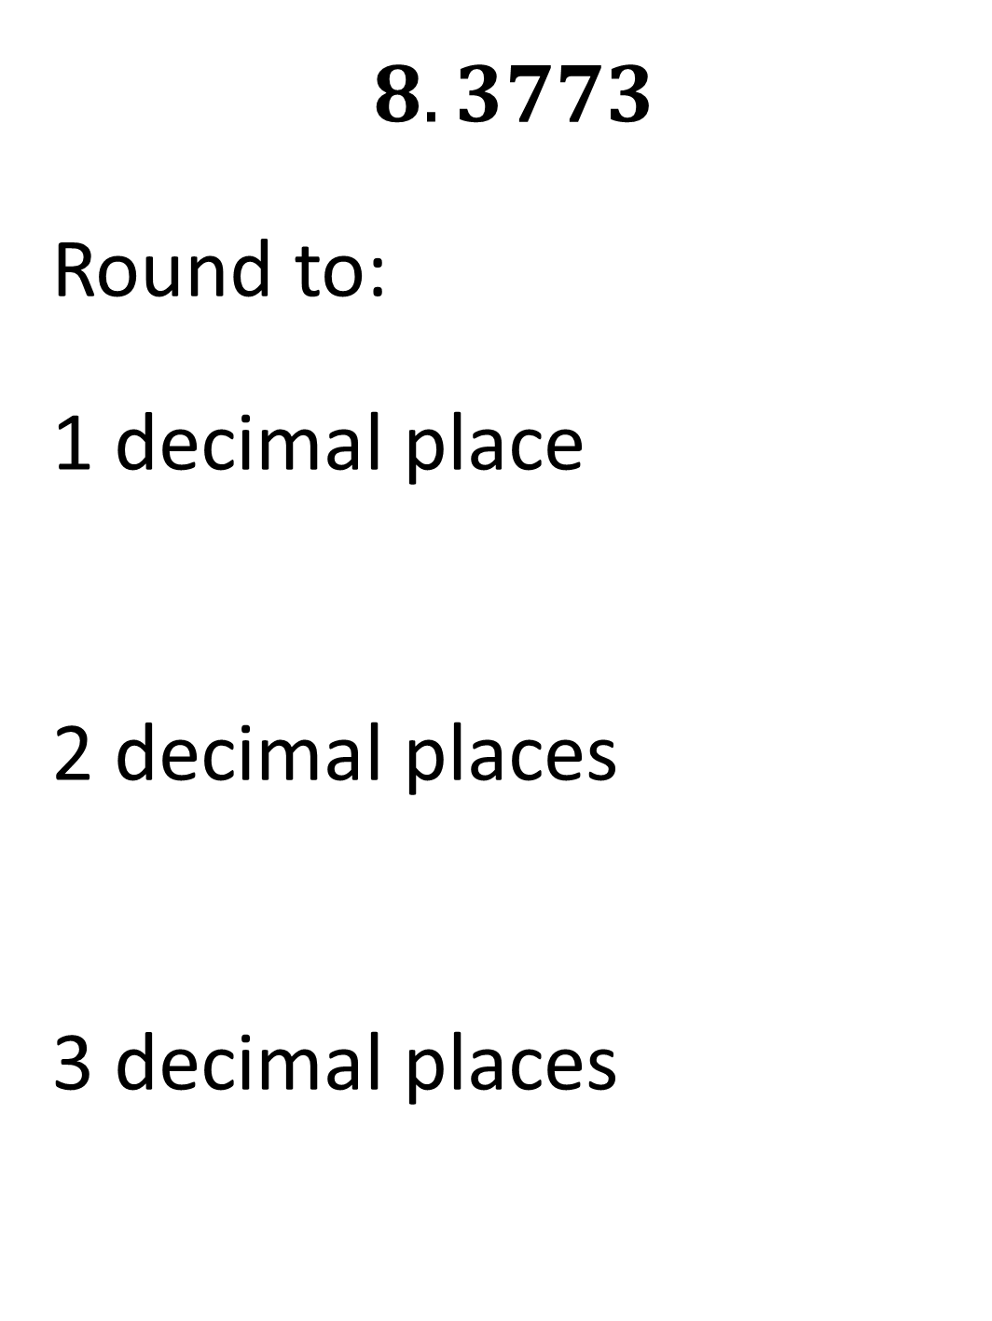
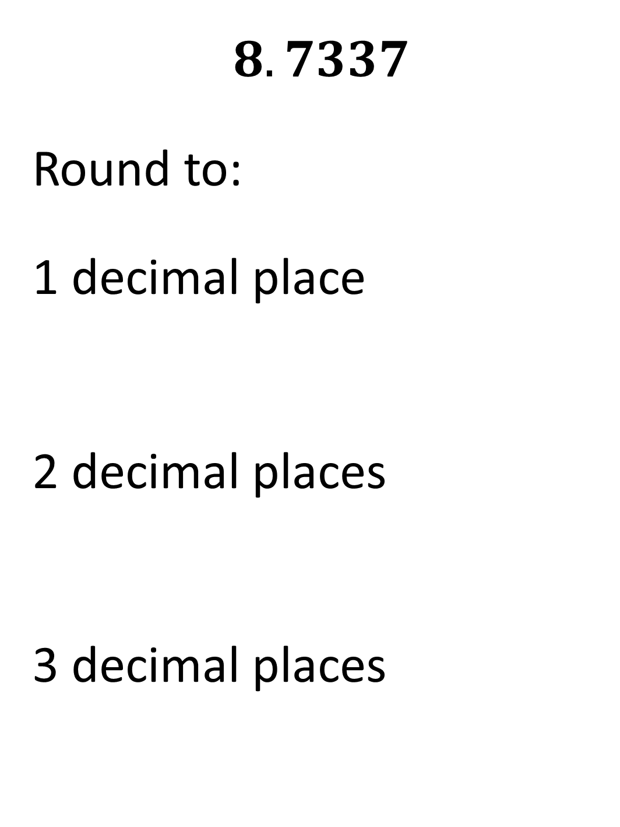
Worked Example
Your Turn
$$8.7337$$
Round to:
1 decimal place
2 decimal places
3 decimal places
$$8.3773$$
Round to:
1 decimal place
2 decimal places
3 decimal places

Slide 12
Number | 1 decimal place | 2 decimal places | 3 decimal places
1. 0.1234
2. 0.2345
3. 0.3456
4. 0.4567
5. 0.04567
6. 0.40567
7. 0.45067
8. 9.45067
9. 9.45967
10. 9.95967

Slide 13
Number | 1 decimal place | 2 decimal places | 3 decimal places
1. 0.1234 | 0.1 | 0.12 | 0.123
2. 0.2345 | 0.2 | 0.23 | 0.235
3. 0.3456 | 0.3 | 0.35 | 0.346
4. 0.4567 | 0.5 | 0.46 | 0.457
5. 0.04567 | 0.0 | 0.05 | 0.046
6. 0.40567 | 0.4 | 0.41 | 0.406
7. 0.45067 | 0.5 | 0.45 | 0.451
8. 9.45067 | 9.5 | 9.45 | 9.451
9. 9.45967 | 9.5 | 9.46 | 9.460
10. 9.95967 | 10.0 | 9.96 | 9.960

Slide 14
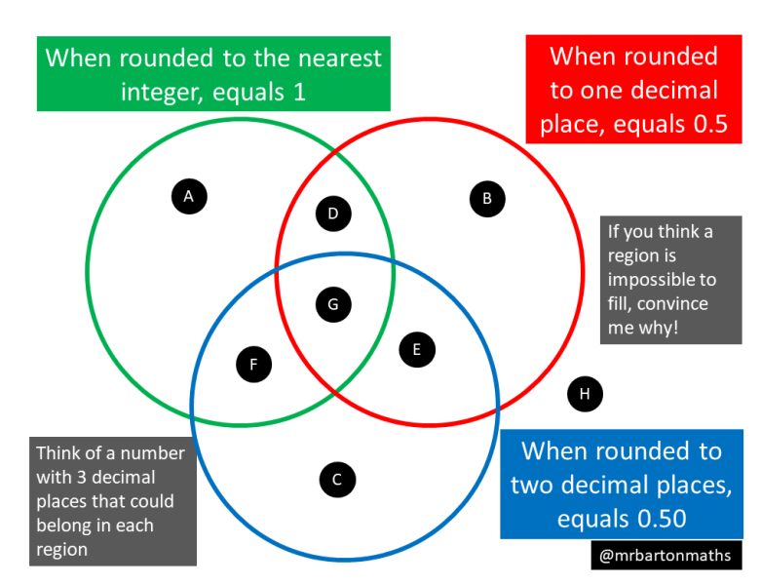
Challenge

