Slide 1








Expand and simplify:
$${(x−3)}^{2}$$
$$=x^{2}−6x+9$$
$${(x−4)}^{2}$$
$$=x^{2}−8x+16$$
$${(x−5)}^{2}$$
$$=x^{2}−10x+25$$
$${(x−b)}^{2}$$
$$=x^{2}−bx+b^{2}$$

Slide 2



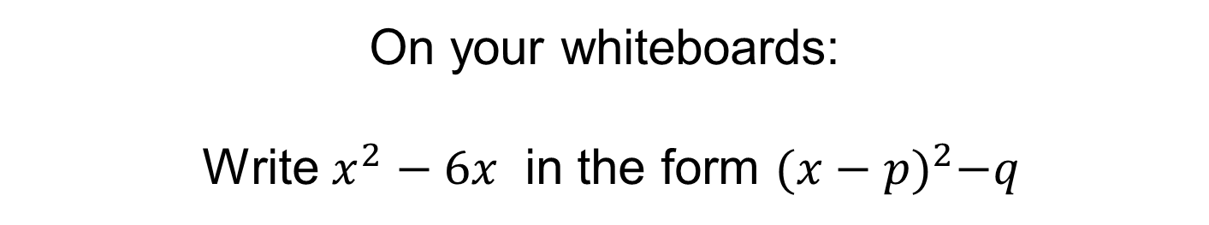

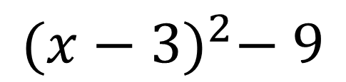




$${(x−3)}^{2}$$
$$=x^{2}−6x+9$$
On your whiteboards:
Write $x^{2}−6x$ in the form ${(x−p)}^{2}−q$
$${(x−3)}^{2}$$
$$−9$$
$$=x^{2}−6x+9$$
$$−9$$
$${(x−3)}^{2}− 9$$
$$=x^{2}−6x$$
$${(x−3)}^{2}− 9$$

Slide 3



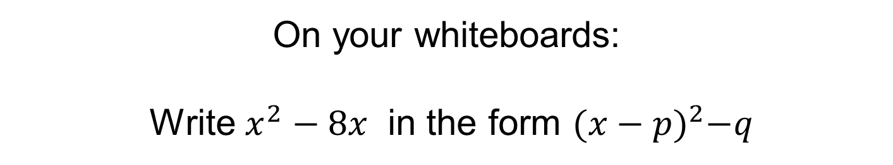

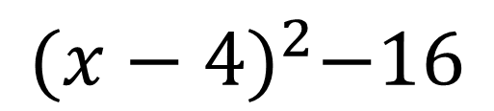




$${(x−4)}^{2}$$
$$=x^{2}−8x+16$$
On your whiteboards:
Write $x^{2}−8x$ in the form ${(x−p)}^{2}−q$
$${(x−4)}^{2}$$
$$−16$$
$$=x^{2}−8x+16$$
$$−16$$
$${(x−4)}^{2}−16$$
$$=x^{2}−8x$$
$${(x−4)}^{2}−16$$

Slide 4
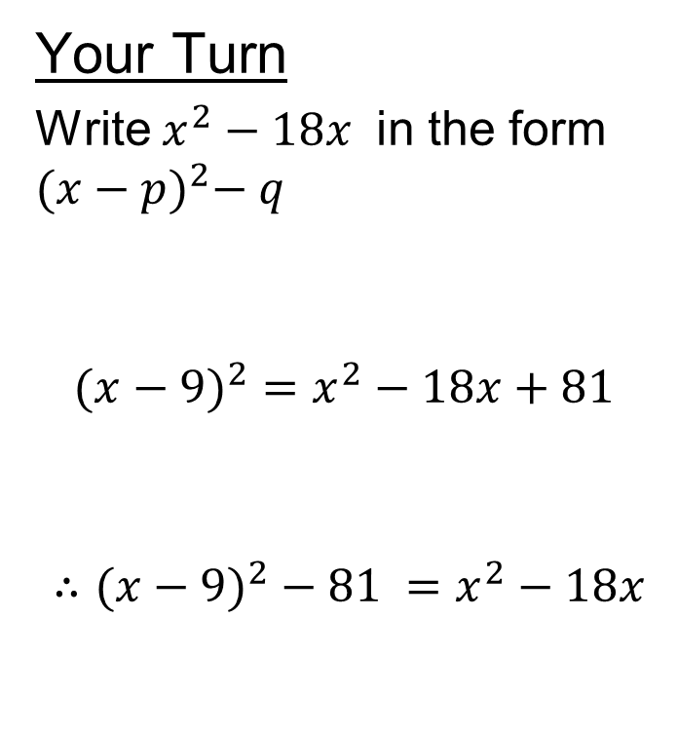
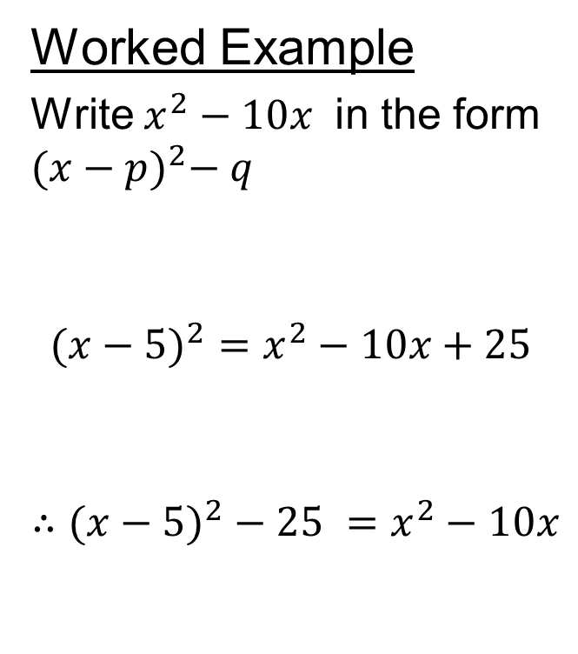
Title – Further Completing the Square
Worked Example
Write $x^{2}−10x$ in the form ${(x−p)}^{2}− q$
$$(x−5)^{2}=x^{2}−10x+25$$
$$∴(x−5)^{2}−25 =x^{2}−10x$$
Your Turn
Write $x^{2}−18x$ in the form ${(x−p)}^{2}− q$
$$(x−9)^{2}=x^{2}−18x+81$$
$$∴(x−9)^{2}−81 =x^{2}−18x$$

Slide 5
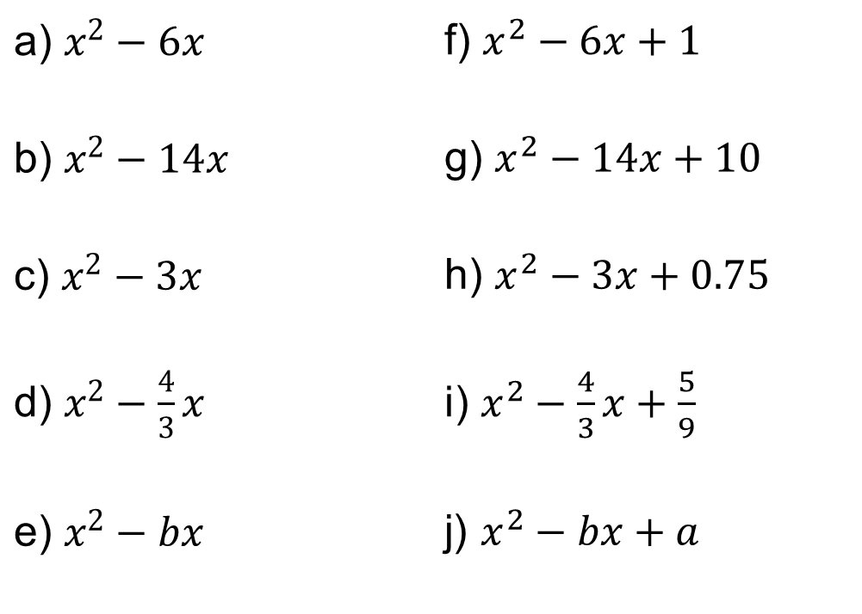
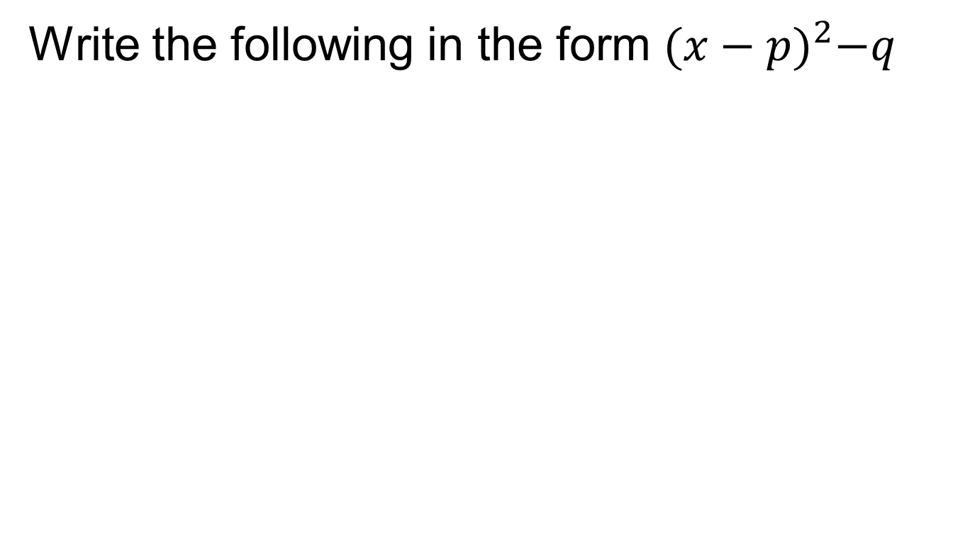
In your books:
Write the following in the form ${(x−p)}^{2}−q$
a) $x^{2}−6x$ | f) $x^{2}−6x+1$
b) $x^{2}−14x$ | g) $x^{2}−14x+10$
c) $x^{2}−3x$ | h) $x^{2}−3x+0.75$
d) $x^{2}−\frac{4}{3}x$ | i) $x^{2}−\frac{4}{3}x+\frac{5}{9}$
e) $x^{2}−bx$ | j) $x^{2}−bx+a$

Slide 6
Completing the Squares Dominoes
Cut along the dotted lines to create 14 domino tiles.
Match up the dominoes by completing the square for the expression on the right-hand side.
When finished, you will have one continuous loop of dominoes.

Slide 7
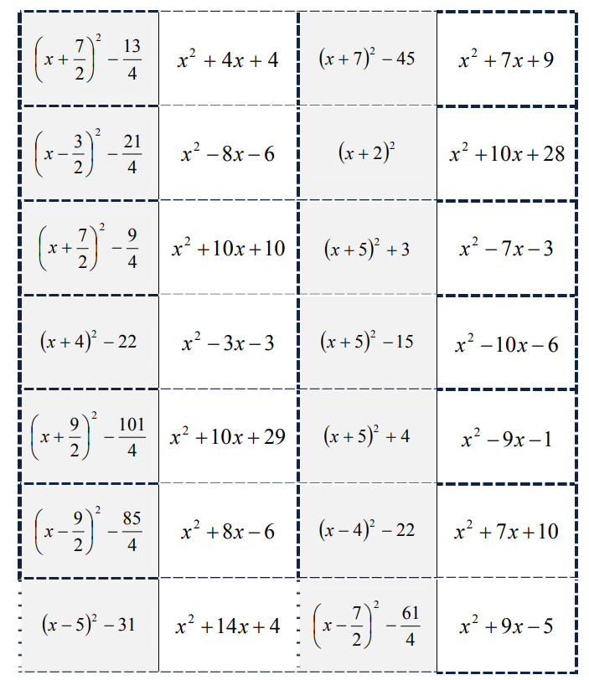
Notes:
Acknowledgements: TeachitMaths

Slide 8
