Slide 1


Algebraic Area Problems
The area of this rectangle is 21cm².
What is its perimeter?
How can we begin?
$$x+1$$
$$x−3$$

Slide 2
Algebraic Area Problems
The area of this rectangle is 21cm².
What is its perimeter?
Write an expression for the area on your whiteboards
$$x+1$$
$$x−3$$

Slide 3
Algebraic Area Problems
The area of this rectangle is 21cm².
What is its perimeter?
Convert your expression into an equation using information from the question
$$x+1$$
$$x−3$$

Slide 4
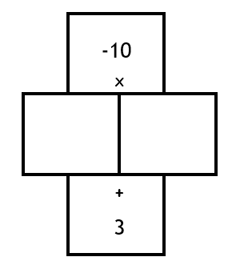
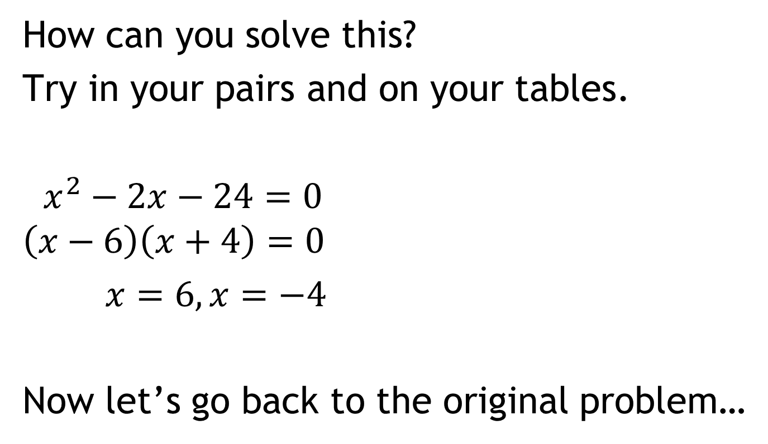

$$x^{2}−2x−3=21$$
How can you solve this?
Try in your pairs and on your tables.
$x^{2}−2x−24=0$
$$\left(x−6\right)\left(x+4\right)=0$$
$x=6, x=−4$
Now let’s go back to the original problem…
-24
-2

Slide 5

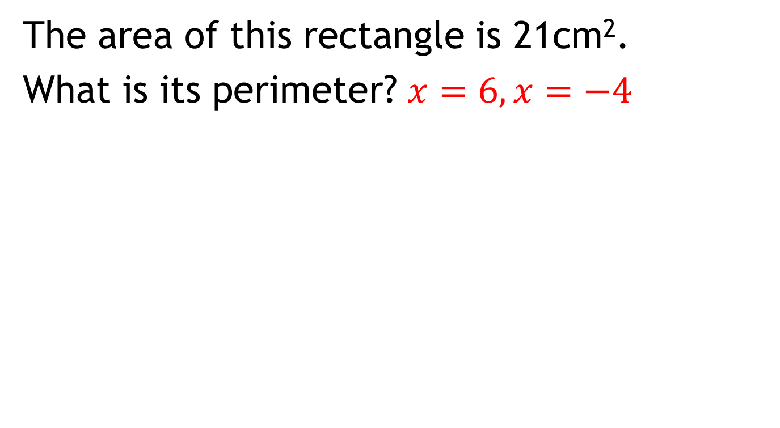

Relate the solutions back to the problem
The area of this rectangle is 21cm².
What is its perimeter? $x=6,x=−4$
$$x+1$$
How can we finish off the problem?
$$x−3$$

Slide 6
Relate the solutions back to the problem
The area of this rectangle is 21cm².
What is its perimeter? $x=6,x=−4$
$$x+1$$
Find the perimeter in your pairs
$$x−3$$

Slide 7

Solve the following problem on your tables
The area of this square is 49cm².
What is its perimeter?
$$x+5$$

Slide 8
Solve the following problem on your tables
The area of this square is 49cm².
What is its perimeter?
$$x+5$$
Was there a quicker way to answer this question?

Slide 9


Solve the following problem on your tables
The area of this rectangle is 5 cm².
What is its perimeter?
$$2x+1$$
$$x−1$$

Slide 10




Solve the following problem on your tables
The areas of these rectangles are the same. What is their area?
$$4x−1$$
$$3x−2$$
$$x$$
$$x+2$$

Slide 11


Solve the following problem on your tables
The area of this triangle is 14cm².
What are the dimensions of the triangle?
$$x+2$$
$$2x−6$$

