Slide 1
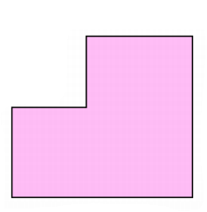




Algebraic Area Problems
The area of this shape is 74 cm².
What is its perimeter?
How can you find the area of an L-shape?
$$2$$
$$x+5$$
$$x+2$$
$$x+3$$

Slide 2
Algebraic Area Problems
Notes:
Look at the different ways the students have split up their L-shapes.

Slide 3


Algebraic Area Problems
The area of this shape is 74 cm².
What is its perimeter?
Ellie attempted to find an expression for the area by splitting the area in this way.
$$2$$
$$x+5$$
$$x+2$$
$$x+3$$

Slide 4




Ellie’s Expression
Ellie has made a mistake in her working out.
In your pairs, go through her working line by line to find her error.
Can you correct it?
$$2$$
$$x+5$$
B
$$x+2$$
A
$$x+3$$

Slide 5
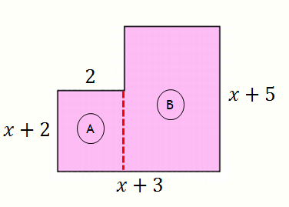
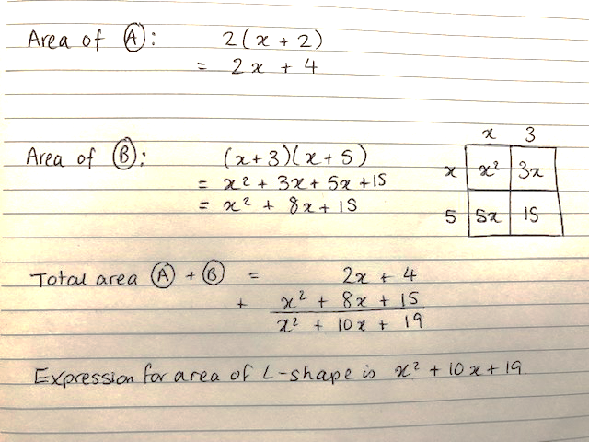
Ellie’s Expression
Notes:
The anticipated problem is that the students will not correctly find the missing lengths. This activity is to identify this before they have a go themselves.
This also models how I would like the question to be set out (breaking down into A and B parts)

Slide 6
Algebraic Area Problems
The area of this shape is 74 cm².
What is its perimeter?
In your pairs, find an expression for the area of the L-shape by splitting this way.
B
$$2$$
$$x+5$$
Finished?
Do you get the same expression if you split the shape in a different way?
And another way?
$$x+2$$
A
$$x+3$$
Notes:
Check:
Area of A = $x^{2}+5x+6$
Area of B = $3\left(x+1\right)=3x+3$
Total Area = $x^{2}+8x+9$

Slide 7
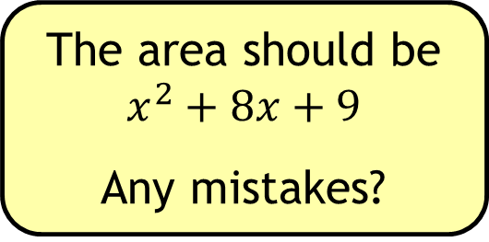
Algebraic Area Problems
The area of this shape is 74 cm².
What is its perimeter?
The area should be
$$x^{2}+8x+9$$
Any mistakes?
B
$$2$$
$$x+5$$
$$x+2$$
A
$$x+3$$
Notes:
Check:
Area of A = $x^{2}+5x+6$
Area of B = $3\left(x+1\right)=3x+3$
Total Area = $x^{2}+8x+9$

Slide 8




Algebraic Area Problems
The area of this shape is 74 cm².
What is its perimeter?
On your whiteboards:
Using the information in the question, turn your expression into an equation.
$$2$$
$$x+5$$
$$x+2$$
$$x+3$$

Slide 9
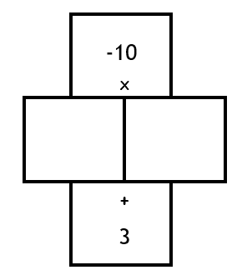
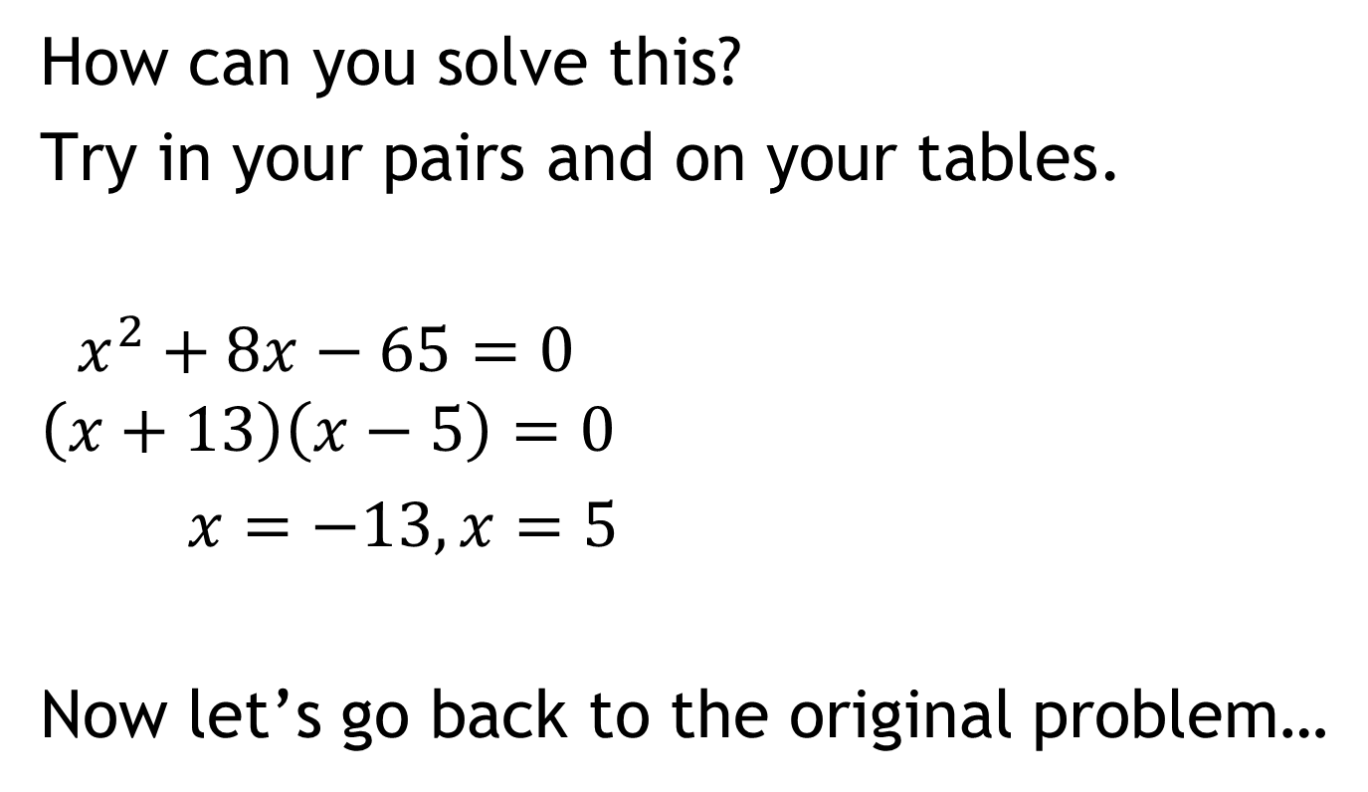

$$x^{2}+8x+9=74$$
How can you solve this?
Try in your pairs and on your tables.
$x^{2}+8x−65=0$
$$\left(x+13\right)\left(x−5\right)=0$$
$x=−13, x=5$
Now let’s go back to the original problem…
-65
8

Slide 10
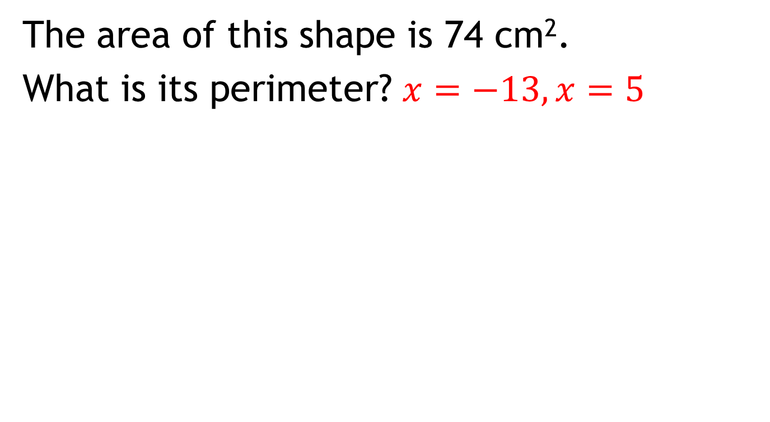
Algebraic Area Problems
The area of this shape is 74 cm².
What is its perimeter? $x=−13,x=5$
What is the perimeter of the shape?
$$2$$
$$x+5$$
$$x+2$$
$$x+3$$

Slide 11
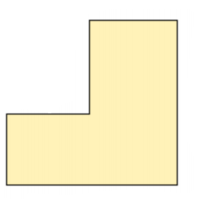


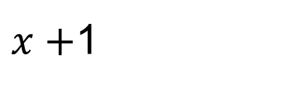

Algebraic Area Problems
In your pairs, split the shape in two different ways to solve the problem. Do you get the same answer?
The area of this shape is 22 cm².
What is its perimeter?
$$4$$
$x+$1
$$x+3$$
$$2x+5$$

Slide 12
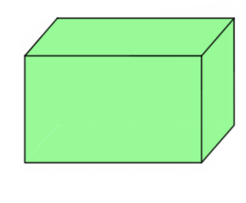



Algebraic Area Problems
Now try this…
The surface area of this cuboid is 3600 cm².
What is its volume?
$$x+15$$
$$x$$
$$x$$

