Slide 1
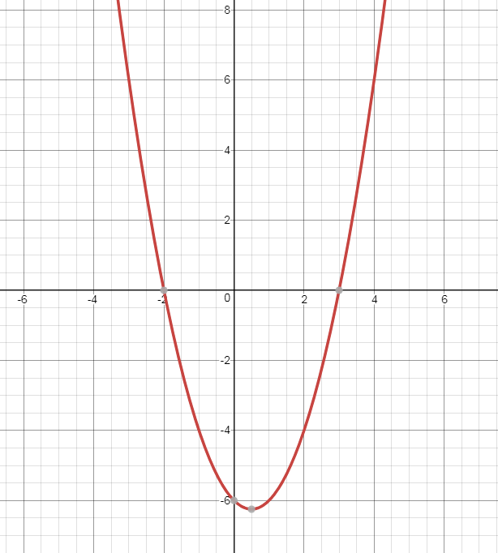
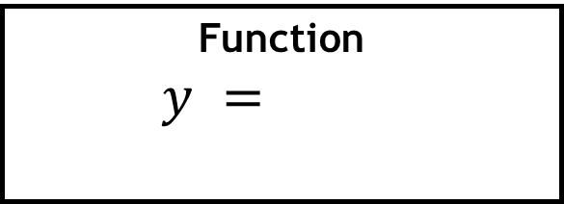
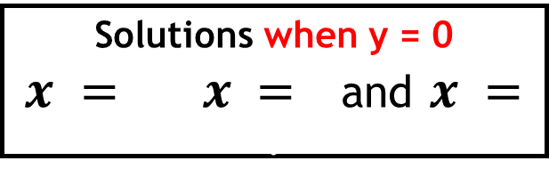
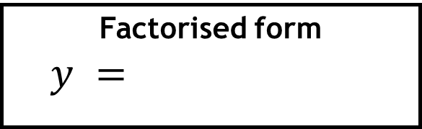
Function
$y =$.
Recap
Factorised form
$y =$…………….
Solutions when y = 0
$x = x =$and $x =$ .

Slide 2
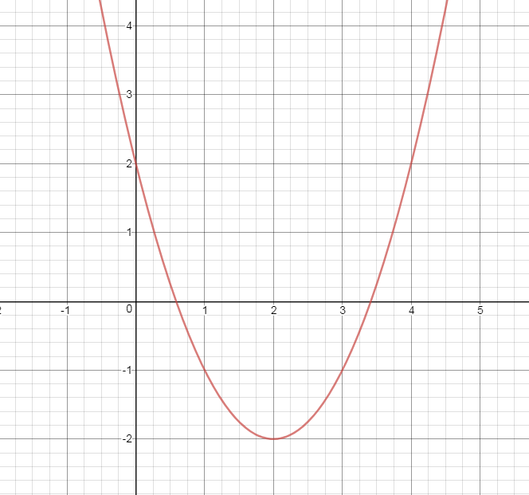
What makes this example more difficult?
Notes:
This shows that it is not easy to find the x-intercepts

Slide 3
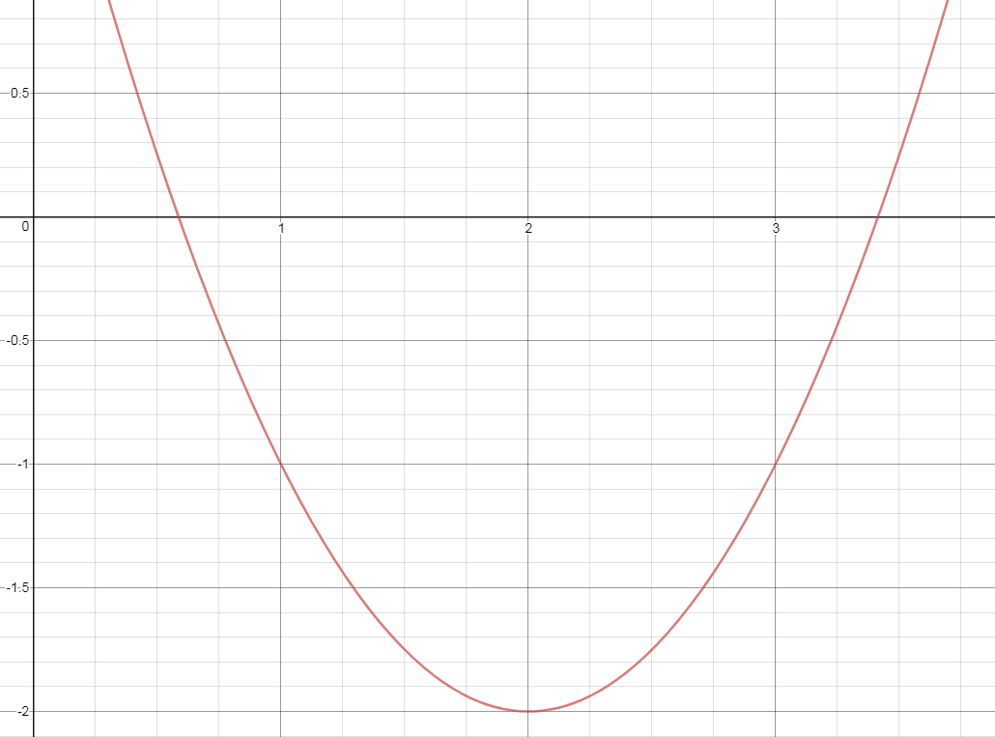
What if we zoom in?
There isn’t a factorised form of the function of this graph
Notes:
Zooming in – it is still difficult. The functions don’t factorise.

Slide 4
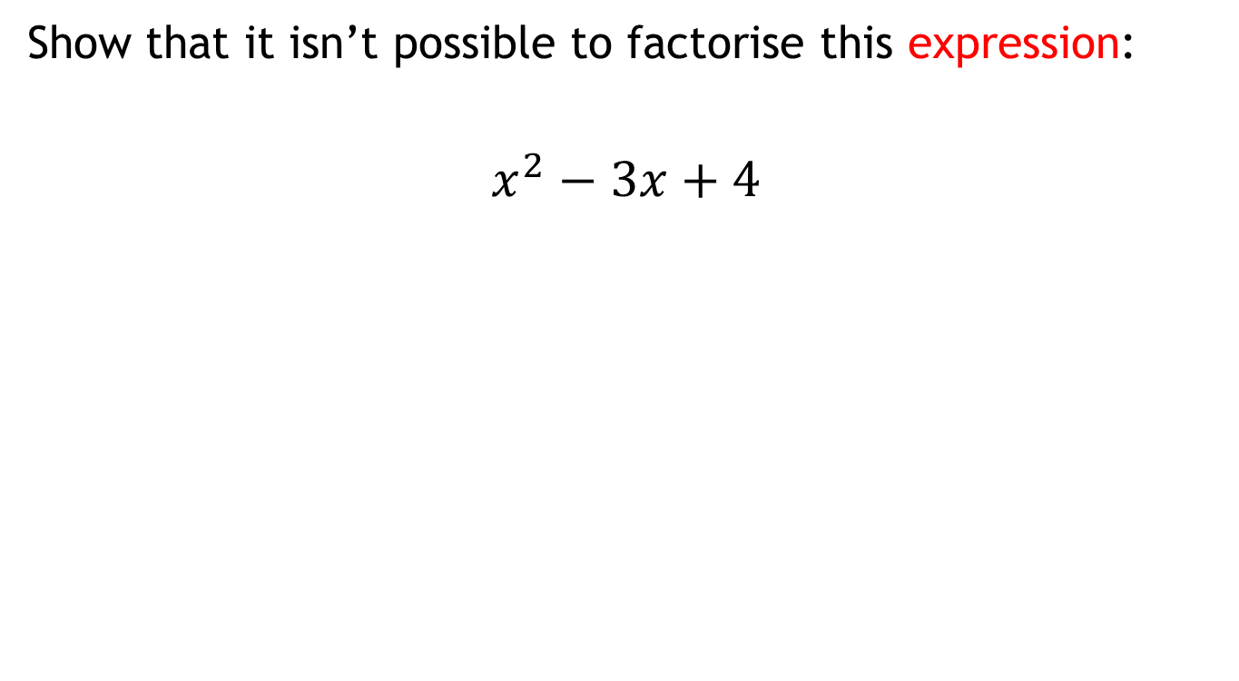
How do we solve quadratic equations if we can’t factorise?
Show that it isn’t possible to factorise this expression:
$$x^{2}−3x+4$$
Hint:
Write down all the factors of 4
Notes:
By considering all of the factors, all options are exhausted.

Slide 5
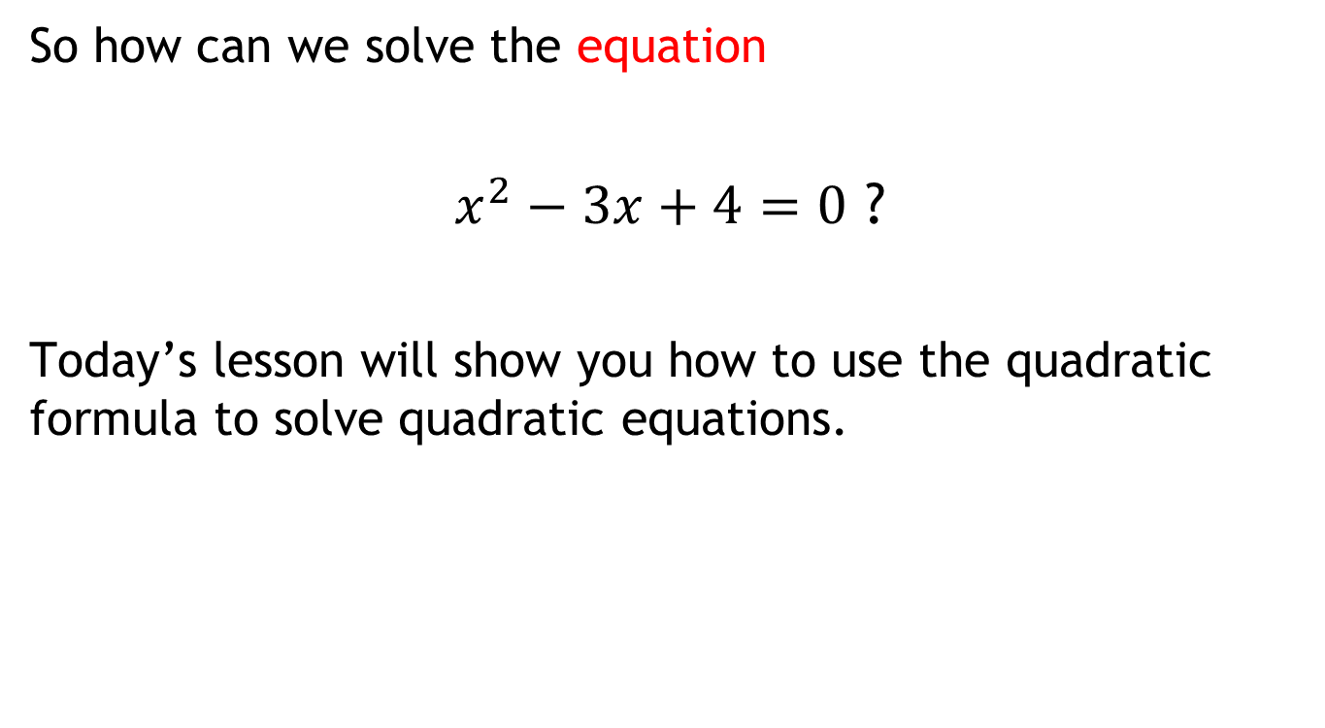
How do we solve quadratic equations if we can’t factorise?
So how can we solve the equation
$x^{2}−3x+4=0$ ?
Today’s lesson will show you how to use the quadratic formula to solve quadratic equations.

Slide 6

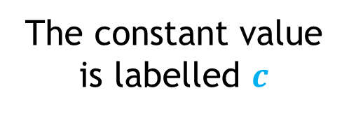
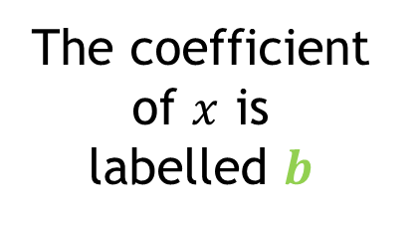
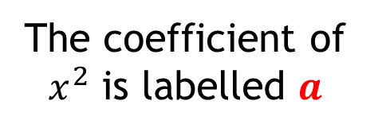
Here is a general quadratic expression:
$$ax^{2}+bx+c$$
The constant value is labelled $c$
The coefficient of $x^{2}$ is labelled $a$
The coefficient of $x$ is
labelled $b$

Slide 7






Discuss: Which of these expressions are quadratic expressions?
How do you know?
$$x^{2}+7$$
$$\sqrt{x}+7x$$
$$4x^{2}−1>0$$
$${3x}^{2}+7x^{3}+x$$
$$x^{2}+7x−9=0$$
$${3x}^{2}+7x+1$$

Slide 8

What is the value of $c$ in this expression?
$$3x^{2}+2x+4$$
3
2
4

Slide 9

What is the value of $b$ in this expression?
$${3x}^{2}+2x+4$$
3
2
4

Slide 10

What is the value of $b$ in this expression?
$${3x}^{2}−2x+4$$
2
-2
3

Slide 11

What is the value of $a$ in this expression?
$$4x^{2}−2x+6$$
6
-2
4

Slide 12

What is the value of $a$ in this expression?
$${−x}^{2}−2x+6$$
-1
0
1

Slide 13

What is the value of $b$ in this expression?
$$2x −3x^{2}+ 6$$
-3
2
3

Slide 14

What is the value of $c$ in this expression?
$$2x−3x^{2}−3$$
-3
2
3

Slide 15

What is the value of $a$ in this expression?
$9+2x−3x^{2}$
-3
2
3

Slide 16

Which of these expressions are quadratic?
$$x^{2}+7$$
$$\sqrt{x}+7x$$
$$4x^{2}−1>0$$
$${3x}^{2}+7x^{3}+x$$
$$x^{2}+7x−9=0$$
$${3x}^{2}+7x+1$$

Slide 17
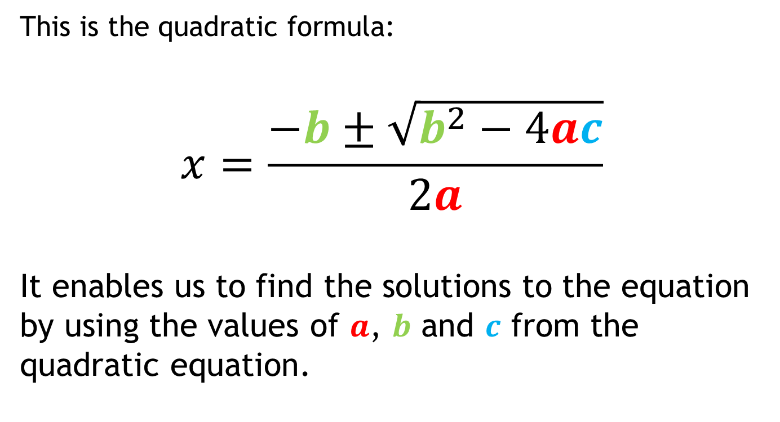
Solving quadratic equations using the quadratic formula.
This is the quadratic formula:
$$x=\frac{−b±\sqrt{b^{2}−4ac}}{2a}$$
It enables us to find the solutions to the equation by using the values of $a$, $b$ and $c$ from the quadratic equation.
Notes:
By considering all of the factors, all options are exhausted.

Slide 18
Memory Game
You will have 10 seconds to look at the quadratic equation
You have to try and recreate as much of it as possible after this time has passed.

Slide 19
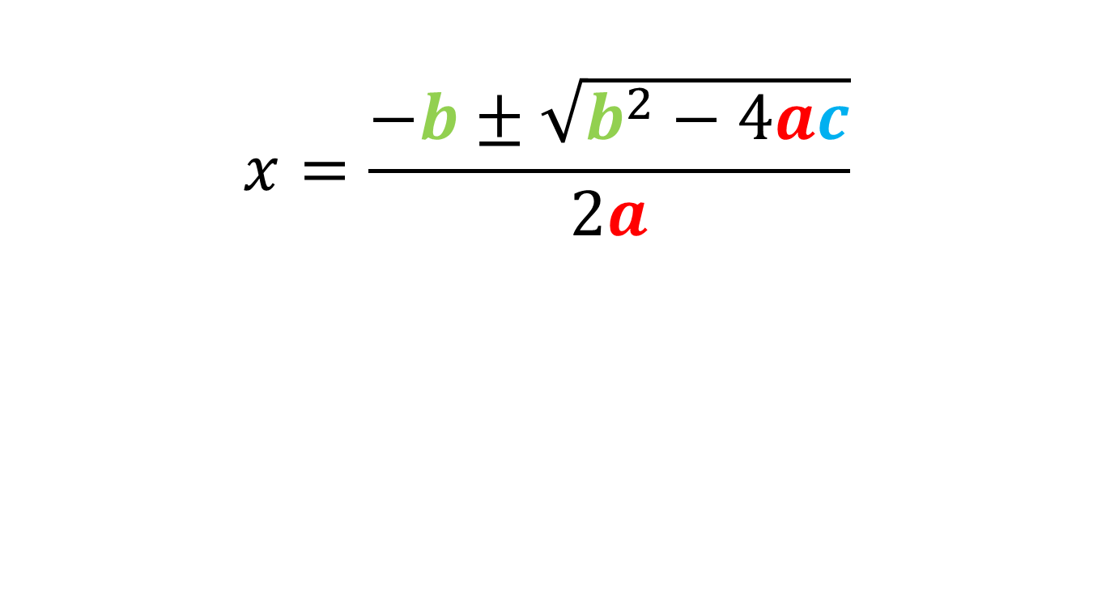
The quadratic formula.
$$x=\frac{−b±\sqrt{b^{2}−4ac}}{2a}$$
Notes:
By considering all of the factors, all options are exhausted.

Slide 20
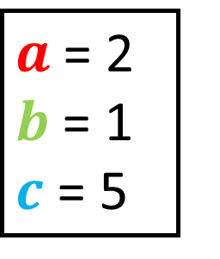
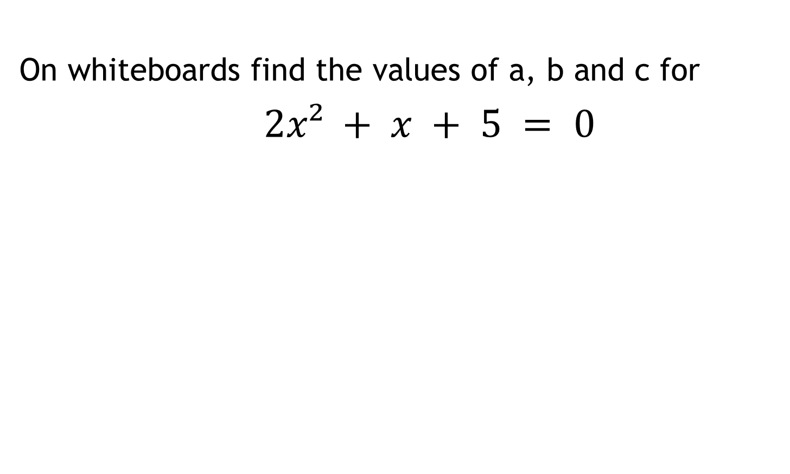
Solving quadratic equations using the quadratic formula.
On whiteboards find the values of a, b and c for
$2x² + x + 5 = 0$
$a$ = 2
$b$ = 1 $c$ = 5

Slide 21
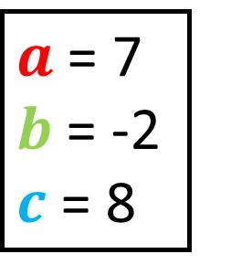
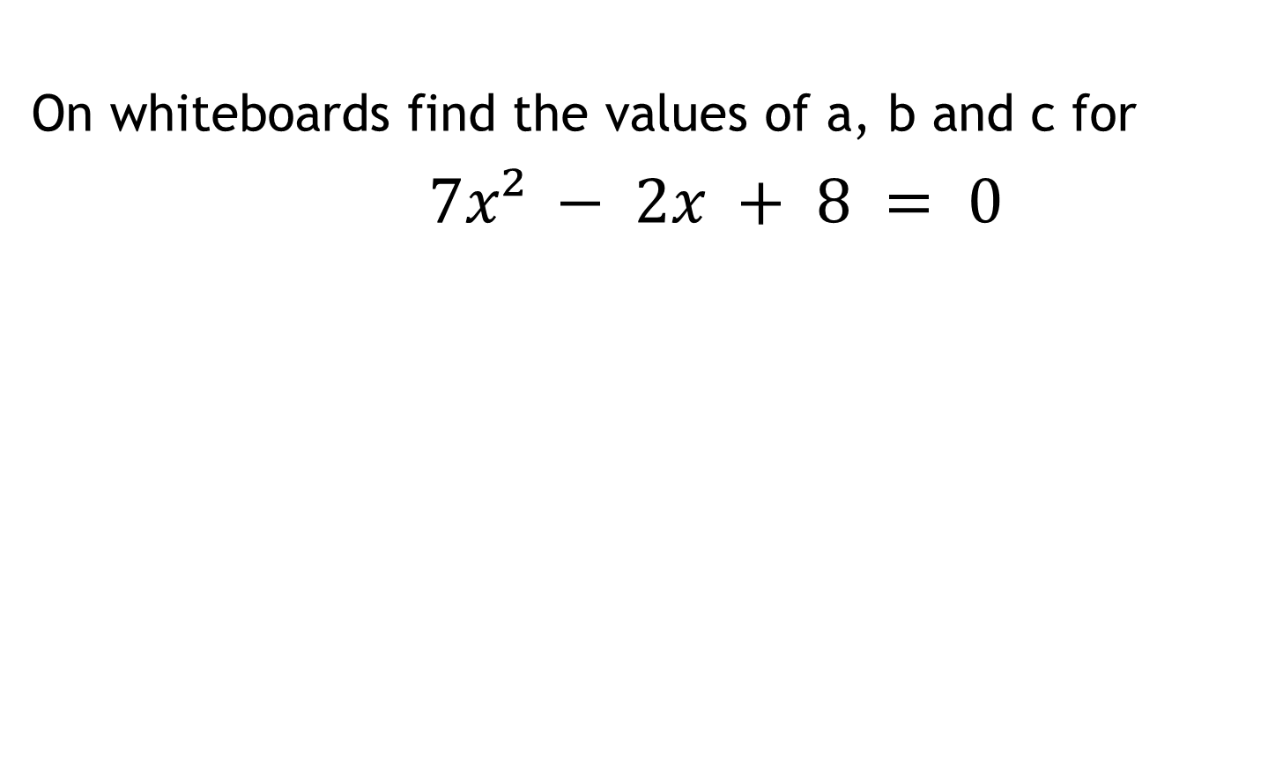
Solving quadratic equations using the quadratic formula.
On whiteboards find the values of a, b and c for
$7x² − 2x + 8 = 0$
$a$ = 7
$b$ = -2 $c$ = 8

Slide 22
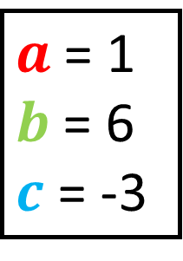
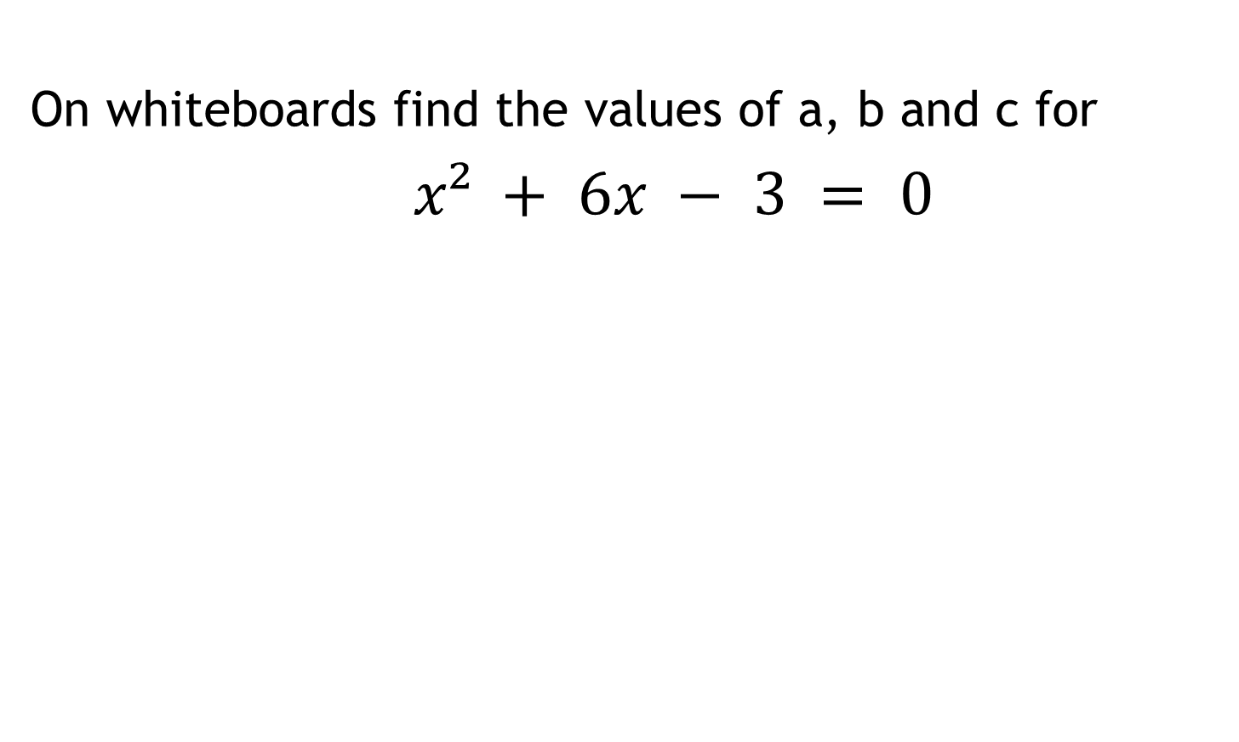
Solving quadratic equations using the quadratic formula.
On whiteboards find the values of a, b and c for
$x² + 6x − 3 = 0$
$a$ = 1
$b$ = 6
$c$ = -3

Slide 23
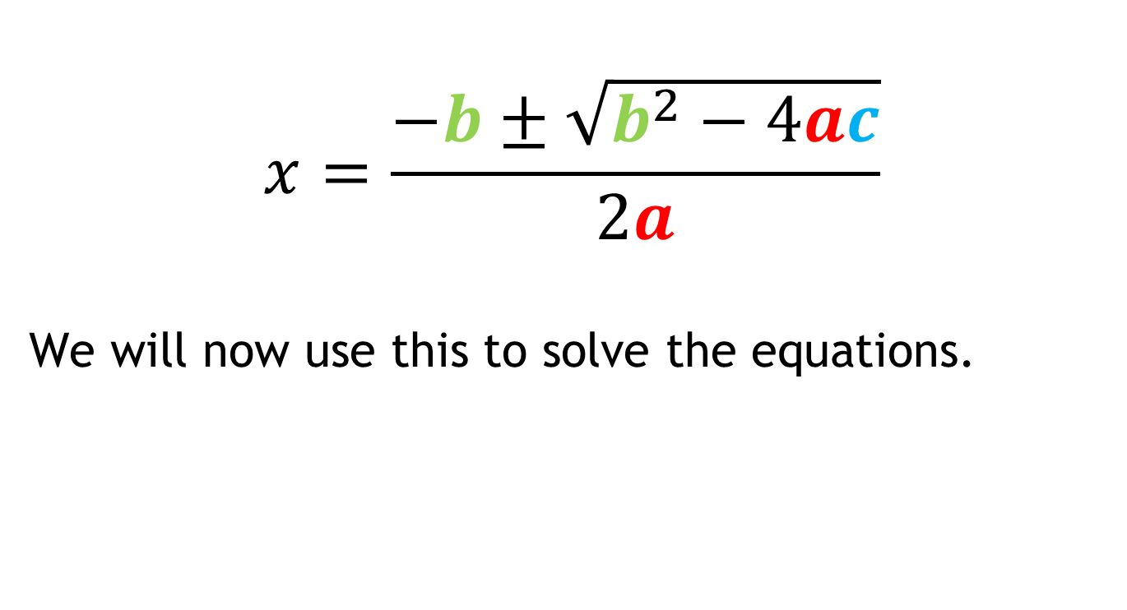
Can you remember the quadratic formula?
Write it on your boards.
$$x=\frac{−b±\sqrt{b^{2}−4ac}}{2a}$$
We will now use this to solve the equations.
Notes:
By considering all of the factors, all options are exhausted.

Slide 24
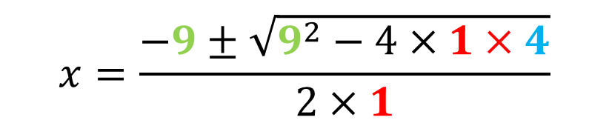
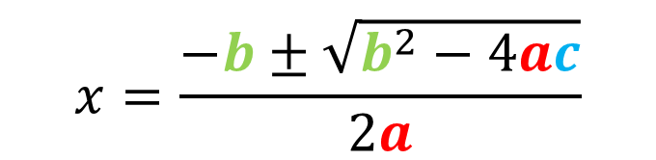
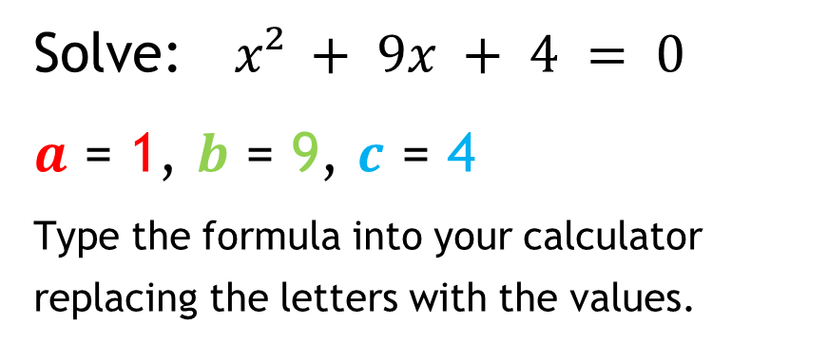
Using the quadratic formula
Solve: $x² + 9x + 4 = 0$
$a$ = 1, $b$ = 9, $c$ = 4
Type the formula into your calculator replacing the letters with the values.
$$x=\frac{−b±\sqrt{b^{2}−4ac}}{2a}$$
$$x=\frac{−9±\sqrt{9^{2}−4×1×4}}{2×1}$$

Slide 25
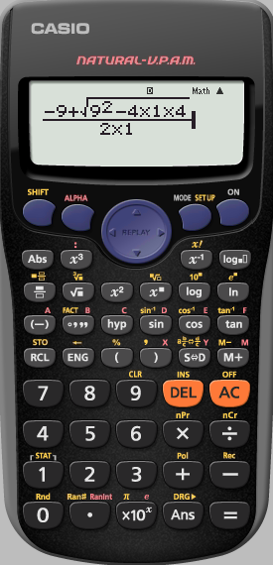
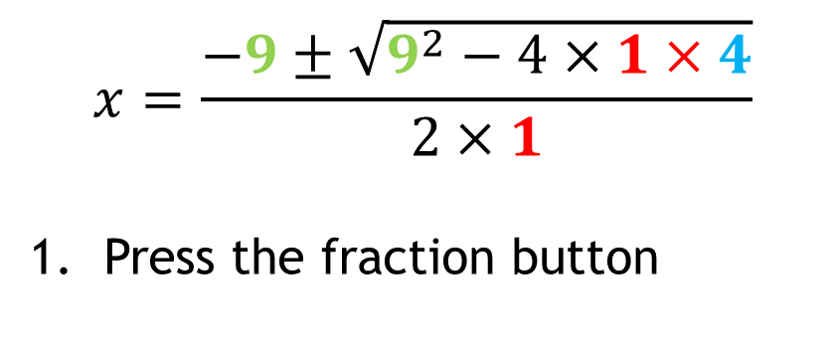
How to type it into your calculator
$$x=\frac{−9±\sqrt{9^{2}−4×1×4}}{2×1}$$
Press the fraction button

Slide 26
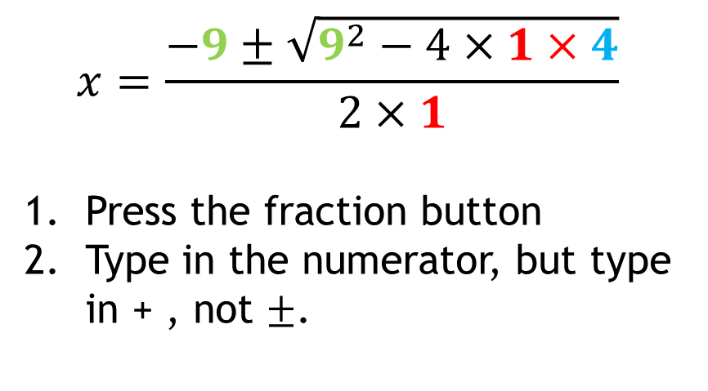
How to type it into your calculator
$$x=\frac{−9±\sqrt{9^{2}−4×1×4}}{2×1}$$
Press the fraction button
Type in the numerator, but type in + , not $±$.

Slide 27
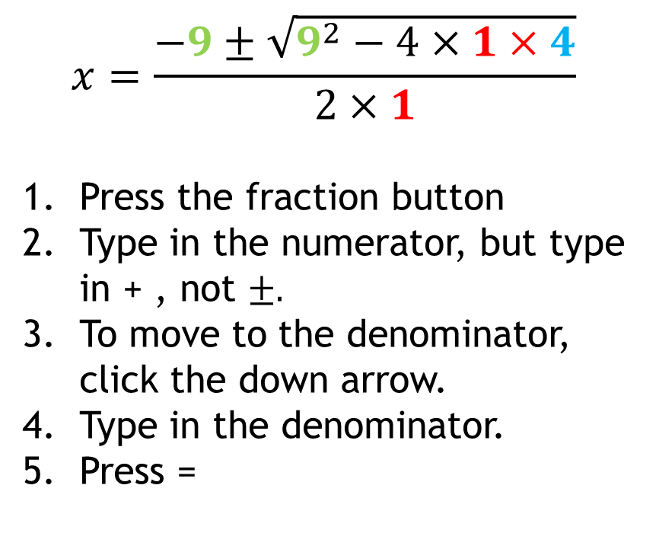
How to type it into your calculator
$$x=\frac{−9±\sqrt{9^{2}−4×1×4}}{2×1}$$
Press the fraction button
Type in the numerator, but type in + , not $±.$
To move to the denominator, click the down arrow.
Type in the denominator.
Press =

Slide 28
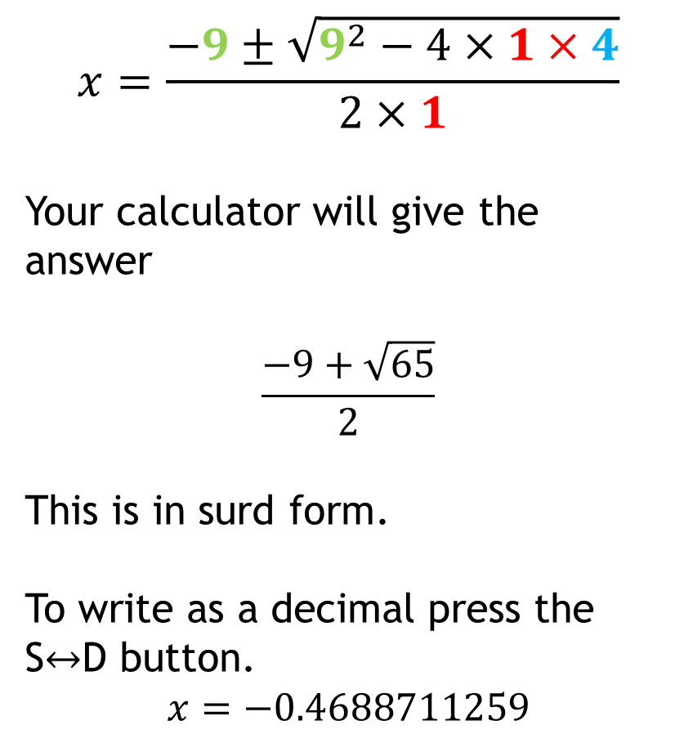
How to type it into your calculator
$$x=\frac{−9±\sqrt{9^{2}−4×1×4}}{2×1}$$
Your calculator will give the answer
$$\frac{−9+\sqrt{65}}{2}$$
This is in surd form.
To write as a decimal press the S$↔$D button.
$$x=−0.4688711259$$

Slide 29
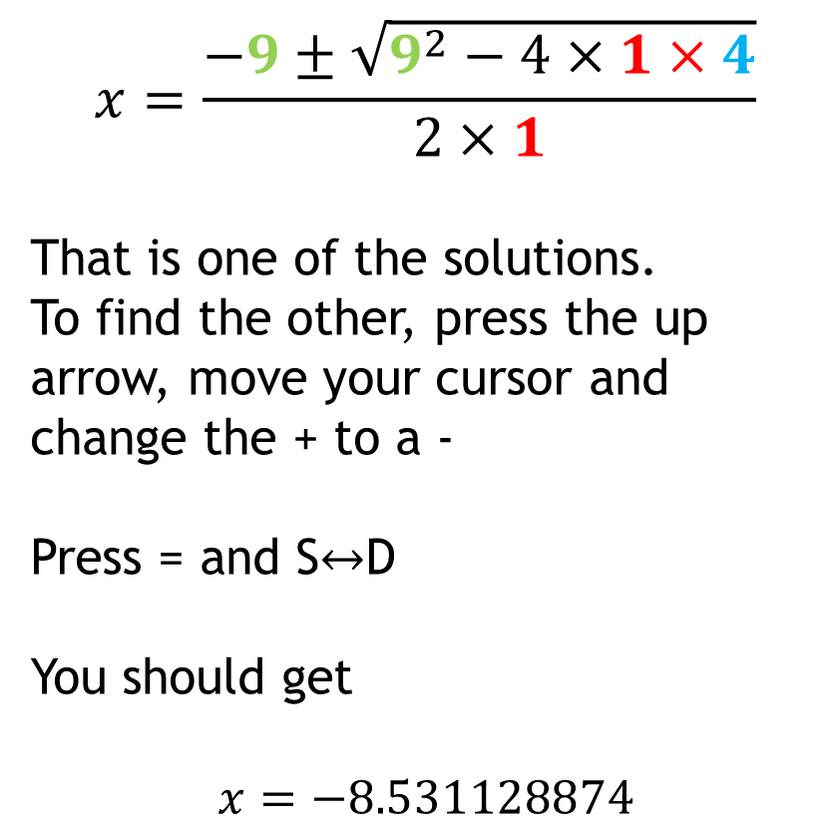
How to type it into your calculator
$$x=\frac{−9±\sqrt{9^{2}−4×1×4}}{2×1}$$
That is one of the solutions.
To find the other, press the up arrow, move your cursor and change the + to a -
Press = and S$↔$D
You should get
$$x=−8.531128874$$

Slide 30
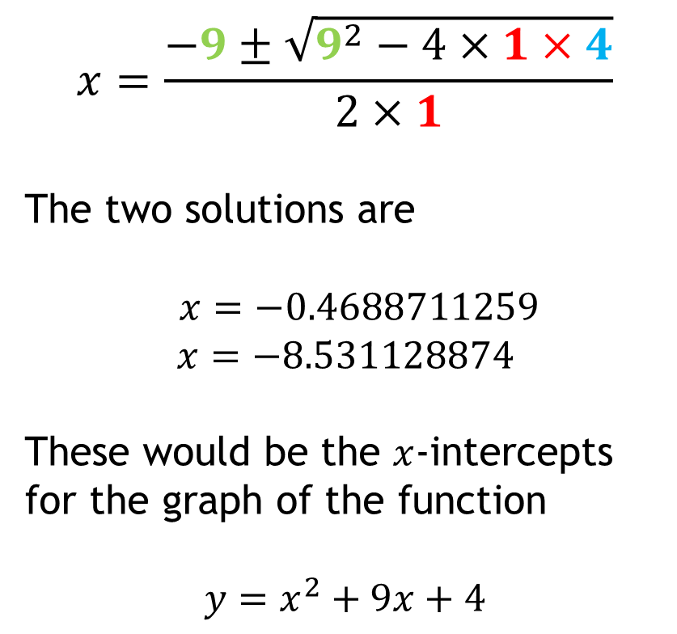
How to type it into your calculator
$$x=\frac{−9±\sqrt{9^{2}−4×1×4}}{2×1}$$
The two solutions are
$x=−0.4688711259$
$$x=−8.531128874$$
These would be the $x$-intercepts for the graph of the function
$$y=x^{2}+9x+4$$

Slide 31
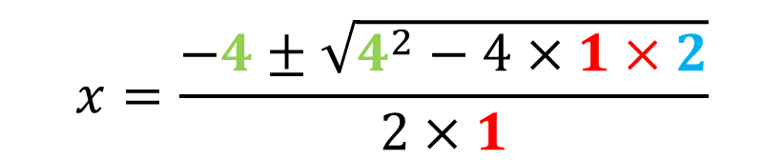
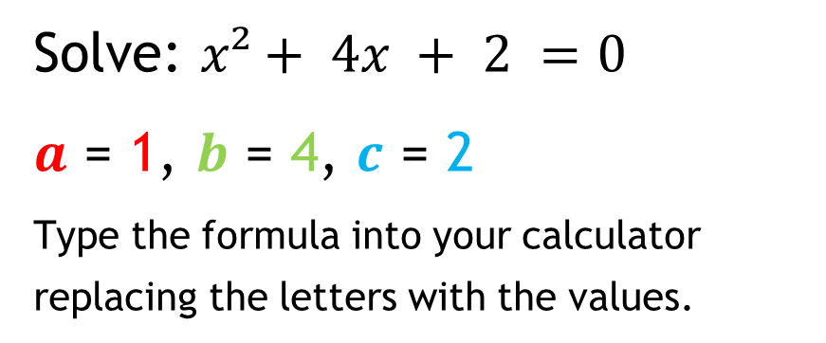
Using the quadratic formula
Solve: $x²+ 4x + 2 =0$
$a$ = 1, $b$ = 4, $c$ = 2
Type the formula into your calculator replacing the letters with the values.
Now type into your calculator to find the two solutions.
$$x=\frac{−b±\sqrt{b^{2}−4ac}}{2a}$$
$$x=\frac{−4±\sqrt{4^{2}−4×1×2}}{2×1}$$

Slide 32
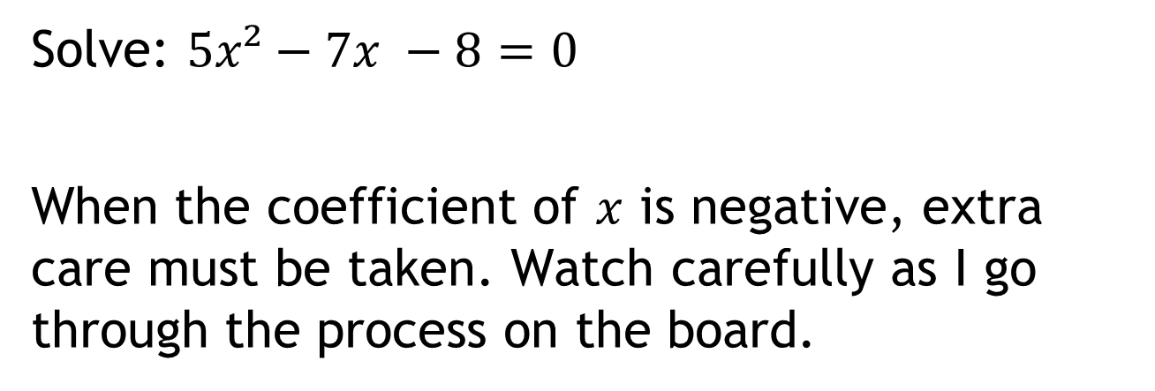
Using the quadratic formula
Solve: $5x²−7x −8=0$
When the coefficient of $x$ is negative, extra care must be taken. Watch carefully as I go through the process on the board.

Slide 33
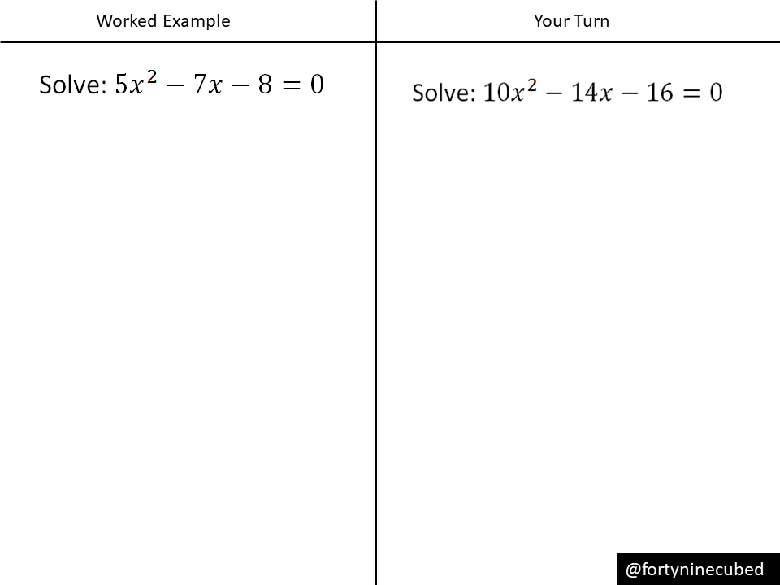
Using the quadratic formula
Now let’s look at some of your work.

Slide 34
For the questions on the next slide:
Before answering each question, look at the previous answer. Do you think it will be related in any way?
Check by working out.
Were you correct?
Predict. Check. Evaluate

Slide 35
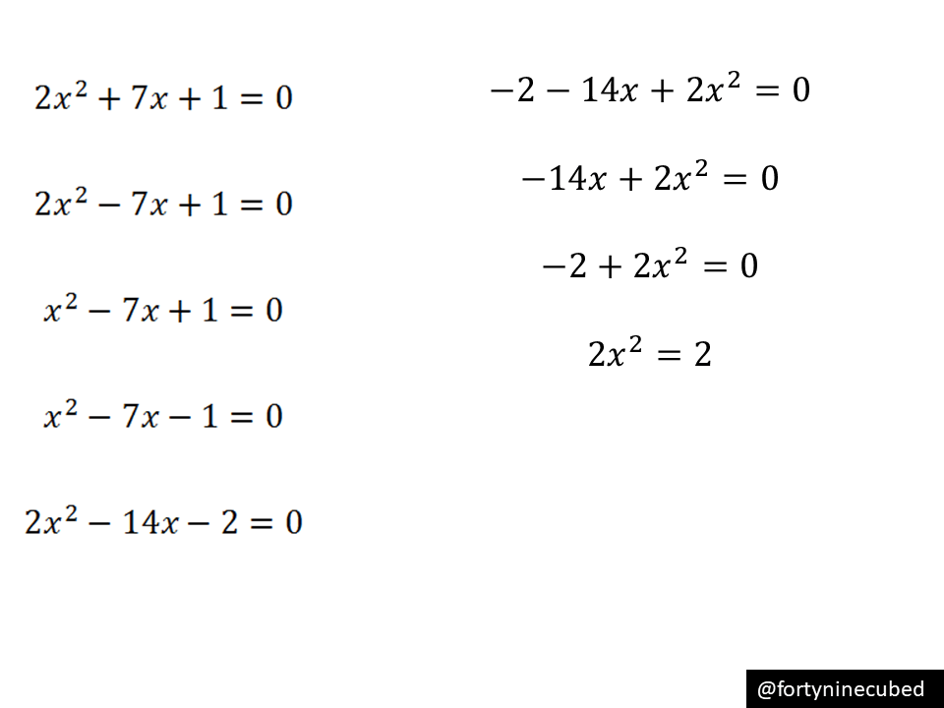

Slide 36
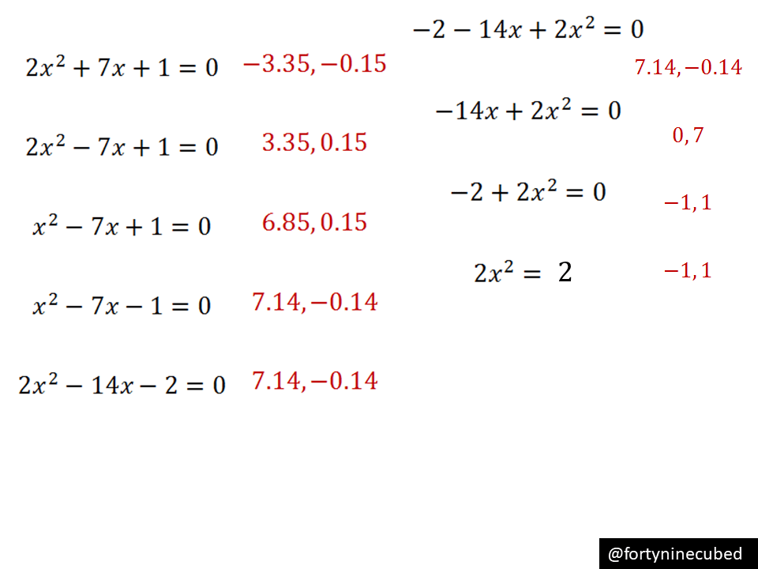

Slide 37
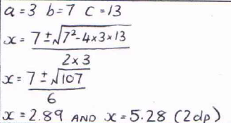
Find and correct the common mistake

