Slide 1
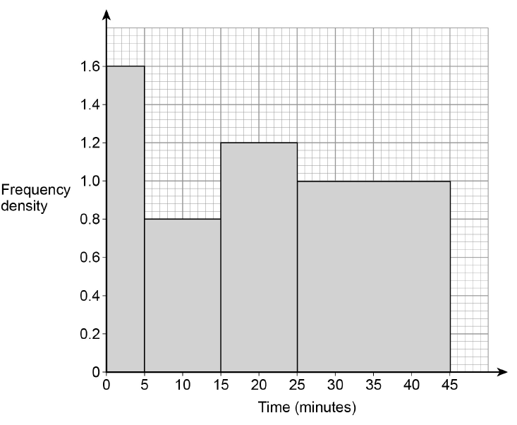
This histogram represents the time a group of students spent on their homework one evening.
Work out as many things as you can!
Notes:
Goal Free Problem

Slide 2
This histogram represents the time a group of students spent on their homework one evening.
Prompts
How many students took part in the survey?
What proportion of students spend less than 5 minutes on their homework?
What percentage of students spent more than 30 minutes on their homework?
Draw a Frequency Table for this Histogram
Draw a Cumulative Frequency Graph for this Histogram
Estimate the mean time students spent on homework.
What is the modal class?
Notes:
Goal Free Problem

Slide 3
This histogram represents the time a group of students spent on their homework one evening.
Further Prompts
Work out the interquartile range from the Histogram
Work out the median from the Histogram
Draw a box plot from the Histogram
Notes:
Goal Free Problem

Slide 4
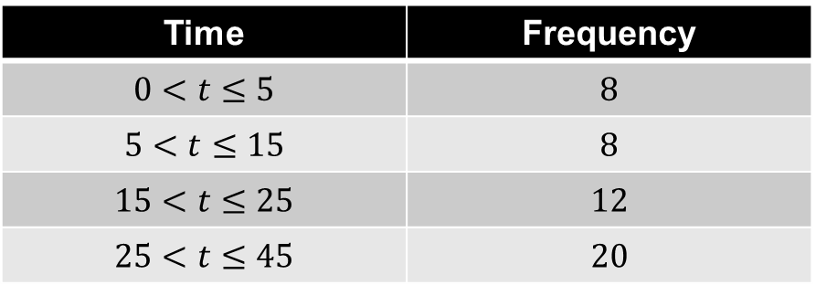

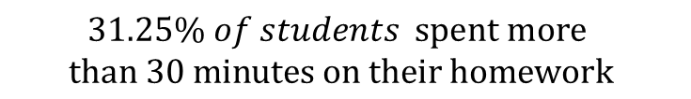

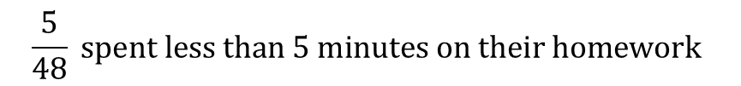


Mark your work
Area of each bar represents the number of students…
Time | Frequency
$$0<t≤5$$ | $$8$$
$$5<t≤15$$ | $$8$$
$$15<t≤25$$ | $$12$$
$$25<t≤45$$ | $$20$$
48 students are part of this survey
$$8$$
$$12$$
$$20$$
$$\frac{5}{48} spent less than 5 minutes on their homework$$
$$8$$
$$31.25\% of students spent more$$
$$than 30 minutes on their homework$$
Notes:
Goal Free Problem

Slide 5
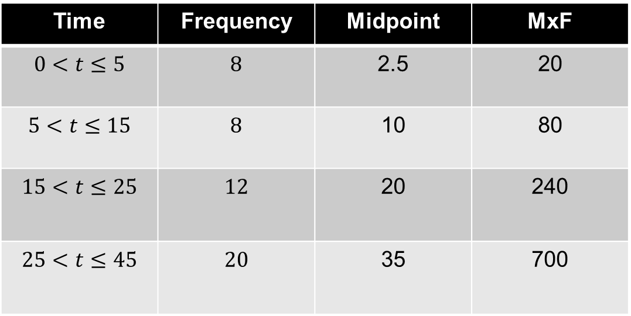


Mark your work
Estimating the Mean:
Time | Frequency | Midpoint | MxF
$$0<t≤5$$ | $$8$$ | 2.5 | 20
$$5<t≤15$$ | $$8$$ | 10 | 80
$$15<t≤25$$ | $$12$$ | 20 | 240
$$25<t≤45$$ | $$20$$ | 35 | 700
$$8$$
$$12$$
$$20$$
$$Mean= \frac{1040}{48}=21.\dot{6}$$
$$8$$
Modal Class : $25<t≤45$
Notes:
Goal Free Problem

Slide 6
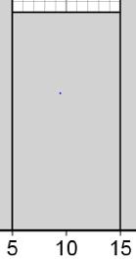
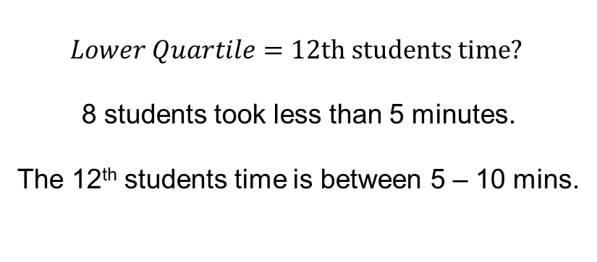




Time | Frequency
$$0<t≤5$$ | $$8$$
$$5<t≤15$$ | $$8$$
$$15<t≤25$$ | $$12$$
$$25<t≤45$$ | $$20$$
$$Lower Quartile=12th students time?$$
8 students took less than 5 minutes.
The 12th students time is between 5 – 10 mins.
$$8$$
$$12$$
$$20$$
$$8$$
$$4$$
$$4$$
$$Lower Quartile=10 mins$$
Notes:
Goal Free Problem

Slide 7
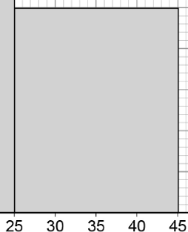





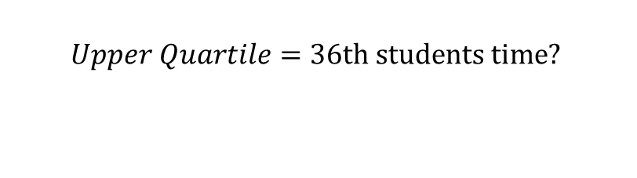

Time | Frequency
$$0<t≤5$$ | $$8$$
$$5<t≤15$$ | $$8$$
$$15<t≤25$$ | $$12$$
$$25<t≤45$$ | $$20$$
$$Upper Quartile=36th students time?$$
$$8$$
$$5$$
$$5$$
$$5$$
$$5$$
$$12$$
$$20$$
$$8$$
$$Lower Quartile=10 mins$$
Notes:
Goal Free Problem

Slide 8
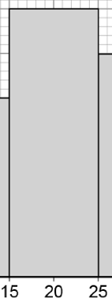






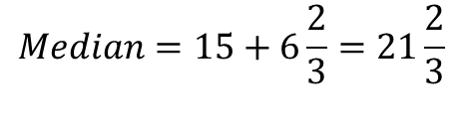
Time | Frequency
$$0<t≤5$$ | $$8$$
$$5<t≤15$$ | $$8$$
$$15<t≤25$$ | $$12$$
$$25<t≤45$$ | $$20$$
$$Median=24th students time?$$
16 students took less than 15 minutes.
28 students took less than 12 minutes.
Therefore 24th student took between
15 – 25 minutes.
$$8$$
$$12$$
$$20$$
$$8$$
$$1.2w=8$$
$$1.2$$
$$8$$
$$w=6\frac{2}{3}$$
$$Median=15+6\frac{2}{3}=21\frac{2}{3}$$
$$w$$
Notes:
Goal Free Problem

