Slide 1
Flash Cards Quiz 1
Higher
8 Questions
How many of your flash cards have you memorised?

Slide 2

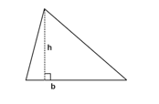
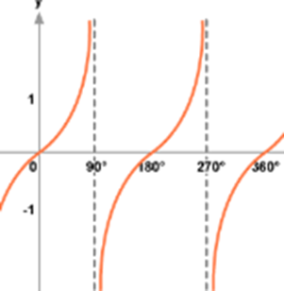
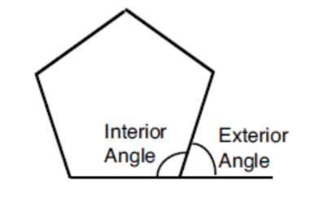

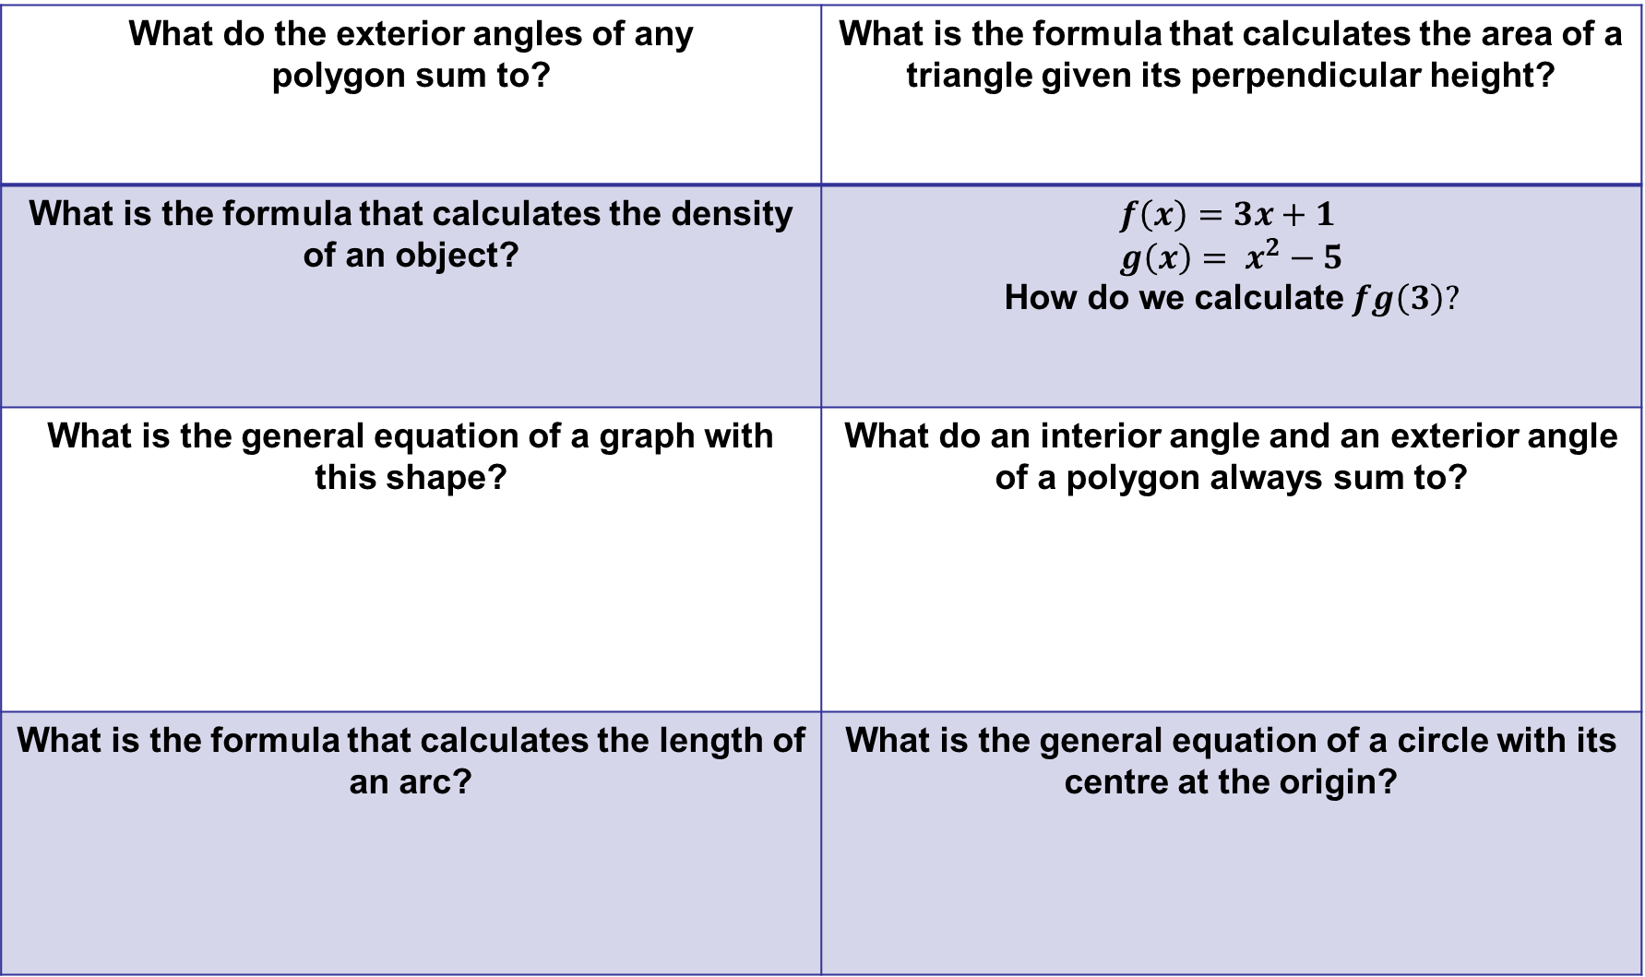
What do the exterior angles of any polygon sum to? | What is the formula that calculates the area of a triangle given its perpendicular height?
What is the formula that calculates the density of an object? | $$f\left(x\right)=3x+1$$ $$g\left(x\right)= x^{2}−5$$ How do we calculate $fg\left(3\right)?$
What is the general equation of a graph with this shape? | What do an interior angle and an exterior angle of a polygon always sum to?
What is the formula that calculates the length of an arc? | What is the general equation of a circle with its centre at the origin?

Slide 3
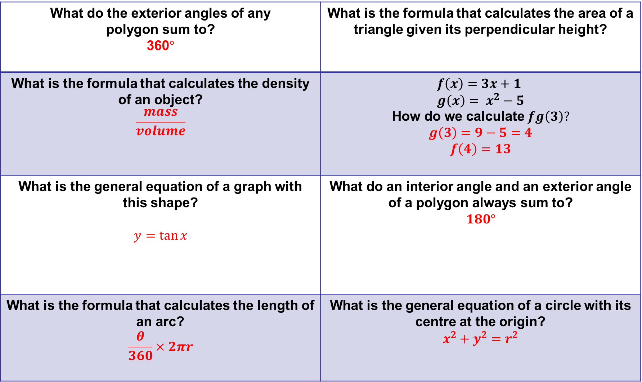
What do the exterior angles of any polygon sum to? 360$°$ | What is the formula that calculates the area of a triangle given its perpendicular height?
What is the formula that calculates the density of an object? $$\frac{mass}{volume}$$ | $$f\left(x\right)=3x+1$$ $$g\left(x\right)= x^{2}−5$$ How do we calculate $fg\left(3\right)?$ $$g\left(3\right)=9−5=4$$ $$f\left(4\right)=13$$
What is the general equation of a graph with this shape? $y=\tan{x }$ | What do an interior angle and an exterior angle of a polygon always sum to? $$180°$$
What is the formula that calculates the length of an arc? $$\frac{θ}{360}×2πr$$ | What is the general equation of a circle with its centre at the origin? $$x^{2}+y^{2}=r^{2}$$

Slide 4
Flash Cards Quiz 2
Higher
8 Questions
How many of your flash cards have you memorised?

Slide 5
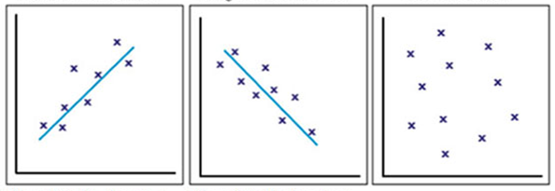
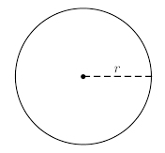
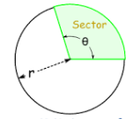
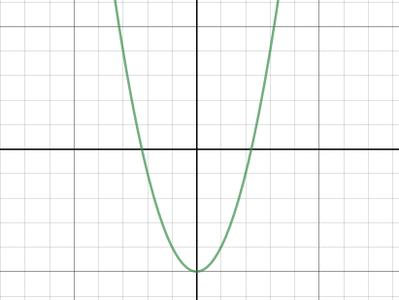
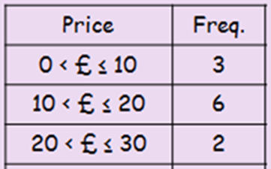
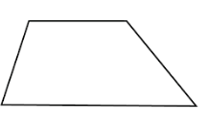
What type of correlation do each of these graphs show? | Which formula calculates the area of a circle?
What is the value of tan 30? WITHOUT A CALCULATOR | What is the formula that calculates the area of a sector?
What is the general equation of a graph with this shape? | How do you estimate the mean from a frequency table?
What function notation would represent a stretch in the x direction by a factor of 3? | Which formula calculates the area of a trapezium?

Slide 6
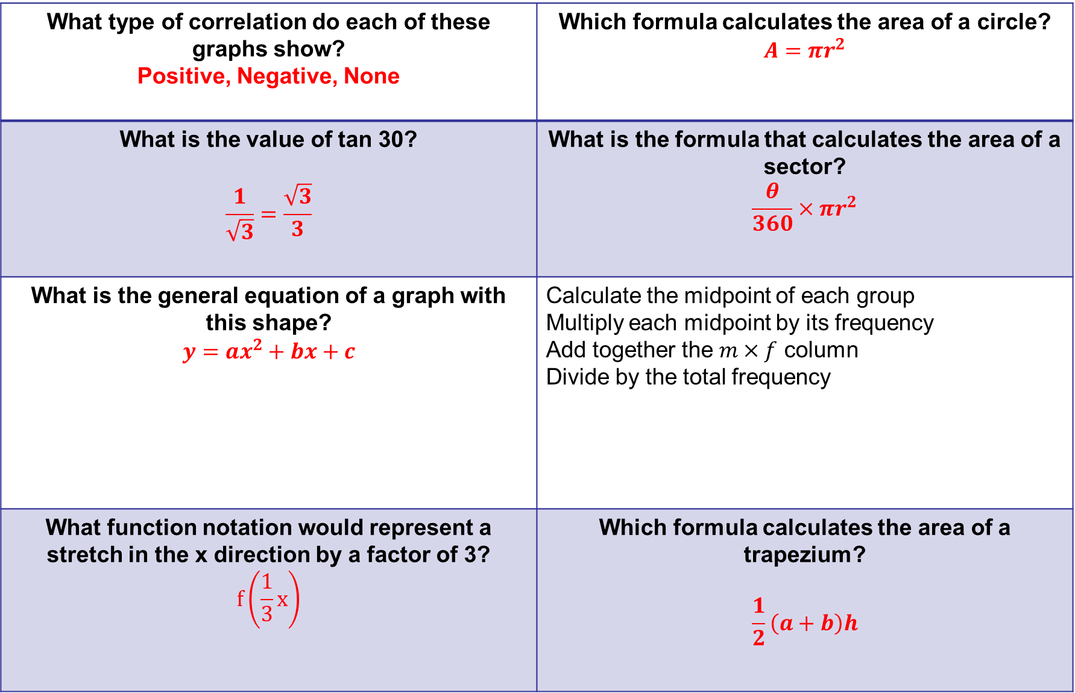
What type of correlation do each of these graphs show? Positive, Negative, None | Which formula calculates the area of a circle? $$A=πr^{2}$$
What is the value of tan 30? $$\frac{1}{\sqrt{3}}=\frac{\sqrt{3}}{3}$$ | What is the formula that calculates the area of a sector? $$\frac{θ}{360}×πr^{2}$$
What is the general equation of a graph with this shape? $y={ax}^{2}+bx+c$ | Calculate the midpoint of each group Multiply each midpoint by its frequency Add together the $m×f$ column Divide by the total frequency
What function notation would represent a stretch in the x direction by a factor of 3? $$f\left(\frac{1}{3}x\right)$$ | Which formula calculates the area of a trapezium? $$\frac{1}{2}\left(a+b\right)h$$

Slide 7
Flash Cards Quiz 3
Higher
8 Questions
How many of your flash cards have you memorised?

Slide 8
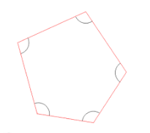
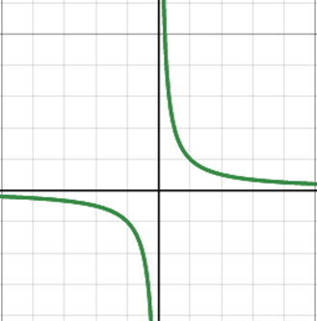
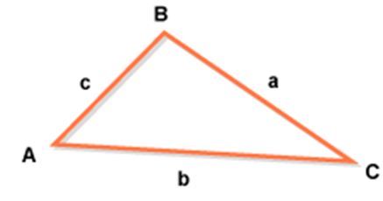
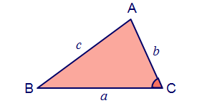
Conditional Probability – What is the formula for P(A given B)? | Which formula calculates the sum of the interior angles of any polygon?
What is general equation of a graph with this shape? | What is the sine rule?
What is the trigonometric formula that calculates the area of any triangle given an angle and the two adjacent sides? | If two events A and B are independent, which two formulae are true?
What is the angle between radius and tangent? | What do parallel lines have in common?

Slide 9

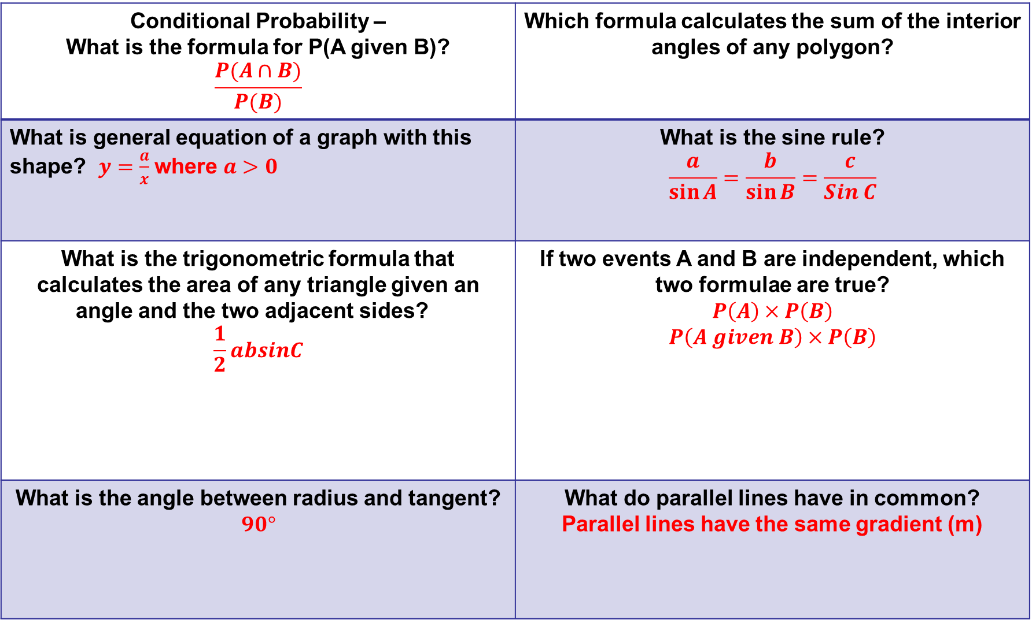
Conditional Probability – What is the formula for P(A given B)? $$\frac{P(A∩B)}{P(B)}$$ | Which formula calculates the sum of the interior angles of any polygon?
What is general equation of a graph with this shape? $y=\frac{a}{x}$ where $a>0$ | What is the sine rule? $$\frac{a}{\sin{A}}=\frac{b}{\sin{B}}=\frac{c}{Sin C}$$
What is the trigonometric formula that calculates the area of any triangle given an angle and the two adjacent sides? $$\frac{1}{2}absinC$$ | If two events A and B are independent, which two formulae are true? $$P\left(A\right)×P\left(B\right)$$ $$P\left(A given B\right)×P\left(B\right)$$
What is the angle between radius and tangent? $$90°$$ | What do parallel lines have in common? Parallel lines have the same gradient (m)
$$(n−2)×180$$

Slide 10
Flash Cards Quiz 4
Higher
8 Questions
How many of your flash cards have you memorised?

Slide 11
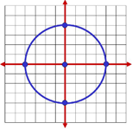

Which two formulae calculate the circumference of a circle? | How is average speed calculated?
What is general equation of a graph with this shape? | How is pressure calculated?
What is the general equation of a straight line? | Frequency Density is required to draw which kind of graph?
How are CUMULATIVE frequency values calculated? | What do each the five lines of a Box Plot represent?

Slide 12
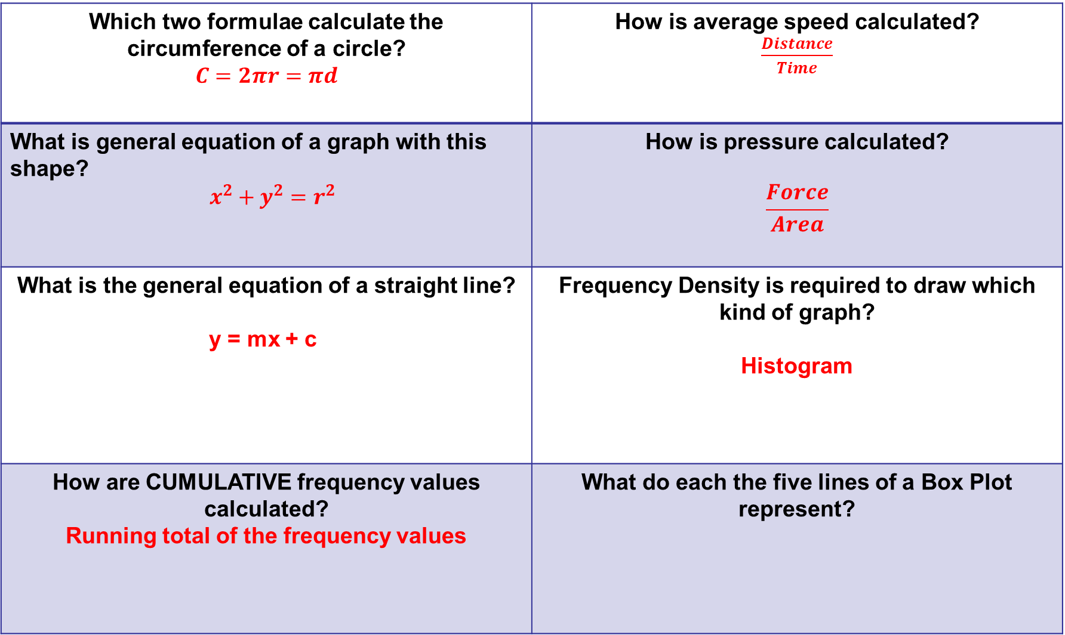
Which two formulae calculate the circumference of a circle? $$C=2πr=πd$$ | How is average speed calculated? $\frac{Distance}{Time}$
What is general equation of a graph with this shape? $x^{2}+y^{2}=r^{2}$ | How is pressure calculated? $$\frac{Force}{Area}$$
What is the general equation of a straight line? y = mx + c | Frequency Density is required to draw which kind of graph? Histogram
How are CUMULATIVE frequency values calculated? Running total of the frequency values | What do each the five lines of a Box Plot represent?
Smallest value, LQ, Median, UQ, Largest Value

Slide 13
Flash Cards Quiz 5
Higher
8 Questions
How many of your flash cards have you memorised?

Slide 14
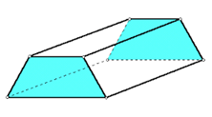
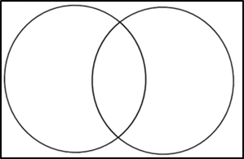
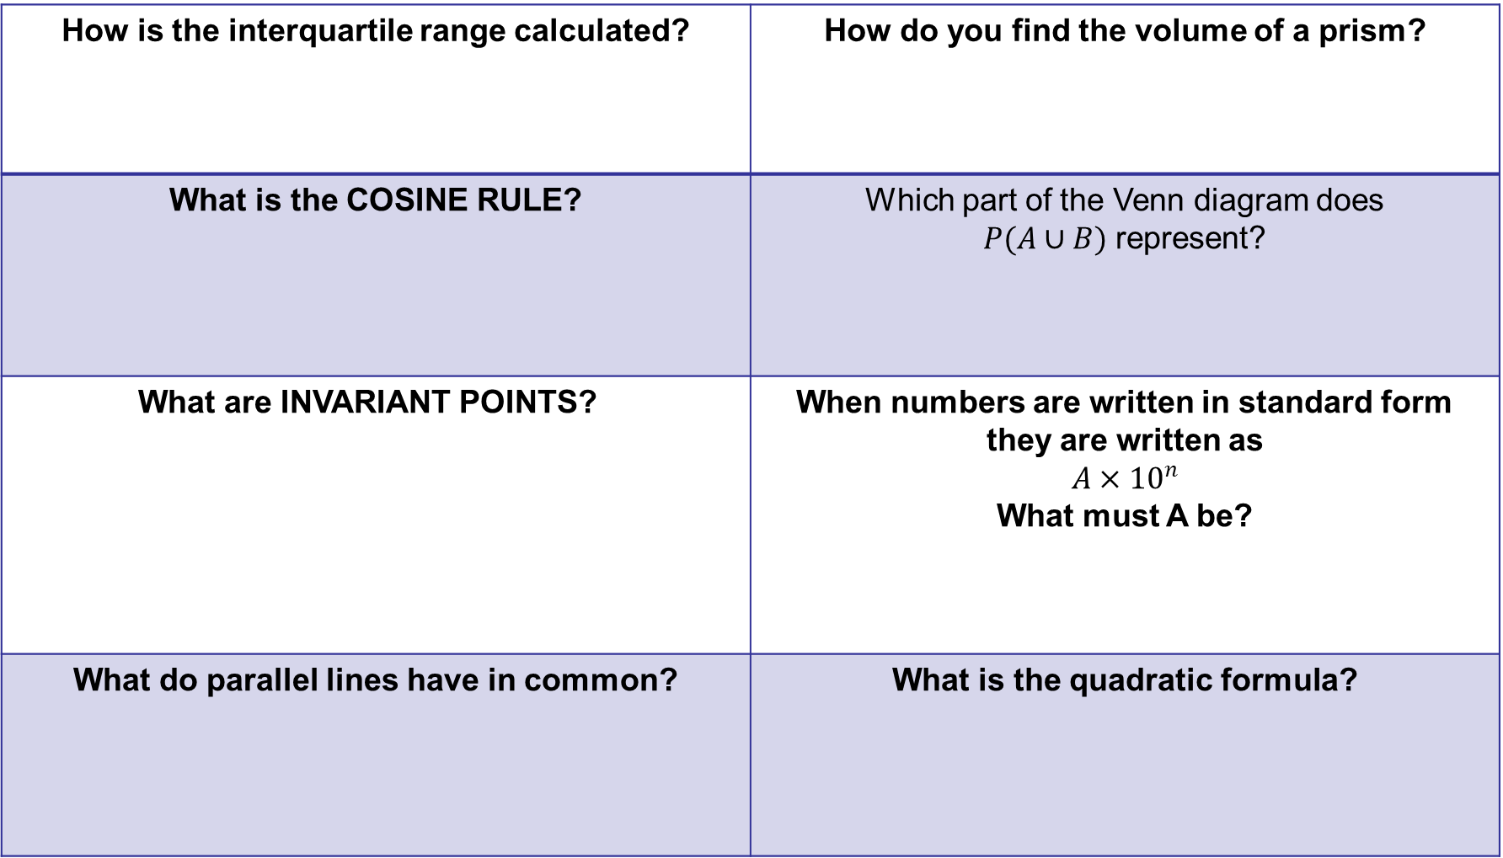
How is the interquartile range calculated? | How do you find the volume of a prism?
What is the COSINE RULE? | Which part of the Venn diagram does $P(A∪B)$ represent?
What are INVARIANT POINTS? | When numbers are written in standard form they are written as $$A×{10}^{n}$$ What must A be?
What do parallel lines have in common? | What is the quadratic formula?

Slide 15
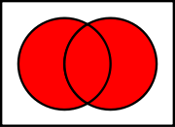
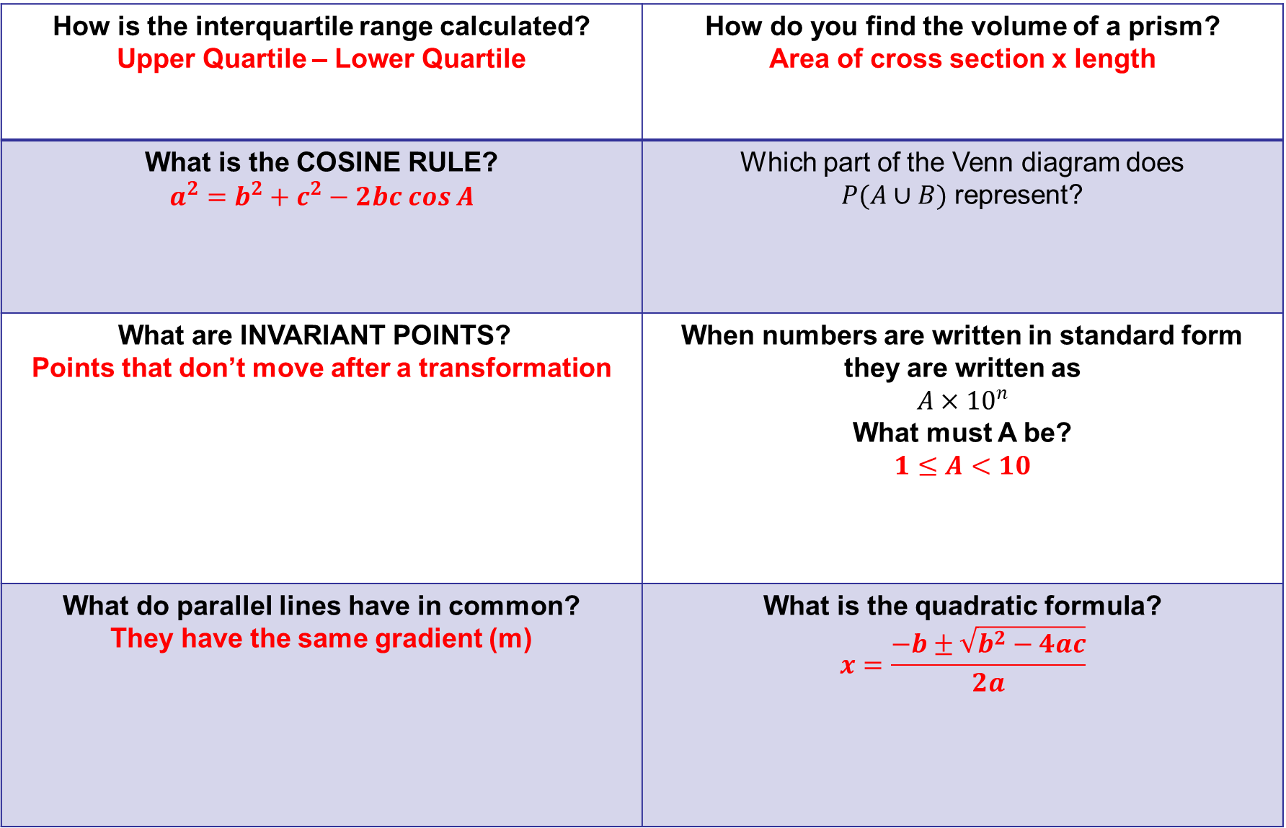
How is the interquartile range calculated? Upper Quartile – Lower Quartile | How do you find the volume of a prism? Area of cross section x length
What is the COSINE RULE? $$a^{2}=b^{2}+c^{2}−2bc cos A$$ | Which part of the Venn diagram does $P(A∪B)$ represent?
What are INVARIANT POINTS? Points that don’t move after a transformation | When numbers are written in standard form they are written as $$A×{10}^{n}$$ What must A be? $1≤A<10$
What do parallel lines have in common? They have the same gradient (m) | What is the quadratic formula? $$x=\frac{−b±\sqrt{b^{2}−4ac}}{2a}$$

