Slide 1
True or False? Sales are rising rapidly!
4370
4360
4350
4340
Sales
4330
4320
4310
4300
2000
2001
2002
2003
2004
2005
Year
Notes:
For students to discuss..
The graph is misleading because it suggests that sales have increased significantly over a five year period. In reality they have only increased by 70 units, which is not much given that they are selling thousands.

Slide 2
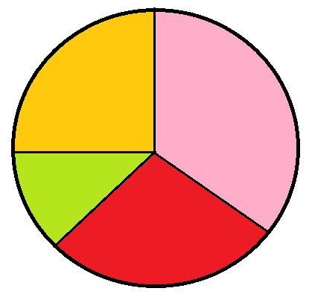
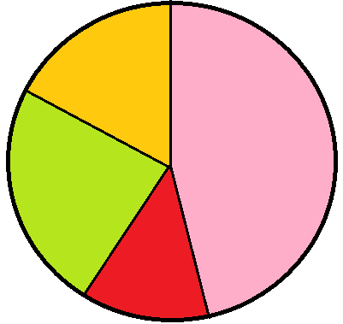
True or False?
There are more 15 year old boys than girls.
Girls
Boys
18 year olds
18 year olds
15 year olds
15 year olds
17 year olds
17 year olds
16 year olds
16 year olds
Notes:
For students to discuss..
False. We cannot make this conclusion from these graphs because we don’t know the totals. There might be 10 boys in total, making roughly 5 aged 15, but 100 girls, 30 of which are 15. It only tells us the proportion of 15 year olds.

Slide 3
True or False?
Twice as many people like Thriller’s than Romance films.
150
120
100
60
Number of People
40
25
20
5
Horror
Comedy
Action
Romance
Thriller
Favourite Films
Notes:
For students to discuss…
The scale on the vertical axis is not linear, so even though the green bar is twice as big as the purple bar, it does not represent twice as many people.

Slide 4
Pablo is hosting a party. He counts how many people are between 15 and 20, and 20 and 50.
Age (years) | Frequency
15 ≤ a < 20 | 15
20 ≤ a < 50 | 15
Why is below graph unhelpful?
How could we fix it?
Draw Graph
15
The 15 people in the second group are more spread out in age, but this graph seems to suggest that people’s ages are spread out uniformly between 15 and 50.
Frequency
10 20 30 40 50
Age
Notes:
Acknowledgements: Dr Frost

Slide 5
Let’s presume that within each age group, the ages are evenly spread.
Then there would 3 people of each age in the 15-20 group, and 0.5 people of each age in the 20-50 group.
Age (years) | Frequency
15 ≤ a < 20 | 15
20 ≤ a < 50 | 15
?
?
Redraw Graph
3
2
1
The resulting diagram is known as a Histogram.
The ‘frequency per age’ is known as the ‘frequency density’. In general, given the frequency and class width, we can calculate it using:
Frequency Density
Estimated Frequency
Frequency
Class Width
?
Frequency Density =
10 20 30 40 50
Age

Slide 6
Bar Charts vs Histograms
Bar Charts
For discrete data.
Frequency given by height of bars.
Histograms
For continuous data.
Data divided into (potentially uneven) intervals.
Frequency given by area of bars.
?
?
?
?
Frequency
Frequency Density
6 7 8 9
0.8m 1.2m 1.4m 1.6m 1.8m
Shoe Size
Height

Slide 7
On your whiteboard
What are the missing Frequency Density values?
Weight (w kg) | Frequency | Frequency Density
0 < w ≤ 10 | 40 | 4
10 < w ≤ 15 | 6 | 1.2
15 < w ≤ 35 | 52 | 2.6
35 < w ≤ 45 | 10 | 1
?
?
?
?
What are the missing Frequency values?

Slide 8
Title: Constructing Histograms
To construct a histogram the frequency density values must be calculated.
The vertical axis represents the frequency density values.
The horizontal axis represents the continuous variable.
Frequency Density is calculated by dividing the frequency of each group by the class width.
Frequency Density

Slide 9
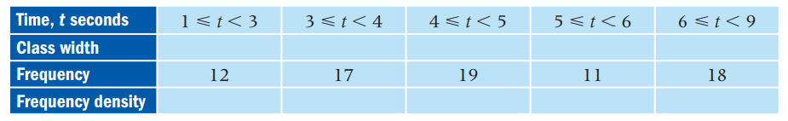
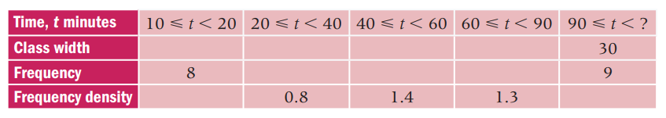
In your books:
1. Draw the Histograms for these two sets of data.

Slide 10



















In your books:
1. Draw the Histograms for these two sets of data.
$$2$$
$$1$$
$$1$$
$$1$$
$$3$$
$$6$$
$$17$$
$$19$$
$$11$$
$$6$$
$$10$$
$$20$$
$$20$$
$$30$$
$$16$$
$$28$$
$$39$$
$$0.8$$
$$0.3$$

Slide 11
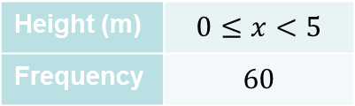
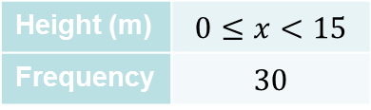
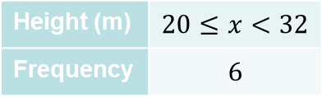
2. Work out the scale of the Frequency Density axis.
Height (m) | $$0≤x<15$$
Frequency | $$30$$
Height (m) | $$0≤x<5$$
Frequency | $$60$$
Height (m) | $$20≤x<32$$
Frequency | $$6$$
4
3
2
1
2
1
?
?
?
16
12
8
4
0 10 20
0 10 20
20 28 36

Slide 12
Summary So Far
?
Purpose:
Histograms allow us to display continuous grouped data.
Area:
The area of a bar is equal to the frequency*.
?
Working out the F.D. scale:
If the frequency is known and the bar height is known, we can work out the scale using the formula on the left.
?
Frequency Density Formula:
?
Frequency
Class Width

