Slide 1



What is the area of each of these shapes?
$$x$$
$$x$$
1
1
1
$$x$$
Notes:
Challenge: Ask what shape is it? Have we seen this before when expanding brackets? What are the side lengths?

Slide 2





1
$$x$$
$$x$$
1
1
$$x$$
$$x$$
$$x^{2}$$
Write an expression for the area of this shape
And another…
And another…

Slide 3
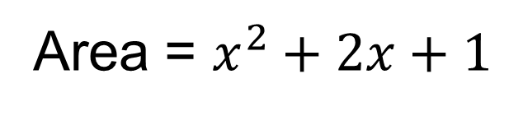

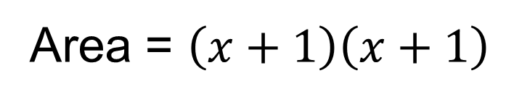



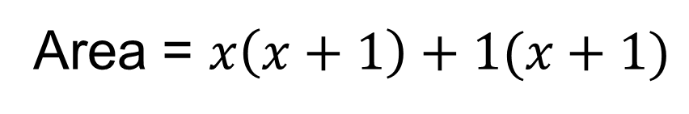
$$x$$
$$1$$
Area = $\left(x+1\right)\left(x+1\right)$
$$x$$
Area = $x^{2}+2x+1$
$$1$$
Area = $x\left(x+1\right)+1(x+1)$

Slide 4
Watch this video and think about:
What is happening to the pieces?
What is being created?
How is the maths written?
https://www.youtube.com/watch?v=bpJyJlCnR3g
Notes:
There is no voice over this video nor music. Keep it muted. Students can write these points on their whiteboards and take notes while the video is being watched. Afterwards, hands up, share your answers to the points above.

Slide 5

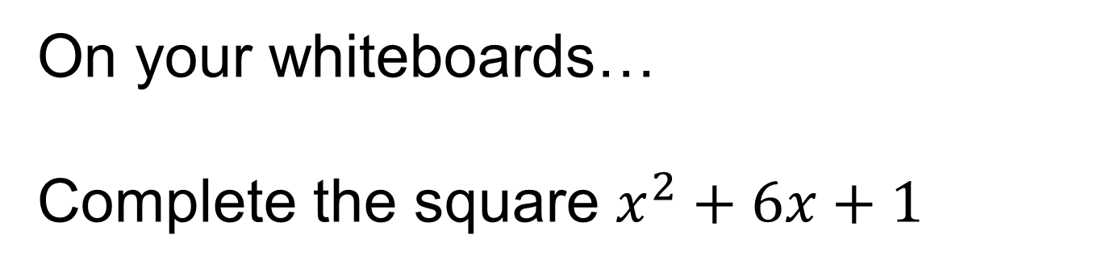


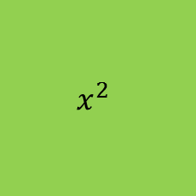



On your whiteboards…
Complete the square $x^{2}+6x+1$
$$x$$
$$x$$
1
$$x$$
$$x^{2}$$
$$x$$
$$x$$
$$x$$
Notes:
Example. Emphasise number of x^2 pieces, how many x pieces will I have?

Slide 6





Complete the square:
$$x^{2}+6x+1$$
$$x^{2}$$
$$x$$
$$x$$
$$x$$
$$x$$
$$x$$
$$x$$
1
Create a square with the pieces.
Notes:
Students may have already noticed that you half the coefficient of x. Half go horizontally below x^2, the other half are vertical next to x^2.

Slide 7










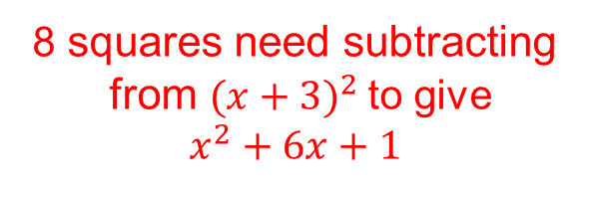


Complete the square:
$$x^{2}+6x+1$$
$$={\left(x+3\right)}^{2}$$
$$−8$$
$$x$$
$$+3$$
$$x^{2}$$
$$x$$
$$x$$
$$x$$
$$x$$
$$x$$
1
8 squares need subtracting
from $(x+3)^{2}$to give
$$x^{2}+6x+1$$
$$+3$$
$$x$$
$$x$$
Notes:
Students should only draw 1’s in the small squares if they have that many pieces… in the missing slots they should not write 1 and have a dotted outline.
Emphasise the word missing (to complete the square we are missing 8 pieces).

Slide 8









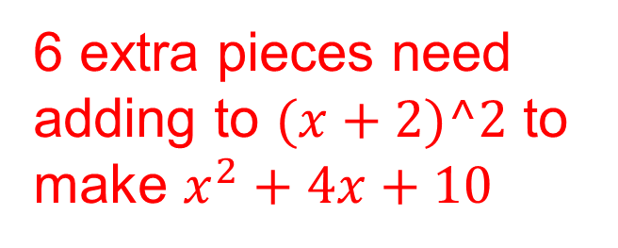

Complete the square:
$$x^{2}+4x+10$$
$$={\left(x+2\right)}^{2}$$
$$+6$$
$$x+2$$
$$x^{2}$$
$$x$$
$$x$$
$$x+2$$
1
1
1
$$x$$
1
1
1
1
1
$$x$$
1
1
6 extra pieces need adding to $(x+2)^2$ to make $x^{2}+4x+10$
Notes:
Example of when we get extra pieces.

Slide 9



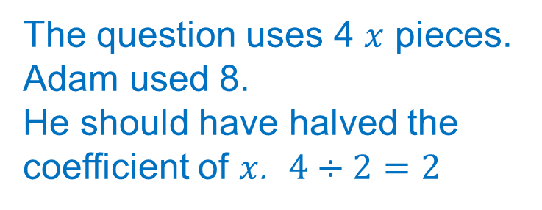




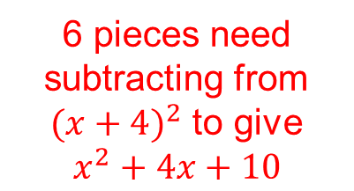








Complete the square:
$$x^{2}+4x+10$$
$$={\left(x+4\right)}^{2}$$
$$−6$$
$$x+4$$
Here is Adam’s answer.
Discuss:
What has Adam done wrong?
$$x^{2}$$
$$x$$
$$x$$
$$x$$
$$x$$
$$x+4$$
$$x$$
1
1
1
1
The question uses 4 $x$ pieces. Adam used 8.
He should have halved the coefficient of $x$. $4÷2=2$
$$x$$
1
1
1
1
$$x$$
1
$$x$$
1
6 pieces need subtracting from $(x+{4)}^{2}$ to give $x^{2}+4x+10$

Slide 10









Complete the square:
$$x^{2}+4x+10$$
$$={\left(x+2\right)}^{2}$$
$$+1$$
$$x+2$$
$$x^{2}$$
Here is Ben’s answer.
Discuss:
What has Ben done wrong?
$$x$$
$$x$$
$$x+2$$
$$x$$
1
1
1
1
1
1
$$x$$
Ben changed the size of the 1 square pieces. He drew a 3 by 3 array when it should be 2 by 2.
1
1
1
1
1 extra piece

Slide 11



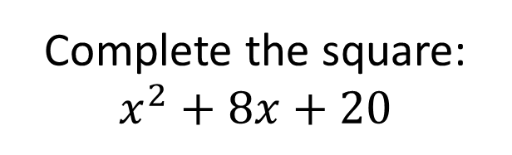
















Complete the square:
$$x^{2}+8x+20$$
Complete the square:
$$x^{2}+2x+100$$
$$={\left(x+4\right)}^{2}+4$$
$$={\left(x+1\right)}^{2}+99$$
$$x+4$$
$$x+1$$
$$x^{2}$$
$$x^{2}$$
99 extra
$$x$$
$$x$$
$$x$$
$$x$$
$$x$$
99
1
$$x+1$$
$$x+4$$
$$x$$
1
1
1
1
1
$$x$$
1
$$x$$
1
1
1
1
1
1
$$x$$
1
1
1
1
4 extra
$$x$$
1
1
1
1
On your whiteboards
Notes:
Question on the right… are you going to draw 99 1’s?

Slide 12
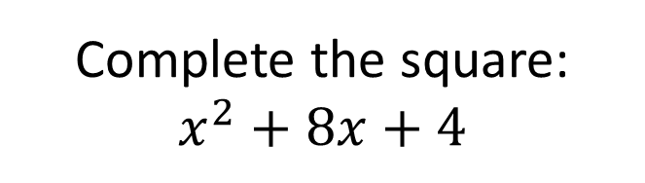

Complete the square:
$$x^{2}+8x+4$$
$$={\left(x+4\right)}^{2}−12$$
$$x+4$$
$$x^{2}$$
$$x$$
$$x$$
$$x$$
$$x$$
$$x+4$$
$$x$$
1
1
1
1
$$x$$
$$x$$
$$x$$
On your whiteboards
Notes:
Introducing negatives. 16 pieces are missing in order to complete the square. AND 4 pieces owed to begin with.
The arrow links the questions by -8, this is also the case for the answer.

Slide 13


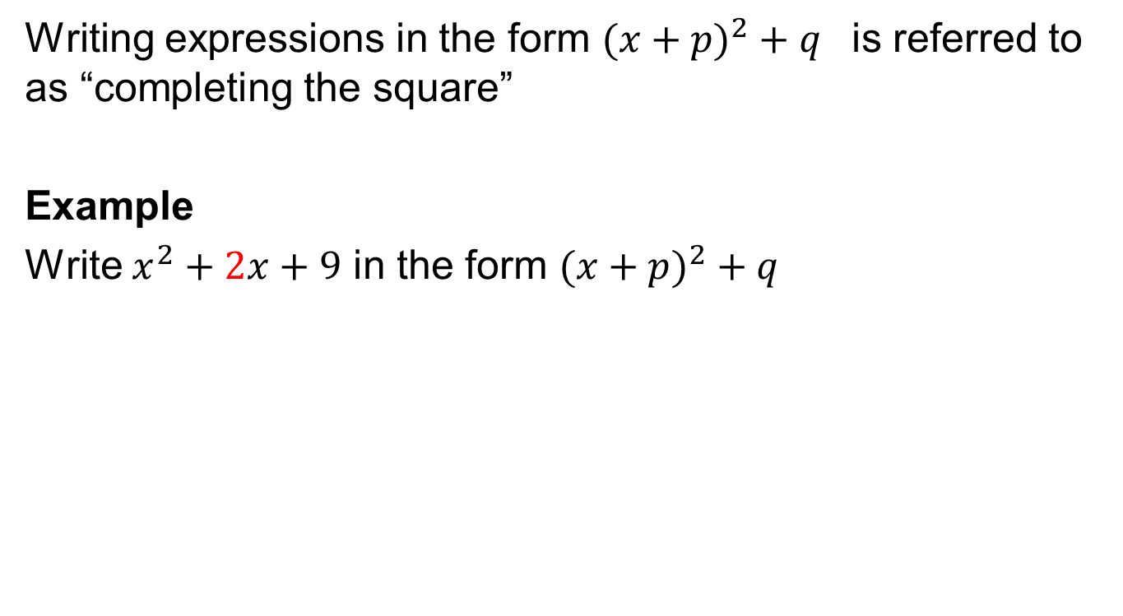


Title: Completing the Square
Writing expressions in the form $(x+p)^{2}+q$ is referred to as “completing the square”
Example
Write $x^{2}+2x+9$ in the form $(x+p)^{2}+q$
$$x^{2}$$
1
1
$$(x+1)^{2}$$
$$+8$$
$$x$$
1
1
1
1
$$x$$
1
Notice how the value of p is half the coefficient of x
1
1

Slide 14
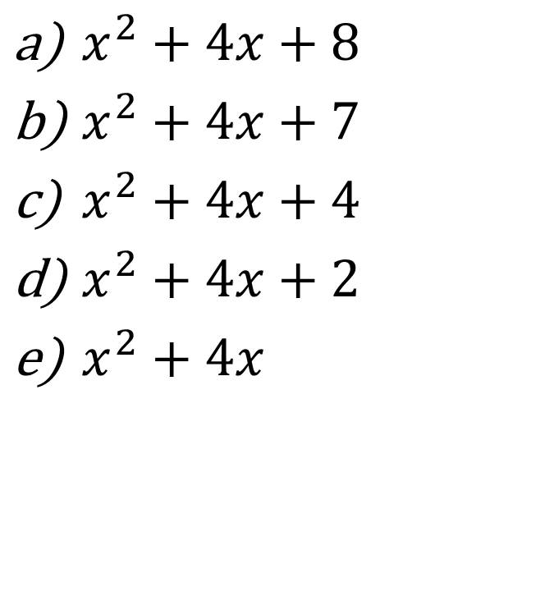
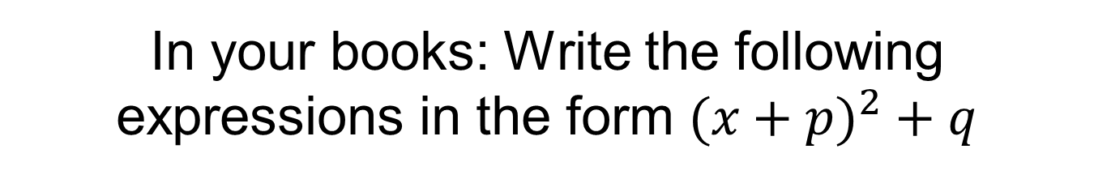
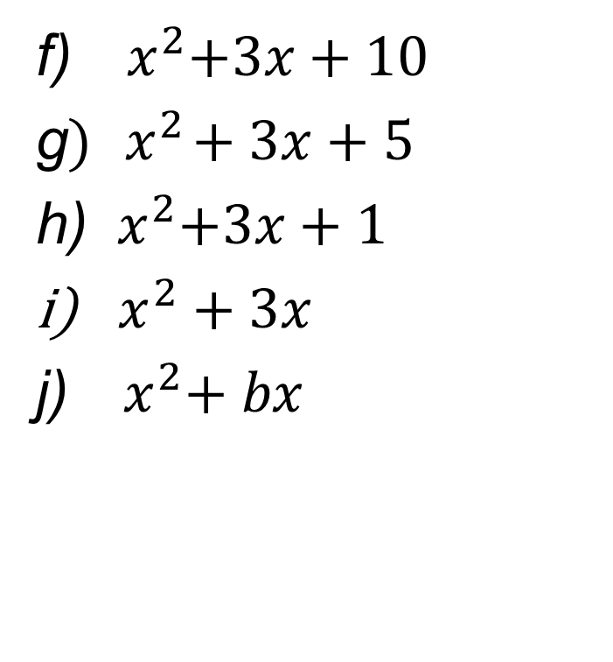
In your books: Write the following expressions in the form $(x+p)^{2}+q$
$x^{2}+4x+8$
$x^{2}+4x+7$
$x^{2}+4x+4$
$x^{2}+4x+2$
$x^{2}+4x$
f) ${ x}^{2}+3x+10$
g$) { x}^{2}+3x+5$
h) ${ x}^{2}+3x+1$
$x^{2}+3x$
j) ${ x}^{2}+ bx$

Slide 15
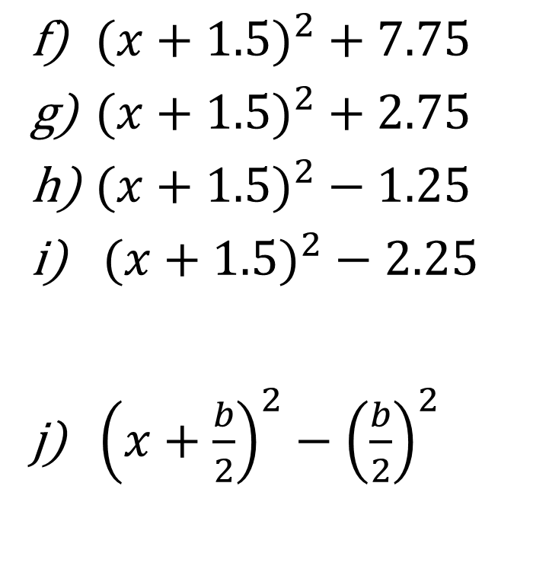
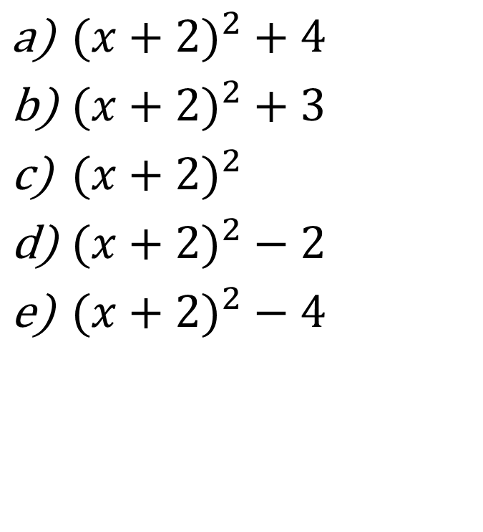
Mark your work
$(x+2)^{2}+4$
$(x+2)^{2}+3$
$(x+2)^{2}$
$(x+2)^{2}−2$
$(x+2)^{2}−4$
$(x+1.5)^{2}+7.75$
$(x+1.5)^{2}+2.75$
$(x+1.5)^{2}−1.25$
$(x+1.5)^{2}−2.25$
j) ${\left(x+\frac{b}{2}\right)}^{2}−{\left(\frac{b}{2}\right)}^{2}$

Slide 16

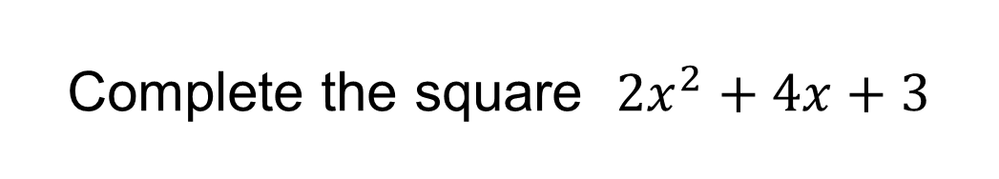






Complete the square ${2x}^{2}+4x+3$
Discuss: How is this different?
$$={2\left(x+1\right)}^{2}+1$$
$$x$$
$$x$$
$$x^{2}$$
$$x^{2}$$
$$x$$
$$x$$
1
1
1
On your whiteboards:
How could this be written mathematically?
Notes:
Impossible to draw a single square. The coefficient of x^2 tells you how many squares you are drawing.

Slide 17










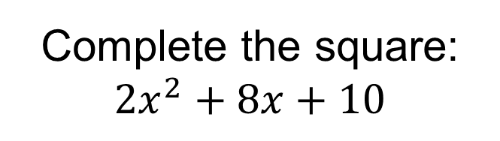
























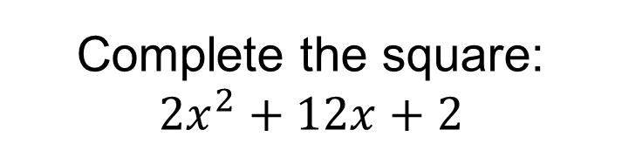
Complete the square:
$${2x}^{2}+8x+10$$
Complete the square:
$${2x}^{2}+12x+2$$
$$={2\left(x+2\right)}^{2}+2$$
$$={2\left(x+3\right)}^{2}−18$$
$$x+3$$
$$x+2$$
$$x^{2}$$
$$x^{2}$$
$$x$$
$$x$$
$$x$$
$$x$$
$$x$$
$$x+2$$
$$x+3$$
$$x$$
1
$$x$$
1
1
$$x$$
$$x$$
1
1
1
$$x$$
$$x+2$$
$$x+3$$
1
$$x^{2}$$
$$x^{2}$$
$$x$$
$$x$$
$$x$$
$$x$$
$$x$$
$$x+2$$
$$x+3$$
$$x$$
1
1
$$x$$
1
$$x$$
1
1
$$x$$
$$x$$

Slide 18






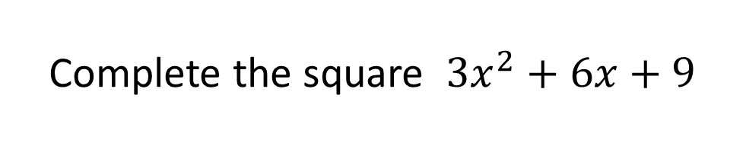
Complete the square ${3x}^{2}+6x+9$
$$={3\left(x+1\right)}^{2}+6$$
$$x$$
$$x$$
$$x$$
$$x^{2}$$
$$x^{2}$$
$$x^{2}$$
$$x$$
$$x$$
$$x$$
1
1
1
On your whiteboards
How could this be written mathematically?
1
1
1
1
1
1
Notes:
The coefficient of x is halved and divided by the coefficient of x^2.

Slide 19
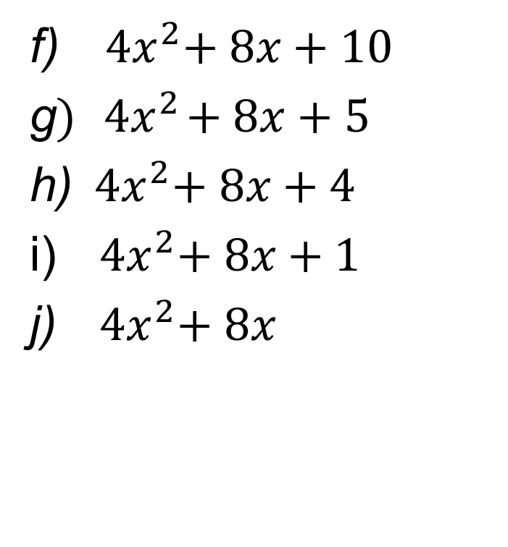
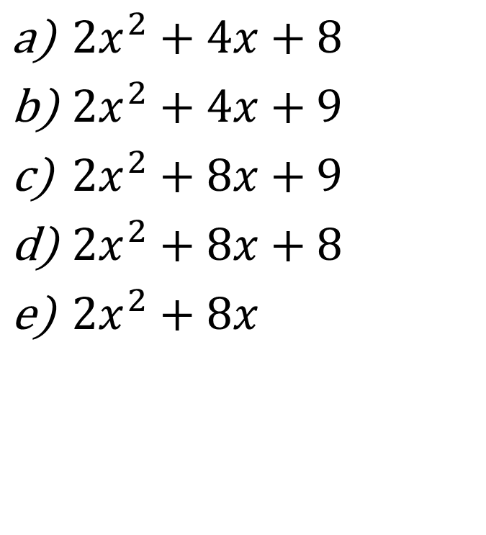
In your books:
Complete the square of the following expressions
${2x}^{2}+4x+8$
${2x}^{2}+4x+9$
${2x}^{2}+8x+9$
${2x}^{2}+8x+8$
${2x}^{2}+8x$
f) ${ 4x}^{2}+ 8x+10$
g$){ 4x}^{2}+8x+5$
h)${ 4x}^{2}+ 8x+4$
i)${ 4x}^{2}+ 8x+1$
j)${ 4x}^{2}+ 8x$

Slide 20
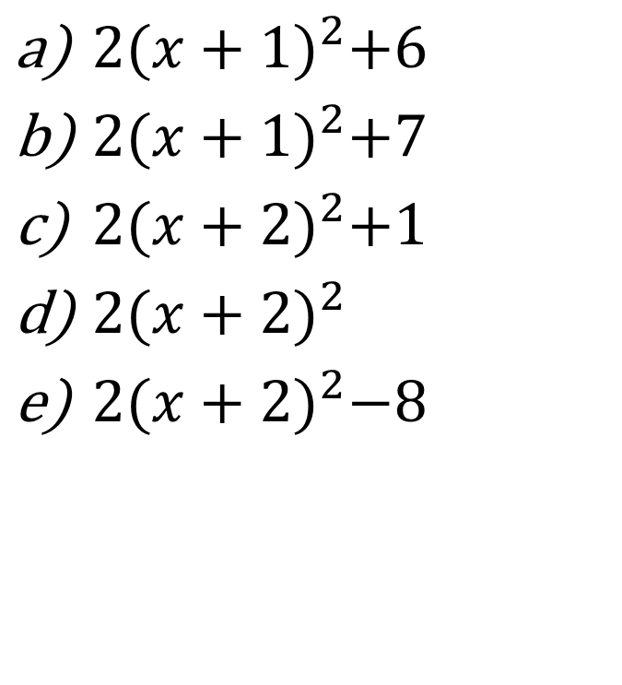
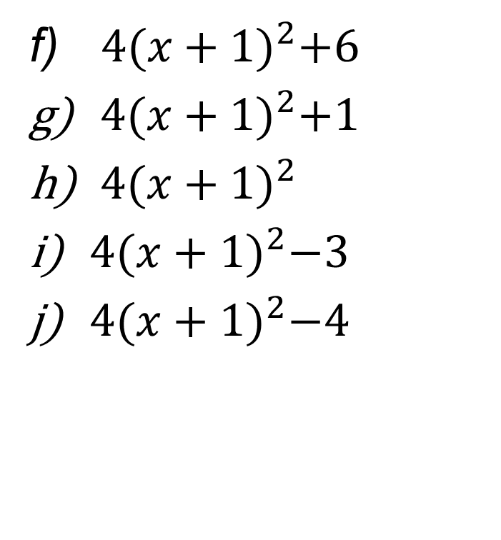
Mark your work
Complete the square of the following expressions
$2{(x+1)}^{2}+6$
$2{(x+1)}^{2}+7$
$2{(x+2)}^{2}+1$
$2{(x+2)}^{2}$
$2{(x+2)}^{2}−8$
f)$4{(x+1)}^{2}+6$
$4{(x+1)}^{2}+1$
$4{(x+1)}^{2}$
$4{(x+1)}^{2}−3$
$4{(x+1)}^{2}−4$
Notes:
Acknowledgements: Neira Miljkovic @ BBA

